Slide 1
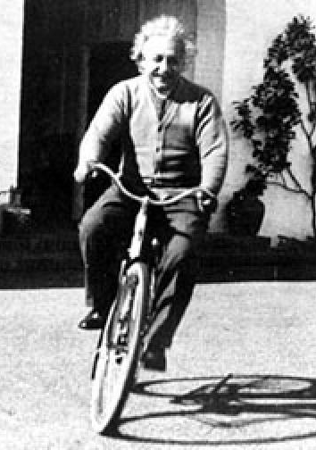
SUPAGWD
An Introduction to
General Relativity,
Gravitational Waves
and
Detection Principles
Prof Martin Hendry
University of Glasgow
Dept of Physics and Astronomy
October 2012

Slide 2
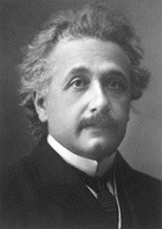
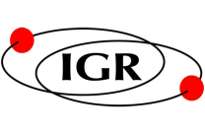
Gravity in Einstein’s Universe
Spacetime tells matter how to move, and matter tells spacetime how to curve
SUPAGWD, October 2012

Slide 3
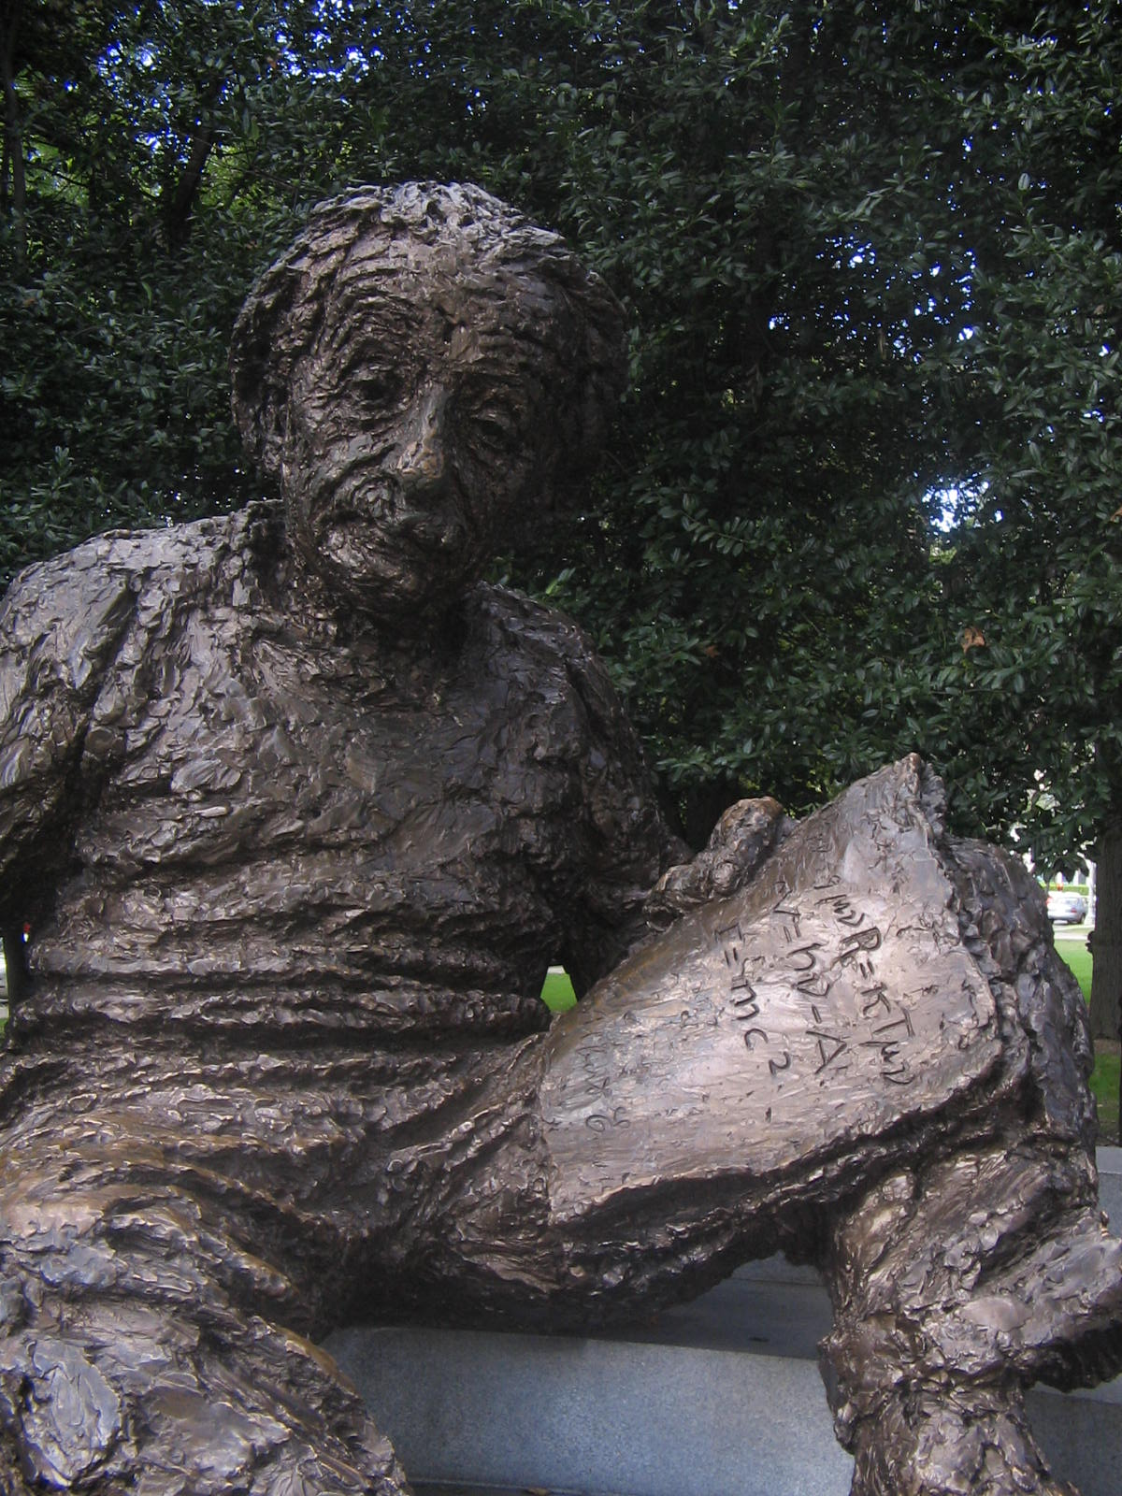
“…joy and amazement at the beauty and grandeur of this world of which man can just form a faint notion.”
Spacetime curvature
Matter
(and energy)
SUPAGWD, October 2012

Slide 4
We are going to cram a lot of mathematics and
physics into approx. 2 hours.
Two-pronged approach:
Comprehensive lecture notes, providing a
‘long term’ resource and reference source
Lecture slides presenting “highlights” and
some additional illustrations / examples
Copies of both available on mySUPA
SUPAGWD, October 2012

Slide 5
What we are going to cover
Foundations of general relativity
Introduction to geodesic deviation
A mathematical toolbox for GR
Spacetime curvature in GR
Einstein’s equations
A wave equation for gravitational radiation
The Transverse Traceless gauge
The effect of gravitational waves on free particles
The production of gravitational waves
SUPAGWD, October 2012

Slide 6
What we are going to cover
Foundations of general relativity
Introduction to geodesic deviation
A mathematical toolbox for GR
Spacetime curvature in GR
Einstein’s equations
A wave equation for gravitational radiation
The Transverse Traceless gauge
The effect of gravitational waves on free particles
The production of gravitational waves
Introduction to GR
Gravitational Waves and detector principles
SUPAGWD, October 2012

Slide 7
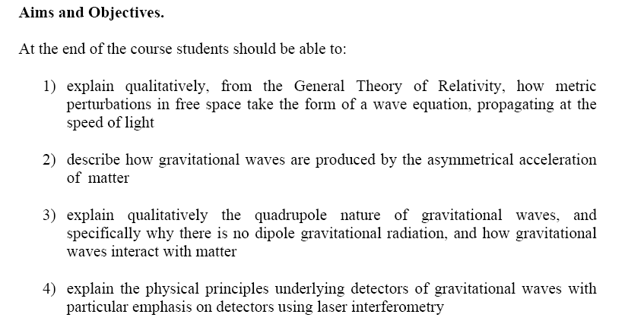
SUPAGWD, October 2012

Slide 8
SUPAGWD, October 2012

Slide 9
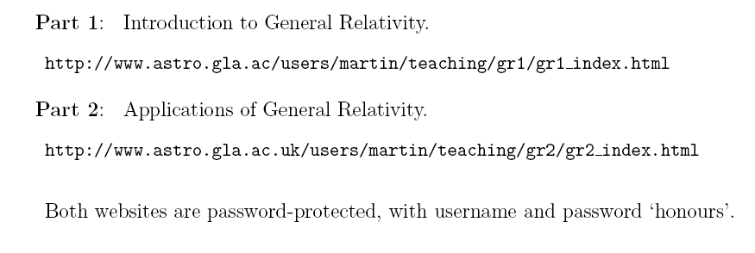
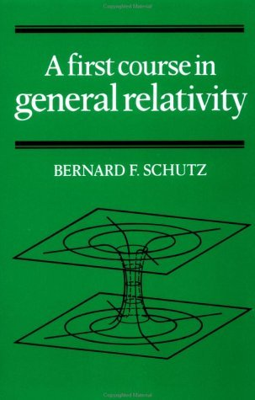
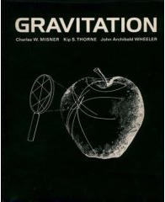
Websites of my Glasgow University Courses
Recommended textbooks
“A First Course in General Relativity”
Bernard Schutz
“Gravitation”
Charles Misner, Kip Thorne, John Wheeler
ISBN: 0716703440
ISBN: 052177035
Excellent introductory textbook. Good discussion of gravitational wave generation, propagation and detection.
The ‘bible’ for studying GR
SUPAGWD, October 2012

Slide 10
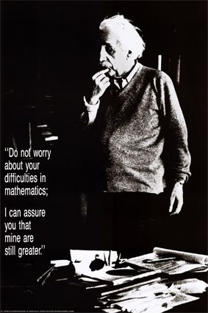
“Do not worry about your difficulties in mathematics;
I can assure you that mine are still greater.”
SUPAGWD, October 2012

Slide 11
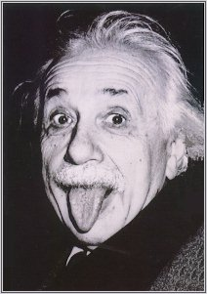
“The hardest thing in the world to understand is the income tax”
SUPAGWD, October 2012

Slide 12
1. Foundations of General Relativity (pgs. 6 – 12)
GR is a generalisation of Special Relativity (1905).
In SR Einstein formulated the laws of physics to be valid for all inertial observers
 Measurements of space and time relative
to observer’s motion.
SUPAGWD, October 2012

Slide 13
1. Foundations of General Relativity (pgs. 6 – 12)
GR is a generalisation of Special Relativity (1905).
In SR Einstein formulated the laws of physics to be valid for all inertial observers
 Measurements of space and time relative
to observer’s motion.
Minkowski
metric
Invariant interval
SUPAGWD, October 2012

Slide 14
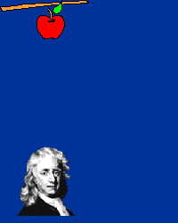
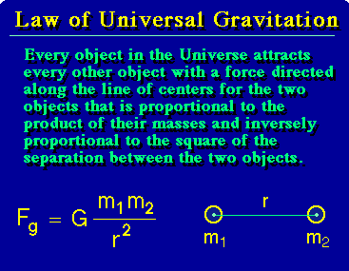
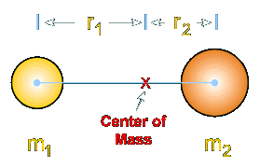
Newtonian gravity is incompatible with SR
Isaac Newton:
1642 – 1727 AD
The Principia: 1684 - 1686
SUPAGWD, October 2012

Slide 15
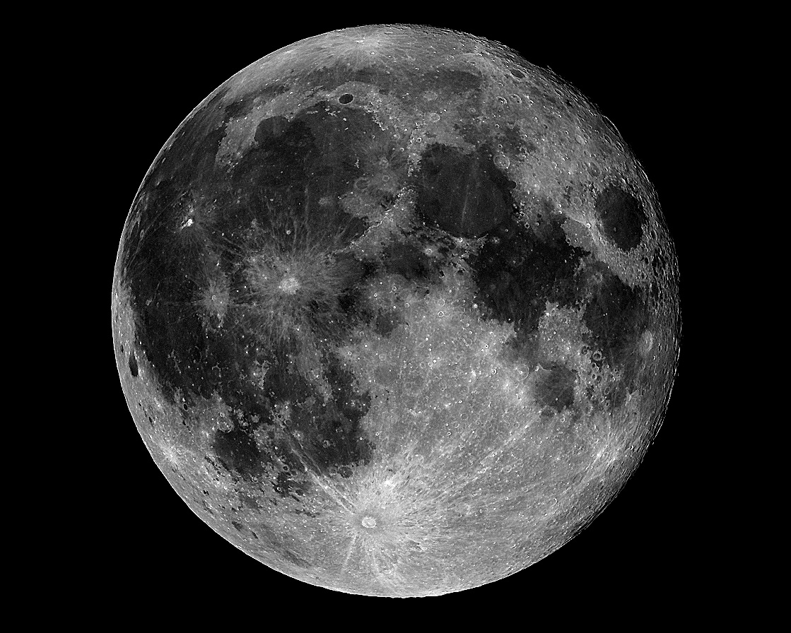
Moon’s orbit
Earth

Slide 16
Moon’s orbit
But how does the Moon know to orbit the Earth?
How does gravity act at a distance across space?
Earth

Slide 17
Principles of Equivalence
Inertial Mass
Gravitational Mass
Weak Equivalence Principle
Gravity and acceleration are equivalent
The Principia: 1684 - 1686
SUPAGWD, October 2012

Slide 18
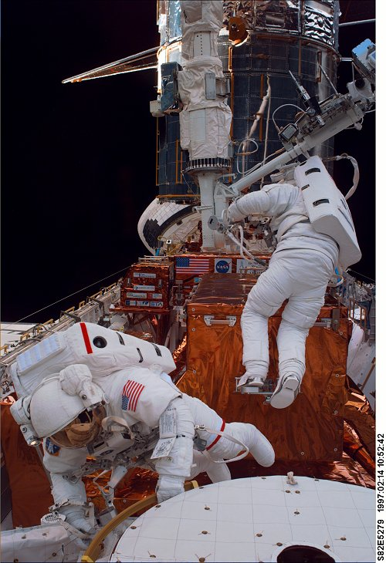
The WEP implies:
A object freely-falling in a uniform gravitational field inhabits an inertial frame in which all gravitational forces have disappeared.
The Principia: 1684 - 1686
SUPAGWD, October 2012

Slide 19
The WEP implies:
A object freely-falling in a uniform gravitational field inhabits an inertial frame in which all gravitational forces have disappeared.
But only LIF: only local over region for which gravitational field is uniform.
The Principia: 1684 - 1686
SUPAGWD, October 2012

Slide 20
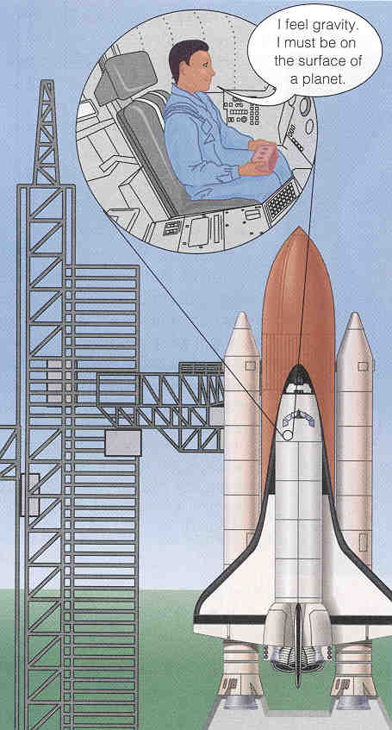
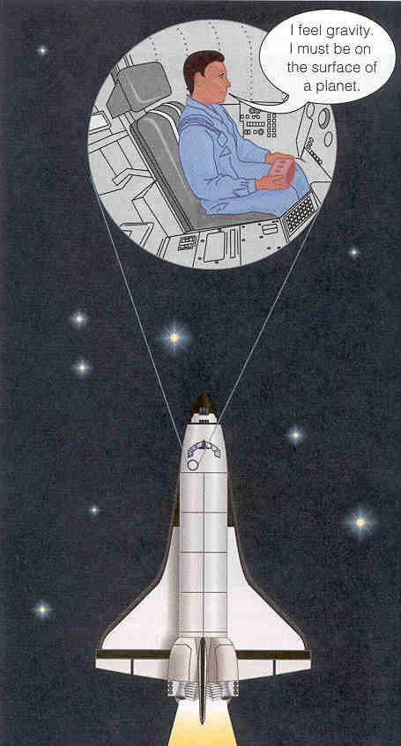
Strong Equivalence Principle
Locally (i.e. in a LIF)
all laws of physics
reduce to their SR
form – apart from
gravity, which simply
disappears.
The Principia: 1684 - 1686
SUPAGWD, October 2012

Slide 21
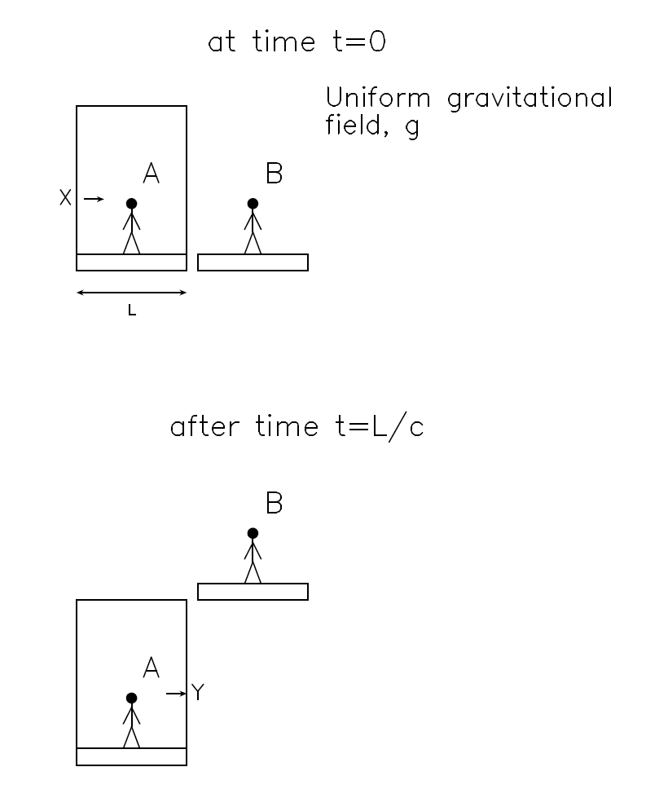
The Equivalence principles also predict gravitational light deflection…
Light path
Light enters lift horizontally at X, at instant when lift begins to free-fall.
Observer A is in LIF. Sees light reach opposite wall at Y (same height as X), in agreement with SR.
To be consistent, observer B outside lift must see light path as curved, interpreting this as due to the gravitational field
The Principia: 1684 - 1686
SUPAGWD, October 2012

Slide 22
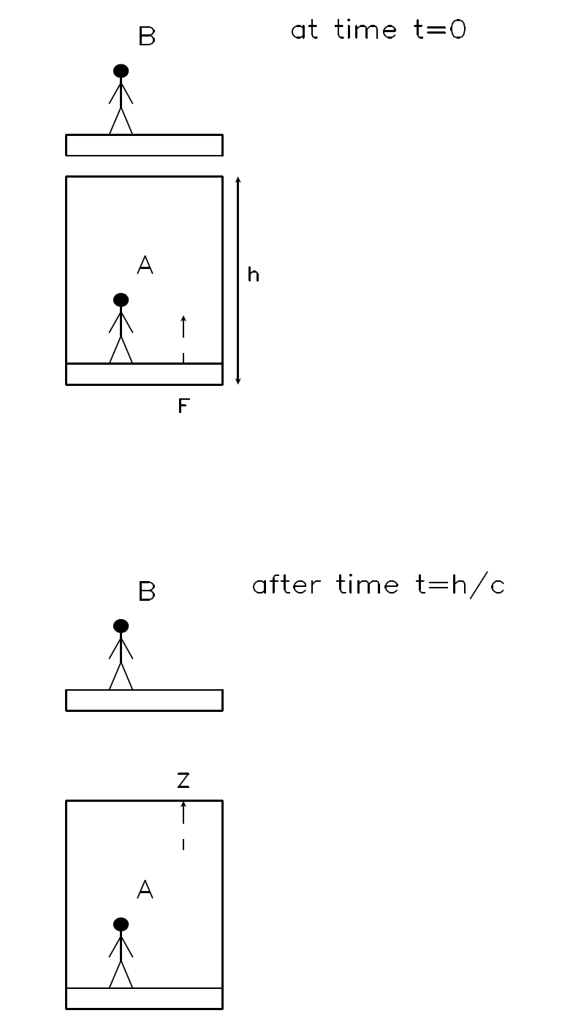
The Equivalence principles also predict gravitational redshift…
Light enters lift vertically at F, at instant when lift begins to free-fall.
Observer A is in LIF. Sees light reach ceiling at Z with unchanged frequency, in agreement with SR.
To be consistent, observer B outside lift must see light as redshifted, interpreting this as due to gravitational field.
Light path
The Principia: 1684 - 1686
SUPAGWD, October 2012

Slide 23
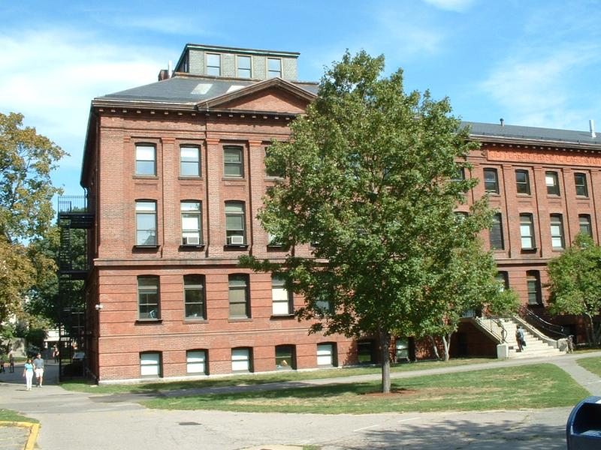
The Equivalence principles also predict gravitational redshift…
Measured in Pound-Rebka experiment
The Principia: 1684 - 1686
SUPAGWD, October 2012

Slide 24
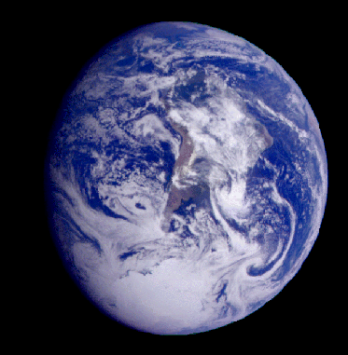
From SR to GR…
How do we ‘stitch’ all the LIFs together?
Can we find a covariant description?
The Principia: 1684 - 1686
SUPAGWD, October 2012

Slide 25
2. Introduction to Geodesic Deviation (pgs.13 – 17)
In GR trajectories of freely-falling particles are geodesics – the equivalent of straight lines in curved spacetime.
Analogue of Newton I: Unless acted upon by a non-gravitational force, a particle will follow a geodesic.
SUPAGWD, October 2012

Slide 26
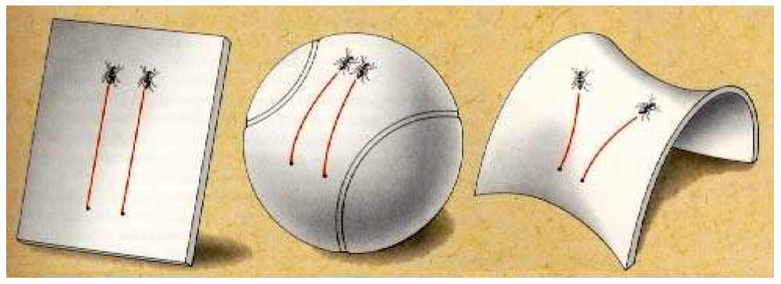
The curvature of spacetime is revealed by the behaviour of neighbouring geodesics.
Consider a 2-dimensional analogy.
Zero curvature: geodesic deviation unchanged.
Positive curvature: geodesics converge
Negative curvature: geodesics diverge
SUPAGWD, October 2012

Slide 27
Non-zero curvature
Acceleration of geodesic deviation
Non-uniform gravitational field
SUPAGWD, October 2012

Slide 28
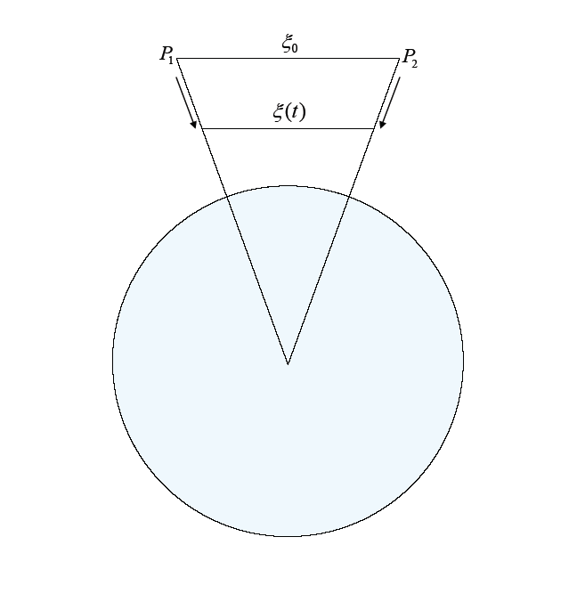
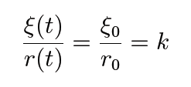
We can first think about geodesic deviation and curvature in a Newtonian context
By similar triangles
Hence
Earth
SUPAGWD, October 2012

Slide 29
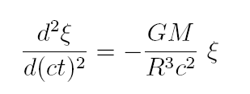
We can first think about geodesic deviation and curvature in a Newtonian context
or
which we can re-write as
Earth
SUPAGWD, October 2012

Slide 30
We can first think about geodesic deviation and curvature in a Newtonian context
or
which we can re-write as
Earth
At Earth’s surface this equals
SUPAGWD, October 2012

Slide 31
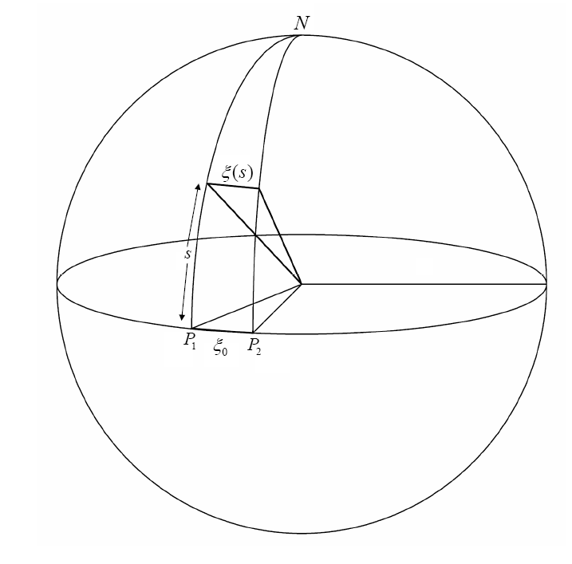
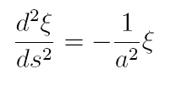
Another analogy will help us to interpret this last term
Sphere of radius a
Differentiating:
SUPAGWD, October 2012

Slide 32
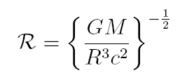
Another analogy will help us to interpret this last term
Sphere of radius a
Differentiating:
Comparing with previous slide:
represents radius of curvature of spacetime at the Earth’s surface
SUPAGWD, October 2012

Slide 33
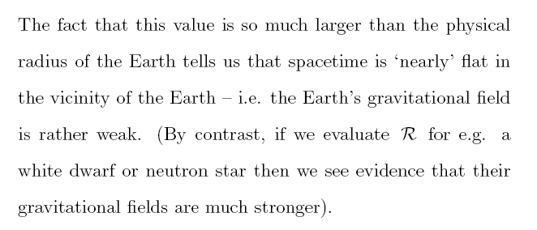
At the surface of the Earth
SUPAGWD, October 2012

Slide 34
3. A Mathematical Toolbox for GR (pgs.18 – 32)
Riemannian Manifold
A continuous, differentiable space which is locally flat and on which a distance, or metric, function is defined.
(e.g. the surface of a sphere)
The mathematical properties of a Riemannian manifold match the physical assumptions of the strong equivalence principle
SUPAGWD, October 2012

Slide 35
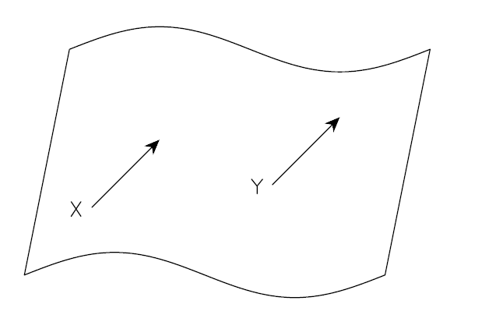
Vectors on a curved manifold
We think of a vector as an arrow representing a displacement.
components
basis vectors
In general, components of vector different at X and Y, even if the vector is the same at both points.
SUPAGWD, October 2012

Slide 36
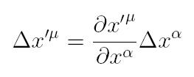
We need rules to tell us how to express the components of a vector in a different coordinate system, and at different points in our manifold.
e.g. in new, dashed, coordinate system, by the chain rule
SUPAGWD, October 2012

Slide 37
We need rules to tell us how to express the components of a vector in a different coordinate system, and at different points in our manifold.
e.g. in new, dashed, coordinate system, by the chain rule
We need to think more carefully about what we mean by a vector.
SUPAGWD, October 2012

Slide 38
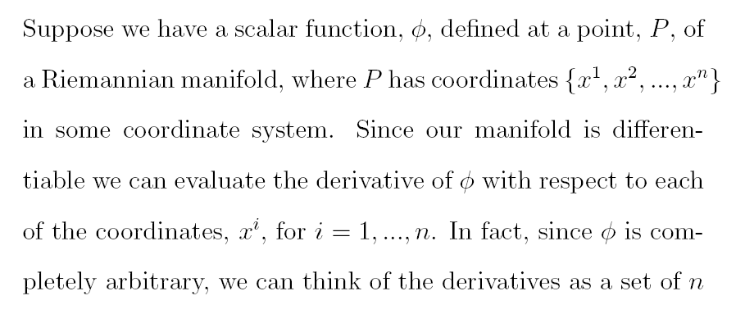
Tangent vectors
We can generalise the concept of vectors to curved manifolds.
SUPAGWD, October 2012

Slide 39
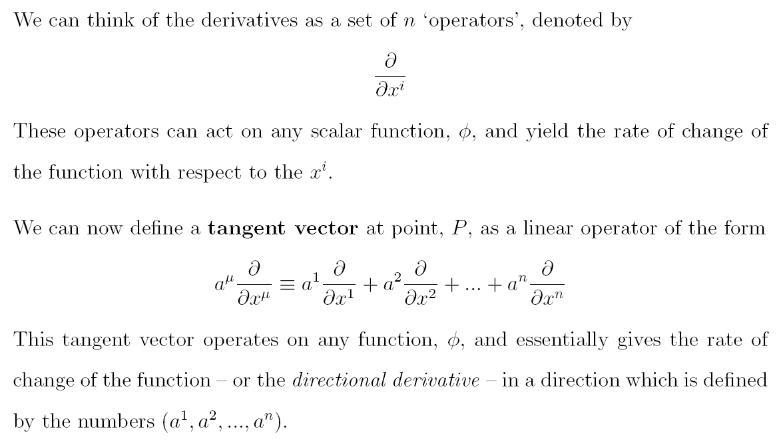
Tangent vectors
SUPAGWD, October 2012

Slide 40
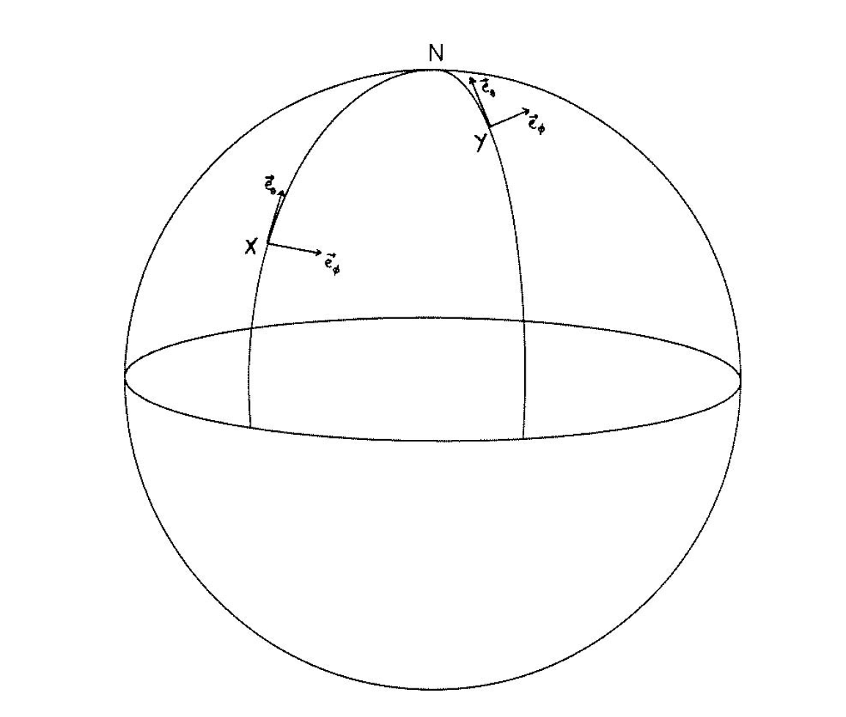
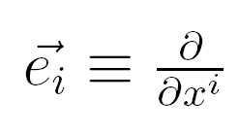
Simple example: 2-D sphere.
Set of curves parametrised by coordinates
tangent to i^{th} curve
Basis vectors different at X and Y.
SUPAGWD, October 2012

Slide 41
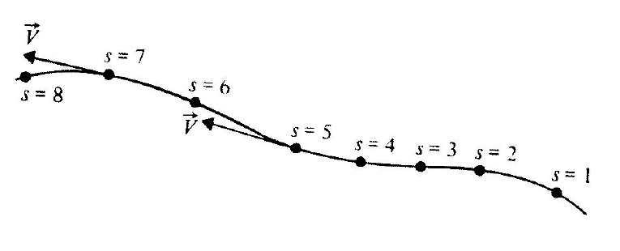
Summary
Extends easily to more general curves, manifolds
SUPAGWD, October 2012

Slide 42
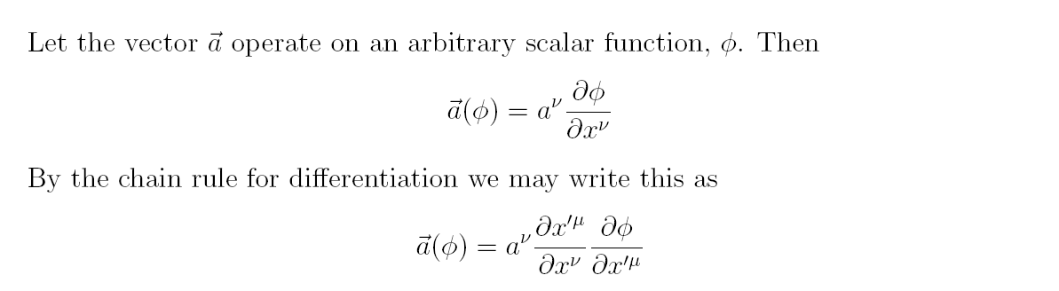
Transformation of vectors
SUPAGWD, October 2012

Slide 43
This is the transformation law for a contravariant vector.
Any set of components which transform according to this law, we call a contravariant vector.
SUPAGWD, October 2012

Slide 44
Transformation of basis vectors
SUPAGWD, October 2012

Slide 45
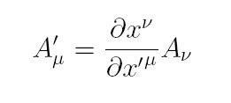
This is the transformation law for a one-form or covariant vector.
Any set of components which transform according to this law, we call a one-form.
A one-form, operating on a vector, produces a real number (and vice-versa)
SUPAGWD, October 2012

Slide 46
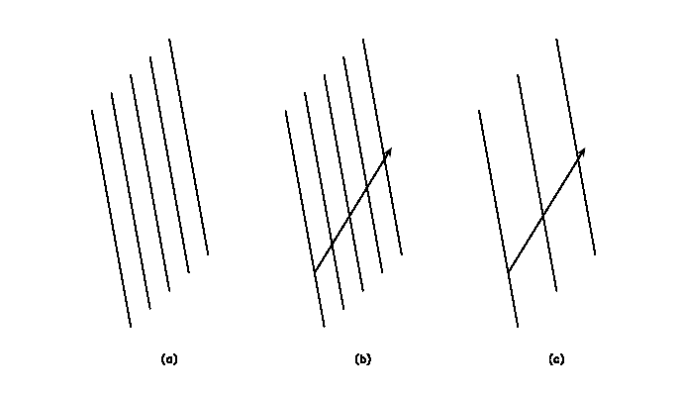
Picture of a one-form
Not a vector, but a way of ‘slicing up’ the manifold.
The smaller the spacing, the larger the magnitude of the one-form.
When one-form shown acts on the vector, it produces a real number: the number of ‘slices’ that the vector crosses.
Example: the gradient operator (c.f. a topographical map)
SUPAGWD, October 2012

Slide 47
Picture of a one-form
Not a vector, but a way of ‘slicing up’ the manifold.
The smaller the spacing, the larger the magnitude of the one-form.
When one-form shown acts on the vector, it produces a real number: the number of ‘slices’ that the vector crosses.
Example: the gradient operator (c.f. a topographical map)
SUPAGWD, October 2012

Slide 48
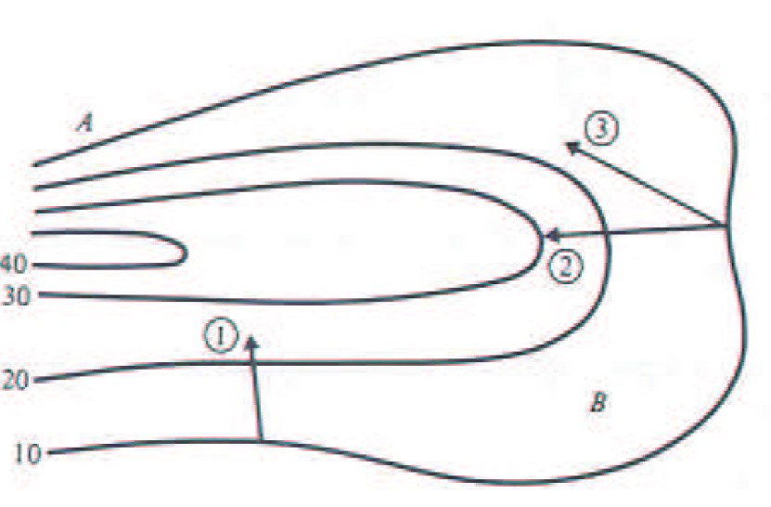
Picture of a one-form
SUPAGWD, October 2012

Slide 49
Extension to tensors
An (l,m) tensor is a linear operator that maps l one-forms and n vectors to a real number.
Transformation law
If a tensor equation can be shown to be valid in a particular coordinate system, it must be valid in any coordinate system.
SUPAGWD, October 2012

Slide 50
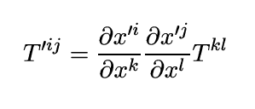
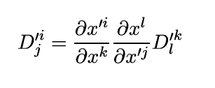
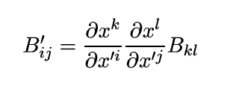
Specific cases
(2,0) tensor
(1,1) tensor
(0,2) tensor
SUPAGWD, October 2012

Slide 51
Example:
metric tensor
which justifies
Invariant interval
(scalar)
Contravariant vectors
or (1,0) tensors
SUPAGWD, October 2012

Slide 52
We can use the metric tensor to convert contravariant vectors to one-forms, and vice versa.
Lowering the index
Raising the index
Can generalise to tensors of arbitrary rank.
(this also explains why we generally think of gradient as a vector operator. In flat, Cartesian space components of vectors and one-forms are identical)
SUPAGWD, October 2012

Slide 53
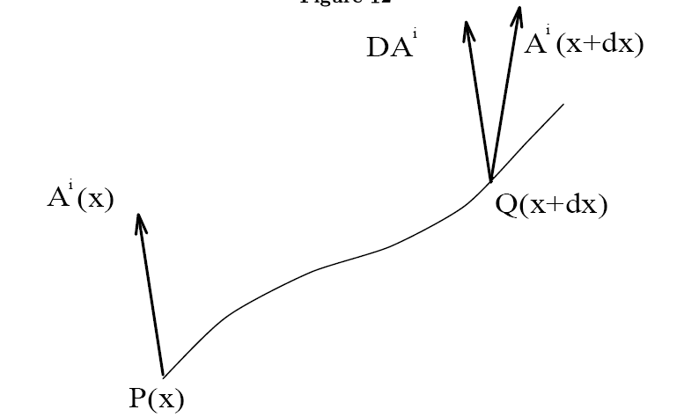
Covariant differentiation
Differentiation of e.g. a vector field involves subtracting vector components at two neighbouring points.
This is a problem because the transformation law for the components of A will in general be different at P and Q.
 Partial derivatives are not tensors
To fix this problem,
we need a procedure for
transporting the components
of A to point Q.
SUPAGWD, October 2012

Slide 54
Covariant differentiation
We call this procedure Parallel Transport
A vector field is parallel transported along a curve, when it mantains a constant angle with the tangent vector to the curve
SUPAGWD, October 2012

Slide 55
Covariant differentiation
We can write
where
Christoffel symbols, connecting the basis vectors at Q to those at P
SUPAGWD, October 2012

Slide 56
Covariant differentiation
We can write
where
Christoffel symbols, connecting the basis vectors at Q to those at P
SUPAGWD, October 2012

Slide 57
Covariant differentiation
We can now define the covariant derivative (which does transform as a tensor)
Vector
One-form
(with the obvious generalisation to arbitrary tensors)
SUPAGWD, October 2012

Slide 58
Covariant differentiation
We can show that the covariant derivatives of the metric tensor are identically zero, i.e.
From which it follows that
SUPAGWD, October 2012

Slide 59
Geodesics
We can now provide a more mathematical basis for the phrase “spacetime tells matter how to move”.
The covariant derivative of a tangent vector, along the geodesic is identically zero, i.e.
SUPAGWD, October 2012

Slide 60
Geodesics
Suppose we parametrise the geodesic by the proper time, , along it (fine for a material particle). Then
i.e.
with the equivalent expression for a photon (replacing with )
SUPAGWD, October 2012

Slide 61
4. Spacetime curvature in GR (pgs.33 – 37)
This is described by the Riemann-Christoffel tensor, which depends on the metric and its first and second derivatives.
We can derive the form of the R-C tensor in several ways
SUPAGWD, October 2012

Slide 62
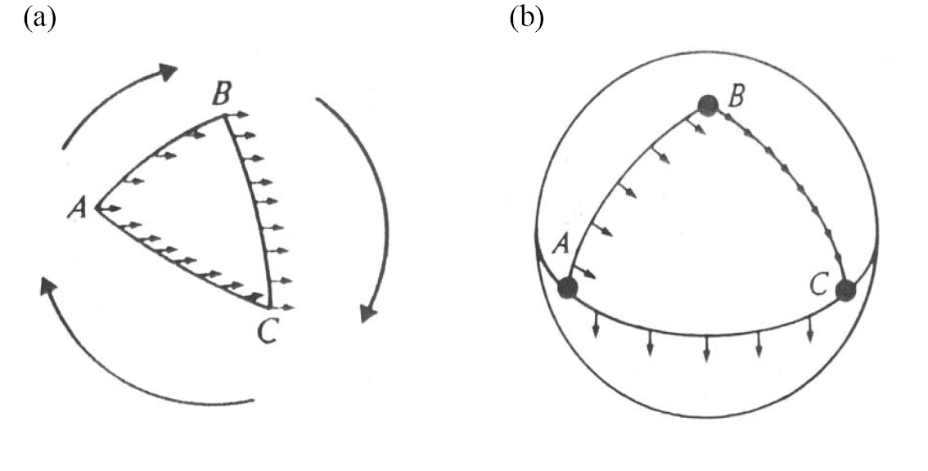
SUPAGWD, October 2012

Slide 63
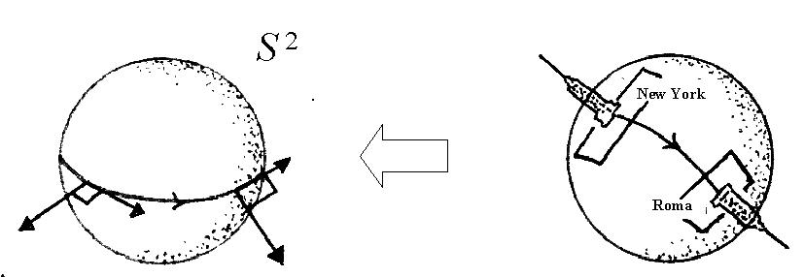
In a flat manifold, parallel transport does not rotate vectors, while on a curved manifold it does.
SUPAGWD, October 2012

Slide 64
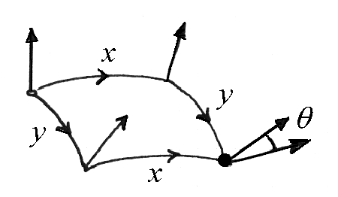
After parallel transport around a closed loop on a curved manifold, the vector does not come back to its original orientation but it is rotated through some angle.
The R-C tensor is related to this angle.
If spacetime is flat then, for all indices
SUPAGWD, October 2012

Slide 65
Another analogy will help us to interpret this last term
Sphere of radius a
Differentiating:
Comparing with previous slide:
represents radius of curvature of spacetime at the Earth’s surface
SUPAGWD, October 2012

Slide 66
5. Einstein’s Equations (pgs.38 – 45)
What about “matter tells spacetime how to curve”?...
The source of spacetime curvature is the Energy-momentum tensor
which describes the presence and motion of gravitating matter (and energy).
We define the E-M tensor for a perfect fluid
In a fluid description we treat our physical system as a smooth continuum, and describe its behaviour in terms of locally averaged properties in each fluid element.
SUPAGWD, October 2012

Slide 67
Each fluid element may possess a bulk motion
with respect to the rest of the fluid, and this relative
motion may be non-uniform.
At any instant we can define
Momentarily comoving rest frame (MCRF)
of the fluid element – Lorentz Frame in which
the fluid element as a whole is
instantaneously at rest.
Particles in the fluid element will not be at rest:
Pressure (c.f. molecules in an ideal gas)
Heat conduction (energy exchange with neighbours)
Viscous forces (shearing of fluid)
SUPAGWD, October 2012

Slide 68
Each fluid element may possess a bulk motion
with respect to the rest of the fluid, and this relative
motion may be non-uniform.
Perfect Fluid if, in MCRF, each fluid
element has no heat conduction or
viscous forces, only pressure.
Dust = special case of pressure-free perfect fluid.
SUPAGWD, October 2012

Slide 69
Definition of E-M tensor
SUPAGWD, October 2012

Slide 70
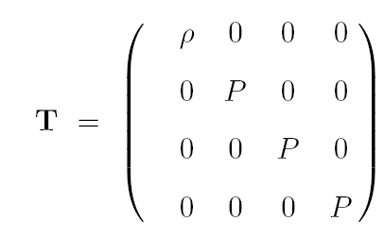
Pressure due to random motion of particles in fluid element
SUPAGWD, October 2012

Slide 71
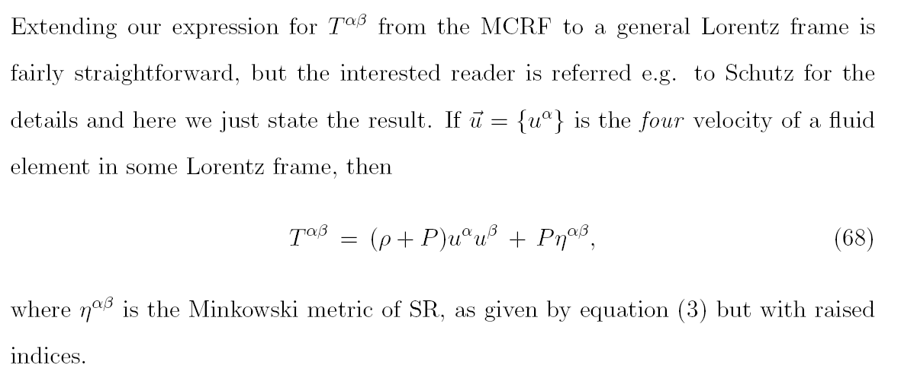
Pressure due to random motion of particles in fluid element
SUPAGWD, October 2012

Slide 72
SUPAGWD, October 2012

Slide 73
Hence
and
Covariant expression of energy conservation in a curved spacetime.
SUPAGWD, October 2012

Slide 74
So how does “matter tell spacetime how to curve”?...
Einstein’s Equations
BUT the E-M tensor is of rank 2, whereas the R-C tensor is of rank 4.
Einstein’s equations involve contractions of the R-C tensor.
Define the Ricci tensor by
and the curvature scalar by
SUPAGWD, October 2012

Slide 75
We can raise indices via
and define the Einstein tensor
We can show that
so that
SUPAGWD, October 2012

Slide 76
Einstein took as solution the form
Solving Einstein’s equations
Given the metric, we can compute the Christoffel symbols, then the geodesics of ‘test’ particles.
We can also compute the R-C tensor, Einstein tensor and E-M tensor.
SUPAGWD, October 2012

Slide 77
What about the other way around?...
Highly non-trivial problem, in general intractable, but given E-M tensor can solve for metric in some special cases.
e.g. Schwarzschild solution, for the spherically symmetric static spacetime exterior to a mass M
Coordinate singularity at r=2M
SUPAGWD, October 2012

Slide 78
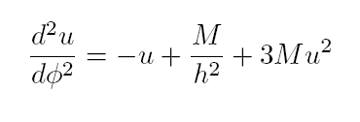
Radial geodesic
or
Extra term, only in GR
SUPAGWD, October 2012

Slide 79
Newtonian solution:
Elliptical orbit
SUPAGWD, October 2012

Slide 80
GR solution:
Precessing ellipse
Here
SUPAGWD, October 2012

Slide 81
GR solution:
Precessing ellipse
SUPAGWD, October 2012

Slide 82
GR solution:
Precessing ellipse
Seen much more dramatically in the
binary pulsar
PSR 1913+16.
Periastron is advancing at a rate of ~4 degrees per year!
SUPAGWD, October 2012

Slide 83
Radial geodesic for a photon
or
Solution reduces to
So that asymptotically
SUPAGWD, October 2012

Slide 84
SUPAGWD, October 2012

Slide 85
1919 expedition, led by Arthur Eddington, to observe total solar eclipse, and measure light deflection.
GR passed the test!
SUPAGWD, October 2012

Slide 86
6. Wave Equation for Gravitational Radiation (pgs.46 – 57)
Weak gravitational fields
In the absence of a gravitational field, spacetime is flat. We define a weak gravitational field as one is which spacetime is ‘nearly flat’
i.e. we can find a coord system
such that
where
This is known as a Nearly Lorentz coordinate system.
SUPAGWD, October 2012

Slide 87
If we find a coordinate system in which spacetime looks nearly flat, we can carry out certain coordinate transformations after which spacetime will still look nearly flat:
1) Background Lorentz transformations
i.e.
SUPAGWD, October 2012

Slide 88
If we find a coordinate system in which spacetime looks nearly flat, we can carry out certain coordinate transformations after which spacetime will still look nearly flat:
1) Background Lorentz transformations
Under this transformation
SUPAGWD, October 2012

Slide 89
If we find a coordinate system in which spacetime looks nearly flat, we can carry out certain coordinate transformations after which spacetime will still look nearly flat:
1) Background Lorentz transformations
SUPAGWD, October 2012

Slide 90
If we find a coordinate system in which spacetime looks nearly flat, we can carry out certain coordinate transformations after which spacetime will still look nearly flat:
2) Gauge transformations
SUPAGWD, October 2012

Slide 91
If we find a coordinate system in which spacetime looks nearly flat, we can carry out certain coordinate transformations after which spacetime will still look nearly flat:
2) Gauge transformations
Then
and we can write
SUPAGWD, October 2012

Slide 92
If we find a coordinate system in which spacetime looks nearly flat, we can carry out certain coordinate transformations after which spacetime will still look nearly flat:
2) Gauge transformations
SUPAGWD, October 2012

Slide 93
To first order, the R-C tensor for a weak field reduces to
and is invariant under gauge transformations.
Similarly, the Ricci tensor is
where
SUPAGWD, October 2012

Slide 94
The Einstein tensor is the (rather messy) expression
but we can simplify this by introducing
So that
And we can choose the Lorentz gauge to eliminate the last 3 terms
SUPAGWD, October 2012

Slide 95
In the Lorentz gauge, then Einstein’s equations are simply
And in free space this gives
Writing
or
SUPAGWD, October 2012

Slide 96
then
This is a key result. It has the mathematical form of a wave equation, propagating with speed c.
We have shown that the metric perturbations – the ‘ripples’ in spacetime produced by disturbing the metric – propagate at the speed of light as waves in free space.
SUPAGWD, October 2012

Slide 97
7. The Transverse Traceless Gauge (pgs.57 – 62)
Simplest solutions of our wave equation are plane waves
Wave vector
Wave amplitude
Note the wave amplitude is symmetric  10 independent components.
Also, easy to show that
i.e. the wave vector is a null vector
SUPAGWD, October 2012

Slide 98
Thus
Also, from the Lorentz gauge condition
which implies that
But this is 4 equations, one for each value of the index .
Hence, we can eliminate 4 more of the wave amplitude components,
SUPAGWD, October 2012

Slide 99
Can we do better? Yes
Our choice of Lorentz gauge, chosen to simplify Einstein’s equations,
was not unique. We can make small adjustments to our original Lorentz gauge transformation and still satisfy the Lorentz condition.
We can choose adjustments that will make our wave amplitude components even simpler – we call this choice the Transverse Traceless gauge:
(traceless)
SUPAGWD, October 2012

Slide 100
Suppose we orient our coordinate axes so that the plane wave is travelling in the positive z direction. Then
and
SUPAGWD, October 2012

Slide 101
So in the transverse traceless gauge,
where
Also, since the perturbation is traceless
SUPAGWD, October 2012

Slide 102
8. Effect of Gravitational Waves on Free Particles (pgs.63 – 75)
Choose Background Lorentz frame in which test particle initially at
rest. Set up coordinate system according to the TT gauge.
Initial acceleration satisfies
i.e. coordinates do not change, but adjust themselves as wave
passes so that particles remain ‘attached’ to initial positions.
Coordinates are frame-dependent labels.
What about proper distance between neighbouring particles?
SUPAGWD, October 2012

Slide 103
Consider two test particles, both initially at rest, one at origin and the other at
i.e.
Now
so
In general, this is time-varying
SUPAGWD, October 2012

Slide 104
More formally, consider geodesic deviation between two particles, initially at rest
i.e. initially with
Then
and
Hence
SUPAGWD, October 2012

Slide 105
Similarly, two test particles initially separated by in the direction satisfy
We can further generalise to a ring of test particles: one at origin, the other initially a :
SUPAGWD, October 2012

Slide 106
So in the transverse traceless gauge,
where
Also, since the perturbation is traceless
SUPAGWD, October 2012

Slide 107
Solutions are:
SUPAGWD, October 2012

Slide 108
SUPAGWD, October 2012

Slide 109
SUPAGWD, October 2012

Slide 110
Rotating axes through an angle of to define
We find that
These are identical to earlier solution, apart from rotation.
SUPAGWD, October 2012

Slide 111
SUPAGWD, October 2012

Slide 112
Distortions are quadrupolar - consequence of fact that
acceleration of geodesic deviation non-zero only for tidal
gravitational field.
At any instant, a gravitational wave is invariant under a rotation of
180 degrees about its direction of propagation.
(c.f. spin states of gauge bosons; graviton must be S=2,
tensor field)
SUPAGWD, October 2012

Slide 113
Design of gravitational wave detectors
SUPAGWD, October 2012

Slide 114
Design of gravitational wave detectors
SUPAGWD, October 2012

Slide 115
Design of gravitational wave detectors
SUPAGWD, October 2012

Slide 116
34 yrs on - Interferometric ground-based detectors
SUPAGWD, October 2012

Slide 117
Gravitational wave propagating along z axis.
Fractional change in proper separation
SUPAGWD, October 2012

Slide 118
More generally, for
Detector ‘sees’
Maximum response for
Null response for
SUPAGWD, October 2012

Slide 119
More generally, for
Detector ‘sees’
Maximum response for
Null response for
SUPAGWD, October 2012

Slide 120
9. The Production of Gravitational Waves (pgs 76 – 80)
Net electric dipole moment
SUPAGWD, October 2012

Slide 121
Gravitational analogues?...
Mass dipole moment:
But
Conservation of linear momentum implies no mass dipole radiation
SUPAGWD, October 2012

Slide 122
Gravitational analogues?...
Conservation of angular momentum implies no mass dipole radiation
SUPAGWD, October 2012

Slide 123
Also, the quadrupole of a spherically symmetric mass distribution is zero.
Metric perturbations which are spherically symmetric don’t produce gravitational radiation.
Example: binary neutron star system.
SUPAGWD, October 2012

Slide 124
SUPAGWD, October 2012

Slide 125
Thus
where
So the binary system emits gravitational waves at twice the orbital frequency of the neutron stars.
Also
SUPAGWD, October 2012

Slide 126
Thus
where
So the binary system emits gravitational waves at twice the orbital frequency of the neutron stars.
Also
Huge
Challenge!
SUPAGWD, October 2012

