Slide 1
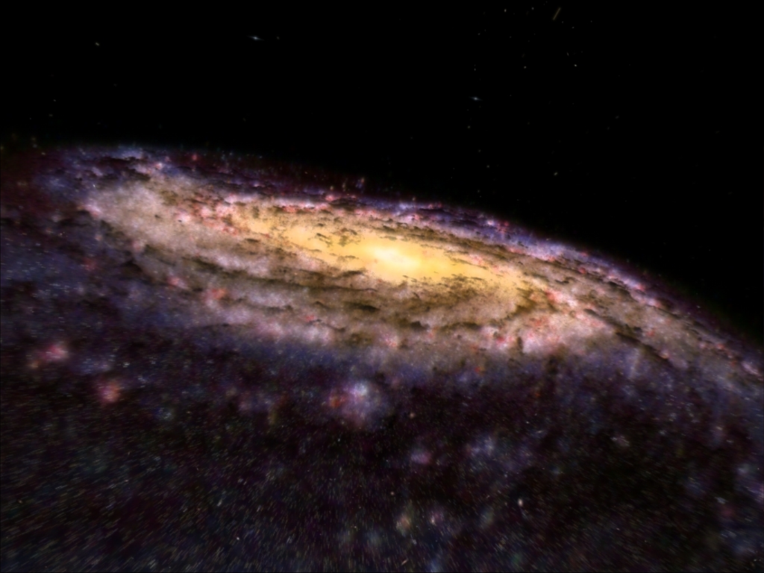
Galaxy formation and evolution
Carlton Baugh
Institute for Computational Cosmology
Durham University
STFC Introductory Summer School
Glasgow 2011

Slide 2


Galaxy formation and evolution:
What do we know observationally?
Galaxy formation in a cosmological context
Why do we need “complicated’’ models?
How do we model galaxy formation?
What have we learnt so far?
Outstanding problems

Slide 3
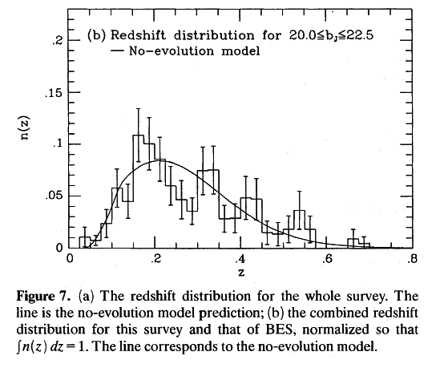
The high redshift universe 1990
Colless et al. 1990

Slide 4
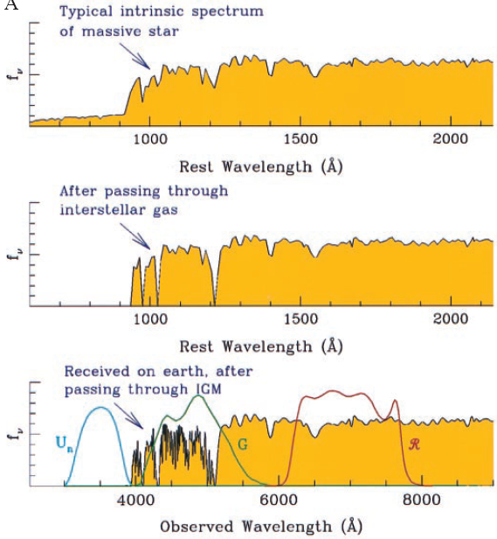
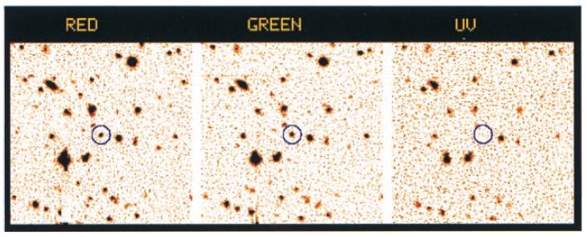
The Lyman break technique
Colour-colour selection of
High redshift galaxies.
Steidel et al. 1996, 1999

Slide 5
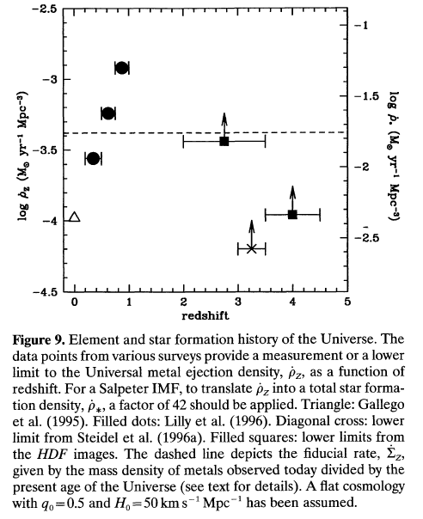
Star formation history of the Universe
Madau et al. 1996; Lilly et al. 1995

Slide 6
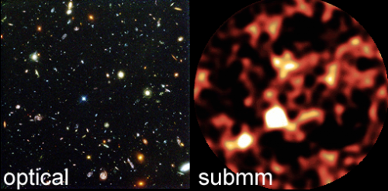
The multi-wavelength view
Hubble Deep Field: Williams et al 1996; Hughes et al. 1998

Slide 7
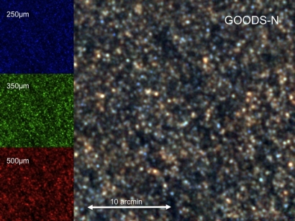
The Herschel Space Observatory view

Slide 8
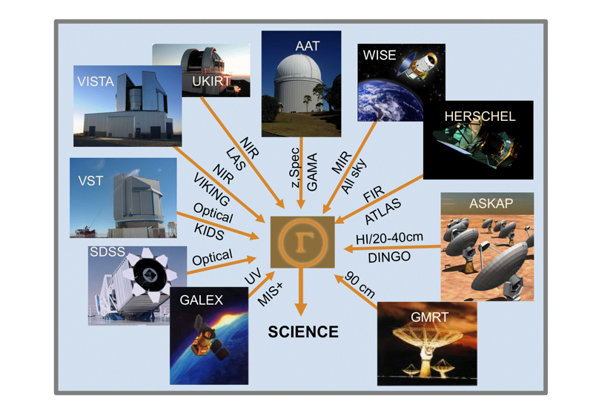
Multi-wavelength astronomy
GAMA Survey Driver et al 2009

Slide 9
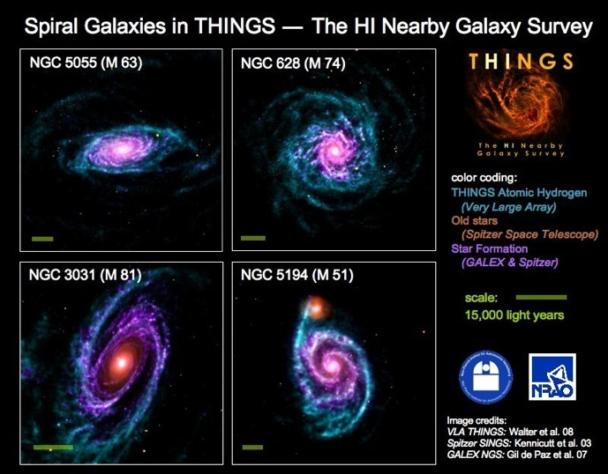

Slide 10
Pseudo-models
Backwards models:
Passive evolution
No evolution
Luminosity evolution
Brief description of data
Unphysical
Ignore structure formation
No predictions

Slide 11
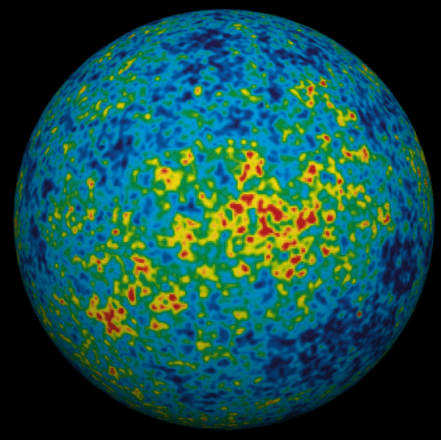
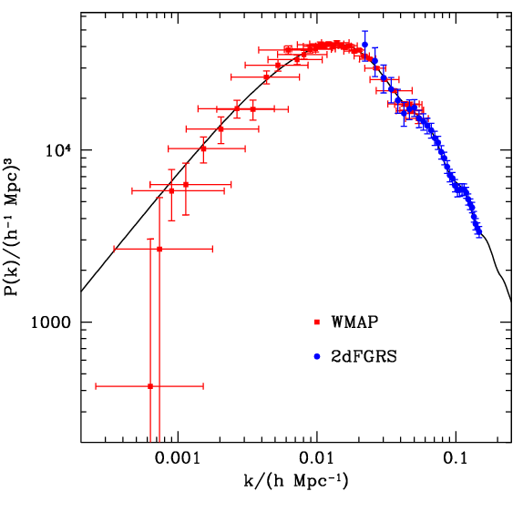

The cosmological setting:
Hierarchical structure formation
z ~ 1100
z~0
Sanchez et al. 2006, 2009

Slide 12
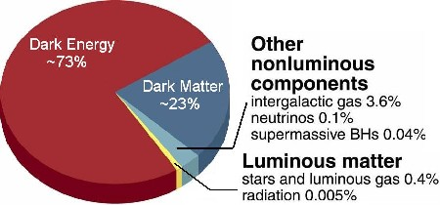
What is the universe made of?

Slide 13
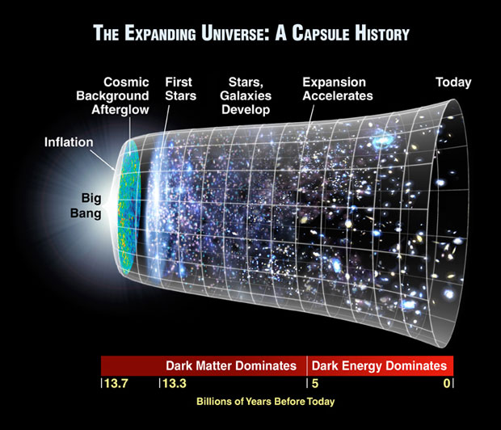

Slide 14


Slide 15
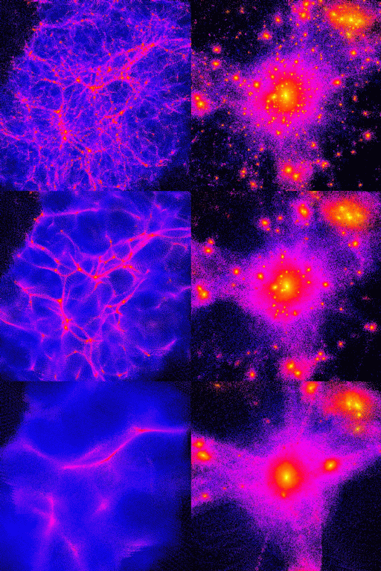
How the nature of dark matter affects cosmic structure
HOT
WARM
COLD
(Ben Moore)

Slide 16
What do we know about galaxies?

Slide 17
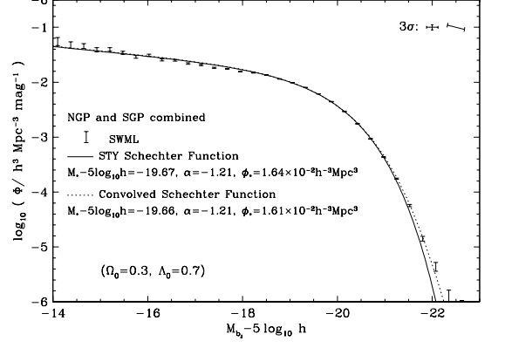

Basic galaxy properties: the galaxy luminosity function
fainter
brighter
Norberg et al. 2002

Slide 18
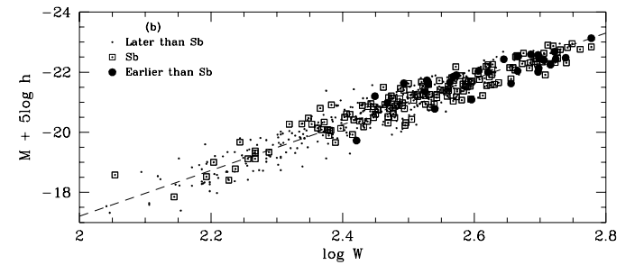
Basic galaxy properties: the “Tully-Fisher” relation
luminosity
Log rotation speed
Giovanelli et al 1997

Slide 19
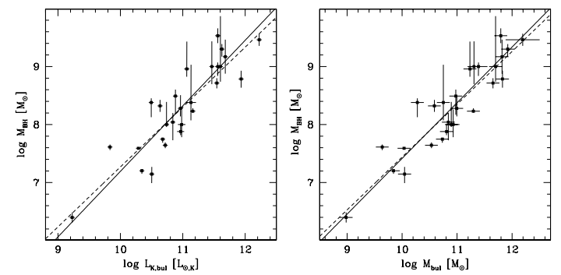
Basic galaxy properties: galactic bulge- black hole mass
Black hole mass – bulge properties: Marconi & Hunt

Slide 20
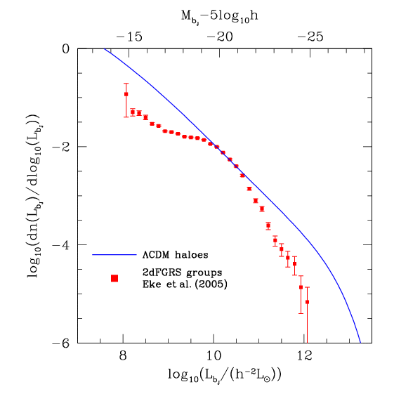
Why do we need “complicated” models?
Baugh 2006 Reports on Progress in Physics, astro-ph/0610031
Galaxy group luminosity function
Measured from 2dFGRS by
Eke et al. 2004, 2005
L = Σ L
abundance
group
galaxy
Simple prediction:
Take CDM halo mass function
plus fixed M/L ratio
Galaxy formation TOO efficient
in both low and high mass haloes
Total group luminosity

Slide 21
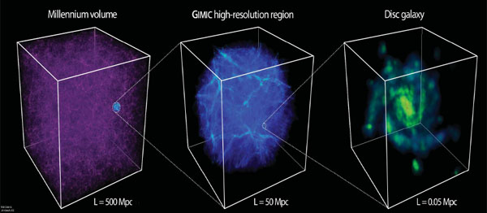
Why is it hard to model galaxy formation?
Huge dynamic range required to follow structure in cosmological setting
Graphic by Rob Crain & Jim Geech

Slide 22
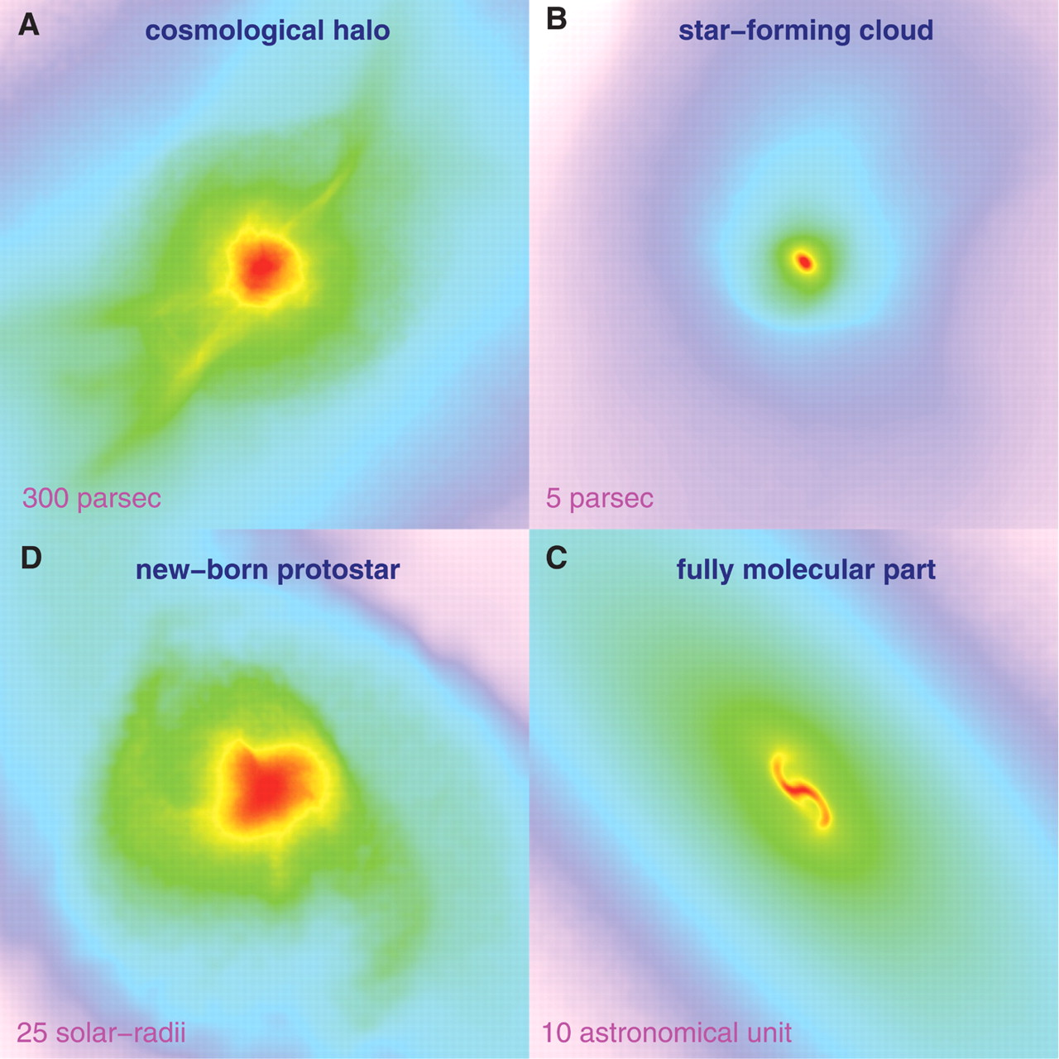

Formation of the first star
Fig. 1. Projected gas distribution around the protostar
N. Yoshida et al., Science 321, 669 -671 (2008)

Slide 23
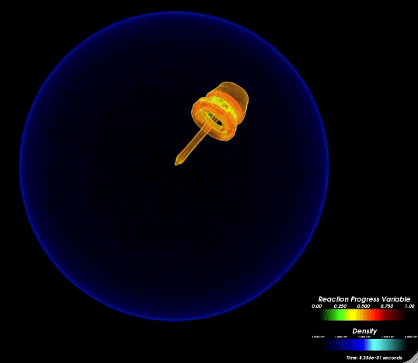
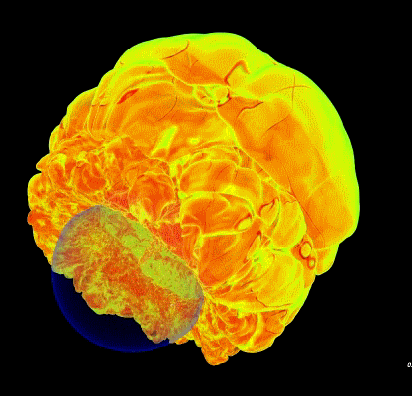
Why is it hard to model galaxy formation?
FLASH AMR simulation of off-centre SN – multiscale physics – peta scale computing

Slide 24


Slide 25
Gas simulations vs.
Semi-analytic modelling
Gas simulations:
More direct
(Sometimes) more information
Challenged by dynamic range
Still use ‘sub-grid’ physics (=semi-analytics)
Semi-analytic models:
More generalised calculation e.g. Spherical symmetry
Faster
Flexible
Modular
Hybrid approach?

Slide 26
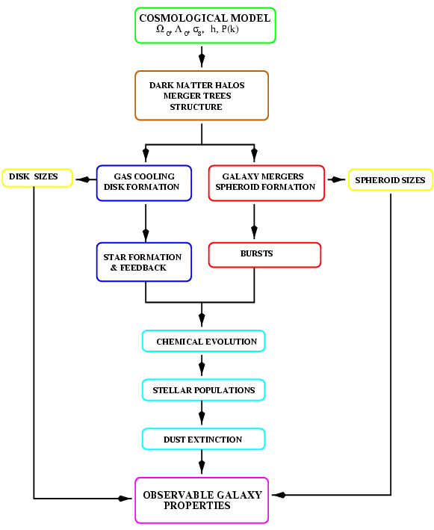
The ingredients of
a model of galaxy
formation
Combination of simulations,
analytic results and recipes
with parameters
Baugh 2006 Rep. Prog. Phys.
Cole et al. 2000

Slide 27
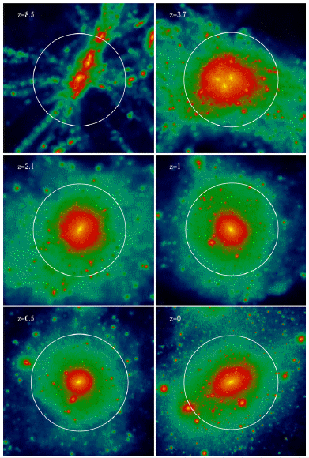
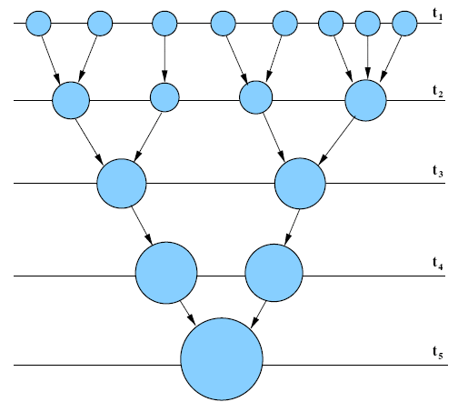
Starting point: halo merger tree
Records assembly of dark matter halo
Image by Chris Power

Slide 28
Case study: gas cooling

Slide 29
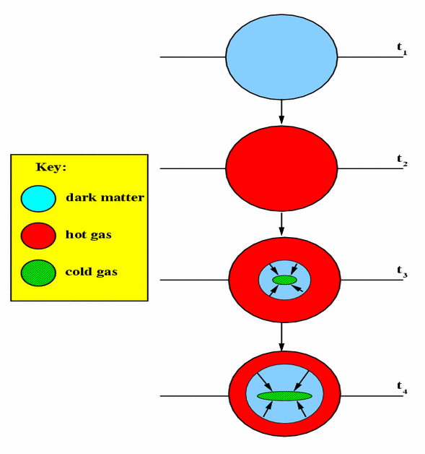
Add in baryonic physics:
Gas cooling inside a dark halo
Baryons shock heated in
gravitational potential
well of the halo.
Gas is ionised and cools
By radiative transitions
Simple model:
Spherical symmetry
Propagate cooling radius

Slide 30
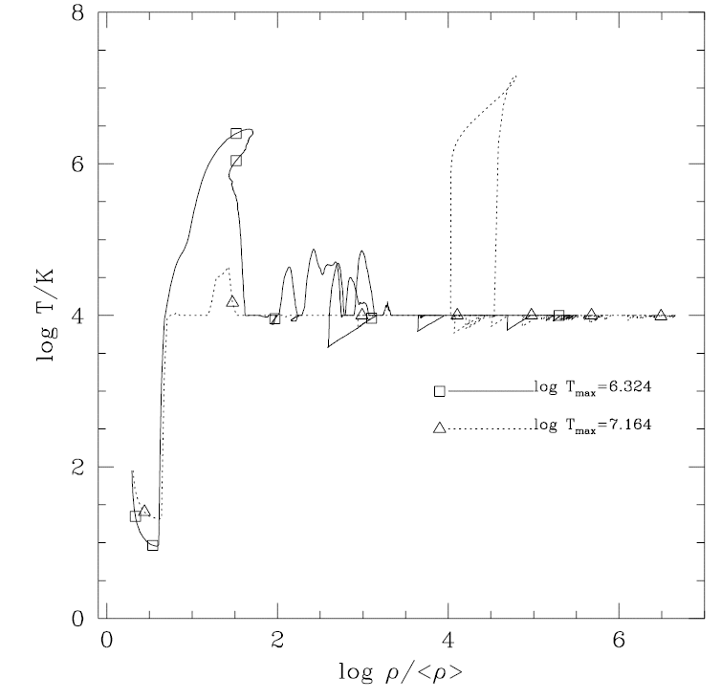
Thermal history of gas in a simulation
Track the temperature and
density of gas in SPH
Some gas never reaches
the virial temperature of
the associated halo
Kay et al. 2000

Slide 31
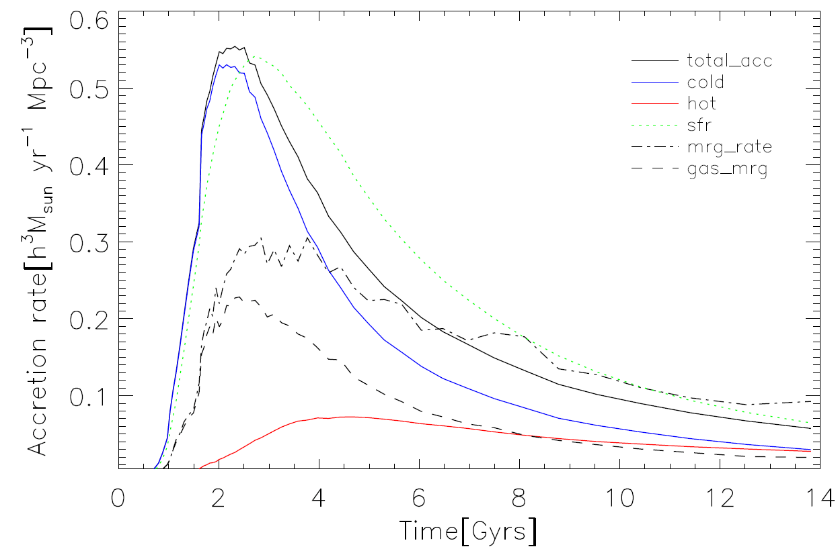
Cold vs hot accretion
SPH simulations of Keres et al 0809.1430

Slide 32
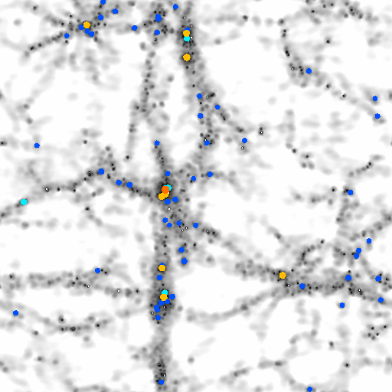
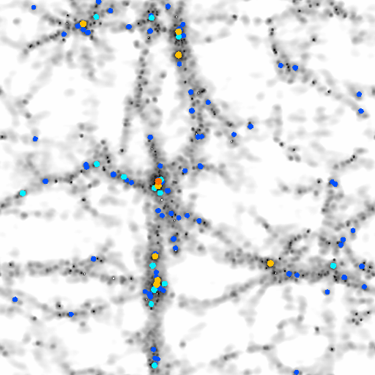
Gas simulations vs semi-analytic recipe
Compare gas cooling in ``stripped down’’ SPH and semi-analytic codes
Helly et al 2003; Yoshida et al 2002

Slide 33
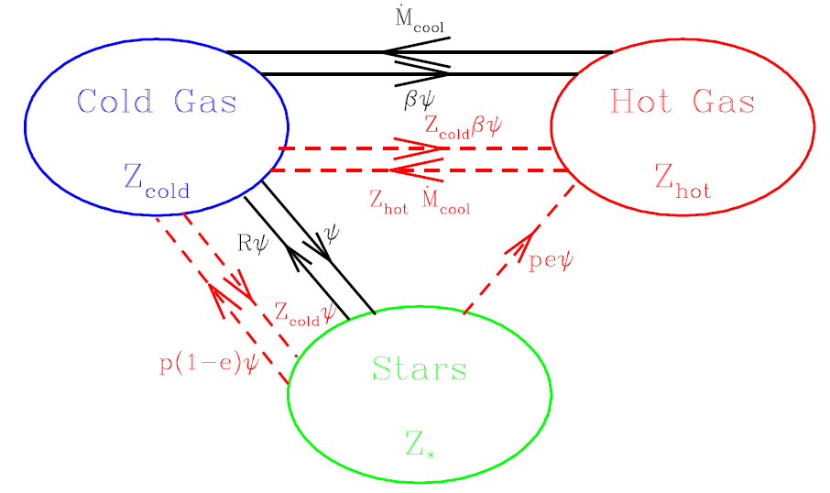
Star formation and feedback
Cole et al. 2000

Slide 34
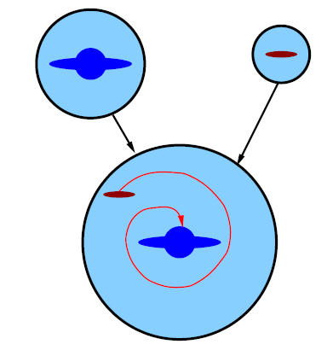
Halo and galaxy mergers
Haloes merge
Diffuse outer parts stripped rapidly
Denser cores survive longer
Galaxies merge through dynamical friction
Merger could be accompanied by star bursts
Galaxy morphology may change

Slide 35
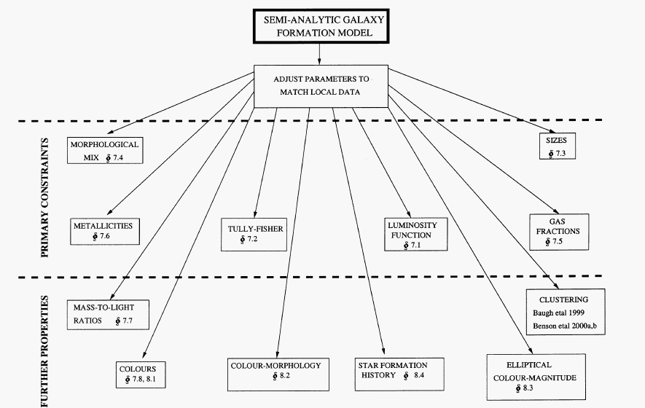
Setting model parameters

Slide 36
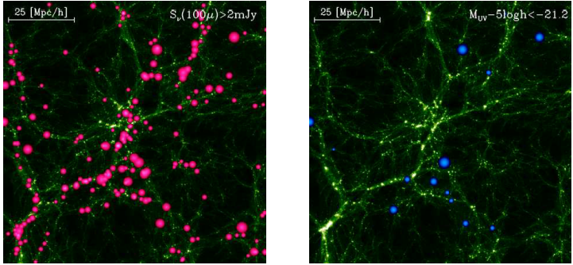
Multi-wavelength multi-property predictions
FAR-IR
UV
Lacey et al. 2010 arXiv:0909.15671

Slide 37
7 things we have learnt about galaxy formation
The need for ‘feedback’
The cosmic star formation history
The scale lengths of galactic disks
A power law galaxy correlation function
Halo Occupation Distribution modelling
The need for AGN feedback
Motivation for a top-heavy IMF in bursts

Slide 38
7 things we have learnt about galaxy formation
The need for ‘feedback’
The cosmic star formation history
The scale lengths of galactic disks
A power law galaxy correlation function
Halo Occupation Distribution modelling
The need for AGN feedback
Motivation for a top-heavy IMF in bursts

Slide 39
7 things we have learnt about galaxy formation
The need for SNe ‘feedback’
The cosmic star formation history
The scale lengths of galactic disks
A power law galaxy correlation function
Halo Occupation Distribution modelling
The need for AGN feedback
Motivation for a top-heavy IMF in bursts

Slide 40
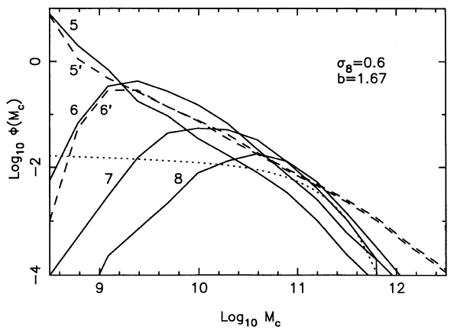
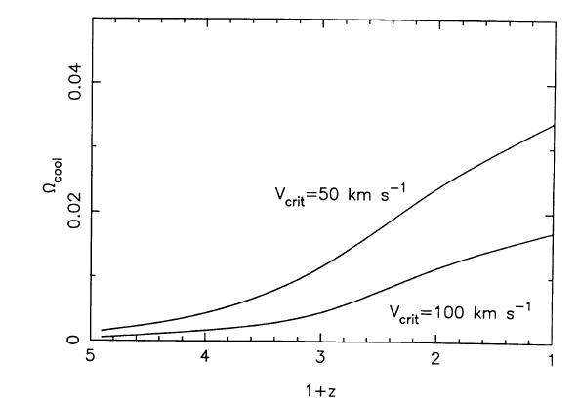
The need for feedback
Cold gas mass function
Cosmic cold gas density
Increasing
SN feedback
Cold gas mass
redshift
Too much gas cools in small haloes without some heating source
Cole 1991

Slide 41
Regulating the formation of faint galaxies
Baugh 2006 Reports on Progress in Physics, astro-ph/0610031
Galaxy group luminosity function
Measured from 2dFGRS by
Eke et al. 2004, 2005
L = Σ L
abundance
group
galaxy
Simple prediction:
Take CDM halo mass function
plus fixed M/L ratio
Galaxy formation TOO efficient
in both low and high mass haloes
Total group luminosity

Slide 42
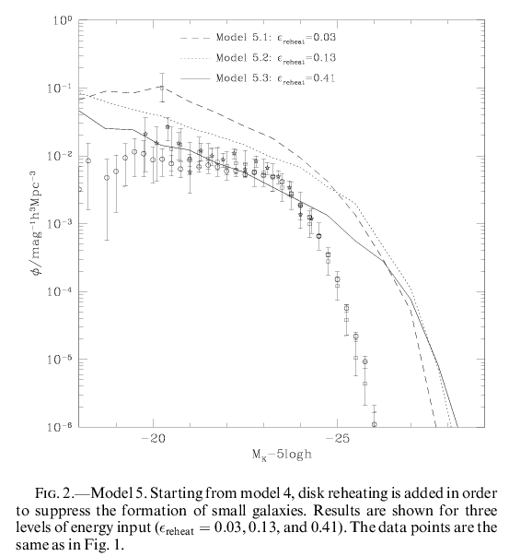
A problem making massive galaxies?
Increasing
SN feedback
With current best fit value
for baryon fraction, predict
far too many bright galaxies
abundance
Increasing supernovae
feedback which heats
disk gas just reduces
number of faint galaxies
z=0 K-band
luminosity function
fainter K-band Mag brighter
Benson et al. 2003

Slide 43
Possible mechanisms to suppress formation of bright galaxies
Regulate gas cooling in massive halos
- turn off gas cooling ``by-hand’’
- conduction of heat in halo gas
- change density profile of hot halo
- inject energy to balance cooling flow
Drive out cooled gas in a superwind
- driven by quasar activity
- driven by star formation

Slide 44
An alternative source of energy accretion onto SMBH
Bower et al. 2006
Need model to track growth of black holes (e.g. Fanidakis etal )
Haloes with quasi-static hot gas halo: t(cool) > t(free-fall)
Rate at which gas cools is quenched, depending on size of black hole
AGN emits luminosity that balances cooling luminosity radiated by gas
See also Croton et al. 2006, MNRAS; de Lucia et al. 2006, MNRAS
Quasar mode feedback: Granato et al 2004, Hopkins et al 2006a,b,….
Cattaneo et al 2006; Lagos, Cora & Padilla 2008; Monaco et al 2007

Slide 45
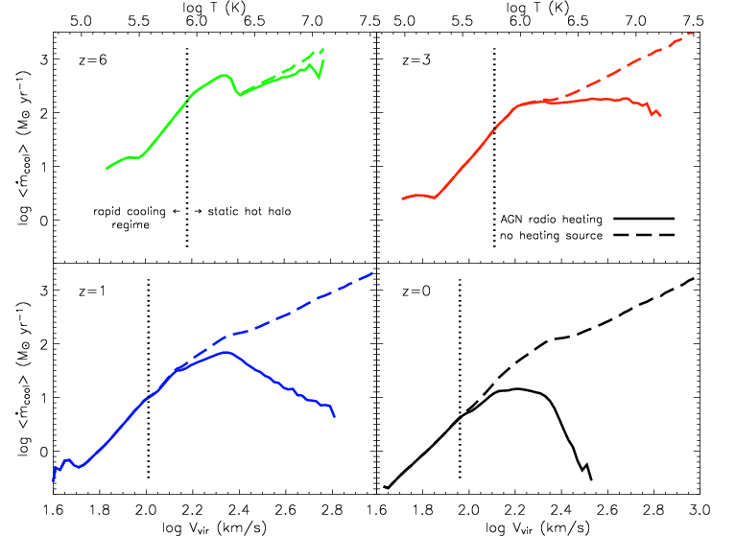
The impact of AGN feedback on gas cooling
Gas cooling rate
Halo virial velocity
Croton et al. 2006

Slide 46
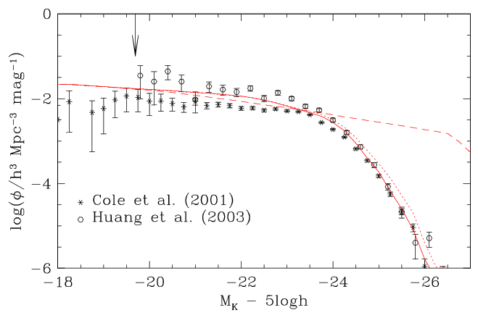
The luminosity function with suppression
of cooling by AGN
Same parameters
but turn off AGN
feedback
With AGN
feedback
Present day K-band field luminosity function
Bower et al. 2006

Slide 47
Outstanding problems?

Slide 48
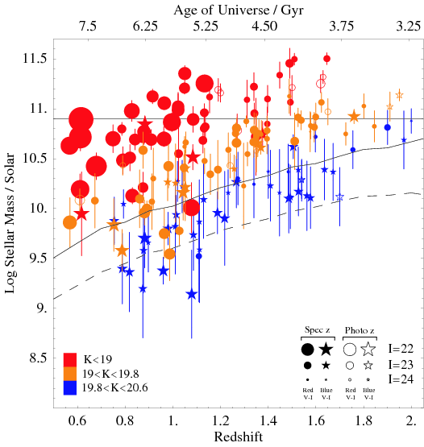
Massive galaxies at z>0
Gemini Deep Deep Survey Glazebrook et al. 2004

Slide 49
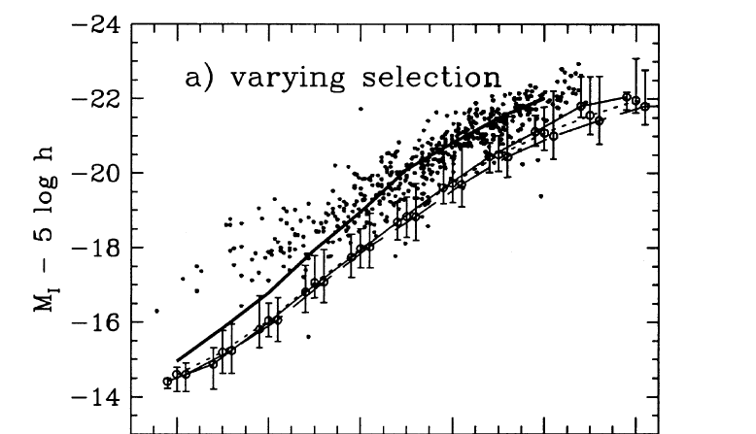

The Tully-Fisher relation
Halo vcirc
Galaxy vcirc at
Half-mass radius

Slide 50
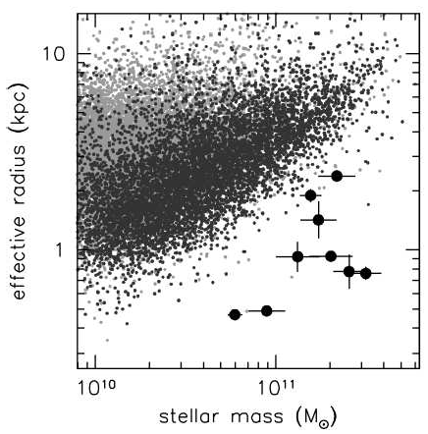
How can we reconcile compact z=2 spheroids with their local counterparts?
SDSS
z=2 spheroids
Van dokkum et al. 2008

Slide 51
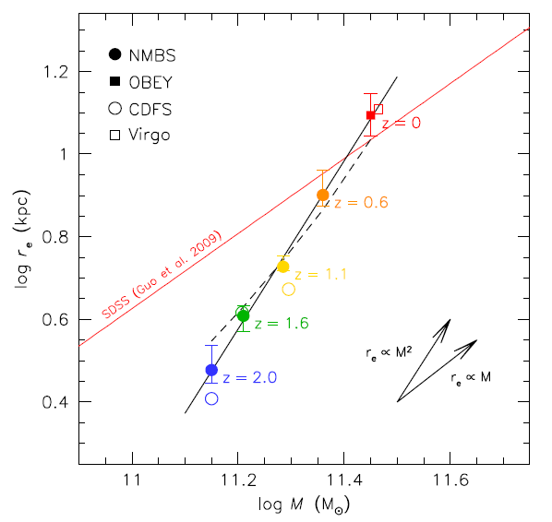
Rapid evolution in radius
More rapid evolution in radius than in stellar mass (at fixed n)
Van Dokkum et al, 2010, ApJ,

Slide 52
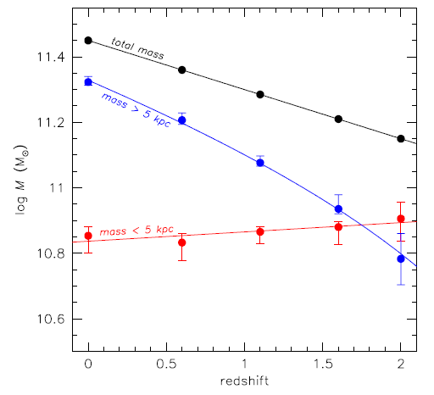
Where is the mass added?
New mass added in outer parts of galaxy
Suggests minor mergers
Van Dokkum et al. 2010

Slide 53
Outstanding problems
Do the models predict the emergence of massive galaxies at high z?
Do the models predict the observed size evolution of these galaxies?
Do the models predict scaling relations as tight as observed
Do the models calculate the right sizes for galaxies today? Is Angular momentum conserved?
Is the amount feedback reasonable?

Slide 54
Summary
Galaxy formation cannot be modelled fully numerically: physics, dynamic range
Semi-analytical modelling complementary to gas dynamic simulations
Rapid exploration of different physical models and parameter space
Modular nature: plug in improved recipes
Only way to generate predictions for galaxy formation in CDM – will apply to any hierarchical cosmology

Slide 55
Learn more about galaxy formation
Baugh 2006
Benson 2010
Cole et al 2000
Mo, Van Den Bosch & White 2010

