Slide 1
N-body Simulation
Frazer Pearce
University of Nottingham

Slide 2
Outline
Why bother with simulation?
Setting up a simulation: initial conditions
Performing a simulation
Re-simulation
Some issues
The future

Slide 3
Why bother?
Theory (and simulation) one of UK’s traditional strengths.
Aids interpretation of what is being observed.
Guides new observations.
Observing proposals
Instrument design
Reduction pipeline testing and training

Slide 4
Only small fraction of Universe visible...

Slide 5
Outline
Why bother with simulation?
Setting up a simulation: initial conditions
Performing a simulation
Re-simulation
Some issues
The future

Slide 7
Initial conditions
Impose small fluctuations on a uniform distribution.
Fluctuations set via “precision cosmology” and transfer function. Typically use CMBFAST.
Λ, Ω, n, h, σ₈ etc from observation (WMAP)
Amplify to start redshift using Zel’dovitch approximation.

Slide 9
Outline
Why bother with simulation?
Setting up a simulation: initial conditions
Performing a simulation
Re-simulation
Some issues
The future

Slide 12
Physics
Gravity
Well understood
Long range
Collisionless
Softened on small scales
computationally challenging

Slide 13
Treecode

Slide 15
Outline
Why bother with simulation?
Setting up a simulation: initial conditions
Performing a simulation
Re-simulation
Some issues
The future

Slide 16
Re-simulation
Run a base simulation.
Trace particles from final region of interest back to initial conditions.
Place higher resolution/lower mass particles where these particles come from.
Re-run simulation.
Check no high mass particles enter region of interest.
Repeat.

Slide 19
Outline
Why bother with simulation?
Setting up a simulation: initial conditions
Performing a simulation
Re-simulation
Some issues
The future

Slide 20
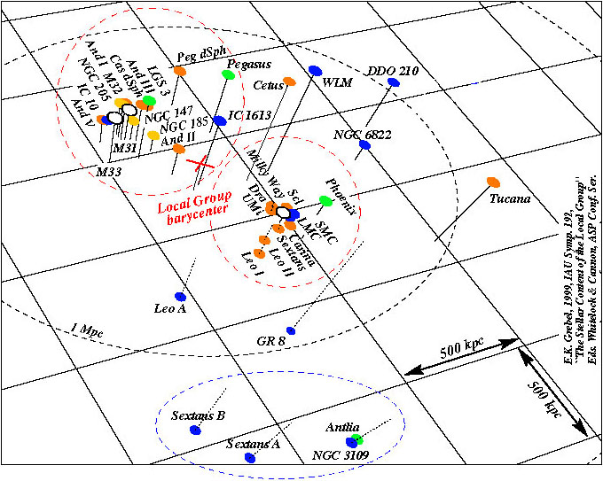
Amount of substructure

Slide 21
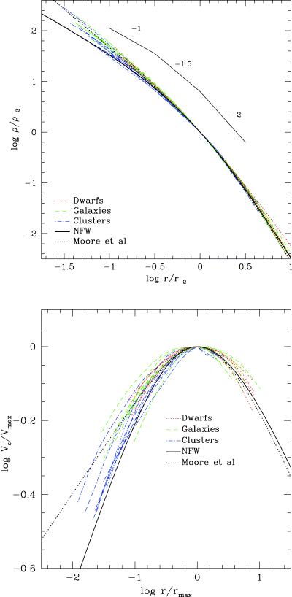
Inner slope of halo profile

Slide 22
Outline
Why bother with simulation?
Setting up a simulation: initial conditions
Performing a simulation
Re-simulation
Some issues
The future

Slide 23
Problem: baryons!

Slide 25
Conclusions
Era of giant pure N-body simulations over.
Resolved down to scale baryon physics dominates
Fluctuations remain linear on largest scales
Still need to understand them to get underlying framework correct.
Hydro-simulations far more physically challenging.
Integrated sub-grid physics model required.

Slide 26
N-body Simulation
Frazer Pearce
University of Nottingham

