Slide 1
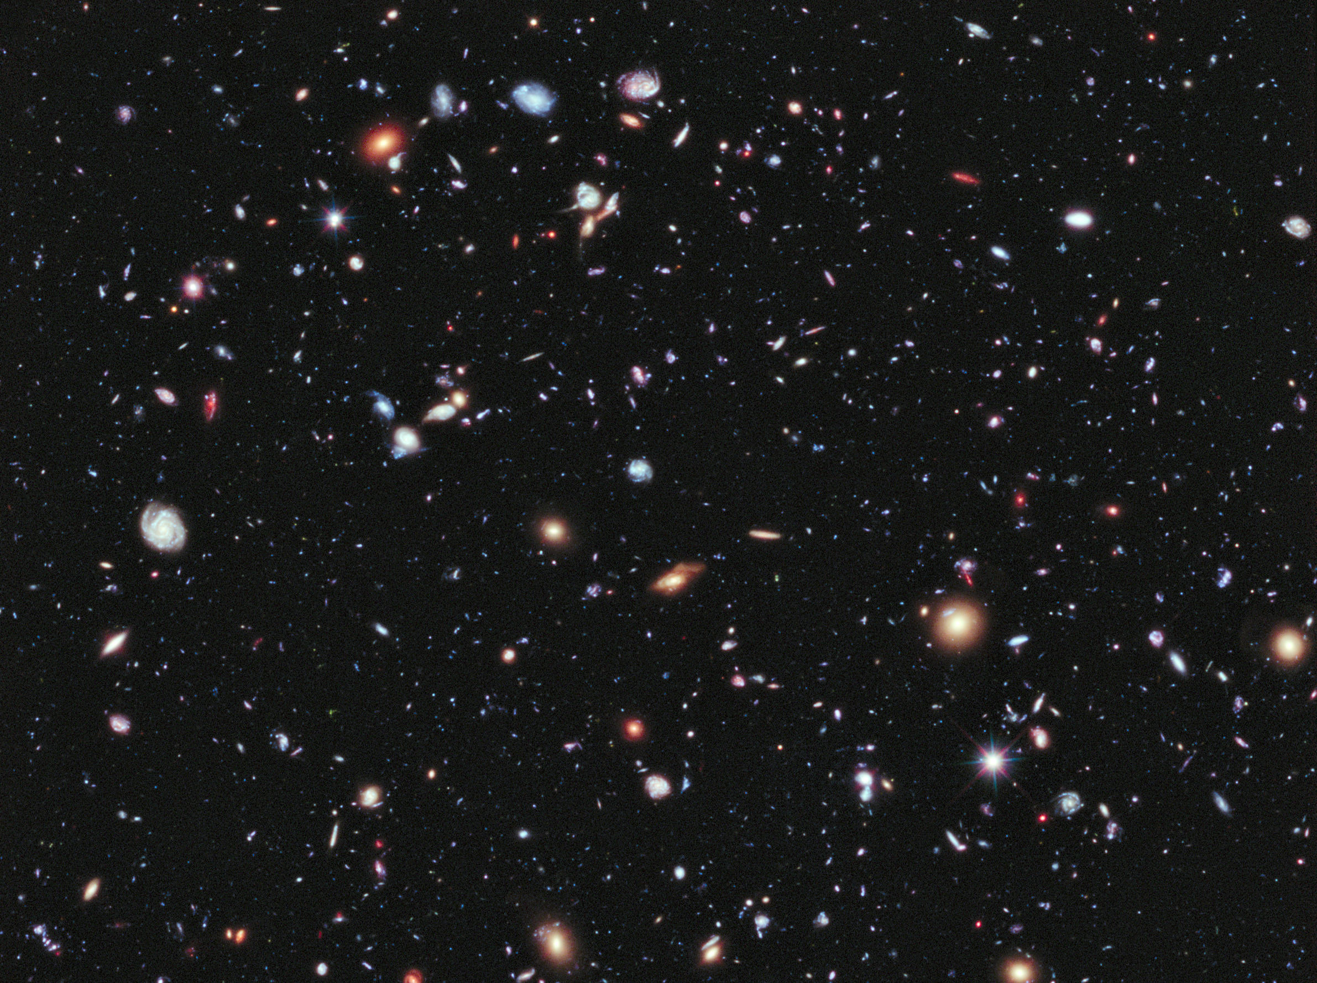
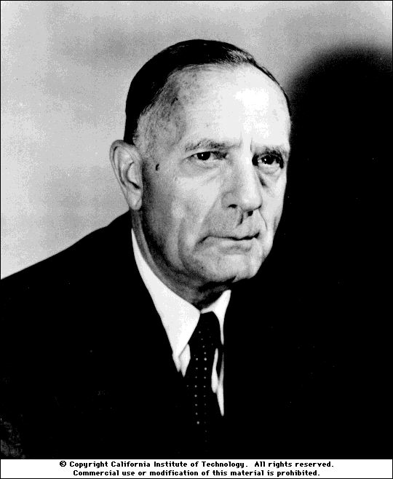
Isotopes, the Big Bang
and the Dark Side
of the Universe
Martin Hendry
School of Physics and Astronomy
University of Glasgow

Slide 2
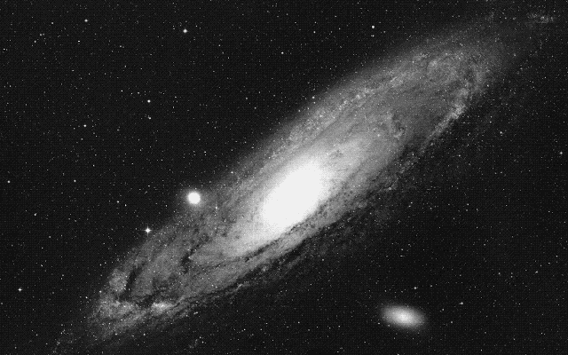
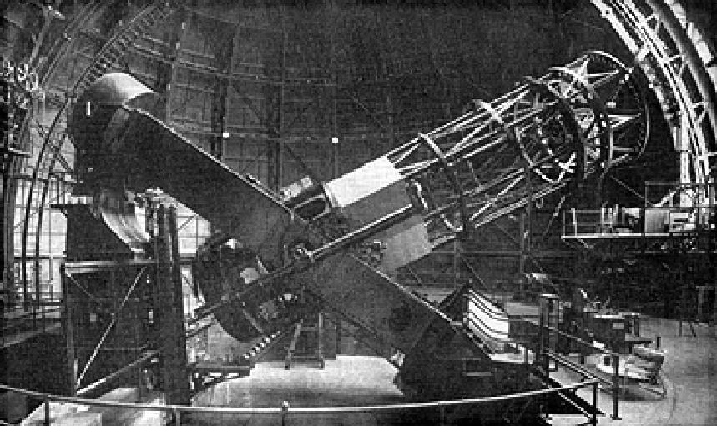

Slide 3
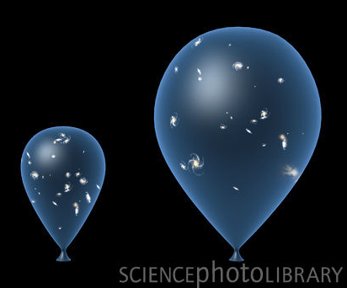
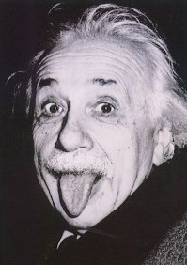

Slide 4
Evidence for the Big Bang
Expansion of the Universe
Evolution of the Universe
Light element abundances
Cosmic background radiation

Slide 5
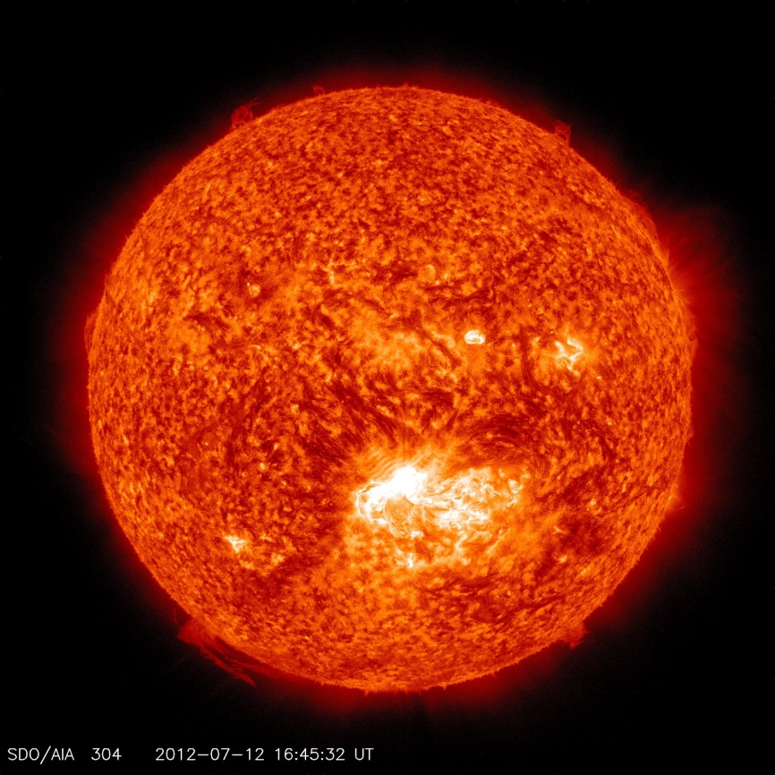
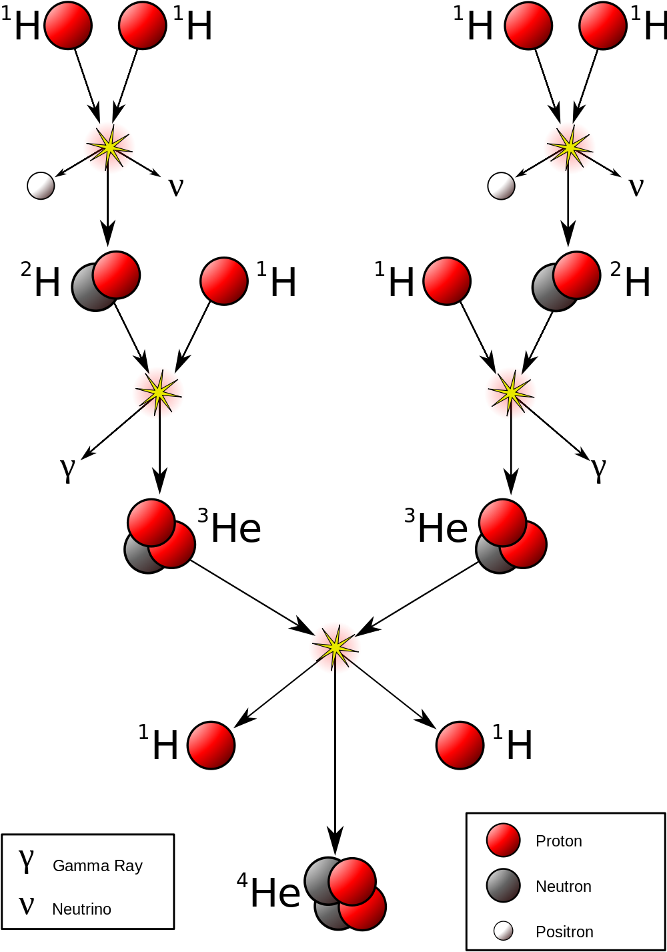
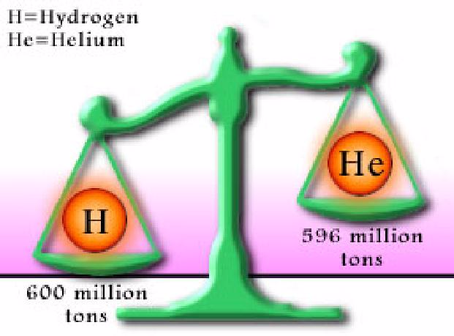
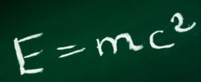

Slide 6
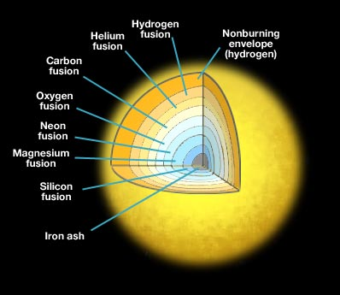

Slide 7
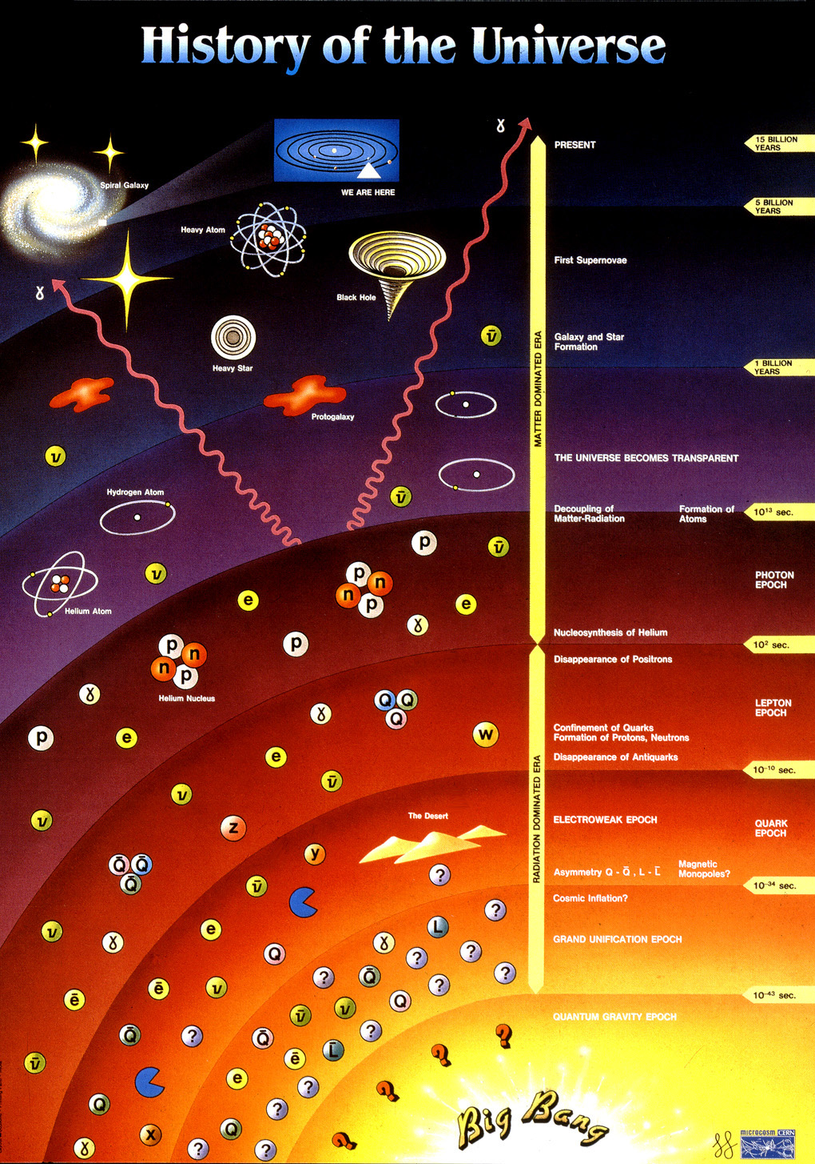
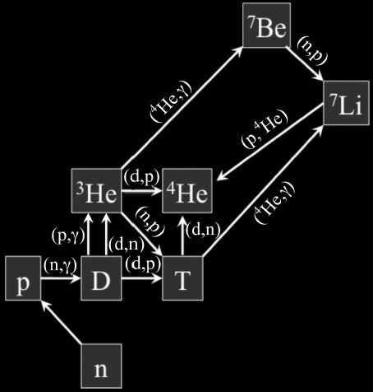
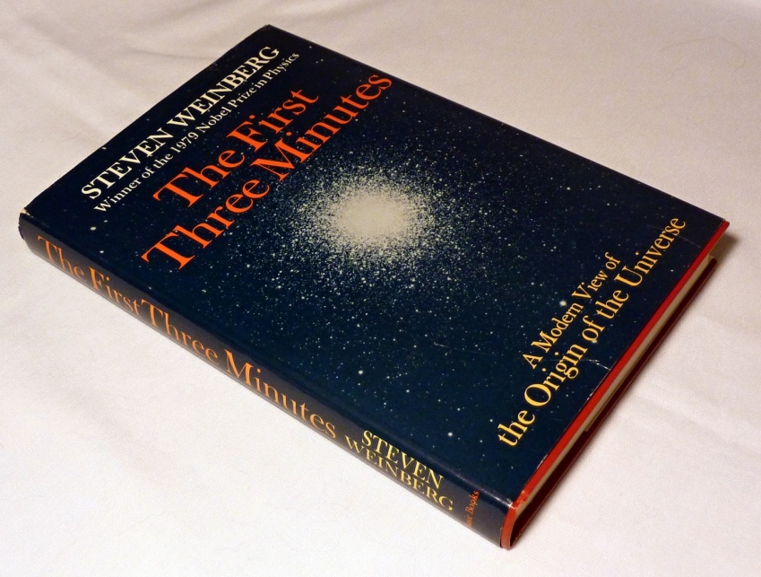

Slide 8
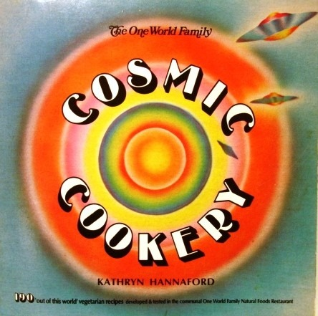
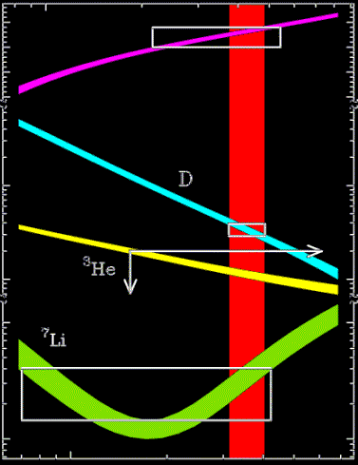
0.25
0.24
0.23
0.22
⁴He mass fraction
10⁻⁴
10⁻⁵
10⁻⁹
10⁻¹⁰
Predicted abundance of isotopes depends on the baryon density of the Universe
Fraction relative to H
1 2 5
Baryon density ( 10⁻⁴⁰ kg m⁻³ )

Slide 9
0.25
0.24
0.23
0.22
⁴He mass fraction
10⁻⁴
10⁻⁵
10⁻⁹
10⁻¹⁰
Predicted abundance of isotopes depends on the baryon density of the Universe
We can compare with observed abundances (white boxes, limits)
Fraction relative to H
1 2 5
Baryon density ( 10⁻⁴⁰ kg m⁻³ )

Slide 10
Observed and predicted abundances
are in excellent agreement.
BUT ONLY if the baryon density lies in the red zone
0.25
0.24
0.23
0.22
⁴He mass fraction
10⁻⁴
10⁻⁵
10⁻⁹
10⁻¹⁰
Fraction relative to H
Well, does it?...
1 2 5
Baryon density ( 10⁻⁴⁰ kg m⁻³ )

Slide 11
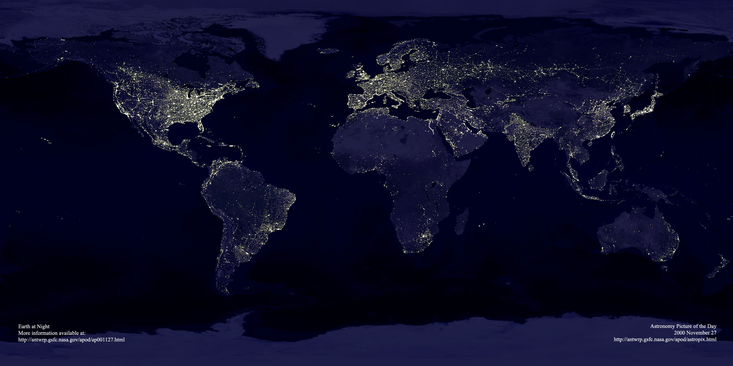
Weighing the Universe

Slide 12
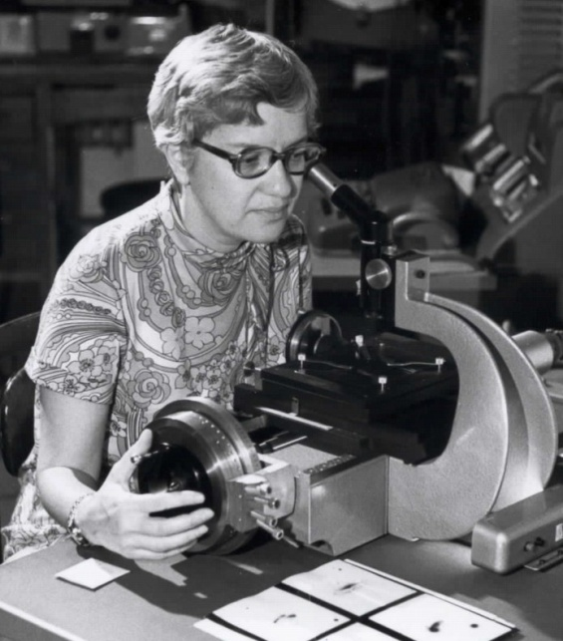
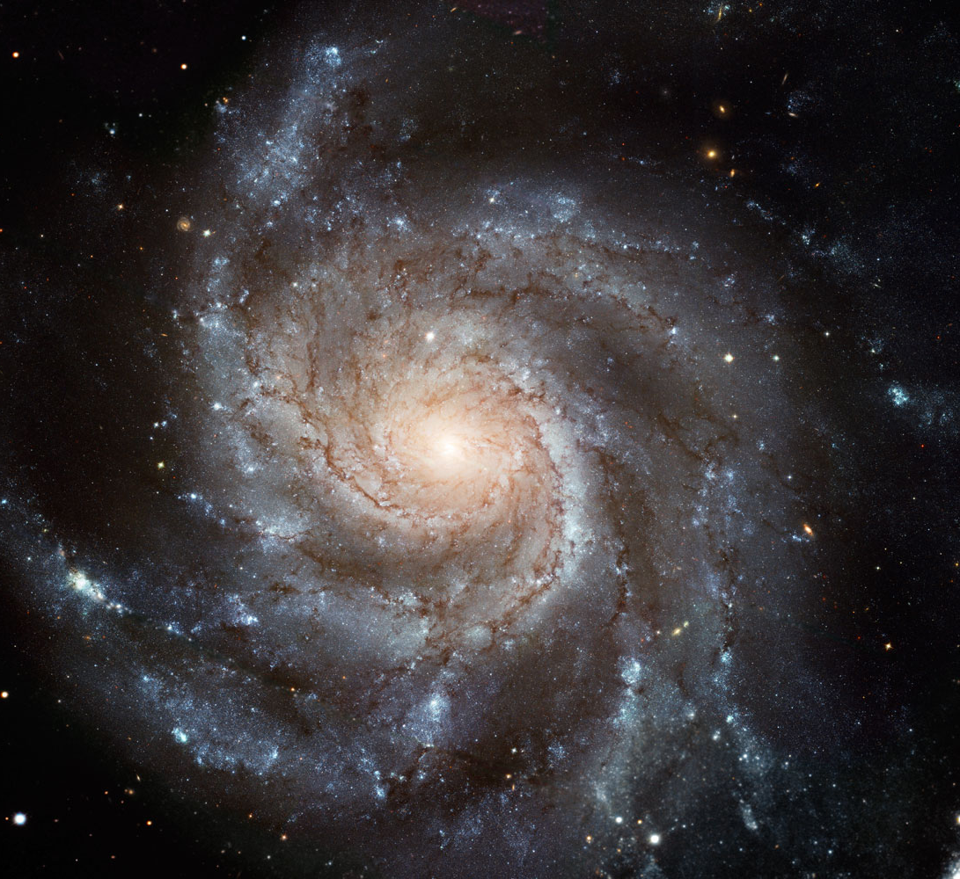
Weighing the Universe
Vera Rubin
1970s: studies the rotation of spiral galaxies.
Galaxies were spinning faster than they should be!

Slide 13
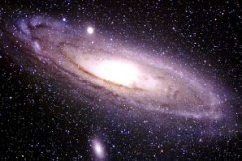
Dark matter
What we see
What we see
What we think is really there….
Much more dark matter than Big Bang theory predicts for the baryon density....

Slide 14
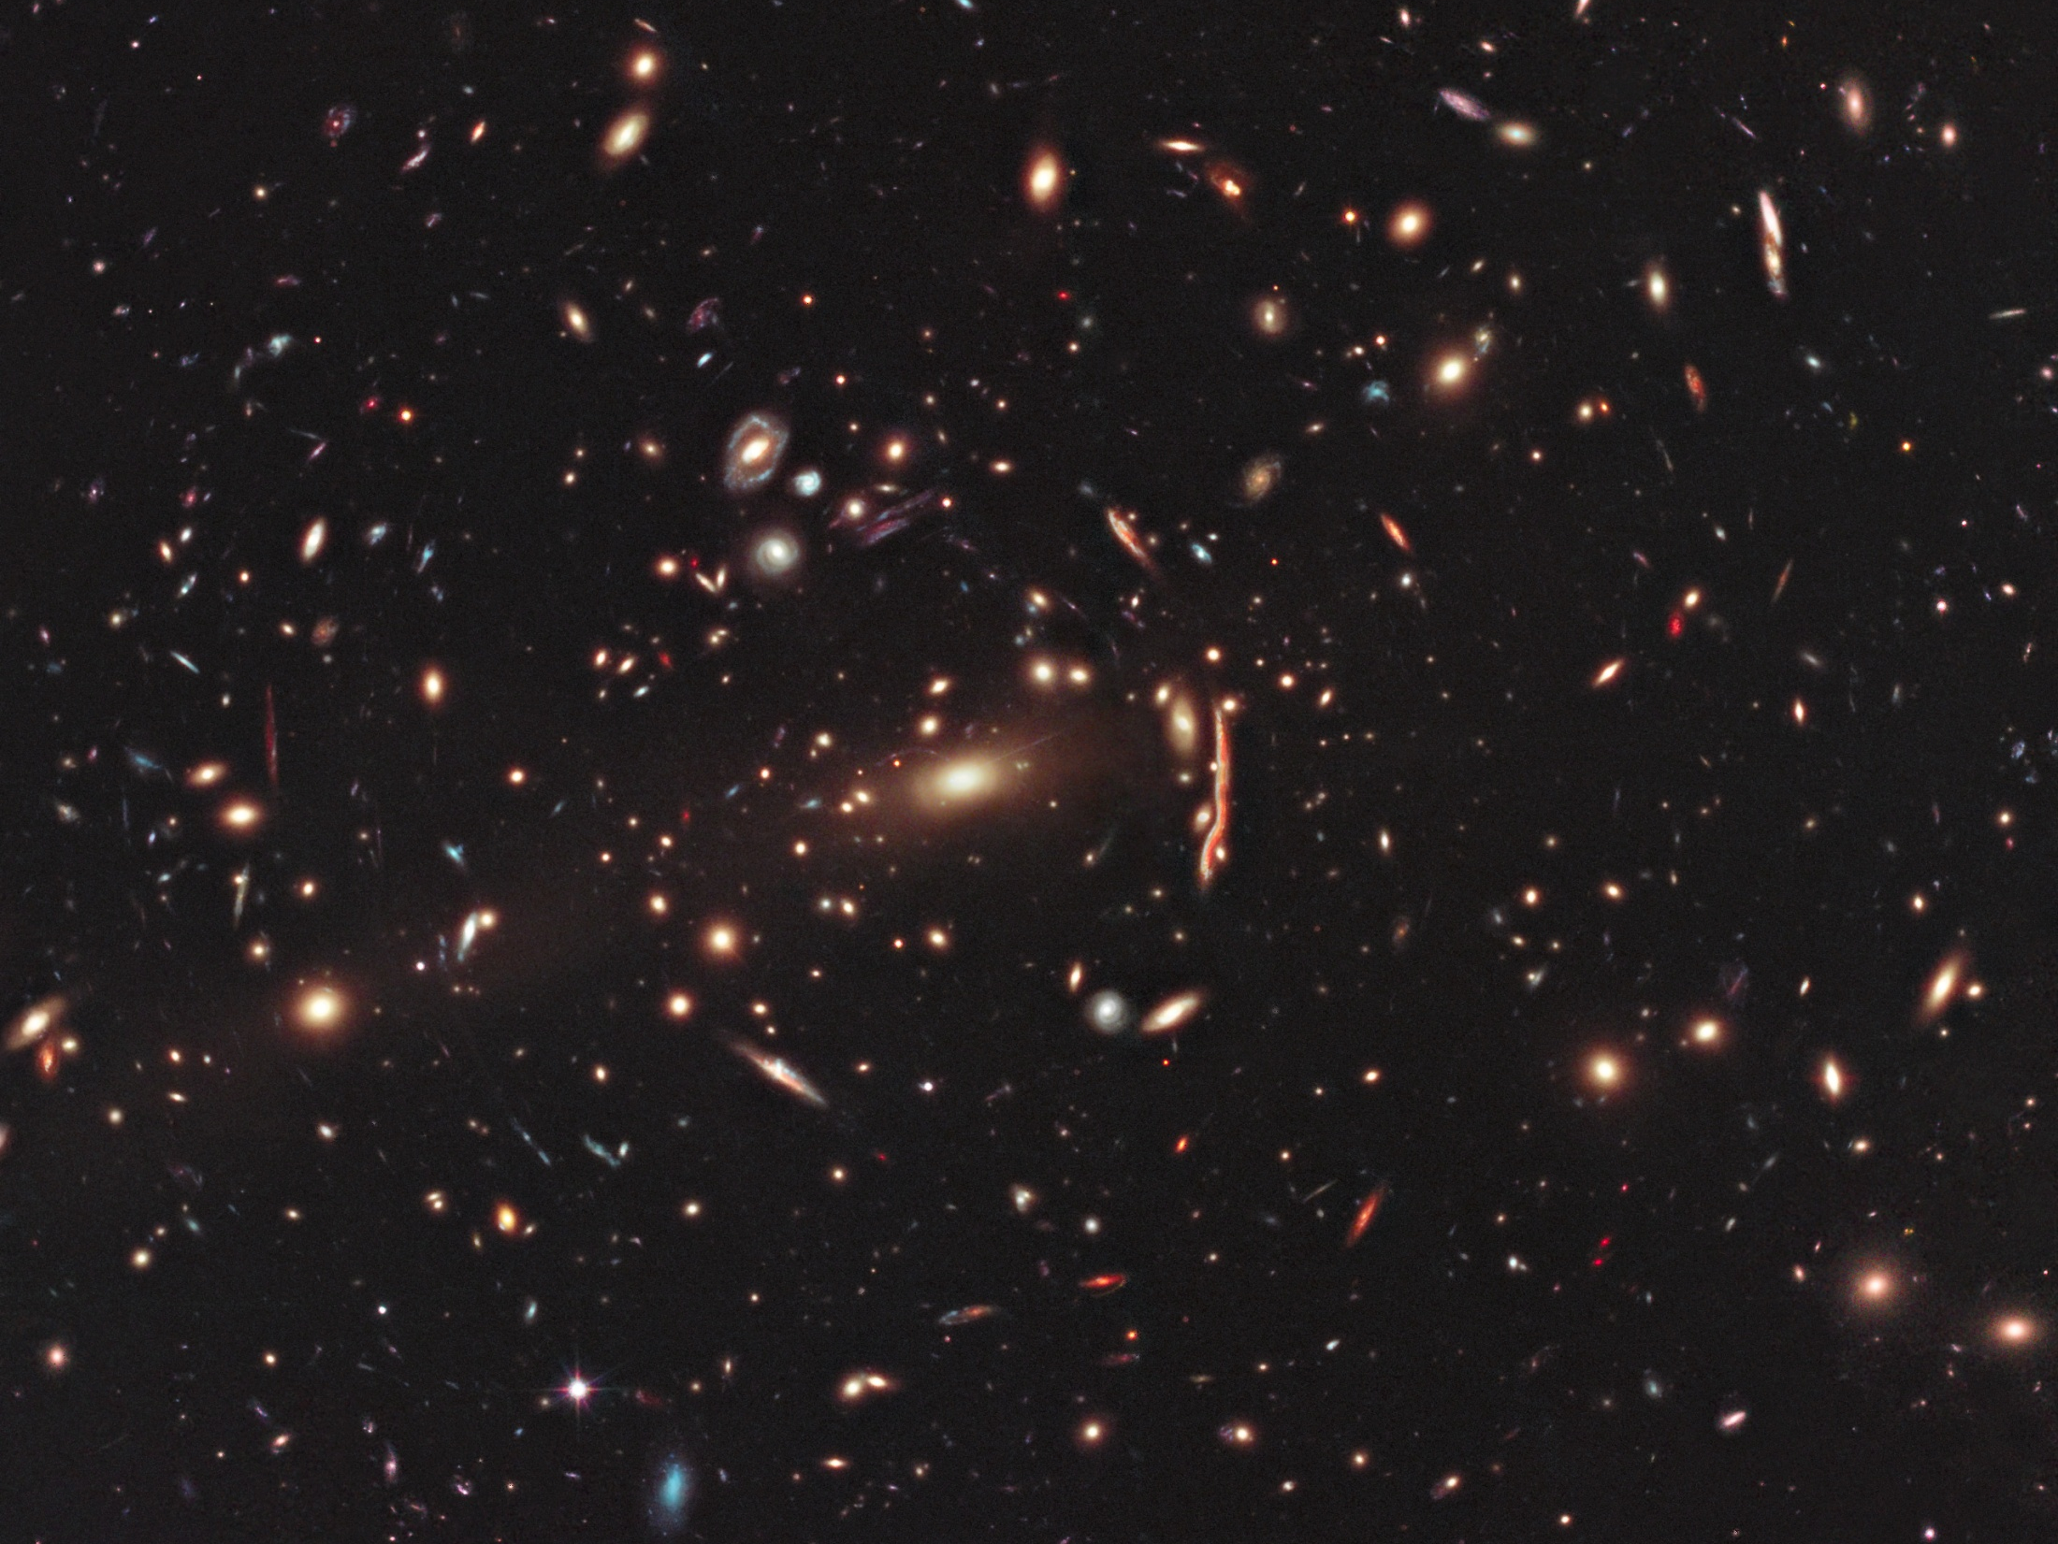
Mapping clusters of galaxies reveals even more
dark matter
Five times more
than Big Bang theory predicts.
So the dark matter isn’t made of atoms!

Slide 15
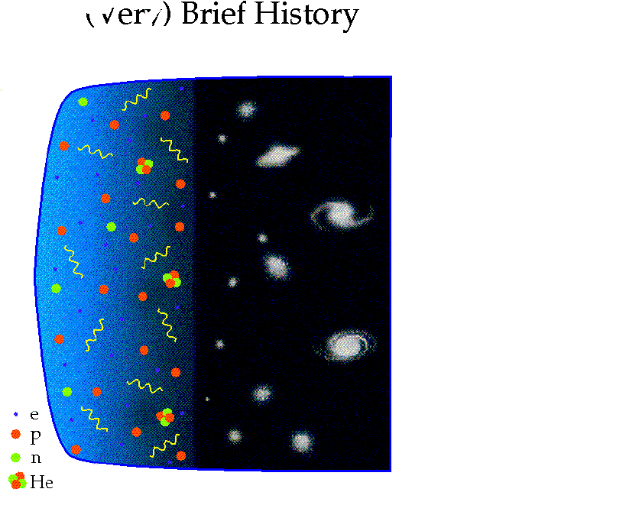
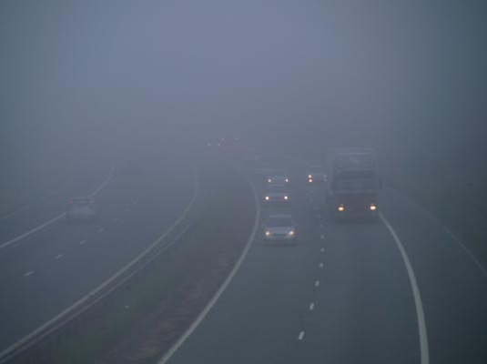
3min
380,000yrs
5 x 10⁹yrs
Light elements form
Cosmic microwave background
Galaxies form

Slide 16
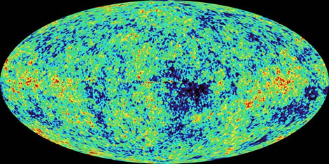
3min
380,000yrs
5 x 10⁹yrs
Light elements form
Cosmic microwave background
Galaxies form
Colours show tiny variations in CMBR temperature

Slide 17
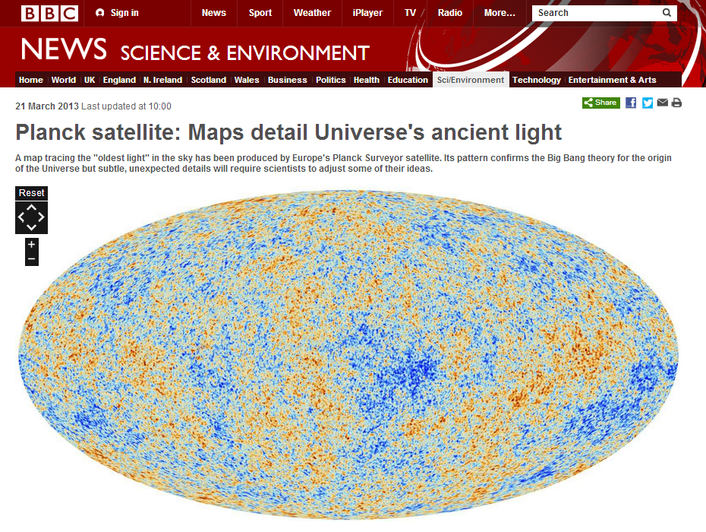
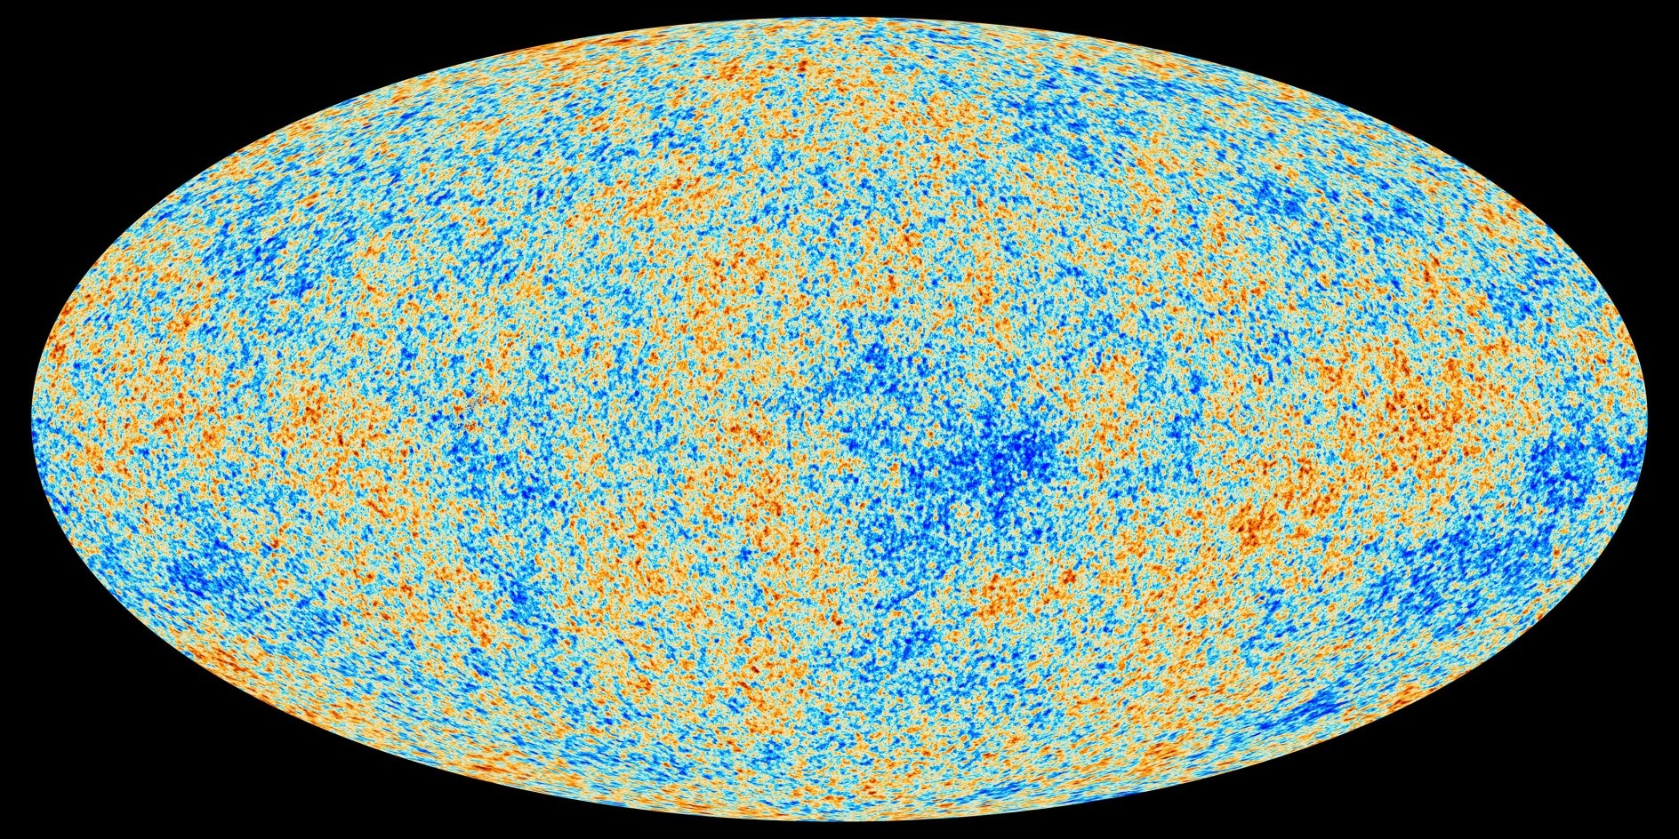

Slide 18
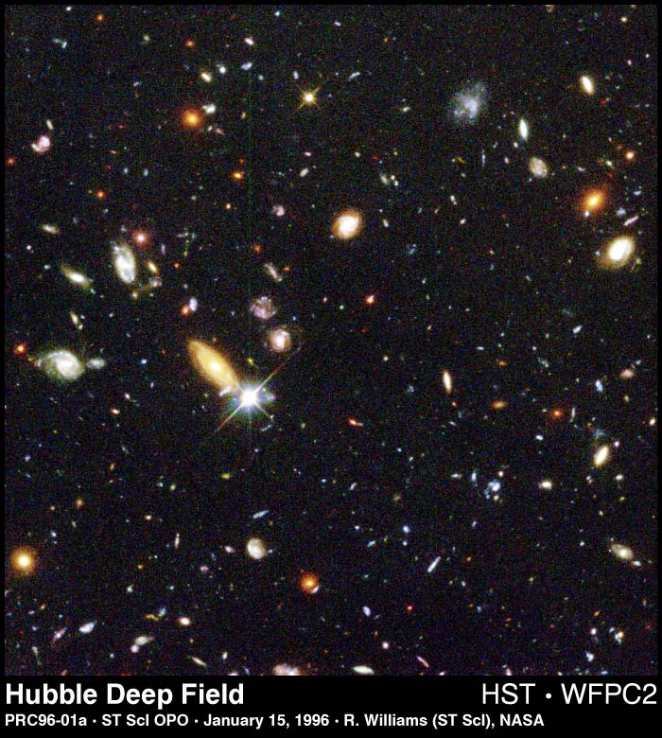
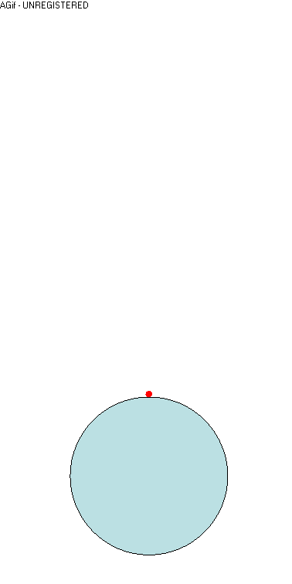
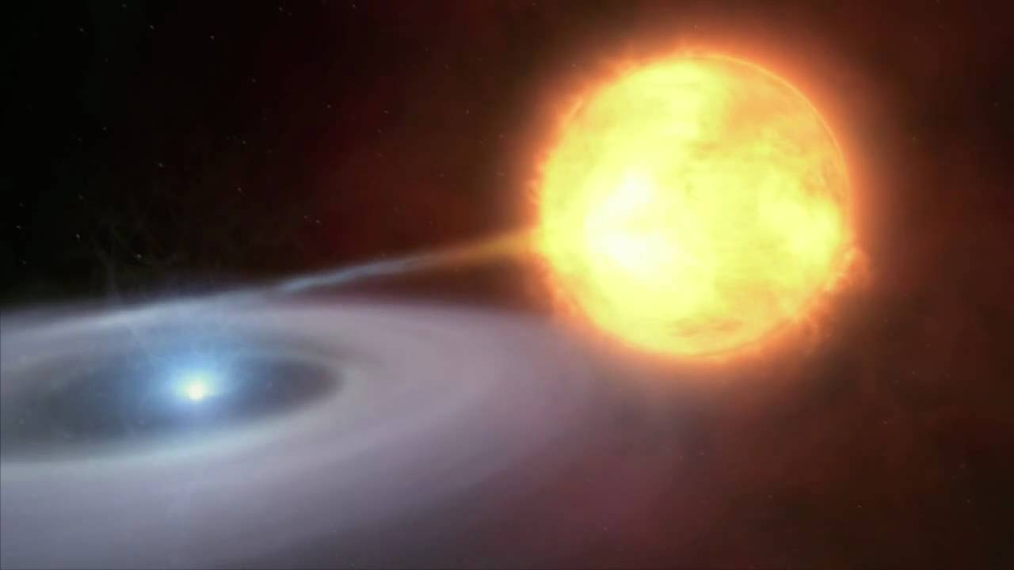
Is there enough dark matter to ever halt the cosmic expansion?...
We can trace the expansion history using distant supernovae

Slide 19
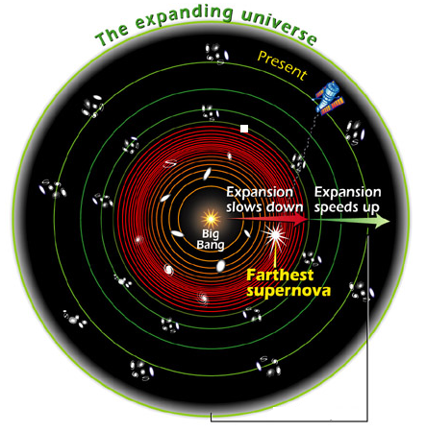
Dark
Energy

Slide 20
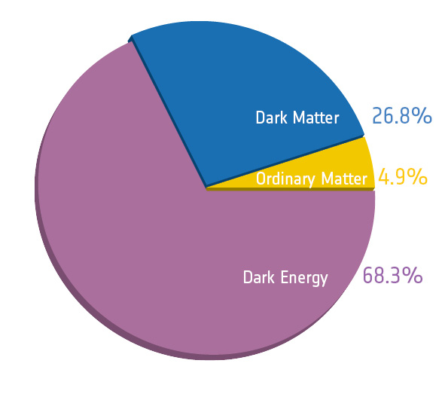
State of the Universe – December 2013
Why does 95% of the Universe consist
of ‘strange’ matter and energy?

