Slide 1
Making the most of Public Engagement
Martin Hendry
Head of School
SUPA, School of Physics and Astronomy, University of Glasgow

Slide 2
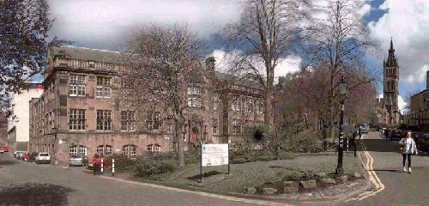
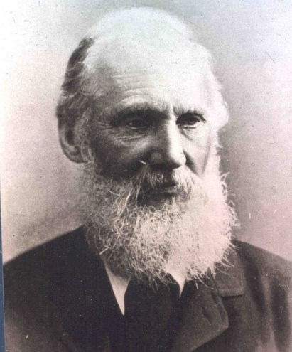
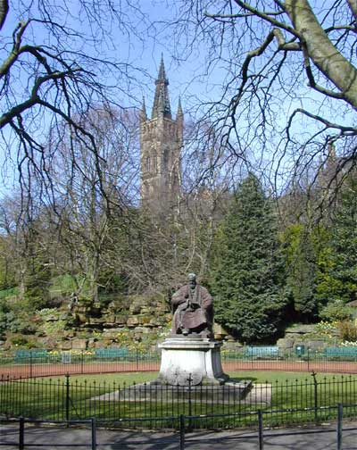
Who am I?…
Head of School of
Physics & Astronomy
University of Glasgow
(the Kelvin Building)
William Thompson
(Lord Kelvin)
1824 - 1907
Scottish Crucible, June 2014

Slide 3
Who am I?…
Head of School of
Physics & Astronomy
University of Glasgow
(the Kelvin Building)
“There is nothing new to be discovered in physics now.
All that remains is more and more precise measurement” (1900)
William Thompson
(Lord Kelvin)
1824 - 1907
Scottish Crucible, June 2014

Slide 4
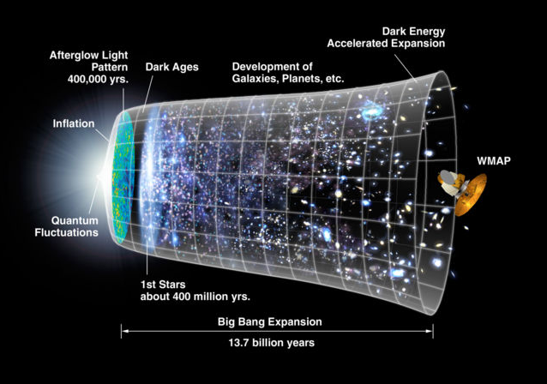
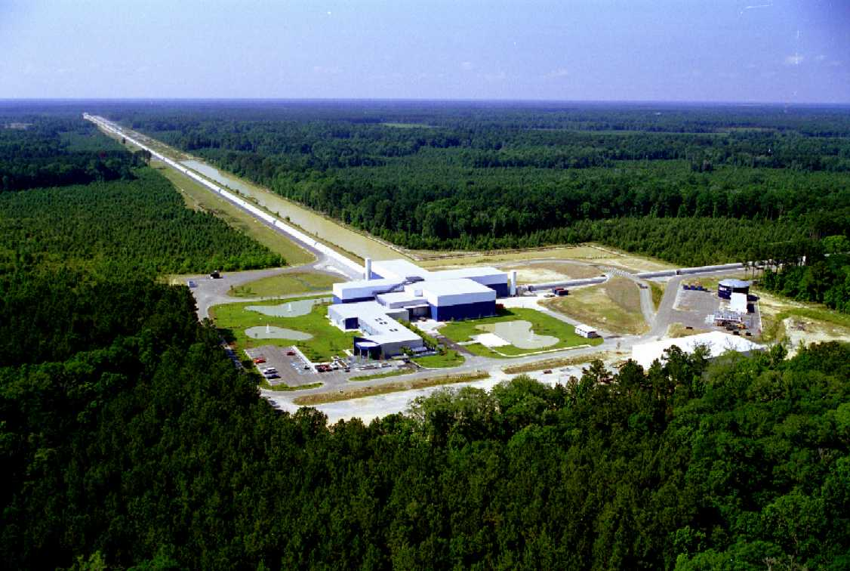
Cosmology: how big is the Universe?
how did it begin?
why is it expanding?
Gravitational wave astronomy:
what are black holes and neutron stars?
what happens when they collide?
was Einstein’s picture of gravity correct?
Scottish Crucible, June 2014

Slide 5
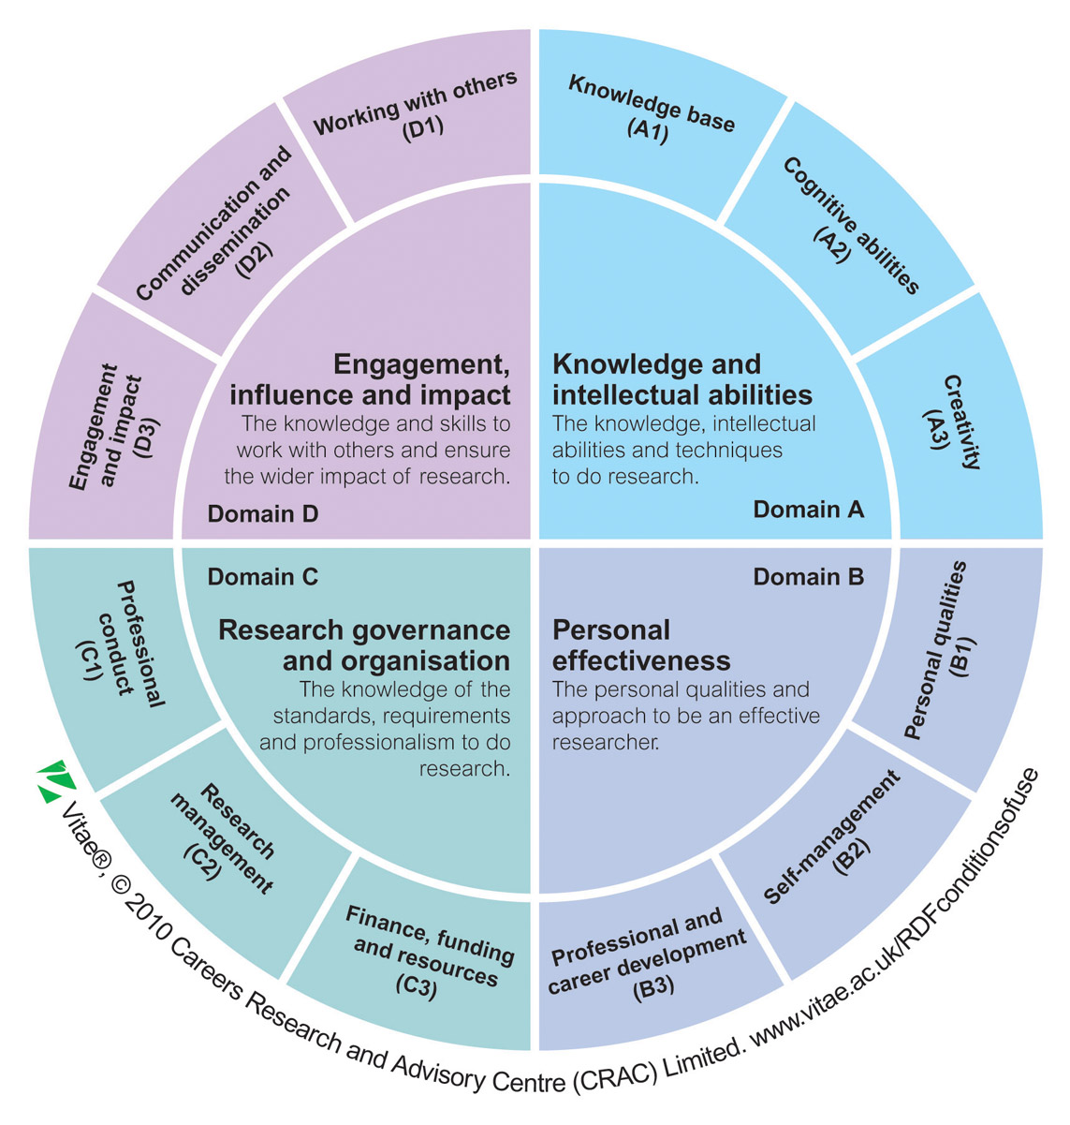
From NCCPE
Scottish Crucible, June 2014

Slide 6
From NCCPE
Scottish Crucible, June 2014

Slide 7
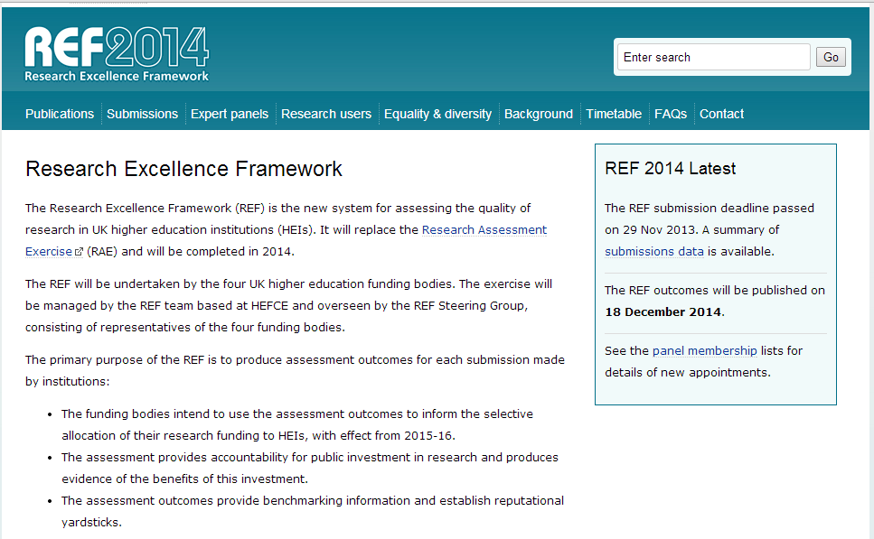
Scottish Crucible, June 2014

Slide 9
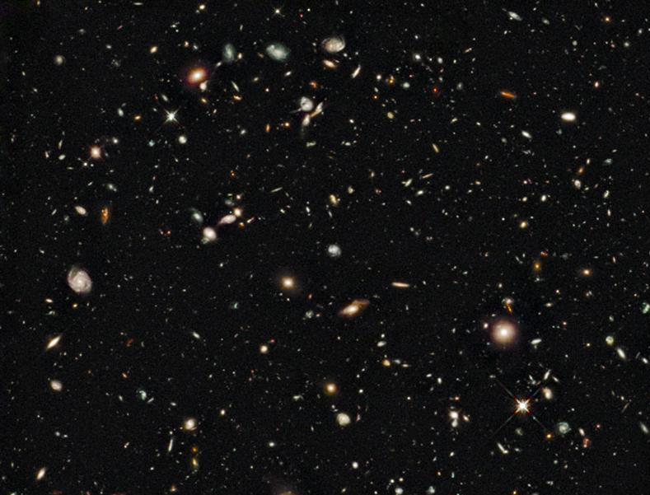
Some PE Highlights
Exhibitions + Festivals
Schools lectures
Community events
Curriculum development
Global coordination

Slide 10
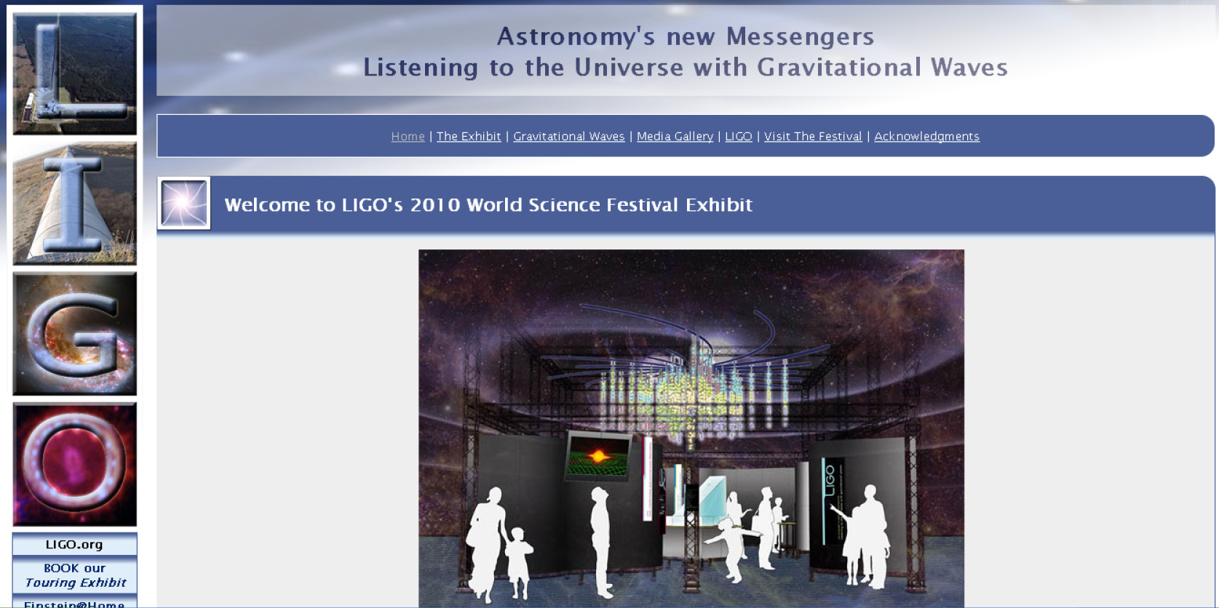
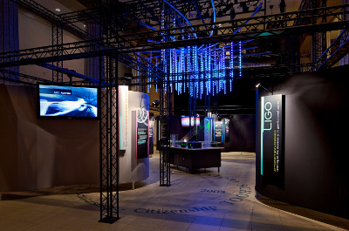
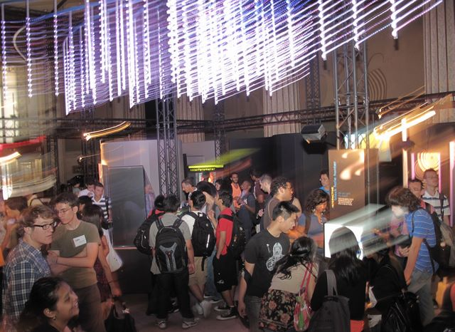
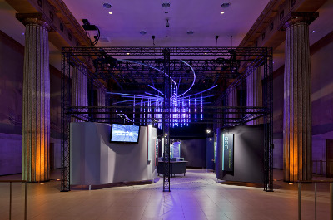
Scottish Crucible, June 2014

Slide 11
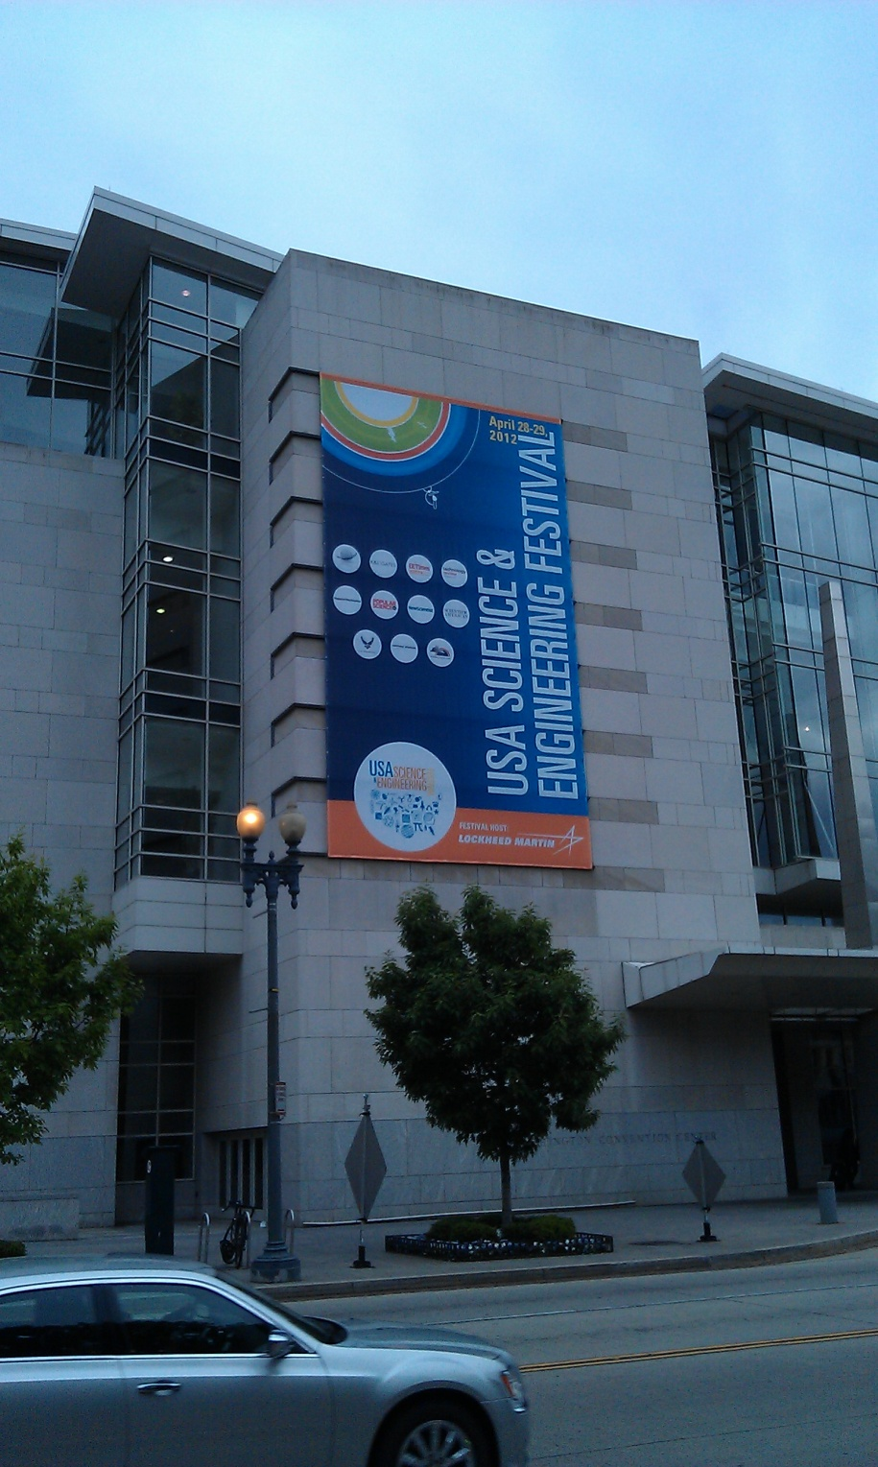
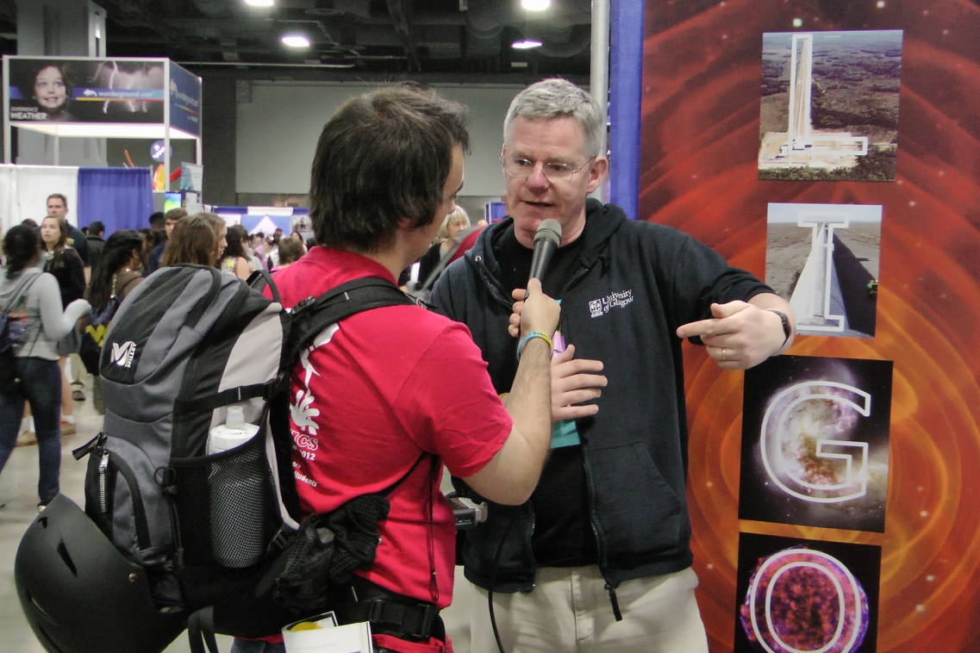
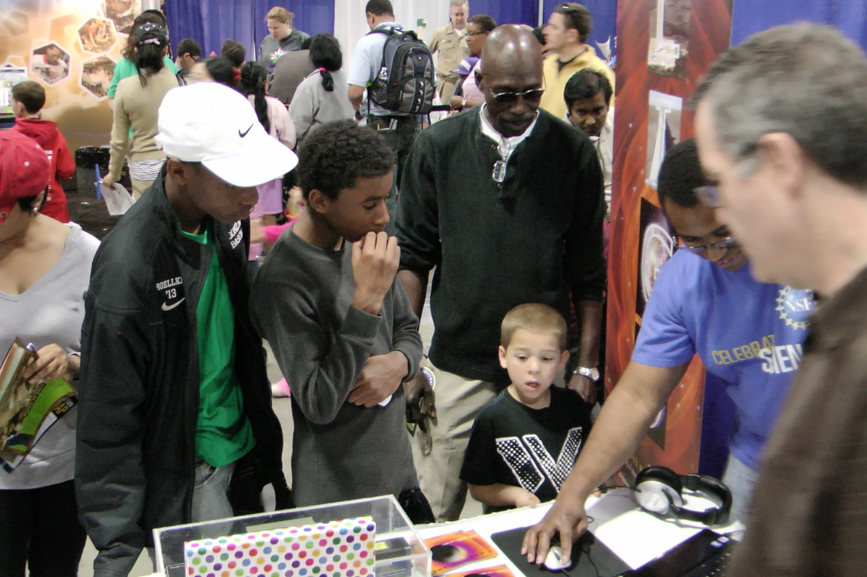
Scottish Crucible, June 2014

Slide 12
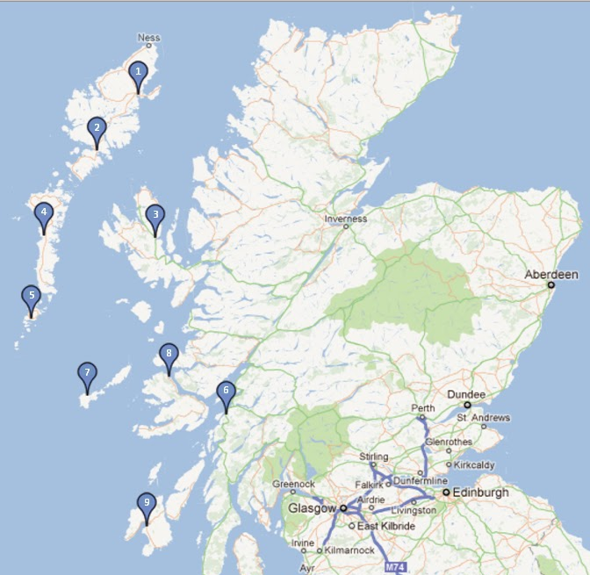
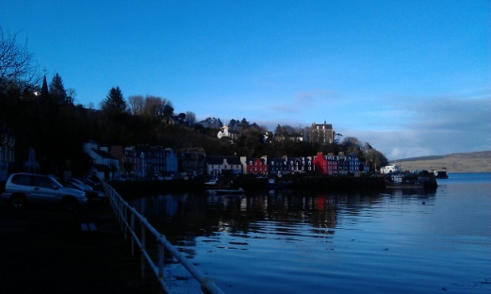
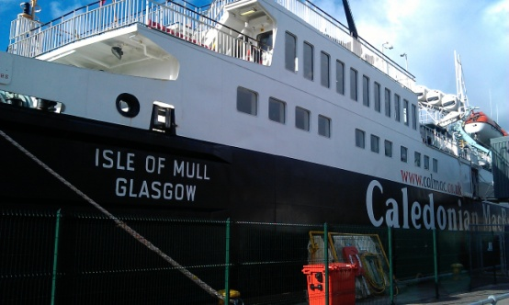
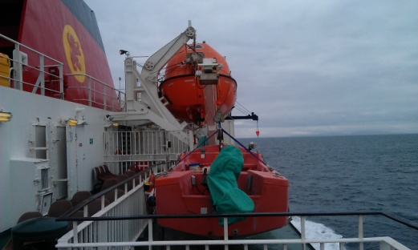
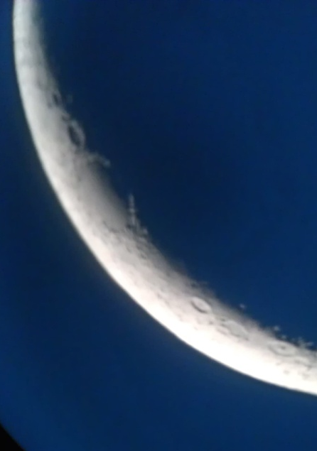
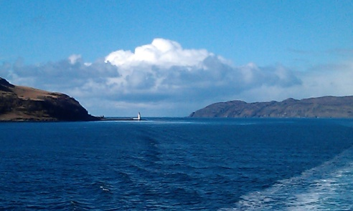
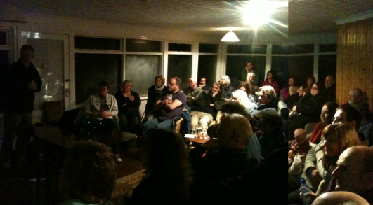
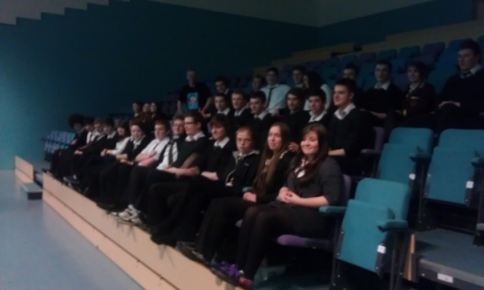
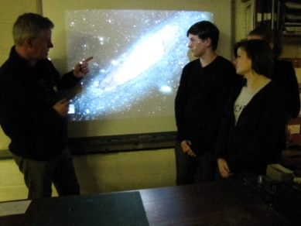
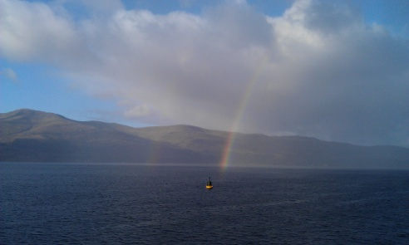
“Island Universe” Schools lectures
http://thecosmicexplorer.blogspot.com/

Slide 13
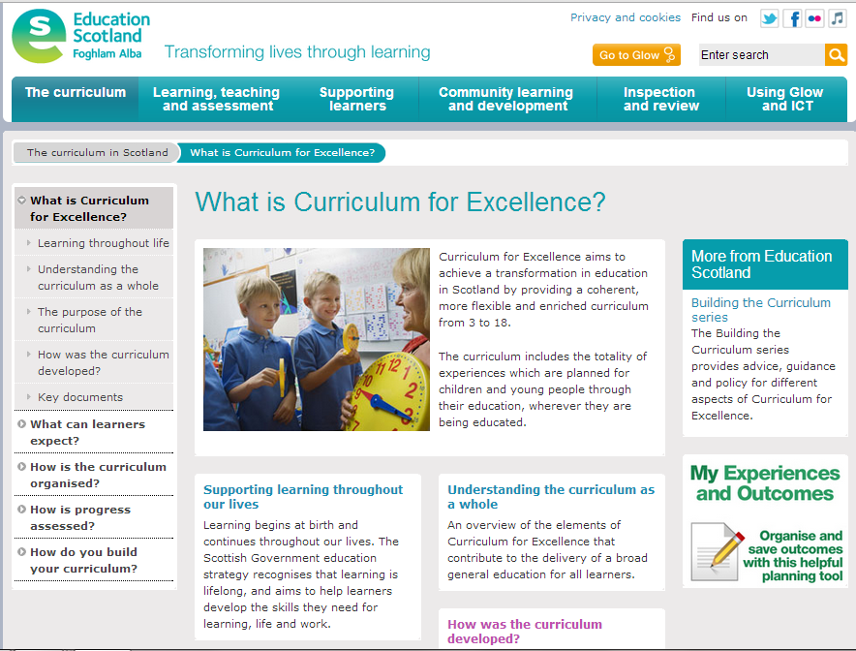

Slide 14
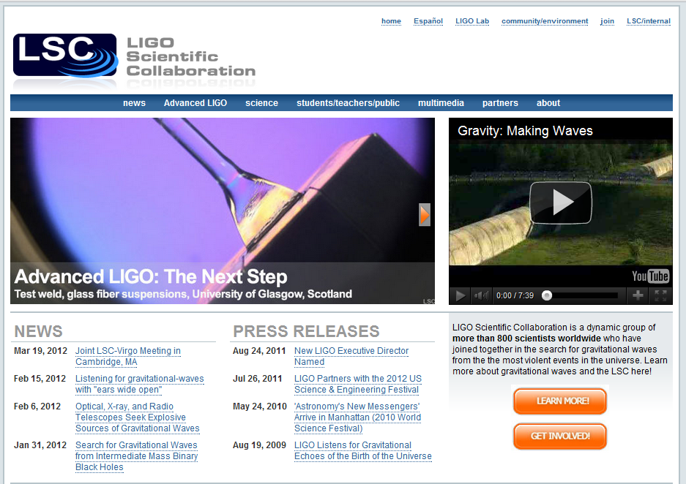
Global Coordination

Slide 15
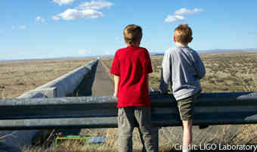
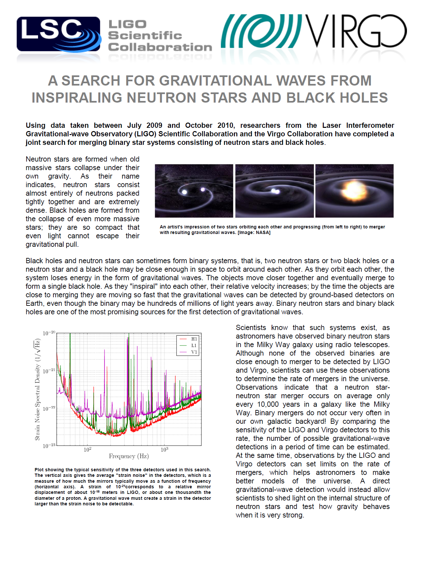
Global Coordination

Slide 16
Top six PE tips I have learnt:
Popular culture
Enthusiasm
Topicality
Interaction
Personality
Syllabus
Scottish Crucible, June 2014

Slide 17
Top six PE tips I have learnt:
Strategy
P&DR
Impact
Technology
Evaluation
Practical support
Scottish Crucible, June 2014

