Slide 1
Making the most of Public Engagement
Martin Hendry
Head of School
SUPA, School of Physics and Astronomy, University of Glasgow

Slide 2
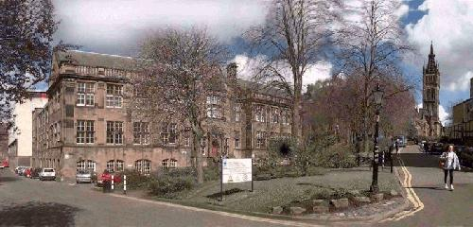
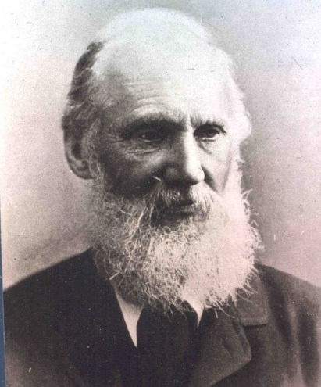
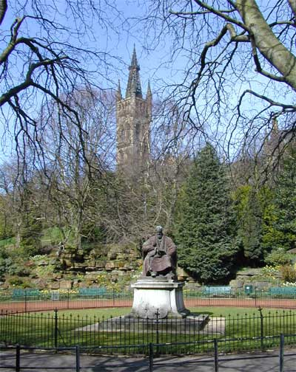



Who am I?…
Head of School of
Physics & Astronomy
University of Glasgow
(the Kelvin Building)
martin.hendry@glasgow,ac.uk
William Thompson
(Lord Kelvin)
1824 - 1907
Astrobiology Workshop, Feb 2015

Slide 3
Who am I?…
Head of School of
Physics & Astronomy
University of Glasgow
(the Kelvin Building)
martin.hendry@glasgow,ac.uk
“There is nothing new to be discovered in physics now.
All that remains is more and more precise measurement” (1900)
William Thompson
(Lord Kelvin)
1824 - 1907
Astrobiology Workshop, Feb 2015

Slide 4
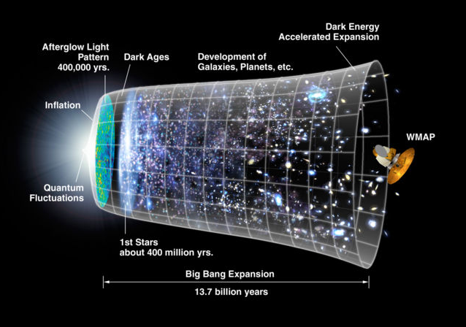
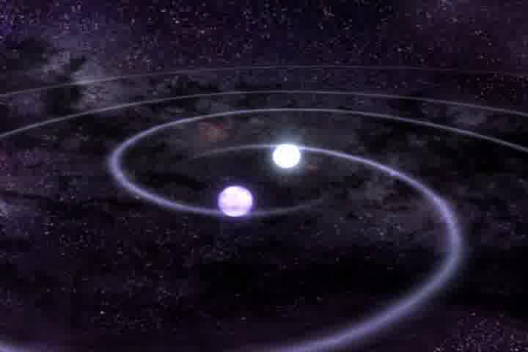
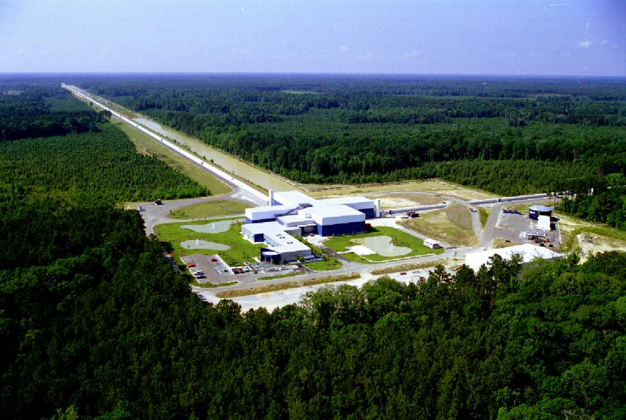
Cosmology: how big is the Universe?
how did it begin?
why is it expanding?
Gravitational wave astronomy:
what are black holes and neutron stars?
what happens when they collide?
was Einstein’s picture of gravity correct?
Astrobiology Workshop, Feb 2015

Slide 5

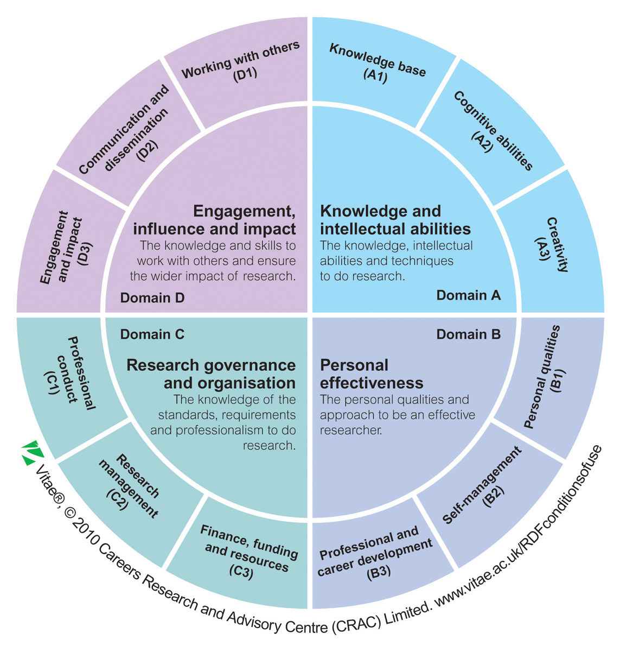
From NCCPE
Astrobiology Workshop, Feb 2015

Slide 6

From NCCPE
Astrobiology Workshop, Feb 2015

Slide 7
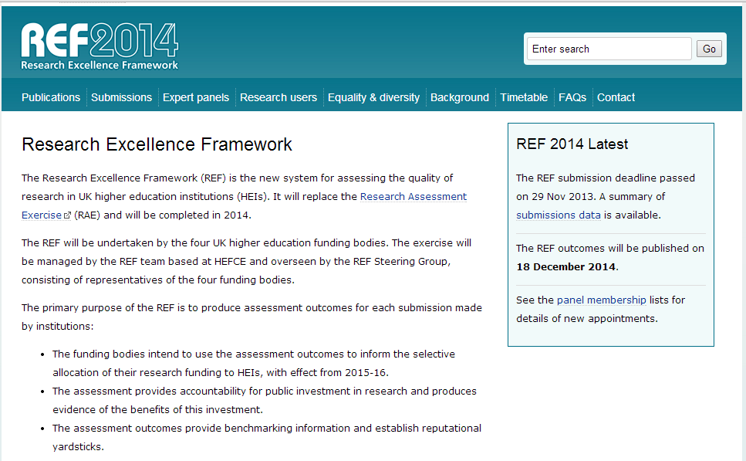
Astrobiology Workshop, Feb 2015

Slide 8
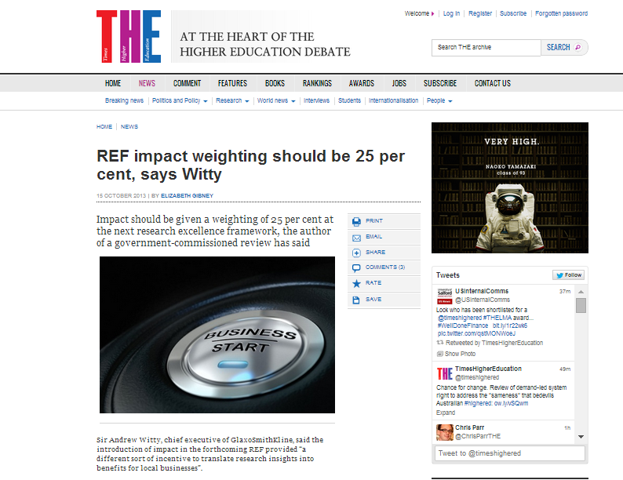

Slide 9
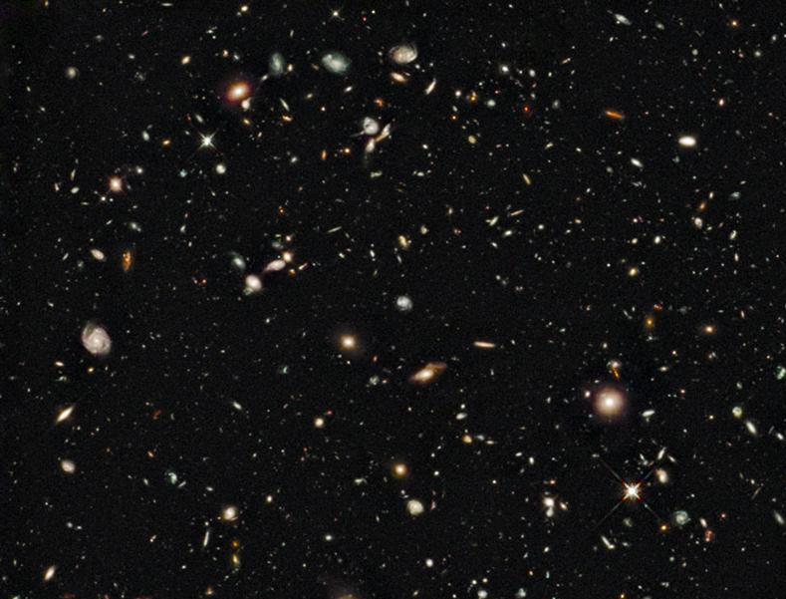
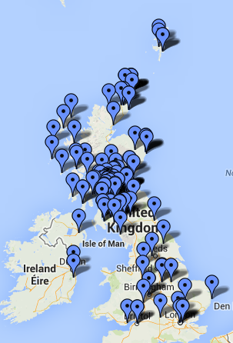
Some PE Highlights
Exhibitions + Festivals
Schools lectures
Community events
Curriculum development
Global coordination

Slide 10
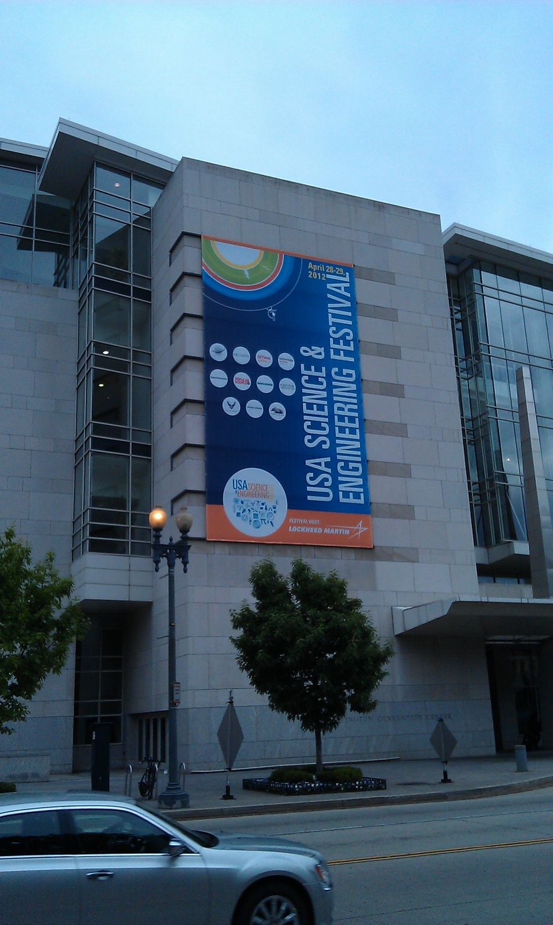
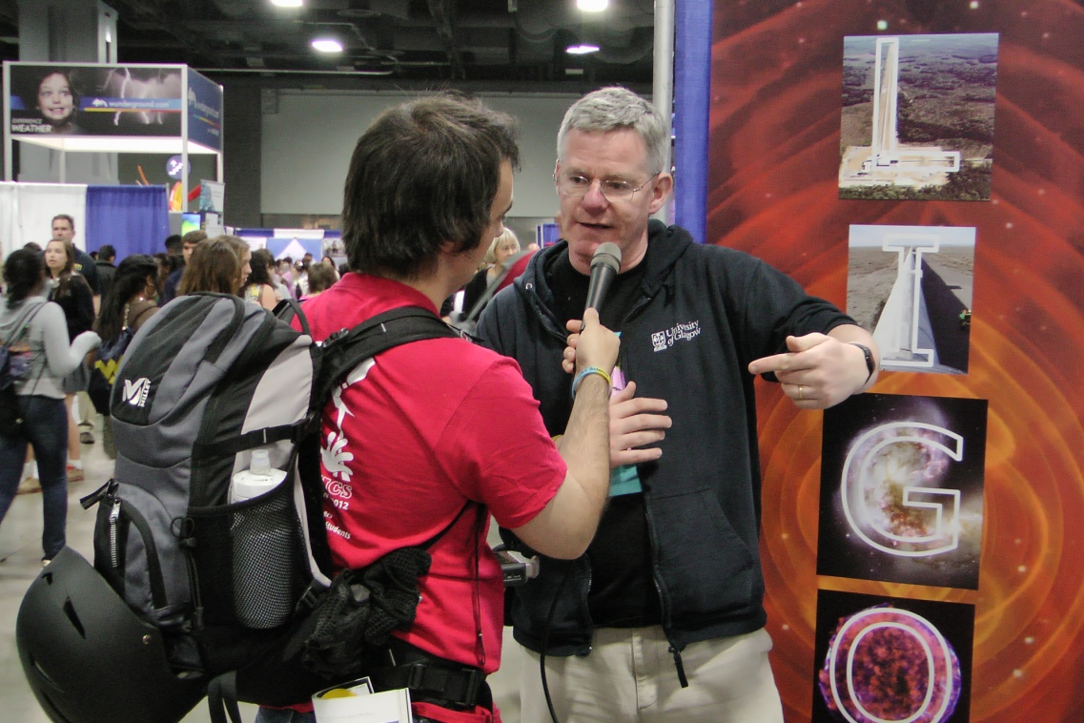
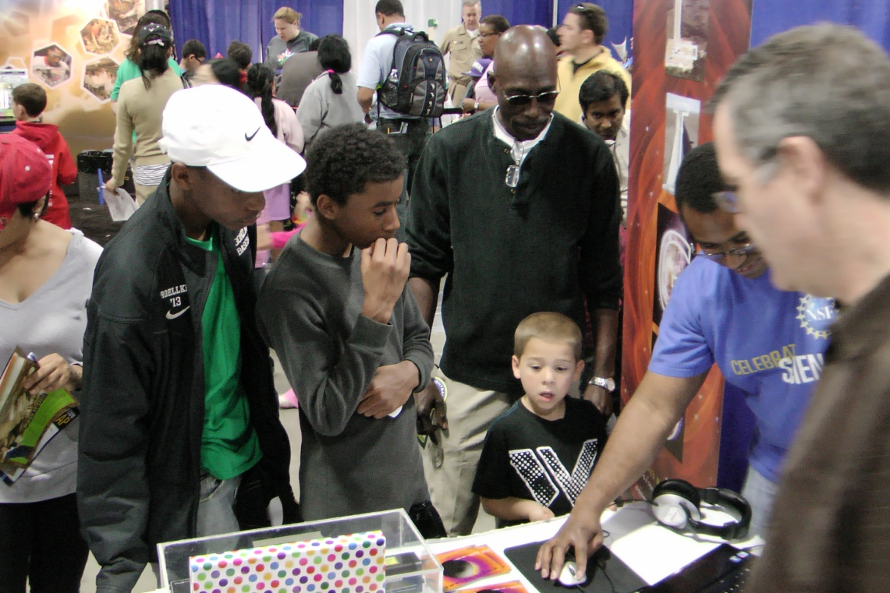
Astrobiology Workshop, Feb 2015

Slide 11
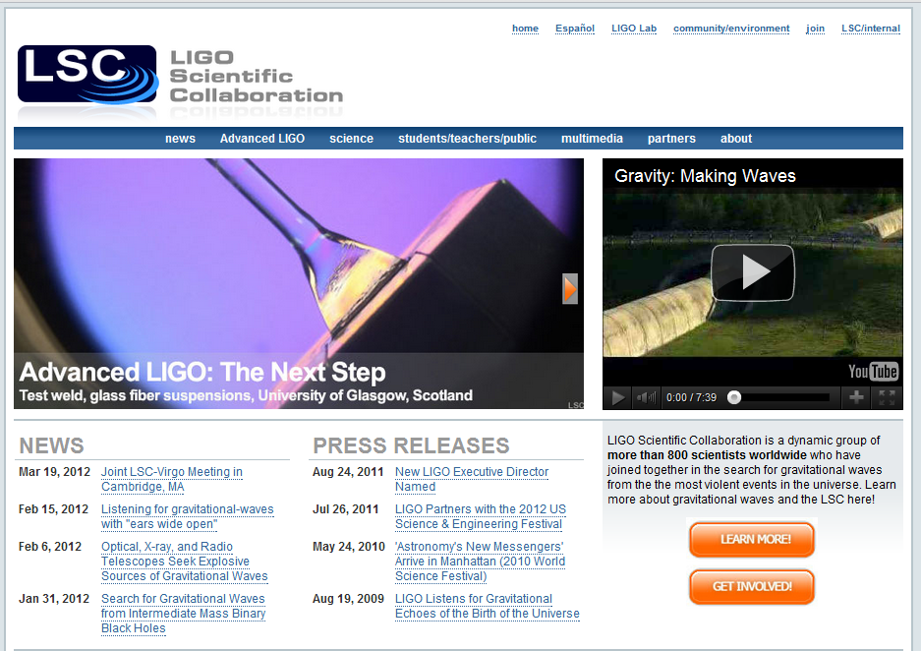
Global profile

Slide 12
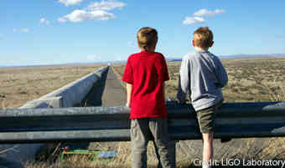
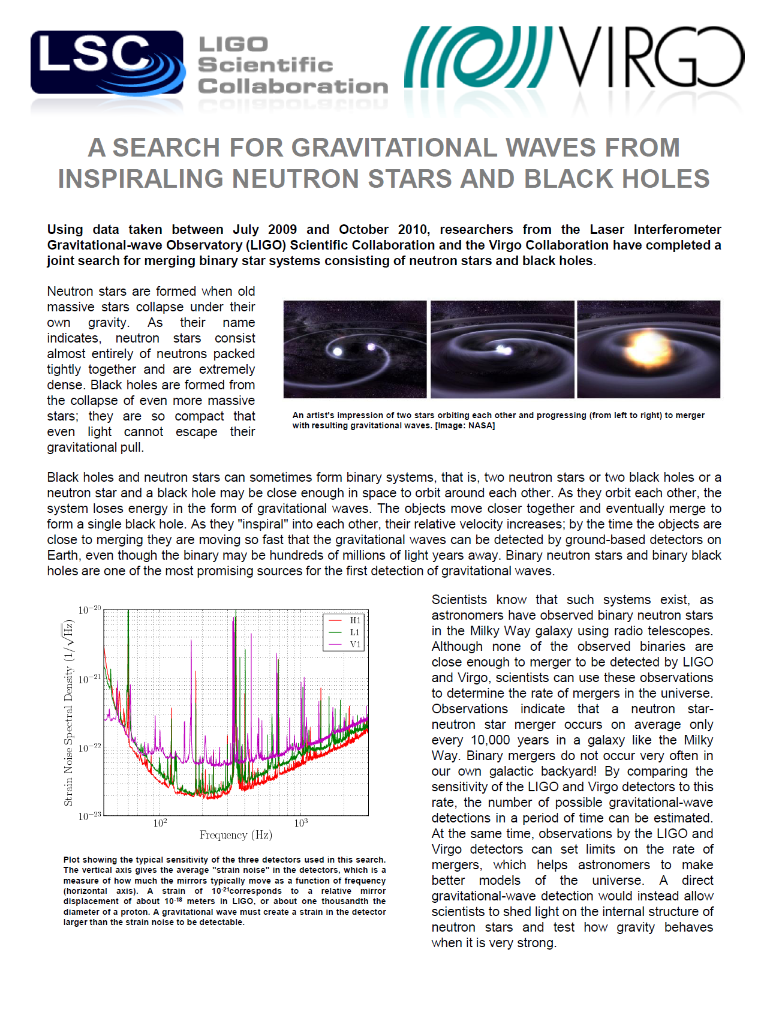
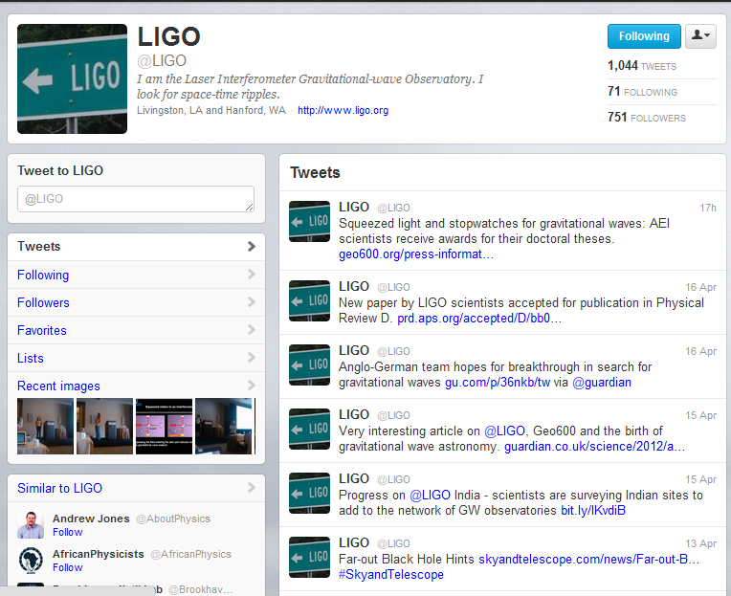
Global profile

Slide 13
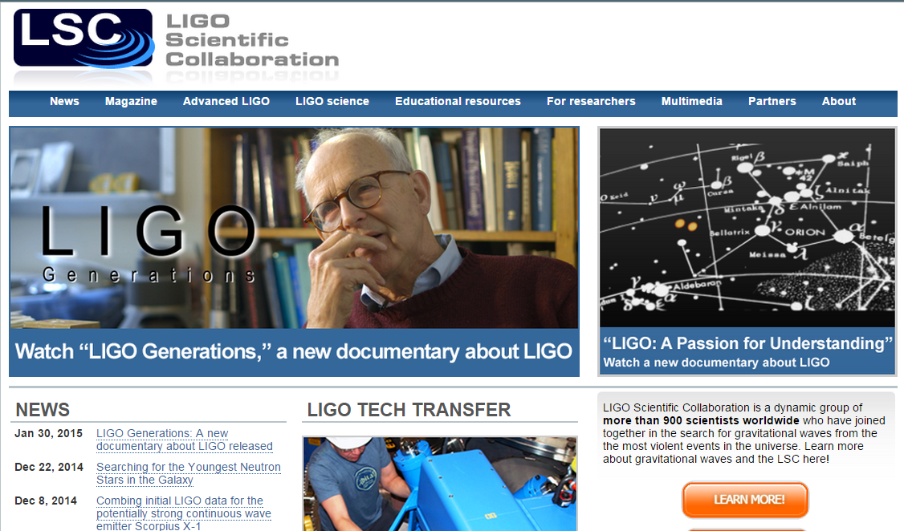
www.ligo.org
www.reddit.com/r/science AMA, Fri 13/2 from 1pm GMT

Slide 14
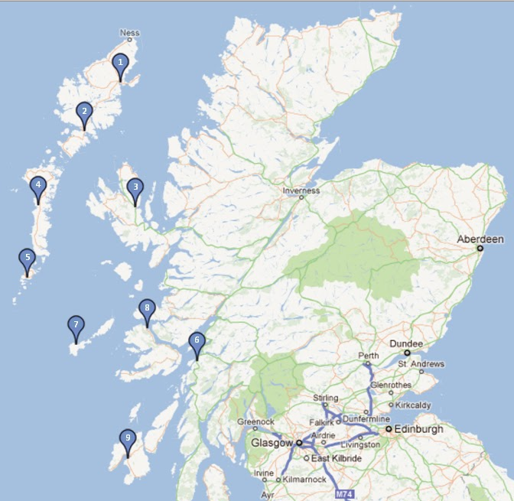

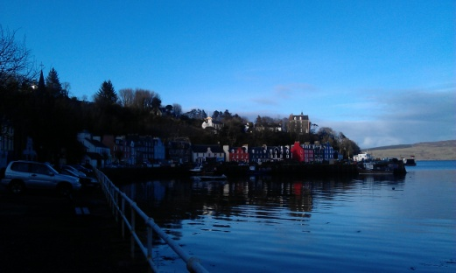
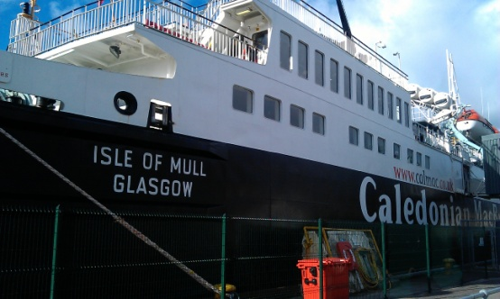
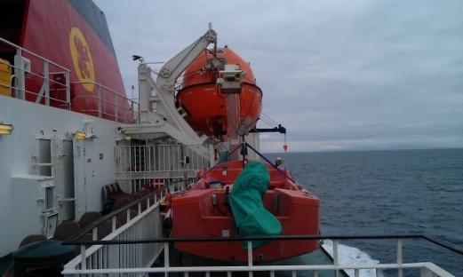
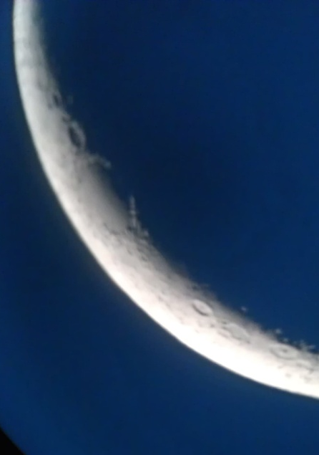
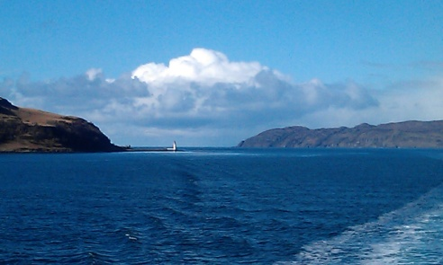
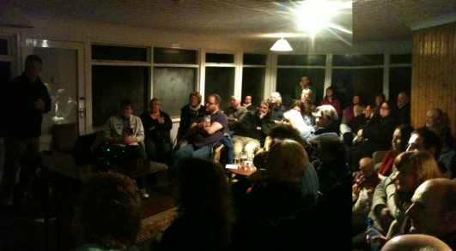
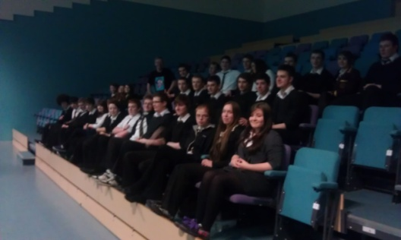
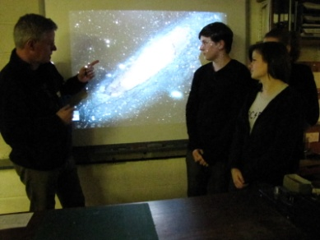
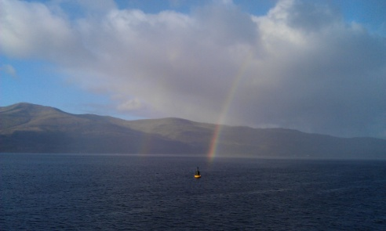
“Island Universe” Schools lectures
http://thecosmicexplorer.blogspot.com/

Slide 15
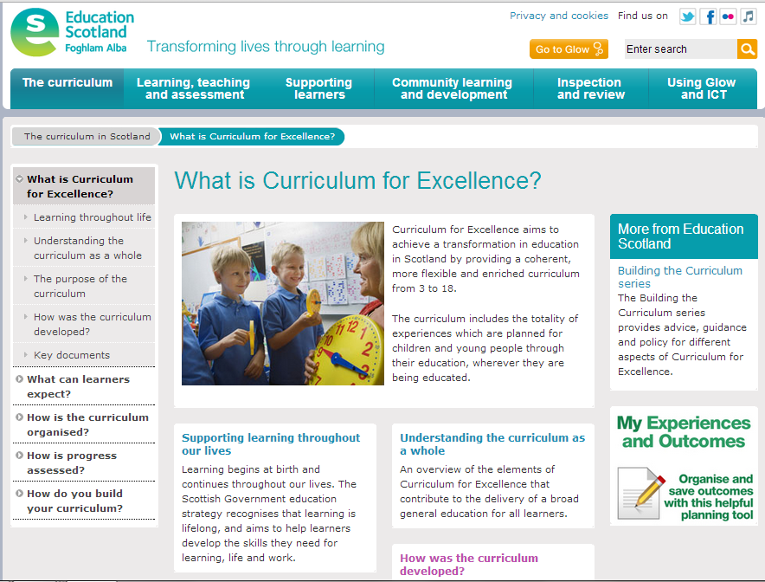

Slide 16

Top six PE tips I have learnt:
Personality
Enthusiasm
Topicality
Interaction
Popular culture
Syllabus
Astrobiology Workshop, Feb 2015

Slide 17
Top six PE tips I have learnt:
Practical support
Evaluation
Technology
Impact
P&DR
Strategy
Astrobiology Workshop, Feb 2015

