Slide 1
Making the most of Public Engagement
Martin Hendry
SUPA, School of Physics and Astronomy, University of Glasgow

Slide 2
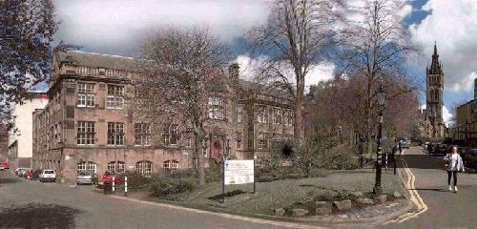
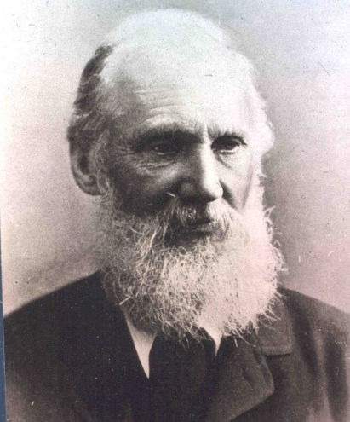
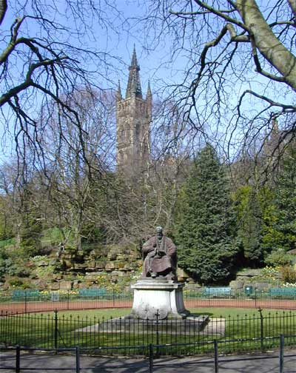
Who am I?…
Head of School of
Physics & Astronomy
University of Glasgow
(the Kelvin Building)
martin.hendry@glasgow,ac.uk
William Thompson
(Lord Kelvin)
1824 - 1907
Astrobiology Workshop, Feb 2015

Slide 3
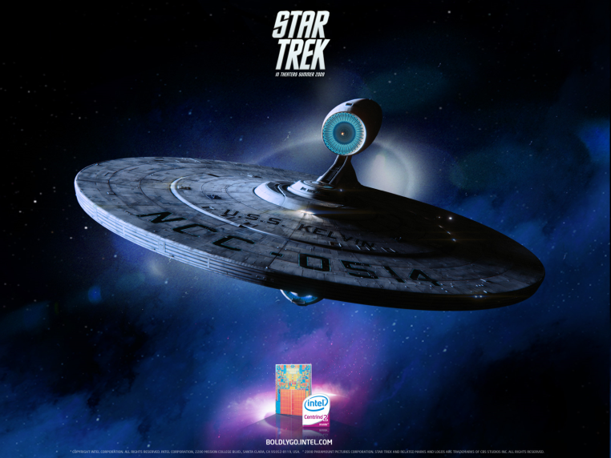
Who am I?…
Head of School of
Physics & Astronomy
University of Glasgow
(the Kelvin Building)
martin.hendry@glasgow,ac.uk
William Thompson
(Lord Kelvin)
1824 - 1907
Astrobiology Workshop, Feb 2015

Slide 4
Who am I?…
Head of School of
Physics & Astronomy
University of Glasgow
(the Kelvin Building)
martin.hendry@glasgow,ac.uk
“There is nothing new to be discovered in physics now.
All that remains is more and more precise measurement” (1900)
William Thompson
(Lord Kelvin)
1824 - 1907
Astrobiology Workshop, Feb 2015

Slide 5
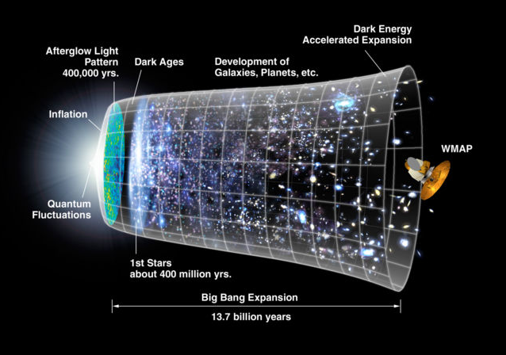
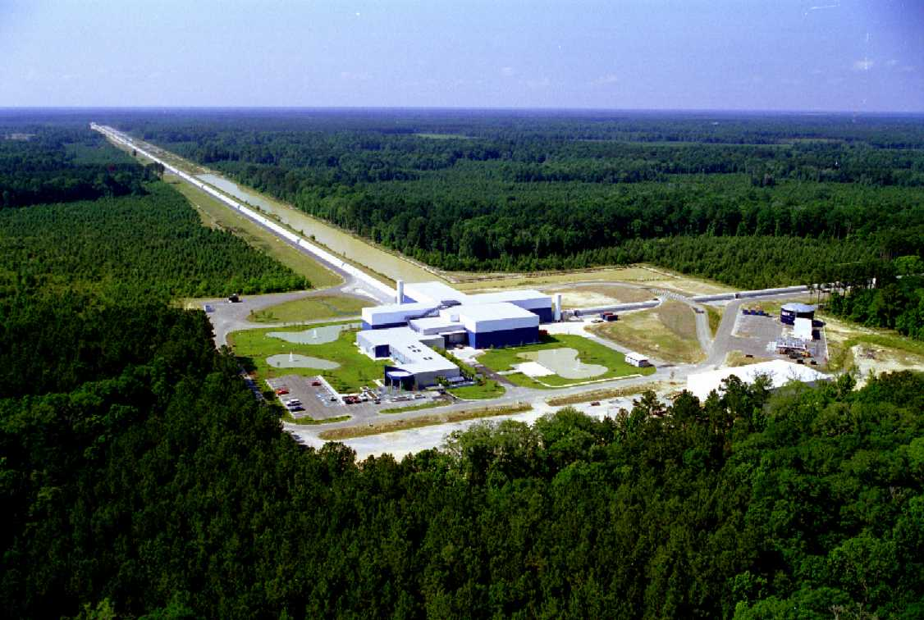
Cosmology: how big is the Universe?
how did it begin?
why is it expanding?
Gravitational wave astronomy:
what are black holes and neutron stars?
what happens when they collide?
was Einstein’s picture of gravity correct?
Astrobiology Workshop, Feb 2015

Slide 6
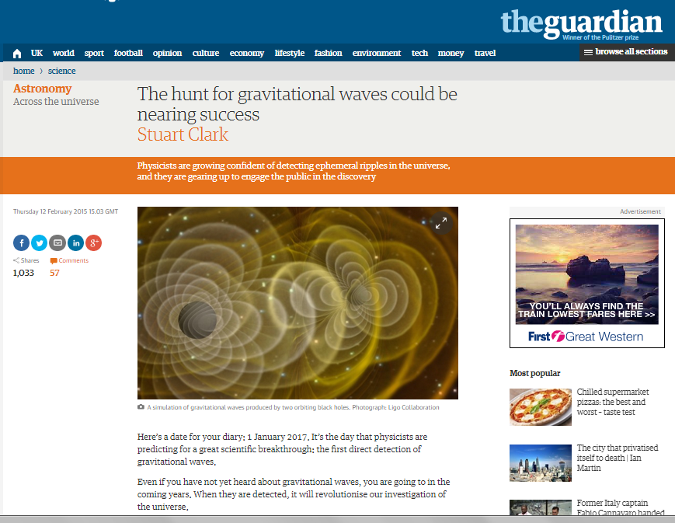

Slide 7
From NCCPE
Astrobiology Workshop, Feb 2015

Slide 8
The public love it!
From NCCPE
Astrobiology Workshop, Feb 2015

Slide 9
The public love it!
From NCCPE
Astrobiology Workshop, Feb 2015

Slide 10
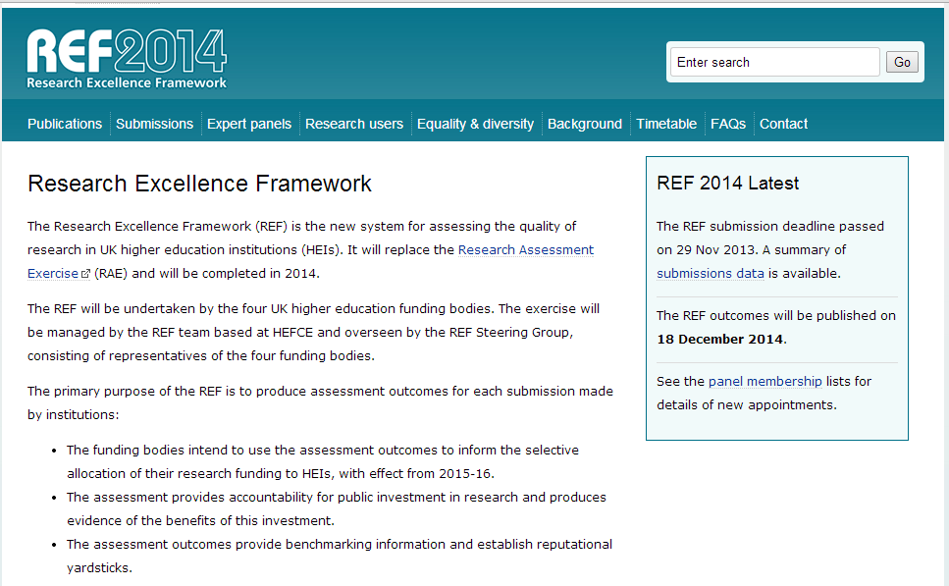
Astrobiology Workshop, Feb 2015

Slide 12
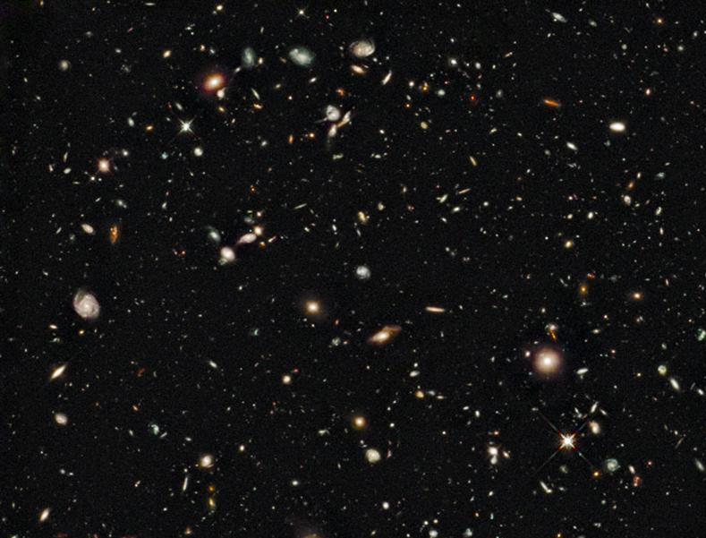
Some examples of PE approaches…
Exhibitions + Festivals
Schools engagement
Community events
Curriculum development
Online engagement

Slide 13
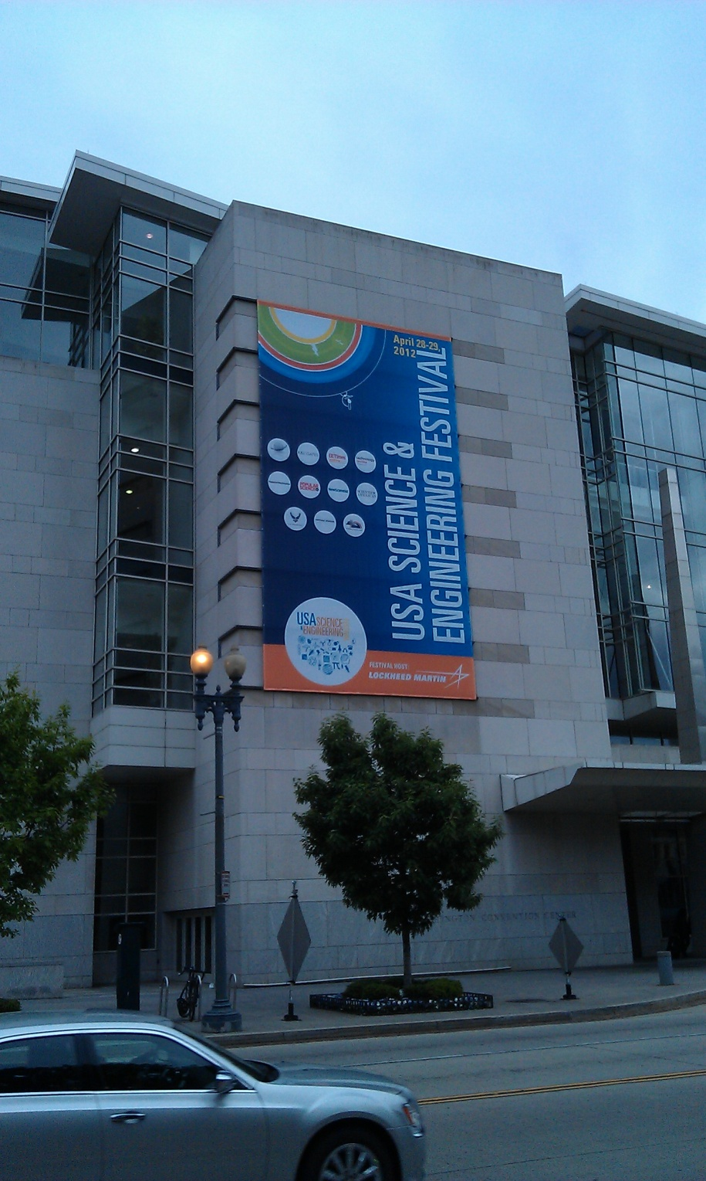
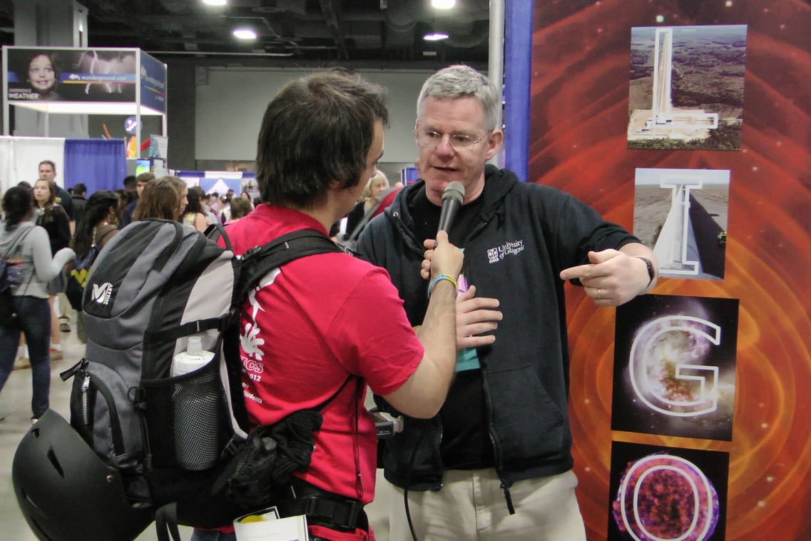
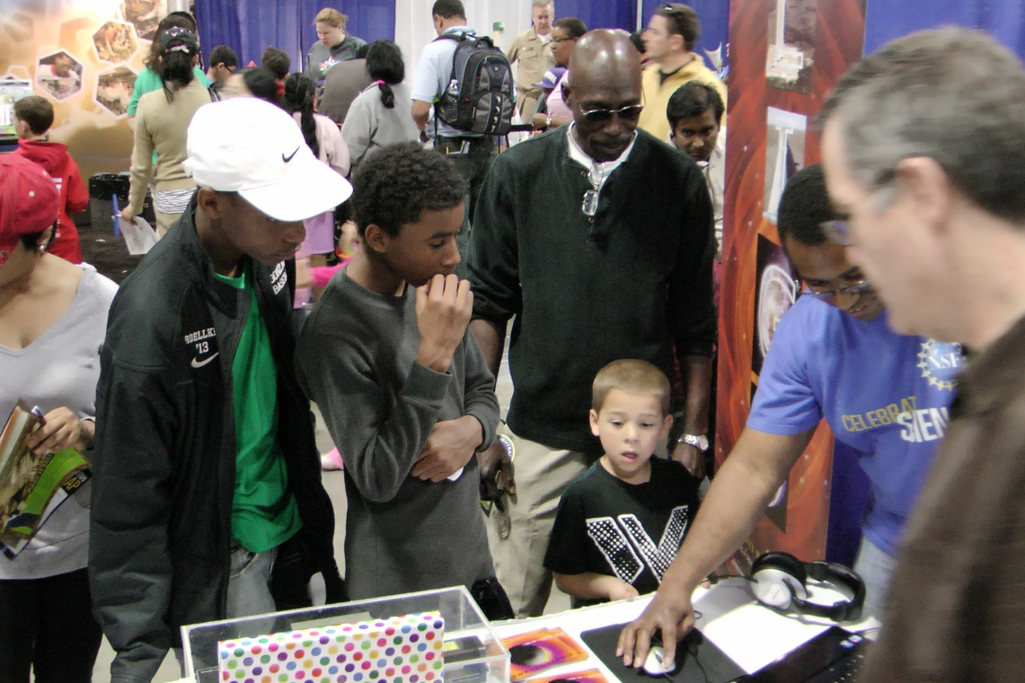
Astrobiology Workshop, Feb 2015

Slide 14
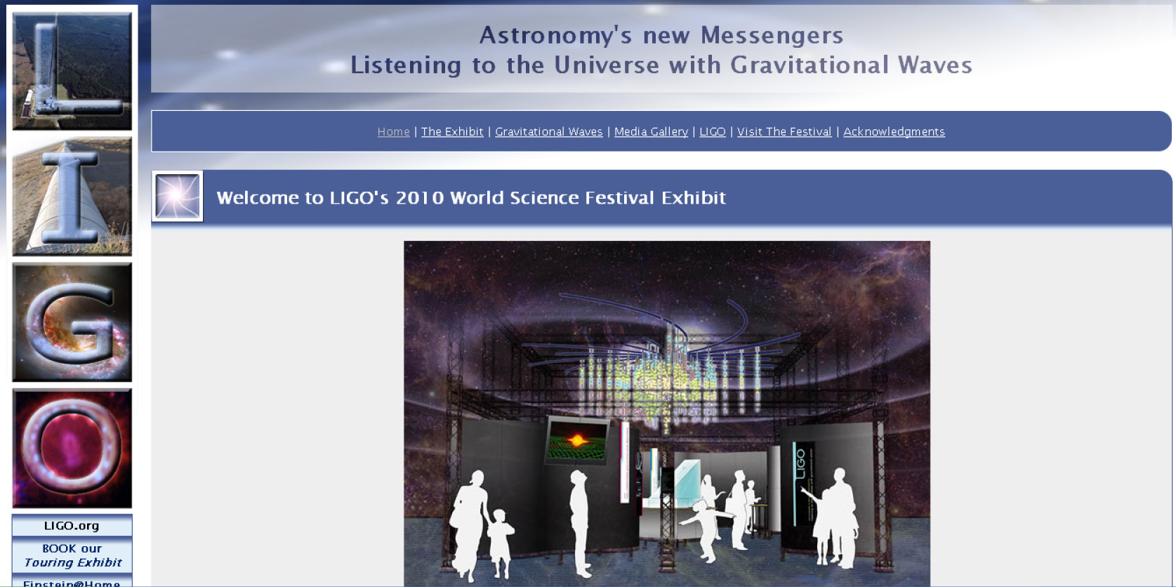
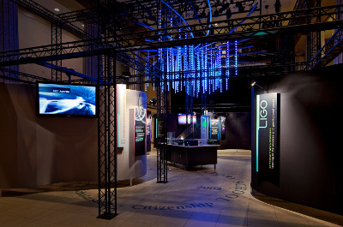
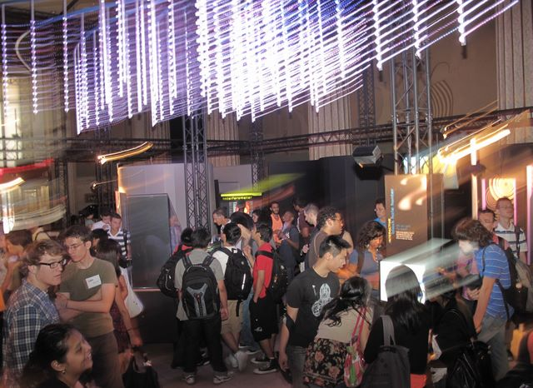
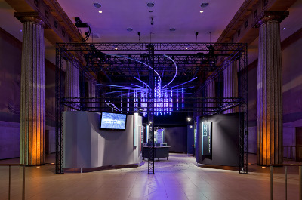
Astrobiology Workshop, Feb 2015

Slide 15
http://www.tinyurl.com/powersof60/

Slide 16
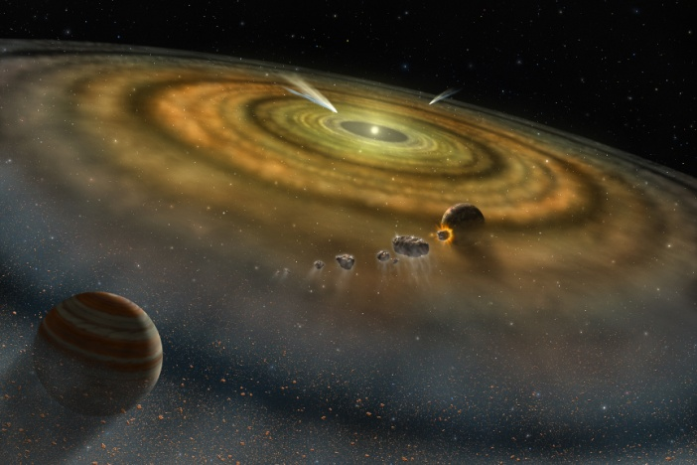
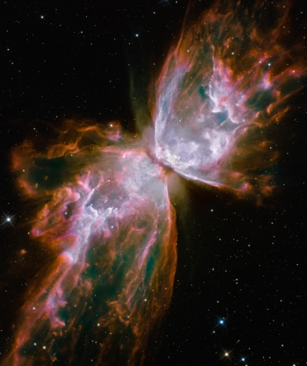
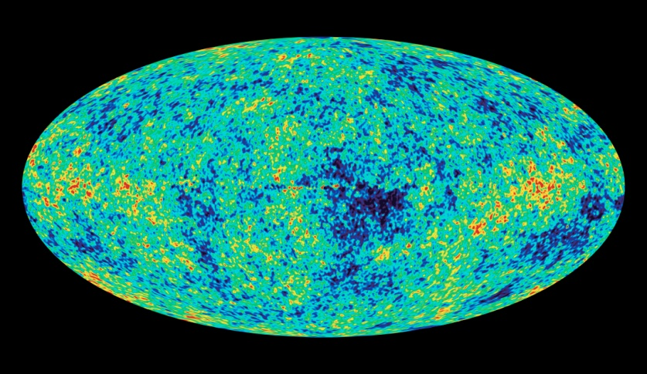
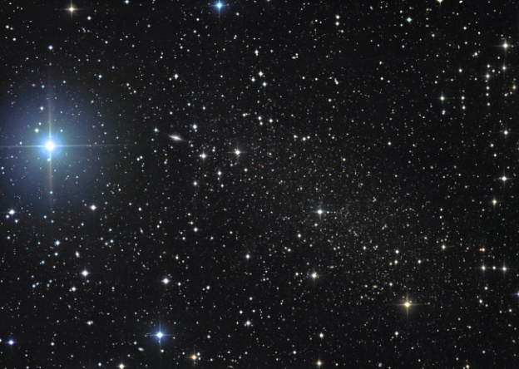
“Powers of 60”: An
Astronomical Jubilee
Discover the multiwavelength universe,
and the scale of the cosmos in powers of 60

Slide 17
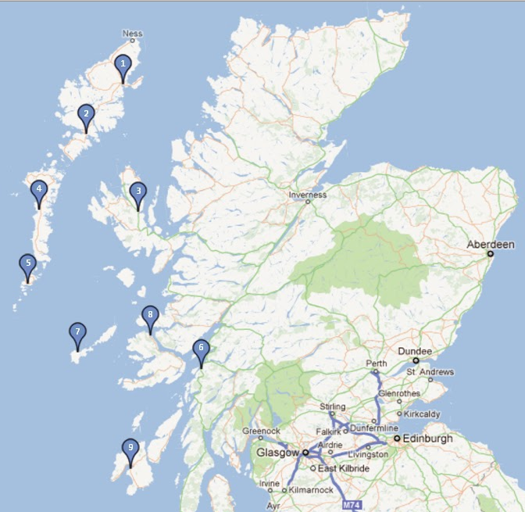
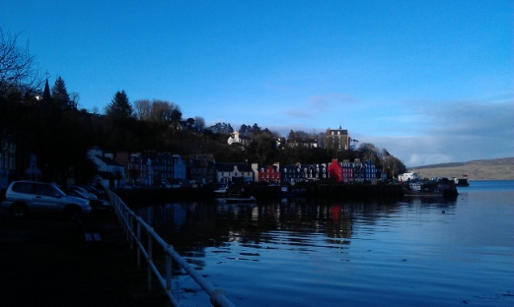
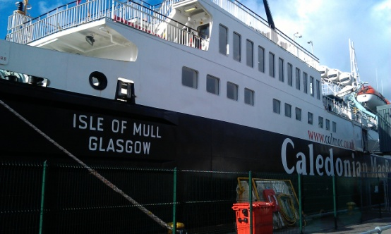
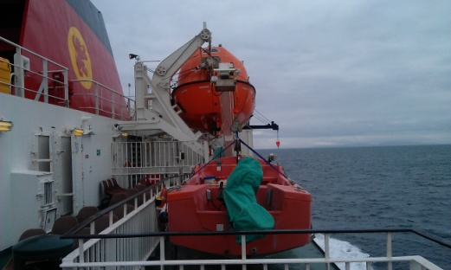
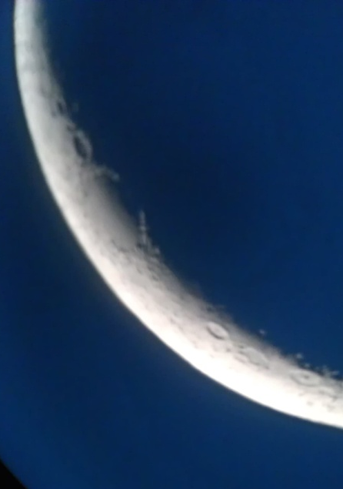
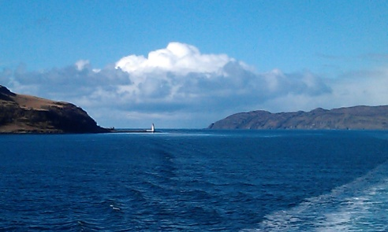
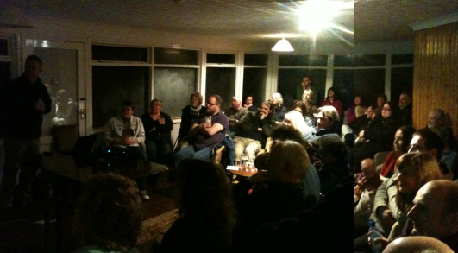
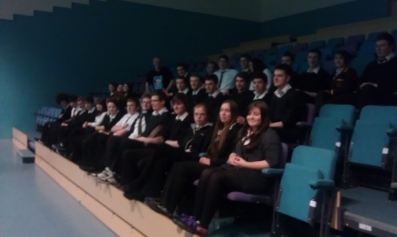
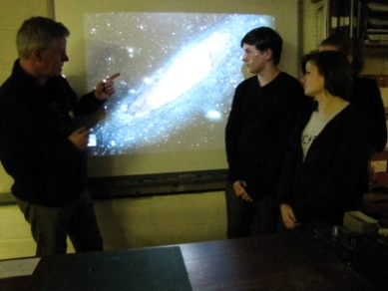
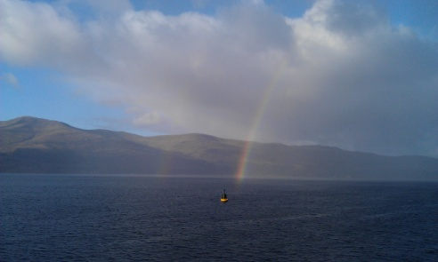
“Island Universe” Schools lecture tour
http://thecosmicexplorer.blogspot.com/

Slide 18
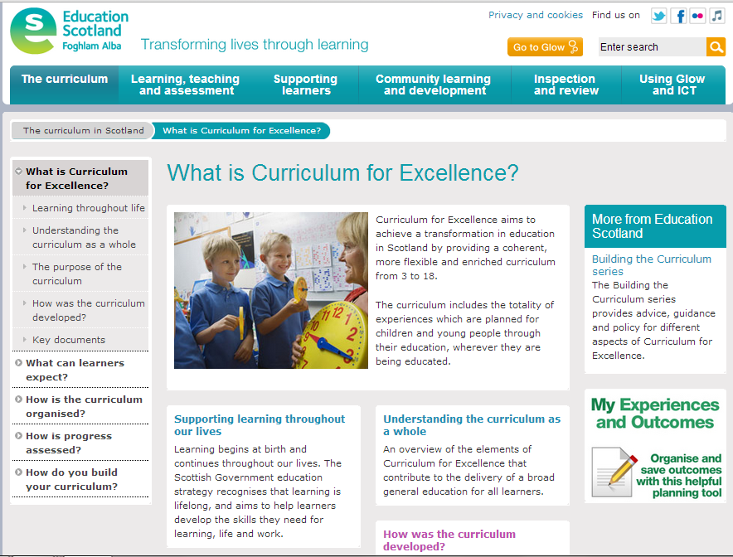

Slide 19
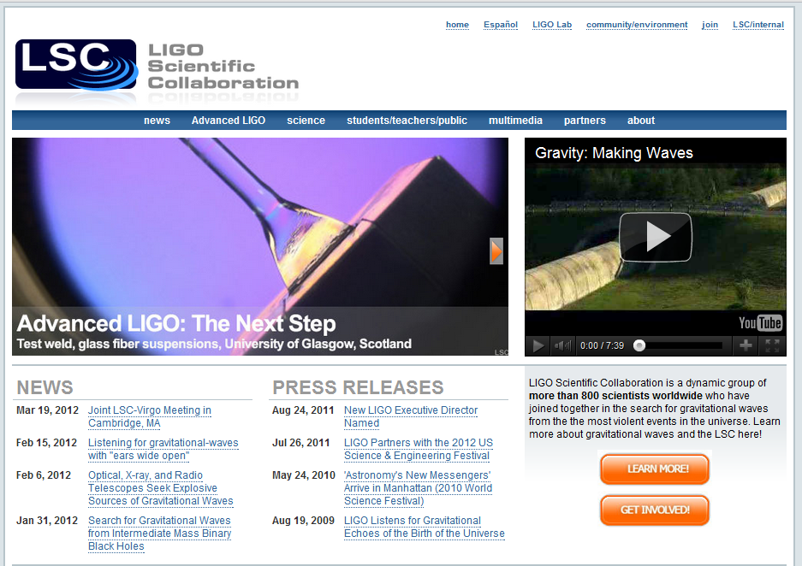
Online engagement

Slide 20
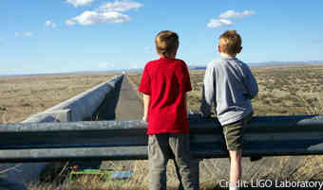
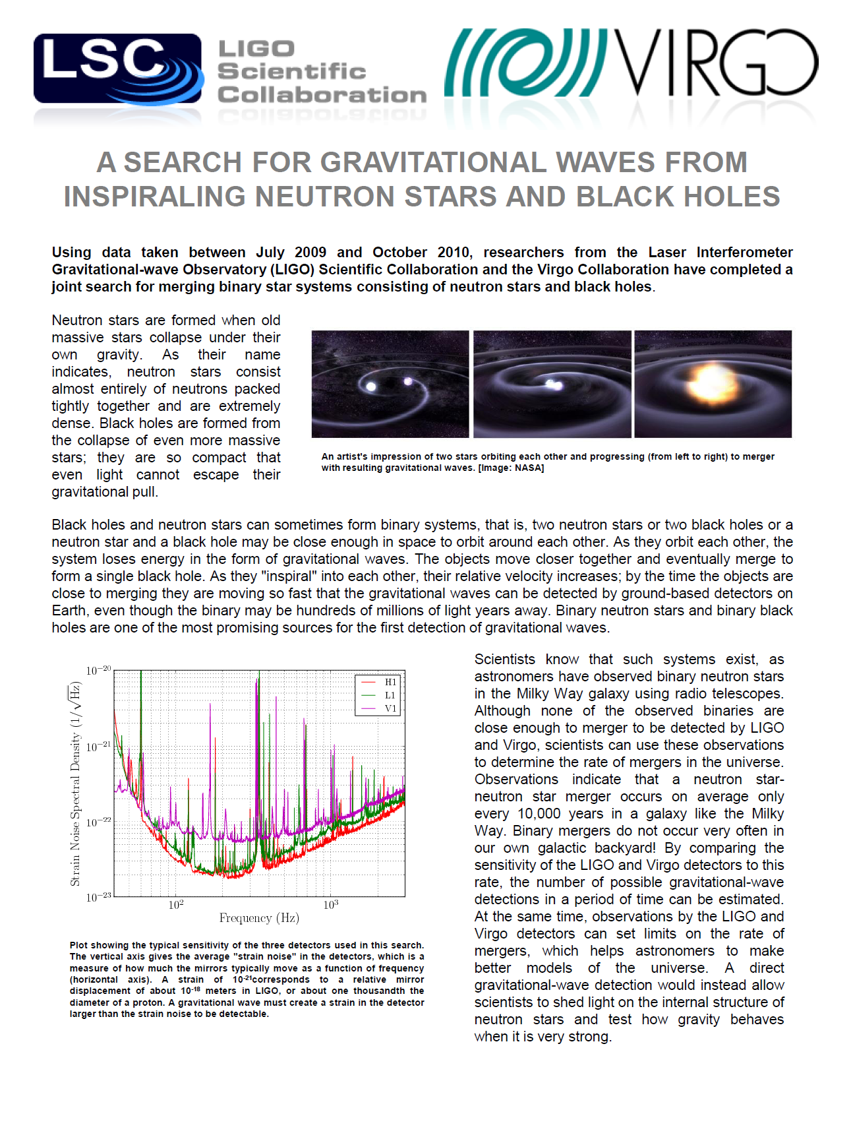
Online engagement

Slide 21
www.ligo.org
www.reddit.com/r/science AMA, Fri 13/2 from 1pm GMT

Slide 22
Top six PE tips I have learnt:
Personality
Enthusiasm
Topicality
Internet
Popular culture
Syllabus
Astrobiology Workshop, Feb 2015

Slide 23
Top six PE tips I have learnt:
Practical support
Evaluation
Technology
Impact
P&DR
Strategy
Astrobiology Workshop, Feb 2015

