Slide 1
Extra-terrestrial life:
Is there anybody out there?…
Bishopbriggs
Academy
Dec 2011
Martin Hendry
University of Glasgow

Slide 2
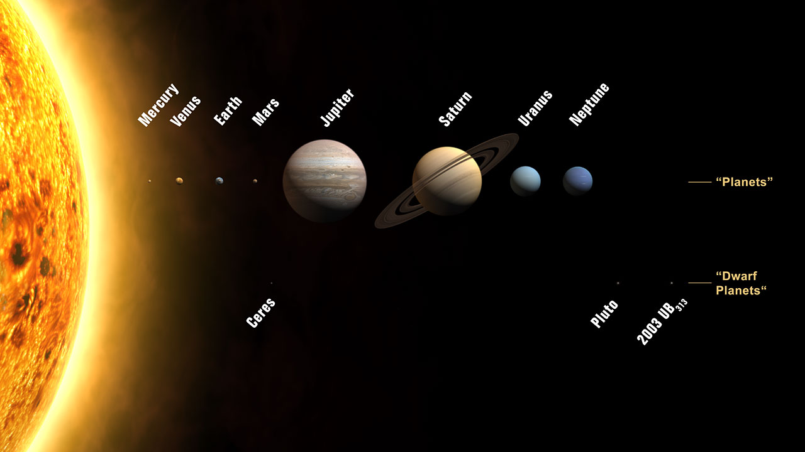

Slide 3
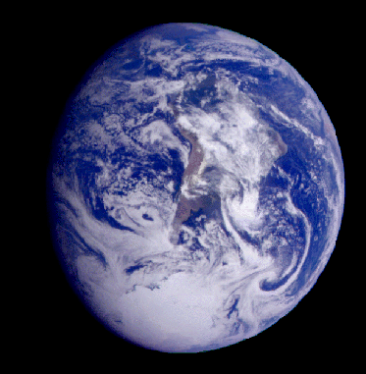

Slide 4
Liquid
Water
Oxygen
Carbon
Dioxide
= life!

Slide 5
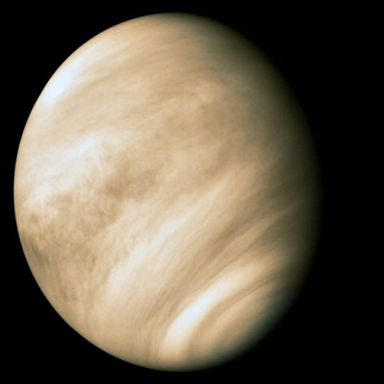

Slide 6
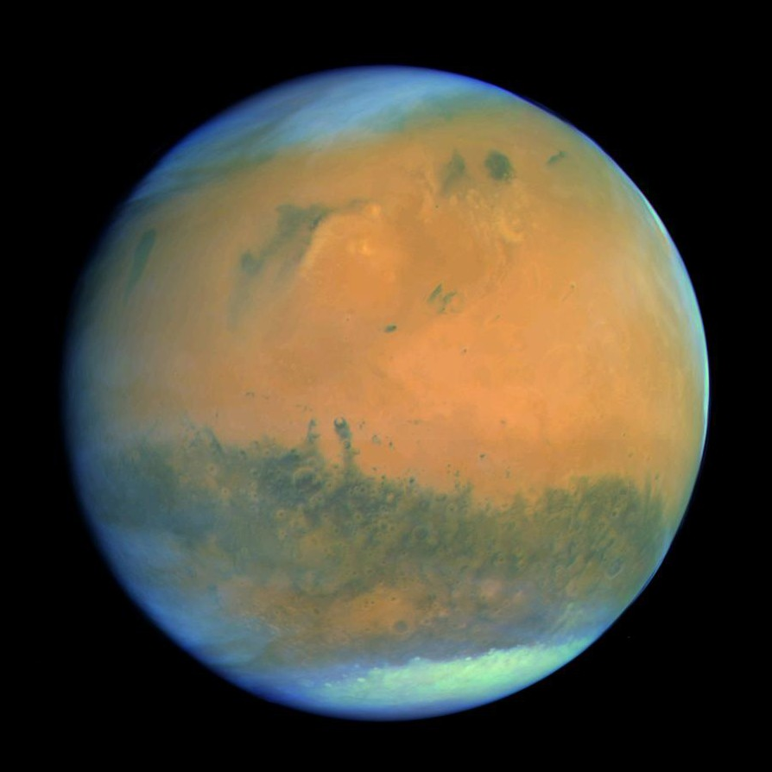

Slide 7
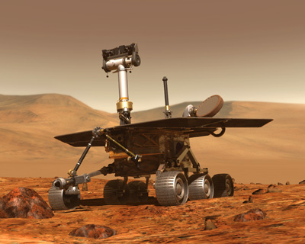
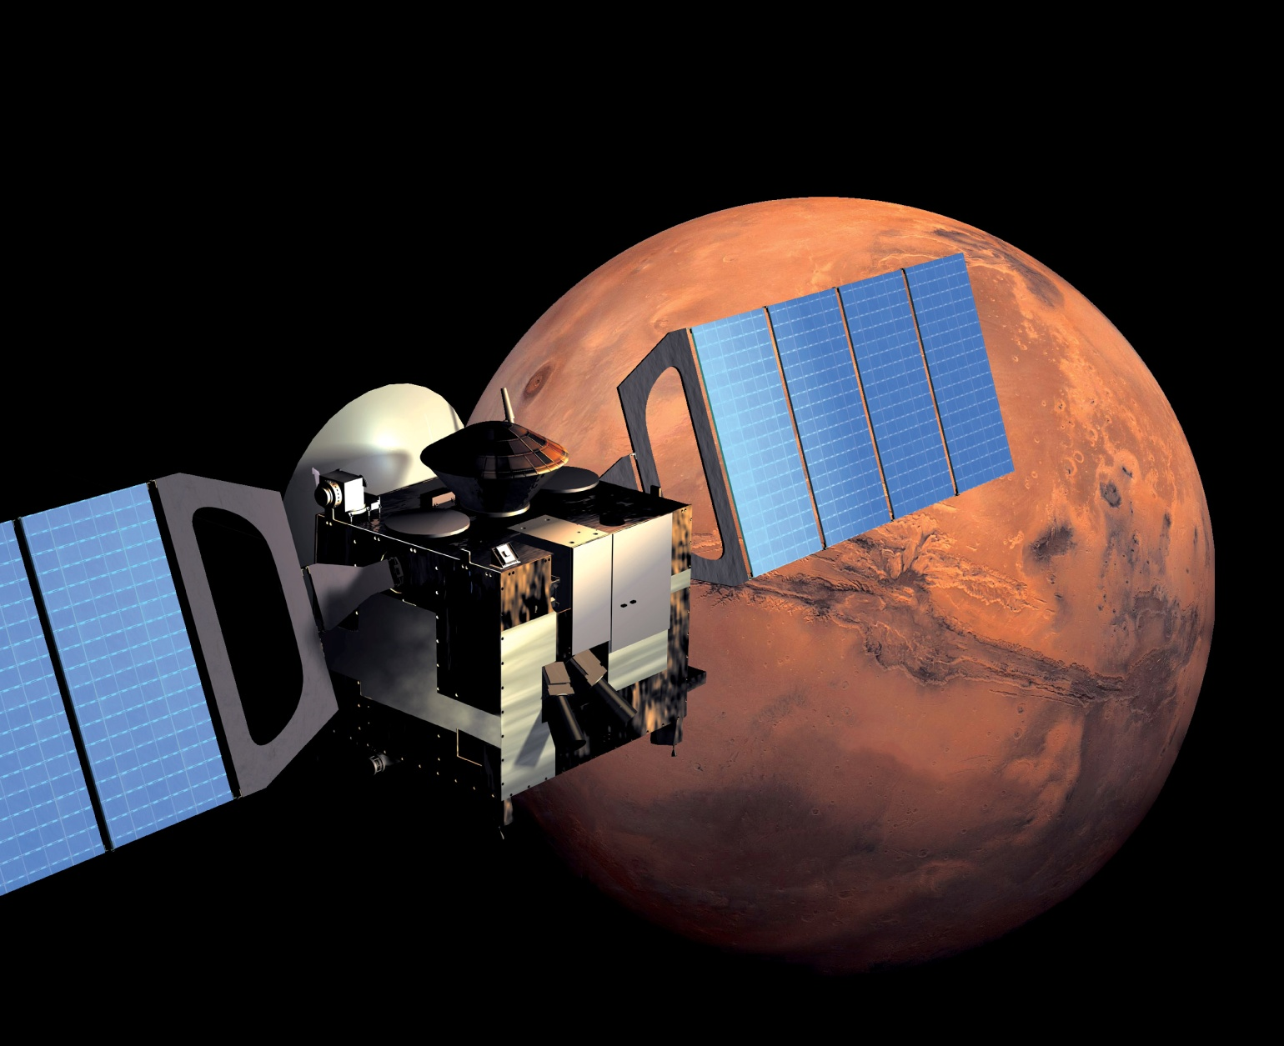
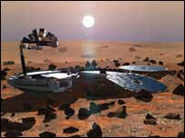
Mars is the best bet:
Mars Express ( + Beagle 2)
Spirit + Opportunity

Slide 8
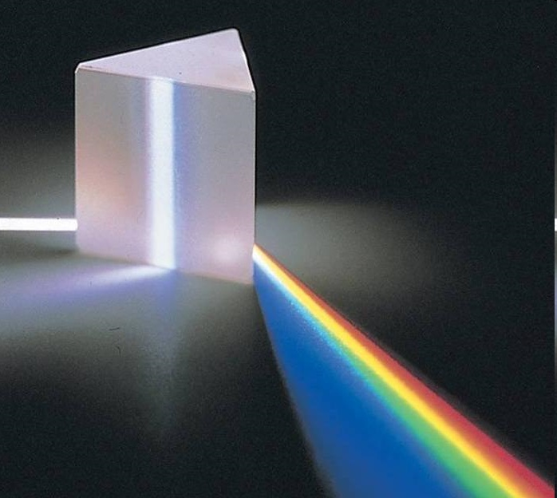
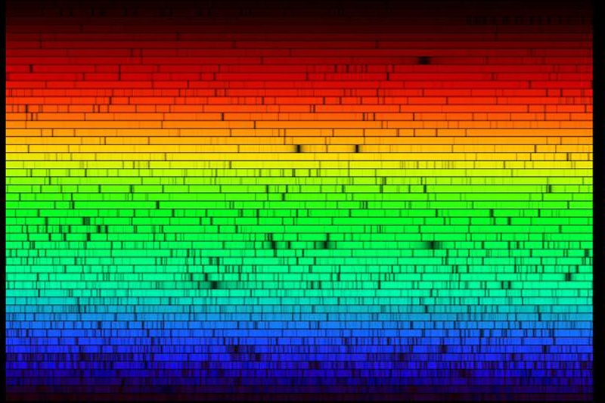
We can use spectral lines, like fingerprints, to identify the chemicals that stars and planets are made of.

Slide 9
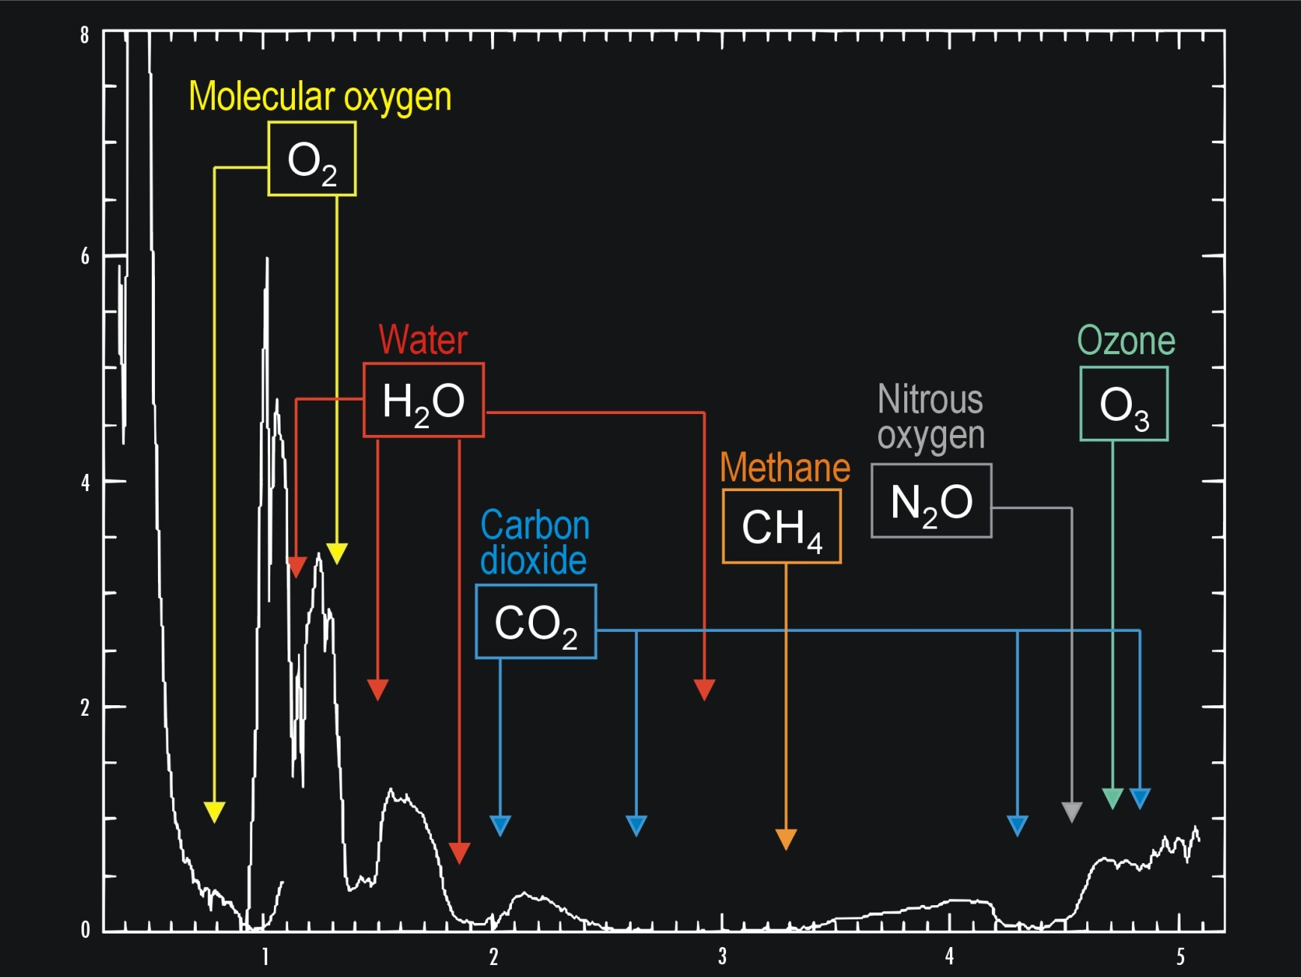
Strength of absorption
Wavelength (microns)

Slide 10
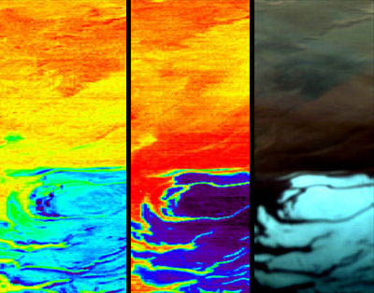
2004:
Mars Express Orbiter detects frozen carbon dioxide and water
at the South Pole
of Mars.
H₂O
CO₂
Visible light

Slide 11
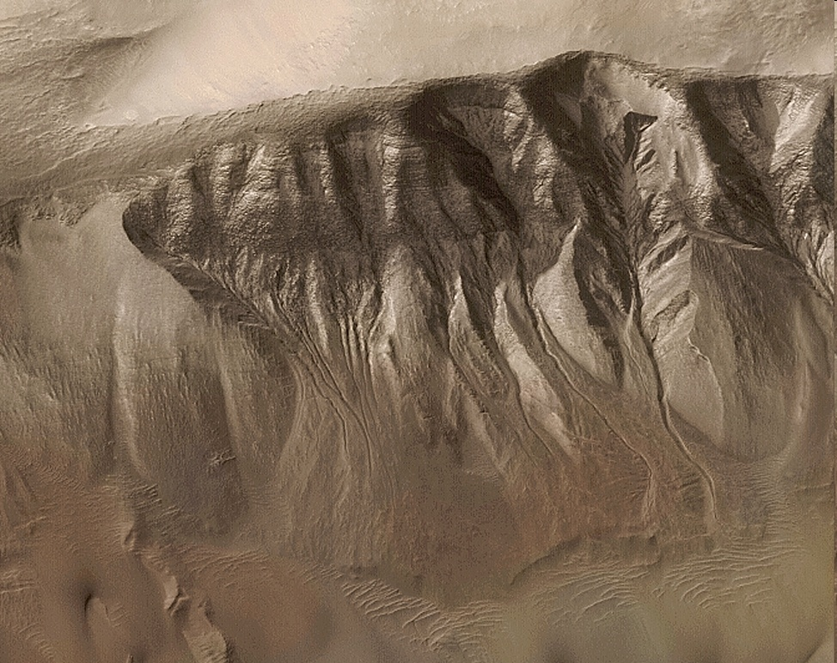
Signs of past running water in many Martian photographs

Slide 13
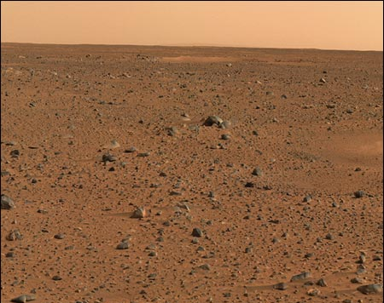

Slide 14
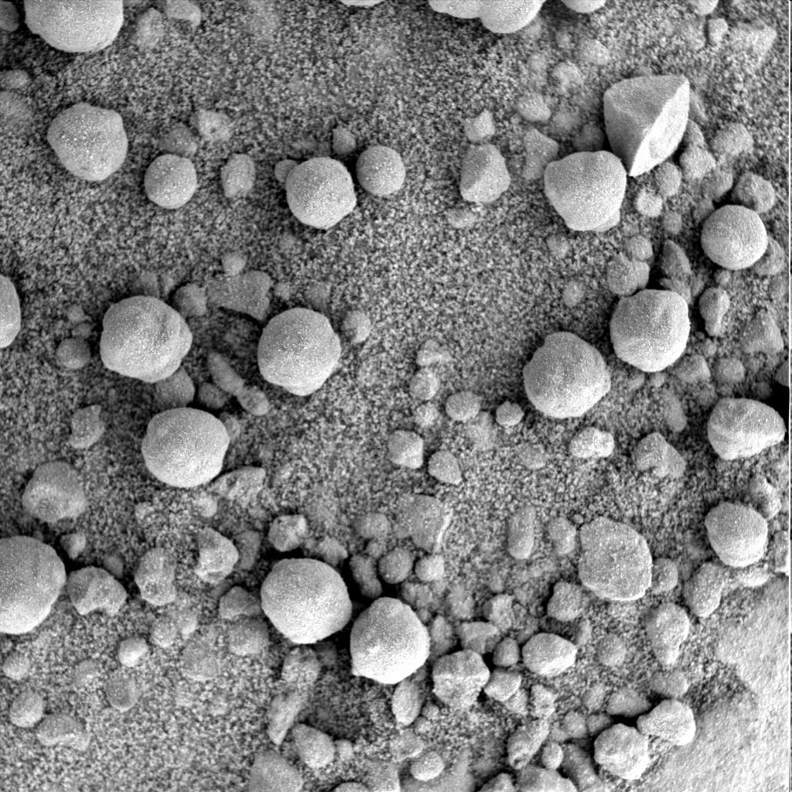

Slide 16
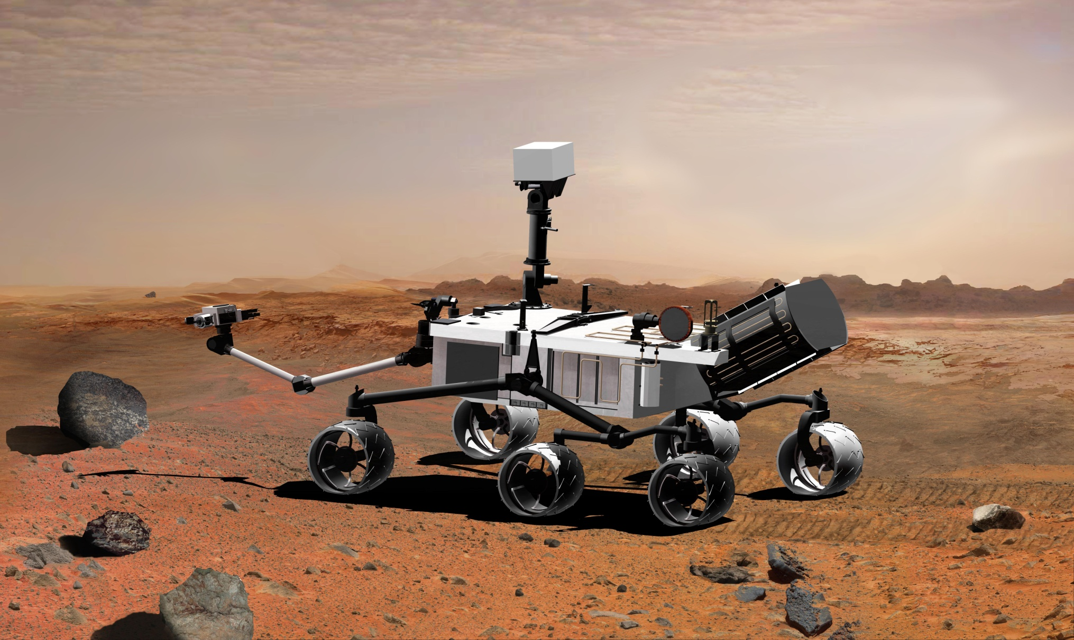

Slide 17
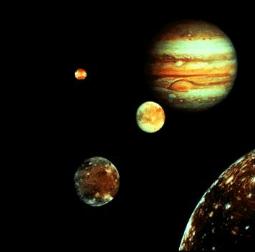
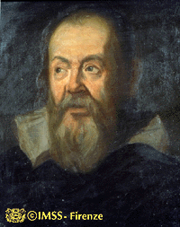
The moons of Jupiter

Slide 18
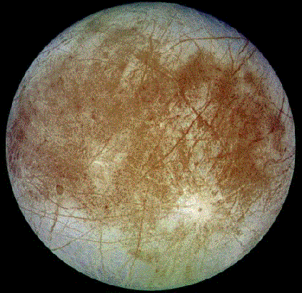

Slide 19
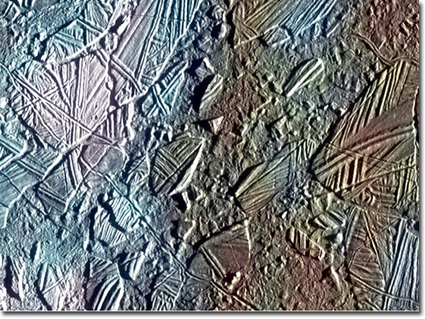

Slide 20
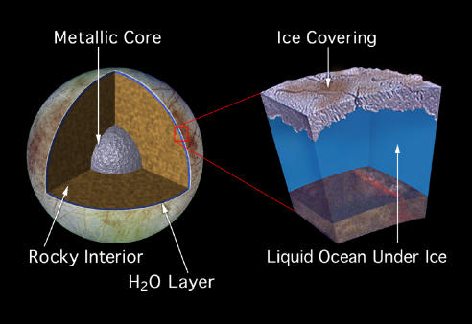
Inside Europa

Slide 21
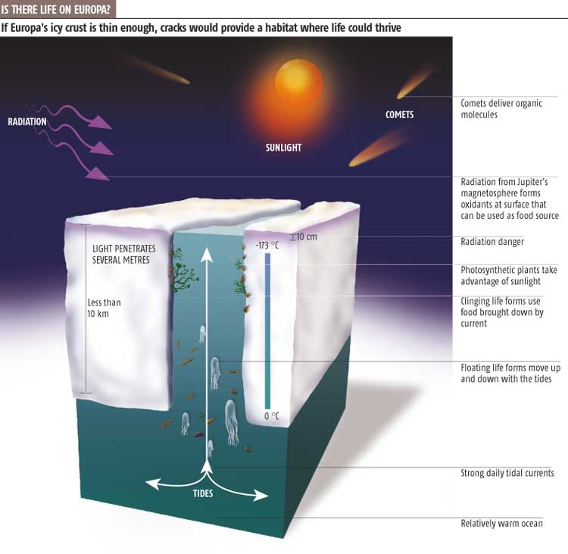

Slide 22
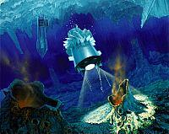

Slide 23
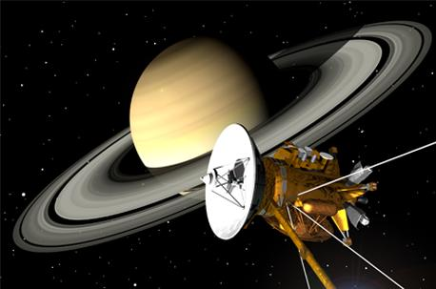

Slide 24
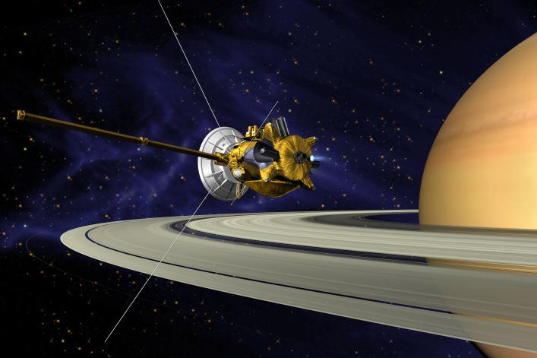

Slide 25
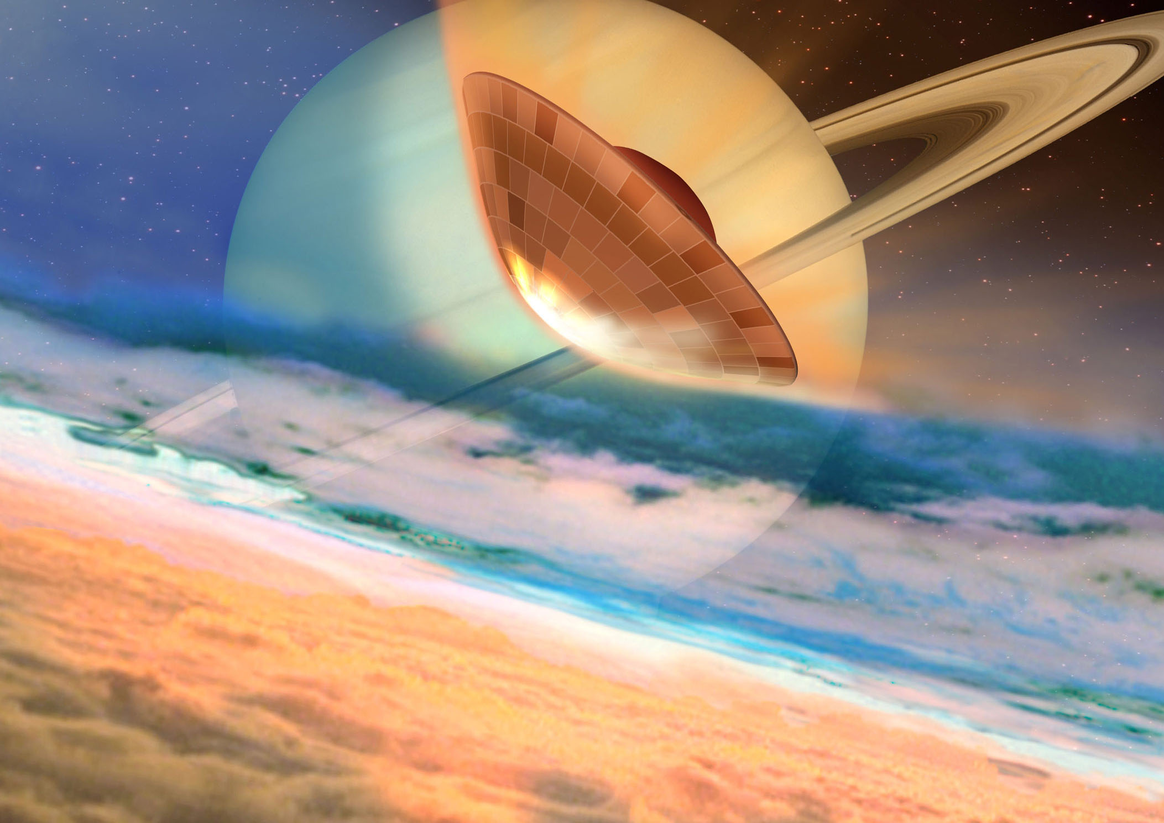

Slide 26
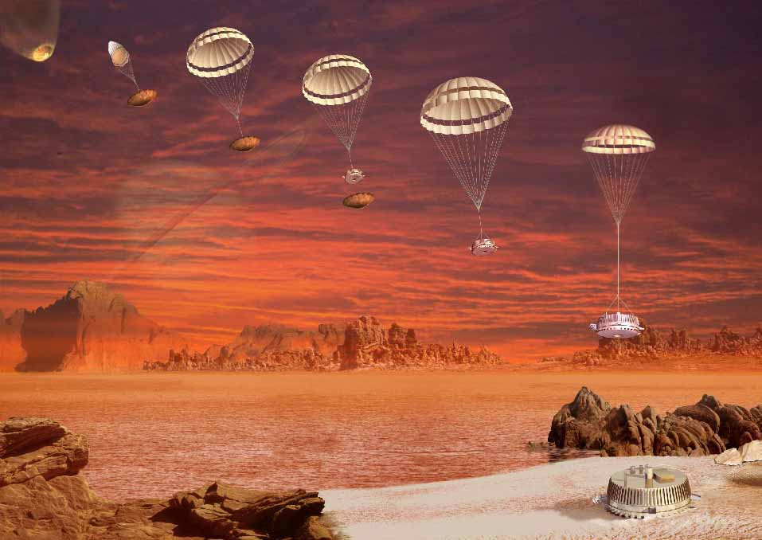

Slide 27
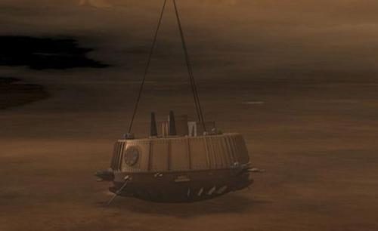

Slide 28
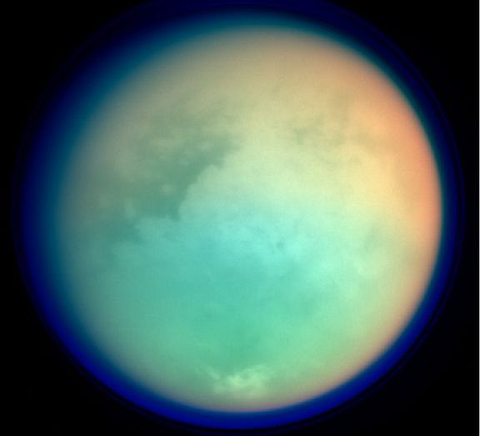

Slide 29
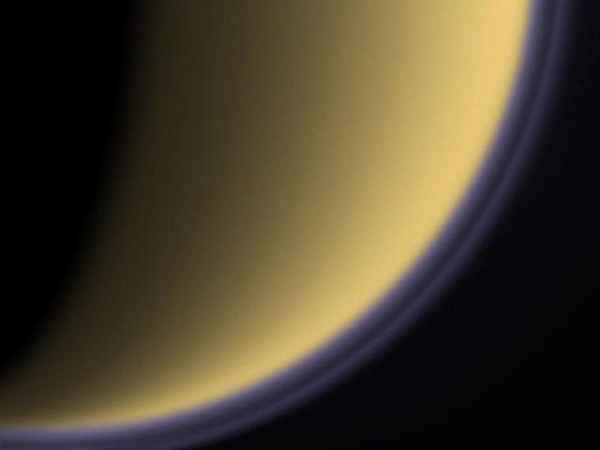

Slide 30
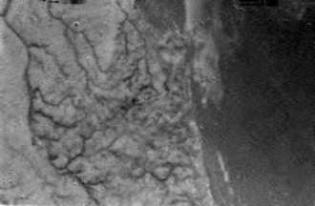

Slide 31
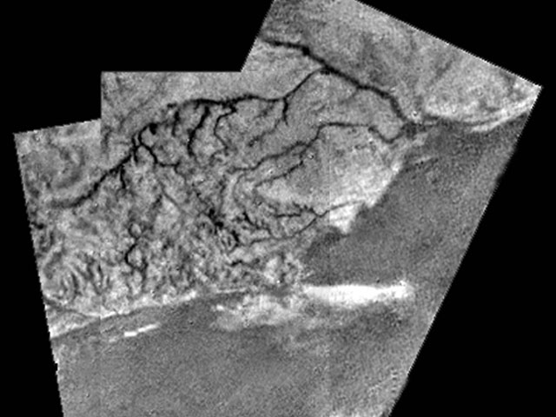

Slide 33
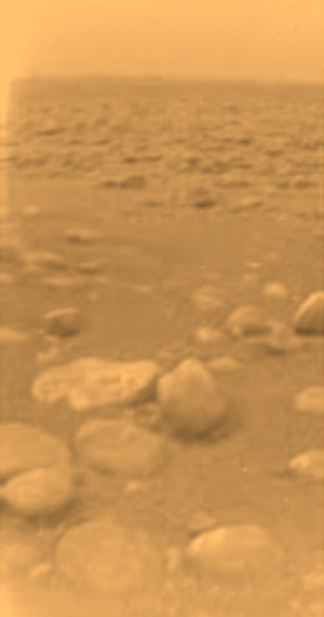

Slide 34
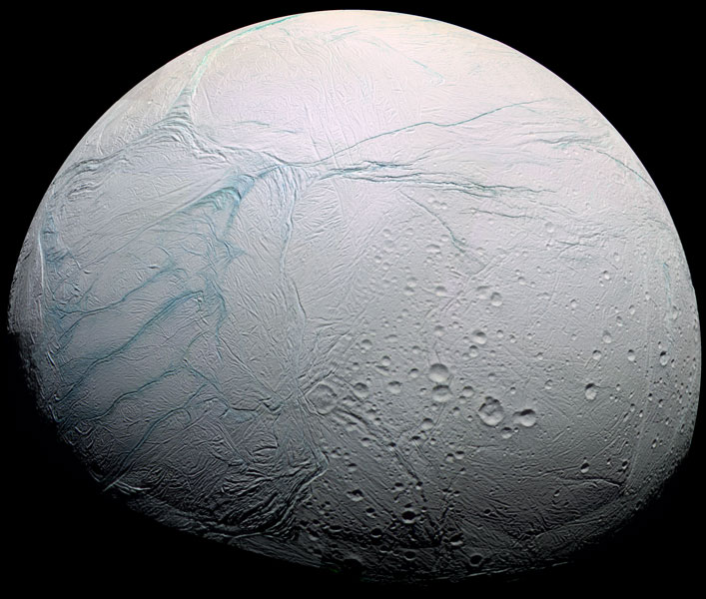

Slide 35
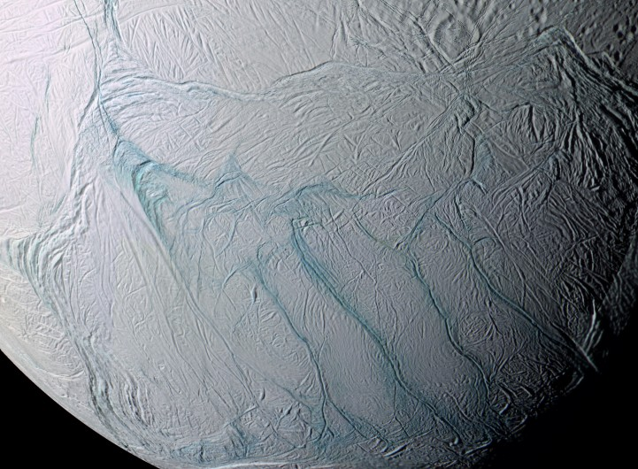

Slide 36
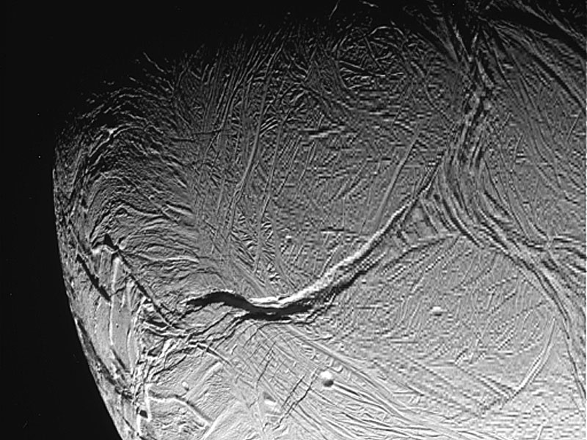

Slide 37
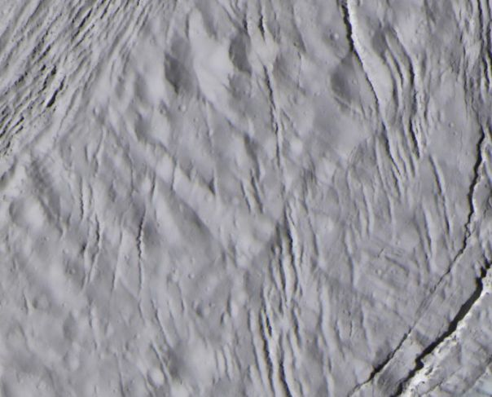

Slide 38
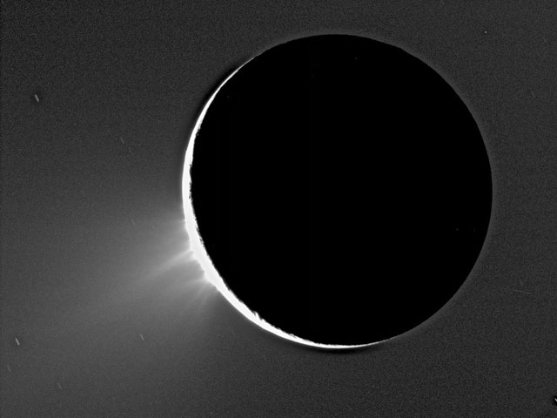

Slide 39
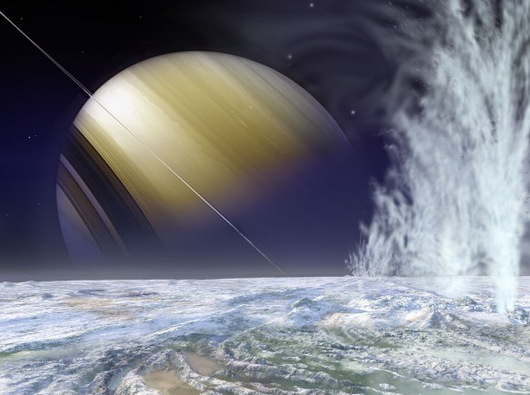

Slide 40
How can we detect planets around other stars?
This isn’t easy because:
other stars (and their planets) are very far away
planets don’t shine by themselves, they just reflect
light from their star, so they get lost in the glare.

Slide 41
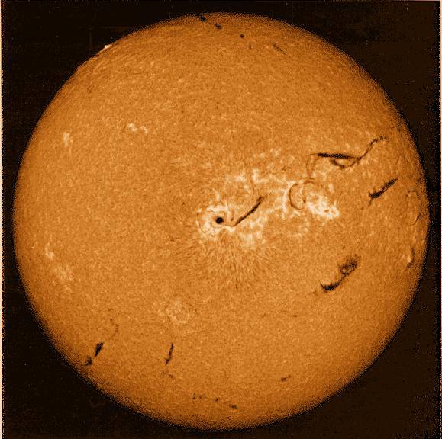
The distance from the Earth to the Sun is 150 million km.
It takes sunlight more than eight minutes to travel this distance.
The light from the next nearest star, Alpha Centauri, takes more than four years to reach the Earth.

Slide 42
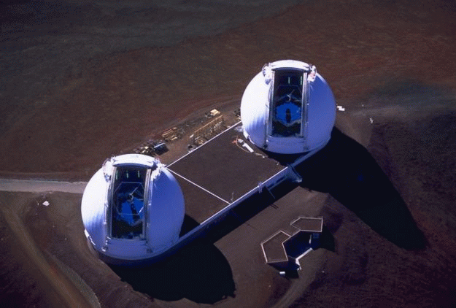
Exoplanets are ‘drowned out’ by their parent star. That makes them very hard to see directly with current telescopes (~10m mirrors)…
Keck telescopes
on Mauna Kea,
Hawaii

Slide 43
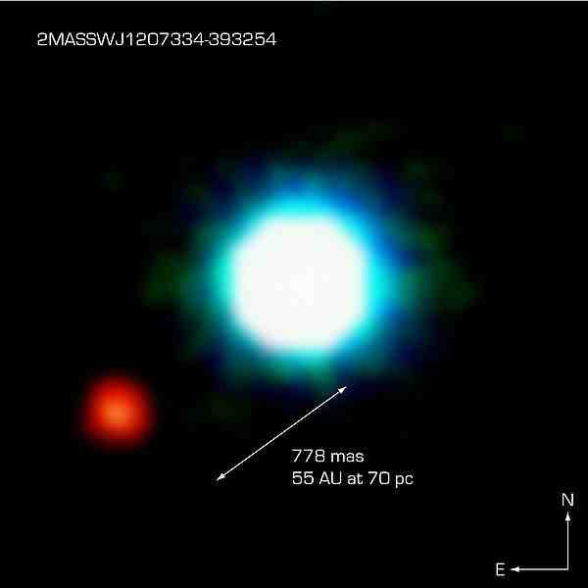

Slide 44
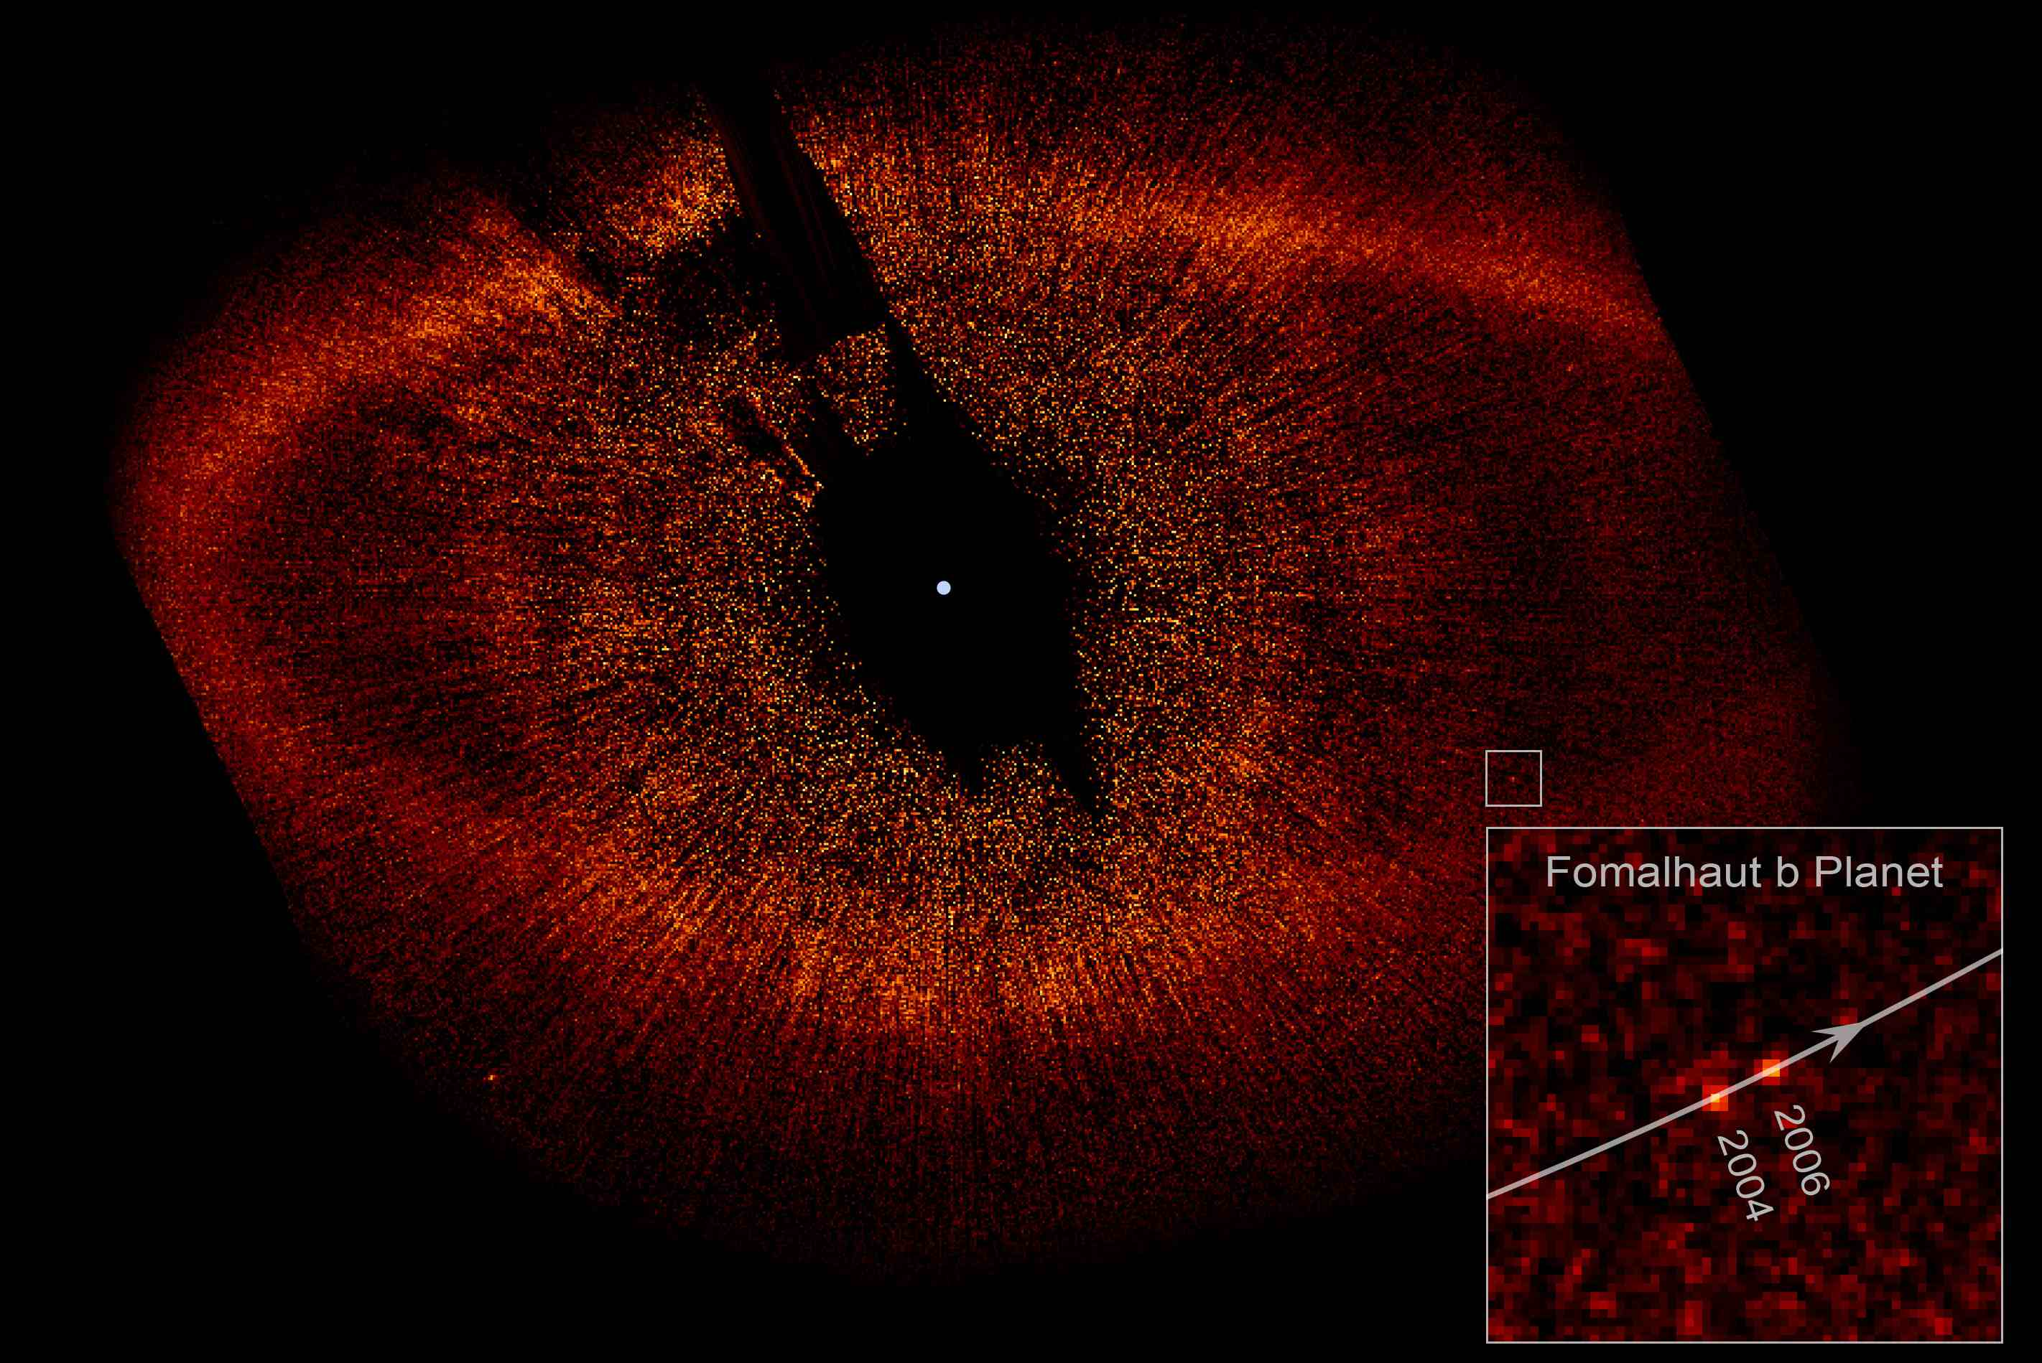

Slide 45
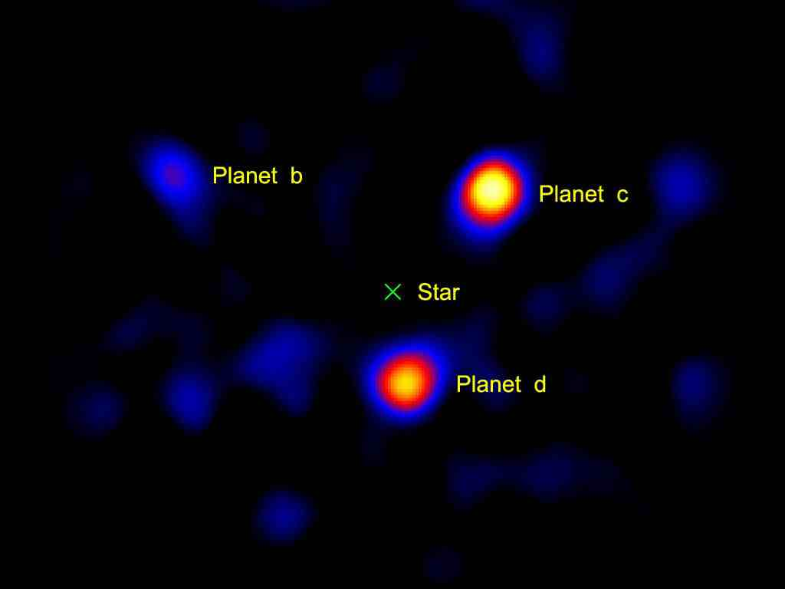

Slide 46
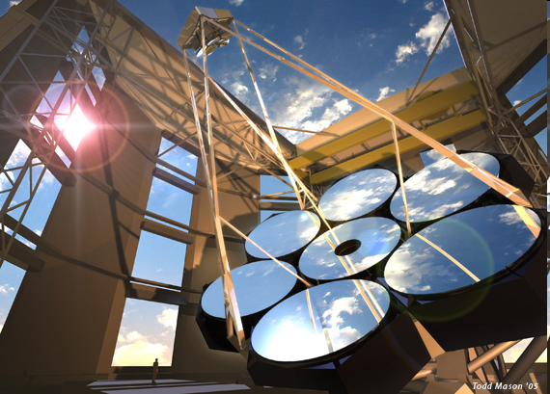

Slide 47
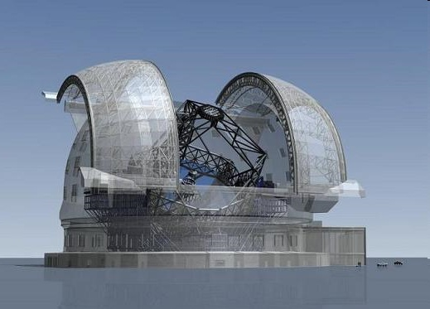
The European Extremely Large Telescope project

Slide 48
The European Extremely Large Telescope project
42m mirror: to be completed by 2020
‘Jupiter’ at 30 l.y.

Slide 49
How can we detect planets around other stars?
This isn’t easy because:
other stars (and their planets) are very far away
planets don’t shine by themselves, they just reflect
light from their star, so they get lost in the glare.
We can tell that planets are there by the effect
they have on their star.

Slide 50
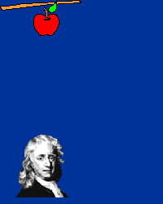
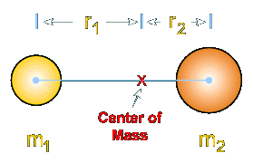
Planets cause their parent star to ‘wobble’
Centre of gravity

Slide 51
Star + planet orbit about centre of gravity

Slide 52
Star + planet orbit about centre of gravity
Can see star ‘wobble’, even when we can’t see the planet.

Slide 53
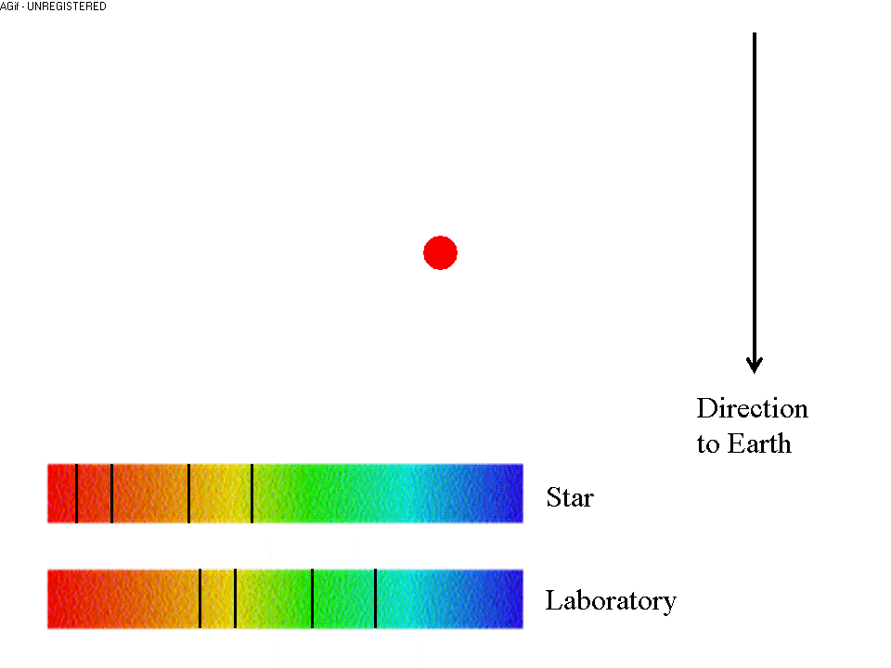
Star + planet orbit about centre of gravity
We can also see the motion of the star from its spectral
lines.

Slide 54
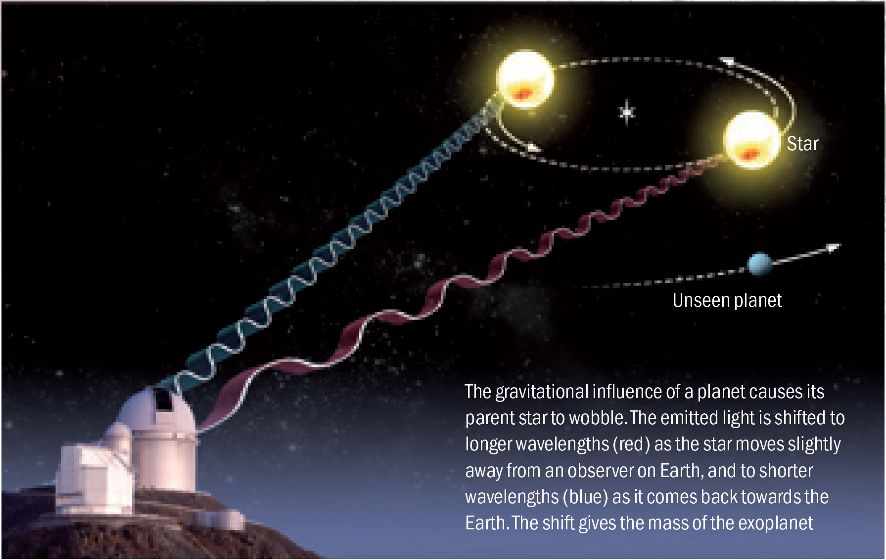

Slide 55
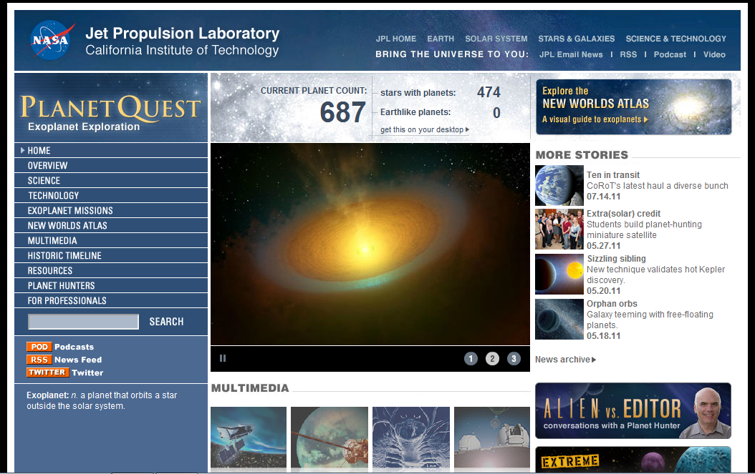
In the past 16 years we have found many planets orbiting other stars in our galaxy…

Slide 56
Could some of those planets be like the Earth?
Most planets we’ve found so far are ‘hot Jupiters’:
gas giants, much bigger and closer to their parent star than the Earth is to the Sun.
These are not good places to look for life like us:
no water,
no oxygen,
much too hot!

Slide 57
In the past 16 years we have found many planets orbiting other stars in our galaxy…
No Earth-like planets, yet….

Slide 58
Transit of Mercury: May 7th 2003

Slide 59
Detecting exoplanets from transits
Brightness
Star
Planet
Time

Slide 63
Kepler
Launched: March 5th 2009

Slide 72
Kepler
If Earth-like planets exist around nearby stars, Kepler should find them

Slide 75
Could some of those planets be like the Earth?

Slide 77
Could there be ET life like us on those planets?
Finding water, carbon dioxide, and especially oxygen would be a very big clue, but we really don’t know!

Slide 79
Could there be ET life like us on those planets?
Finding water, carbon dioxide, and especially oxygen would be a very big clue, but we really don’t know!
If life does exist, what would it look like?
How would this depend on the type of planet and star?...

