Slide 1
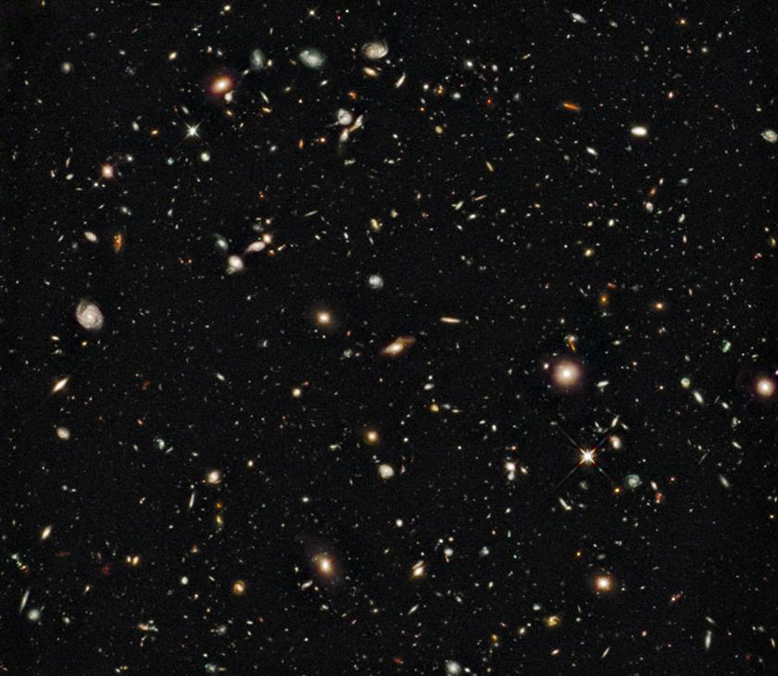
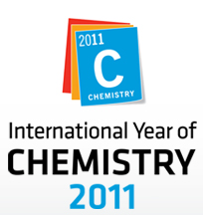
Putting the
Iron in
Martin Hendry
University of Glasgow

Slide 2
Thurso High School, Oct 2011

Slide 3
Thurso High School, Oct 2011

Slide 4
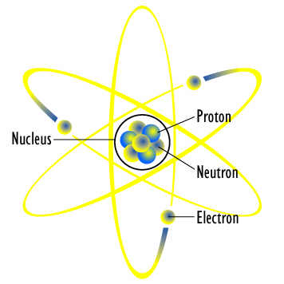
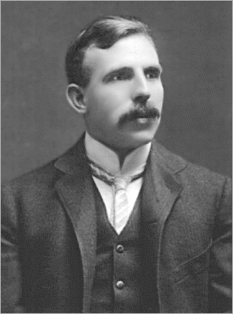
Thurso High School, Oct 2011

Slide 5
“All science is either physics or stamp collecting”
Thurso High School, Oct 2011

Slide 6
Thurso High School, Oct 2011

Slide 7
Thurso High School, Oct 2011

Slide 8
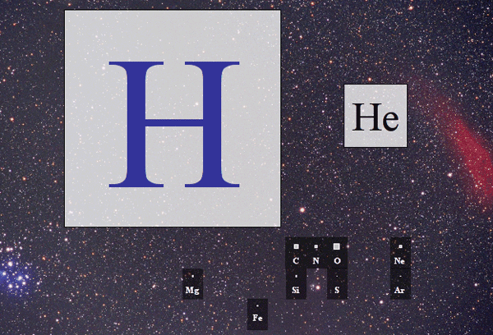
Thurso High School, Oct 2011

Slide 9
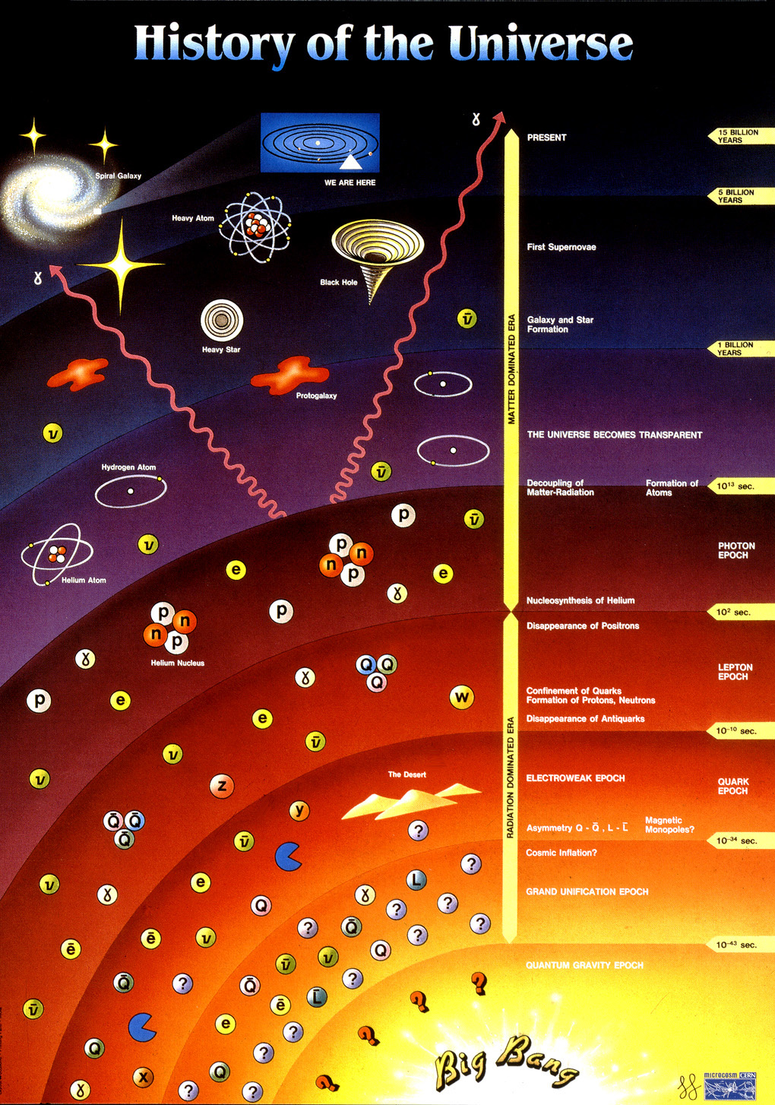
Thurso High School, Oct 2011

Slide 10
Thurso High School, Oct 2011

Slide 11
Thurso High School, Oct 2011

Slide 12
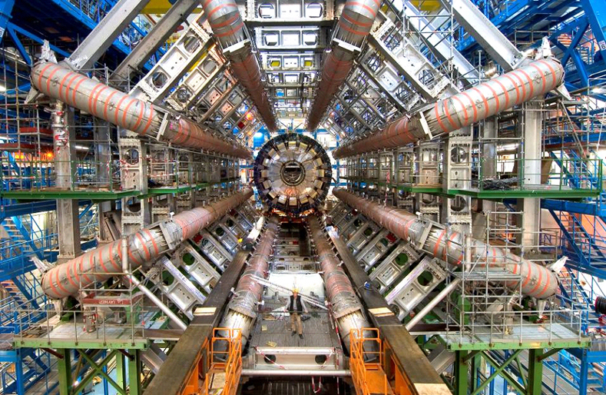
Thurso High School, Oct 2011

Slide 13
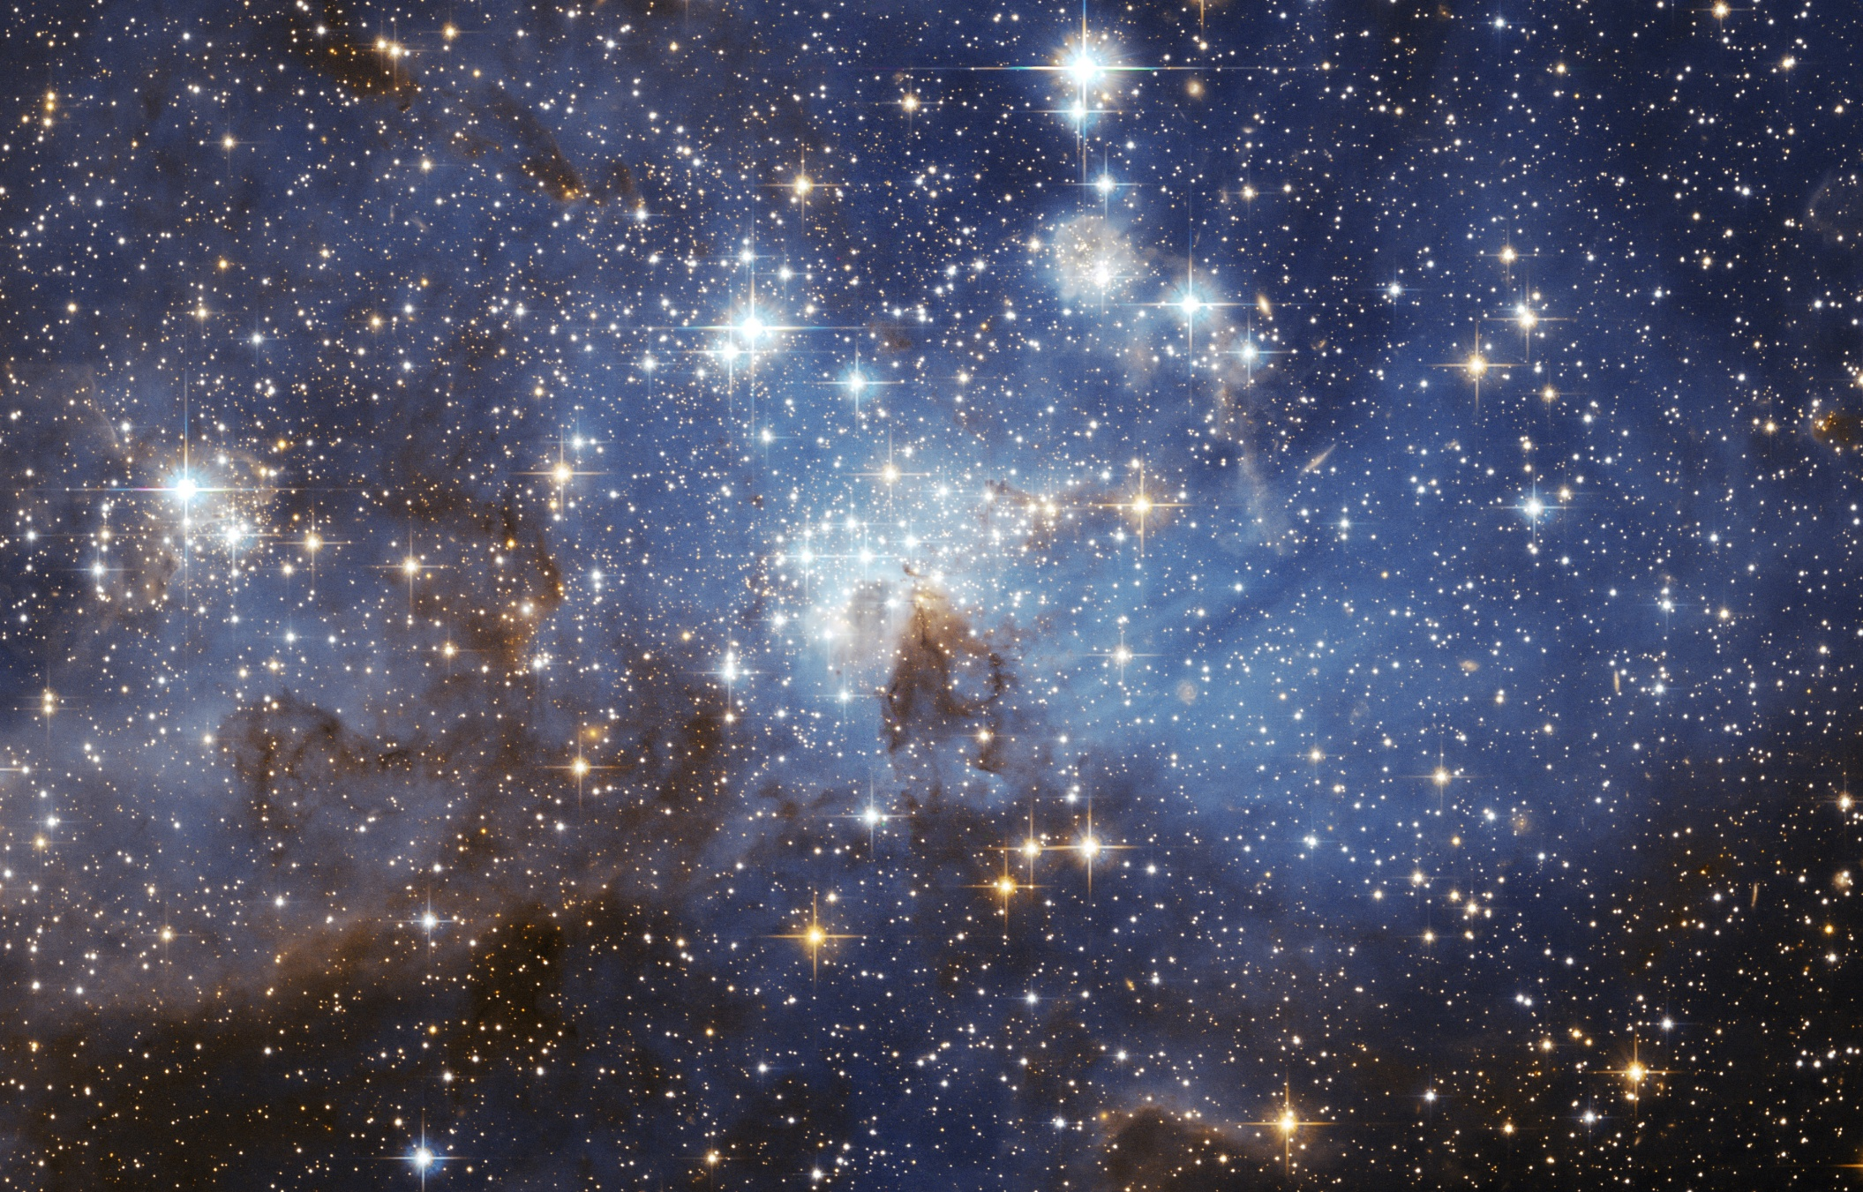
Thurso High School, Oct 2011

Slide 14
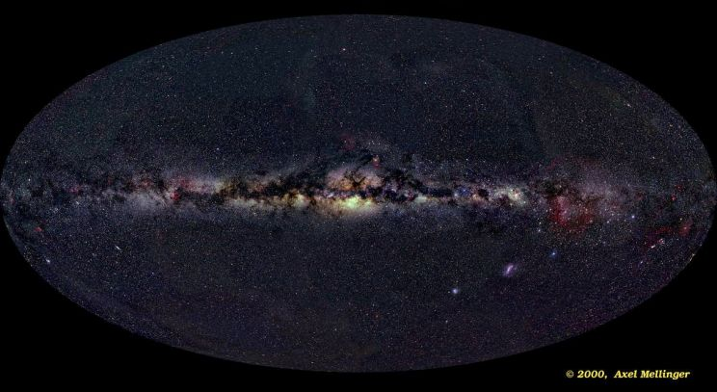
Thurso High School, Oct 2011

Slide 17
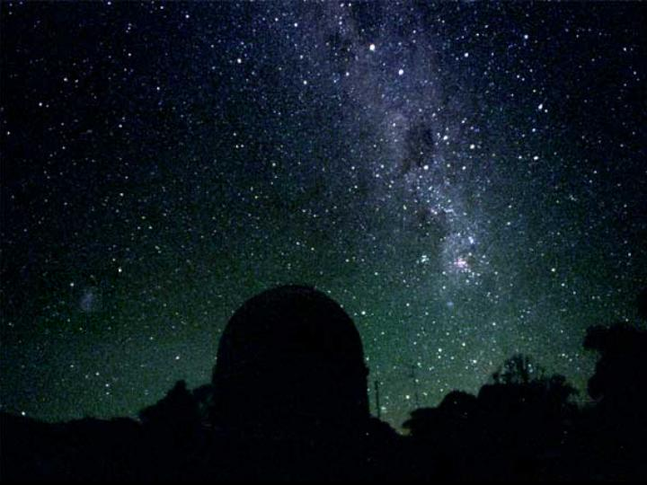
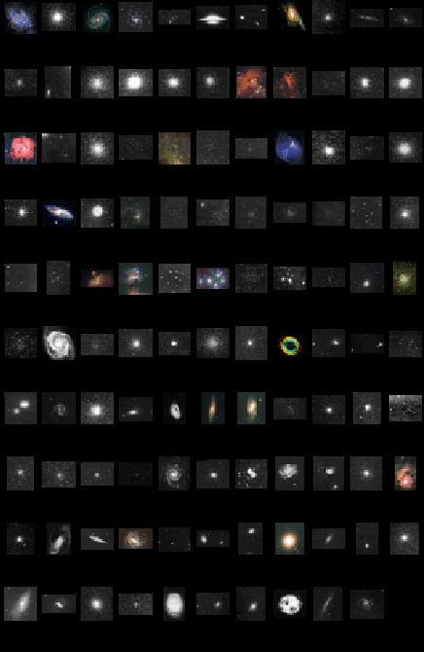
How do stars and planets form?
from
Nebulae
Thurso High School, Oct 2011

Slide 18
How do stars and planets form?
from
Nebulae
Thurso High School, Oct 2011

Slide 19
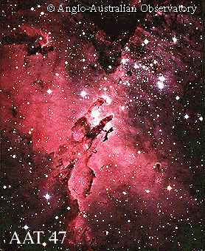
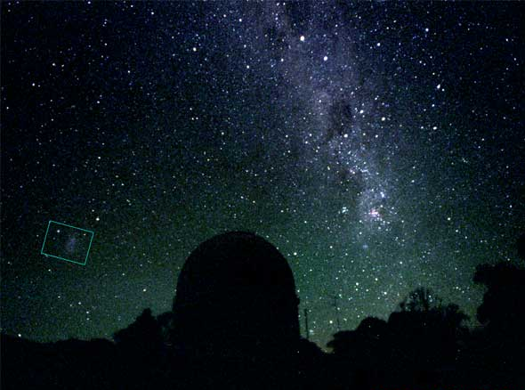
Thurso High School, Oct 2011

Slide 20
Thurso High School, Oct 2011

Slide 21
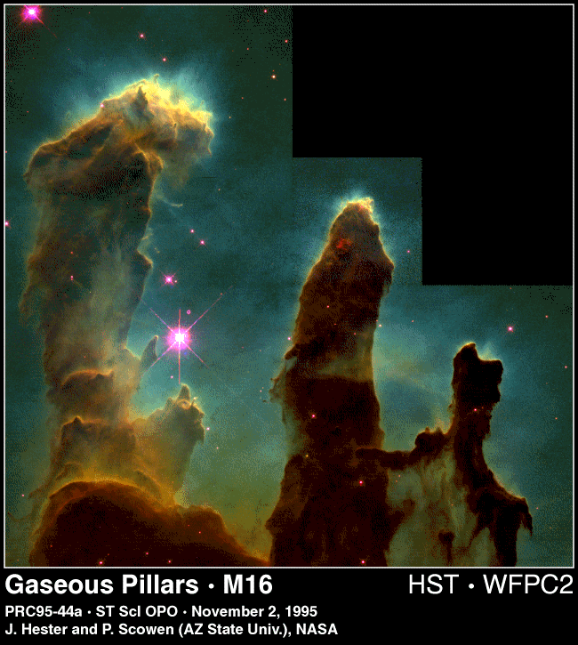
Thurso High School, Oct 2011

Slide 22
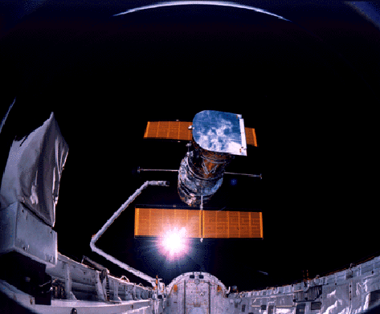
Thurso High School, Oct 2011

Slide 23
Thurso High School, Oct 2011

Slide 24
Thurso High School, Oct 2011

Slide 25
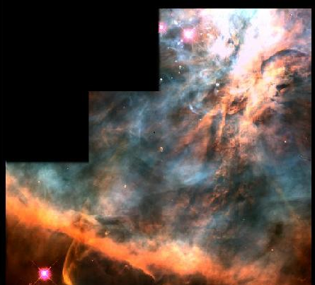
Thurso High School, Oct 2011

Slide 26
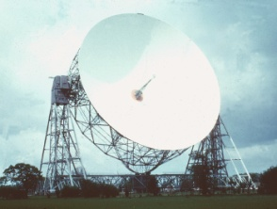
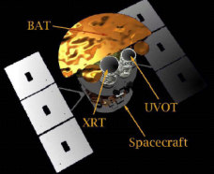
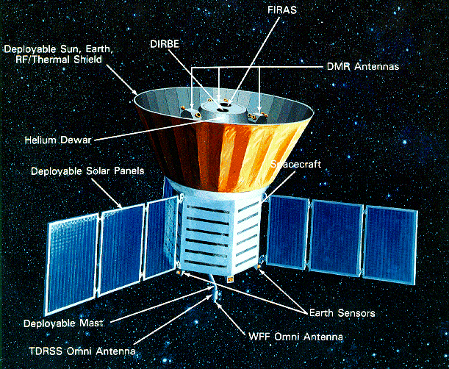
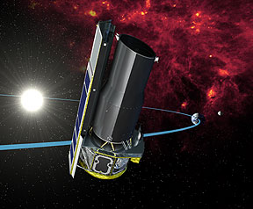
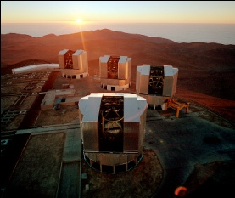
Thurso High School, Oct 2011

Slide 27
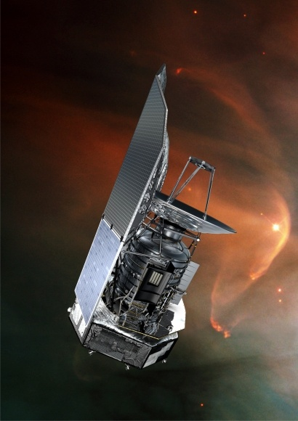
Thurso High School, Oct 2011

Slide 28
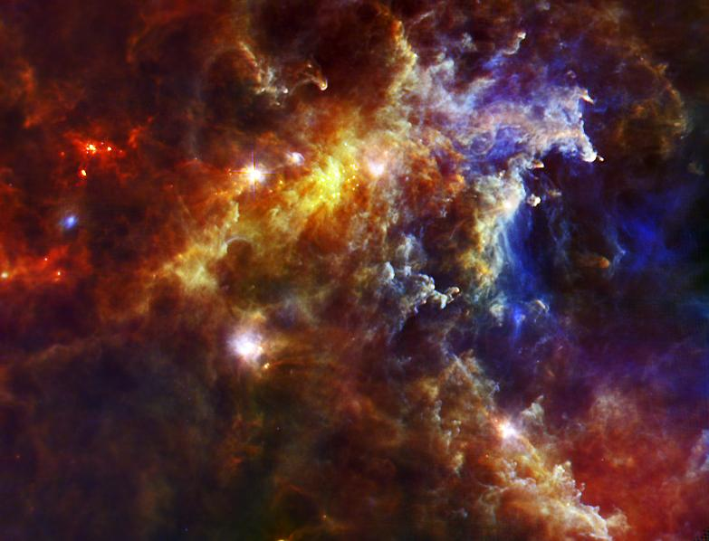
Thurso High School, Oct 2011

Slide 29
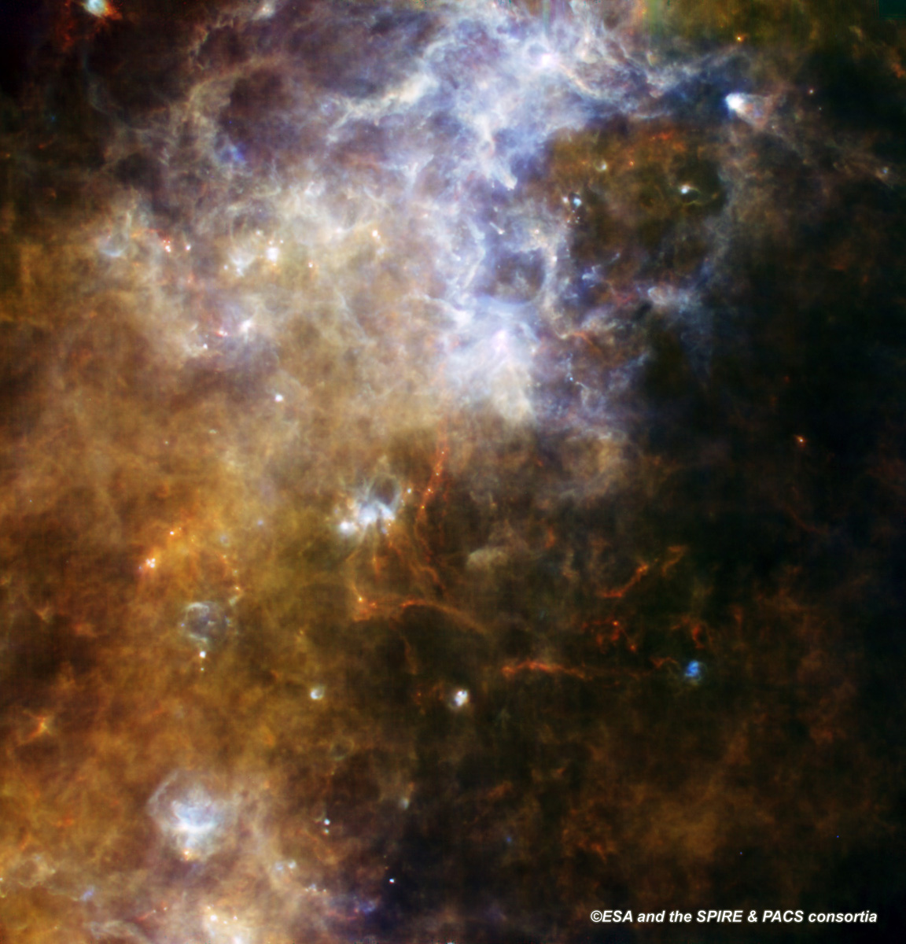
Thurso High School, Oct 2011

Slide 30
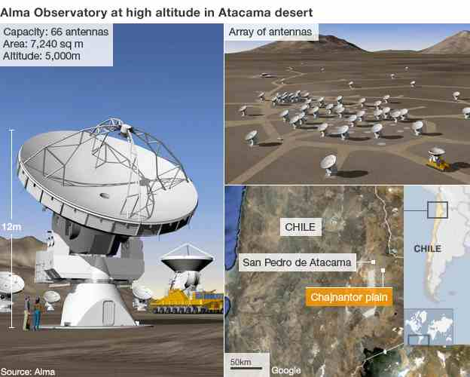

Slide 31
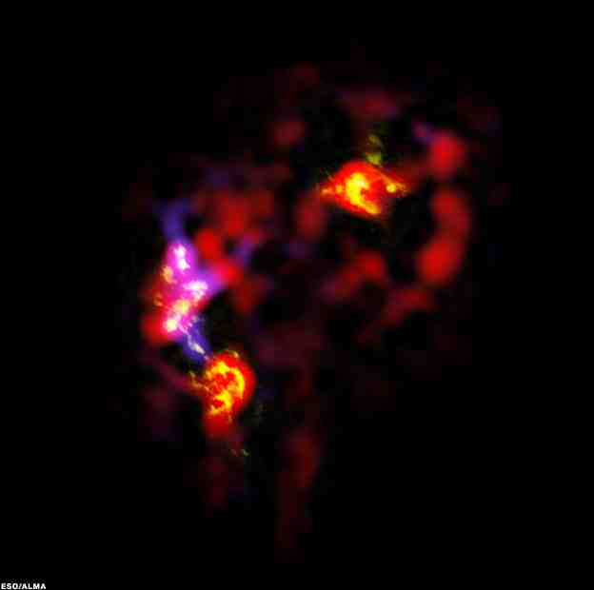
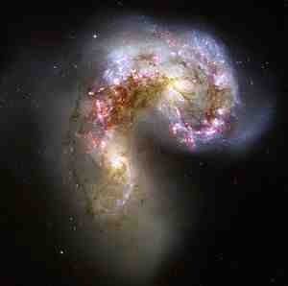

Slide 32
Forming stars
Pressure
versus
Gravity
Thurso High School, Oct 2011

Slide 33
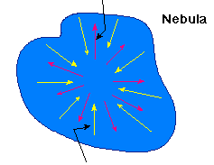
Gas pressure trying to expand the cloud
Forming stars
Pressure
versus
Gravity
Gravity trying to collapse the cloud
Thurso High School, Oct 2011

Slide 34
Thurso High School, Oct 2011

Slide 35
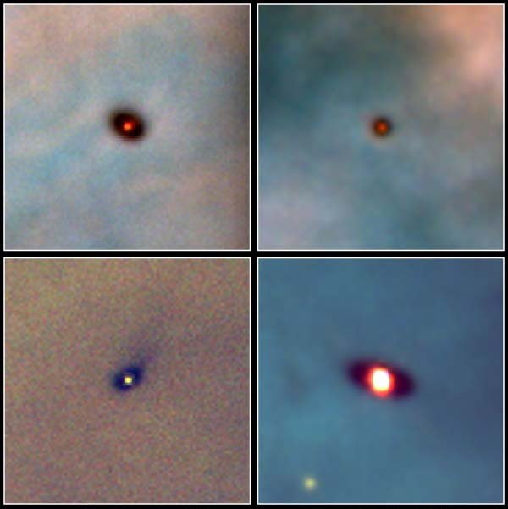
Thurso High School, Oct 2011

Slide 36
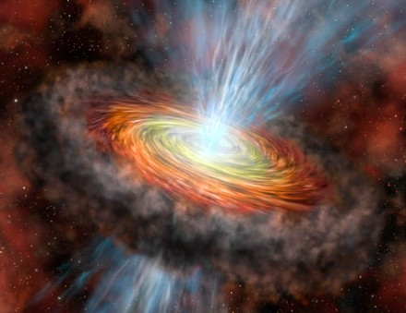
Thurso High School, Oct 2011

Slide 37
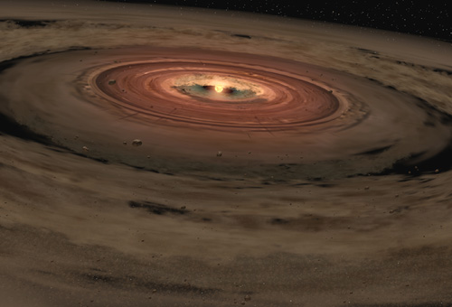
Thurso High School, Oct 2011

Slide 38
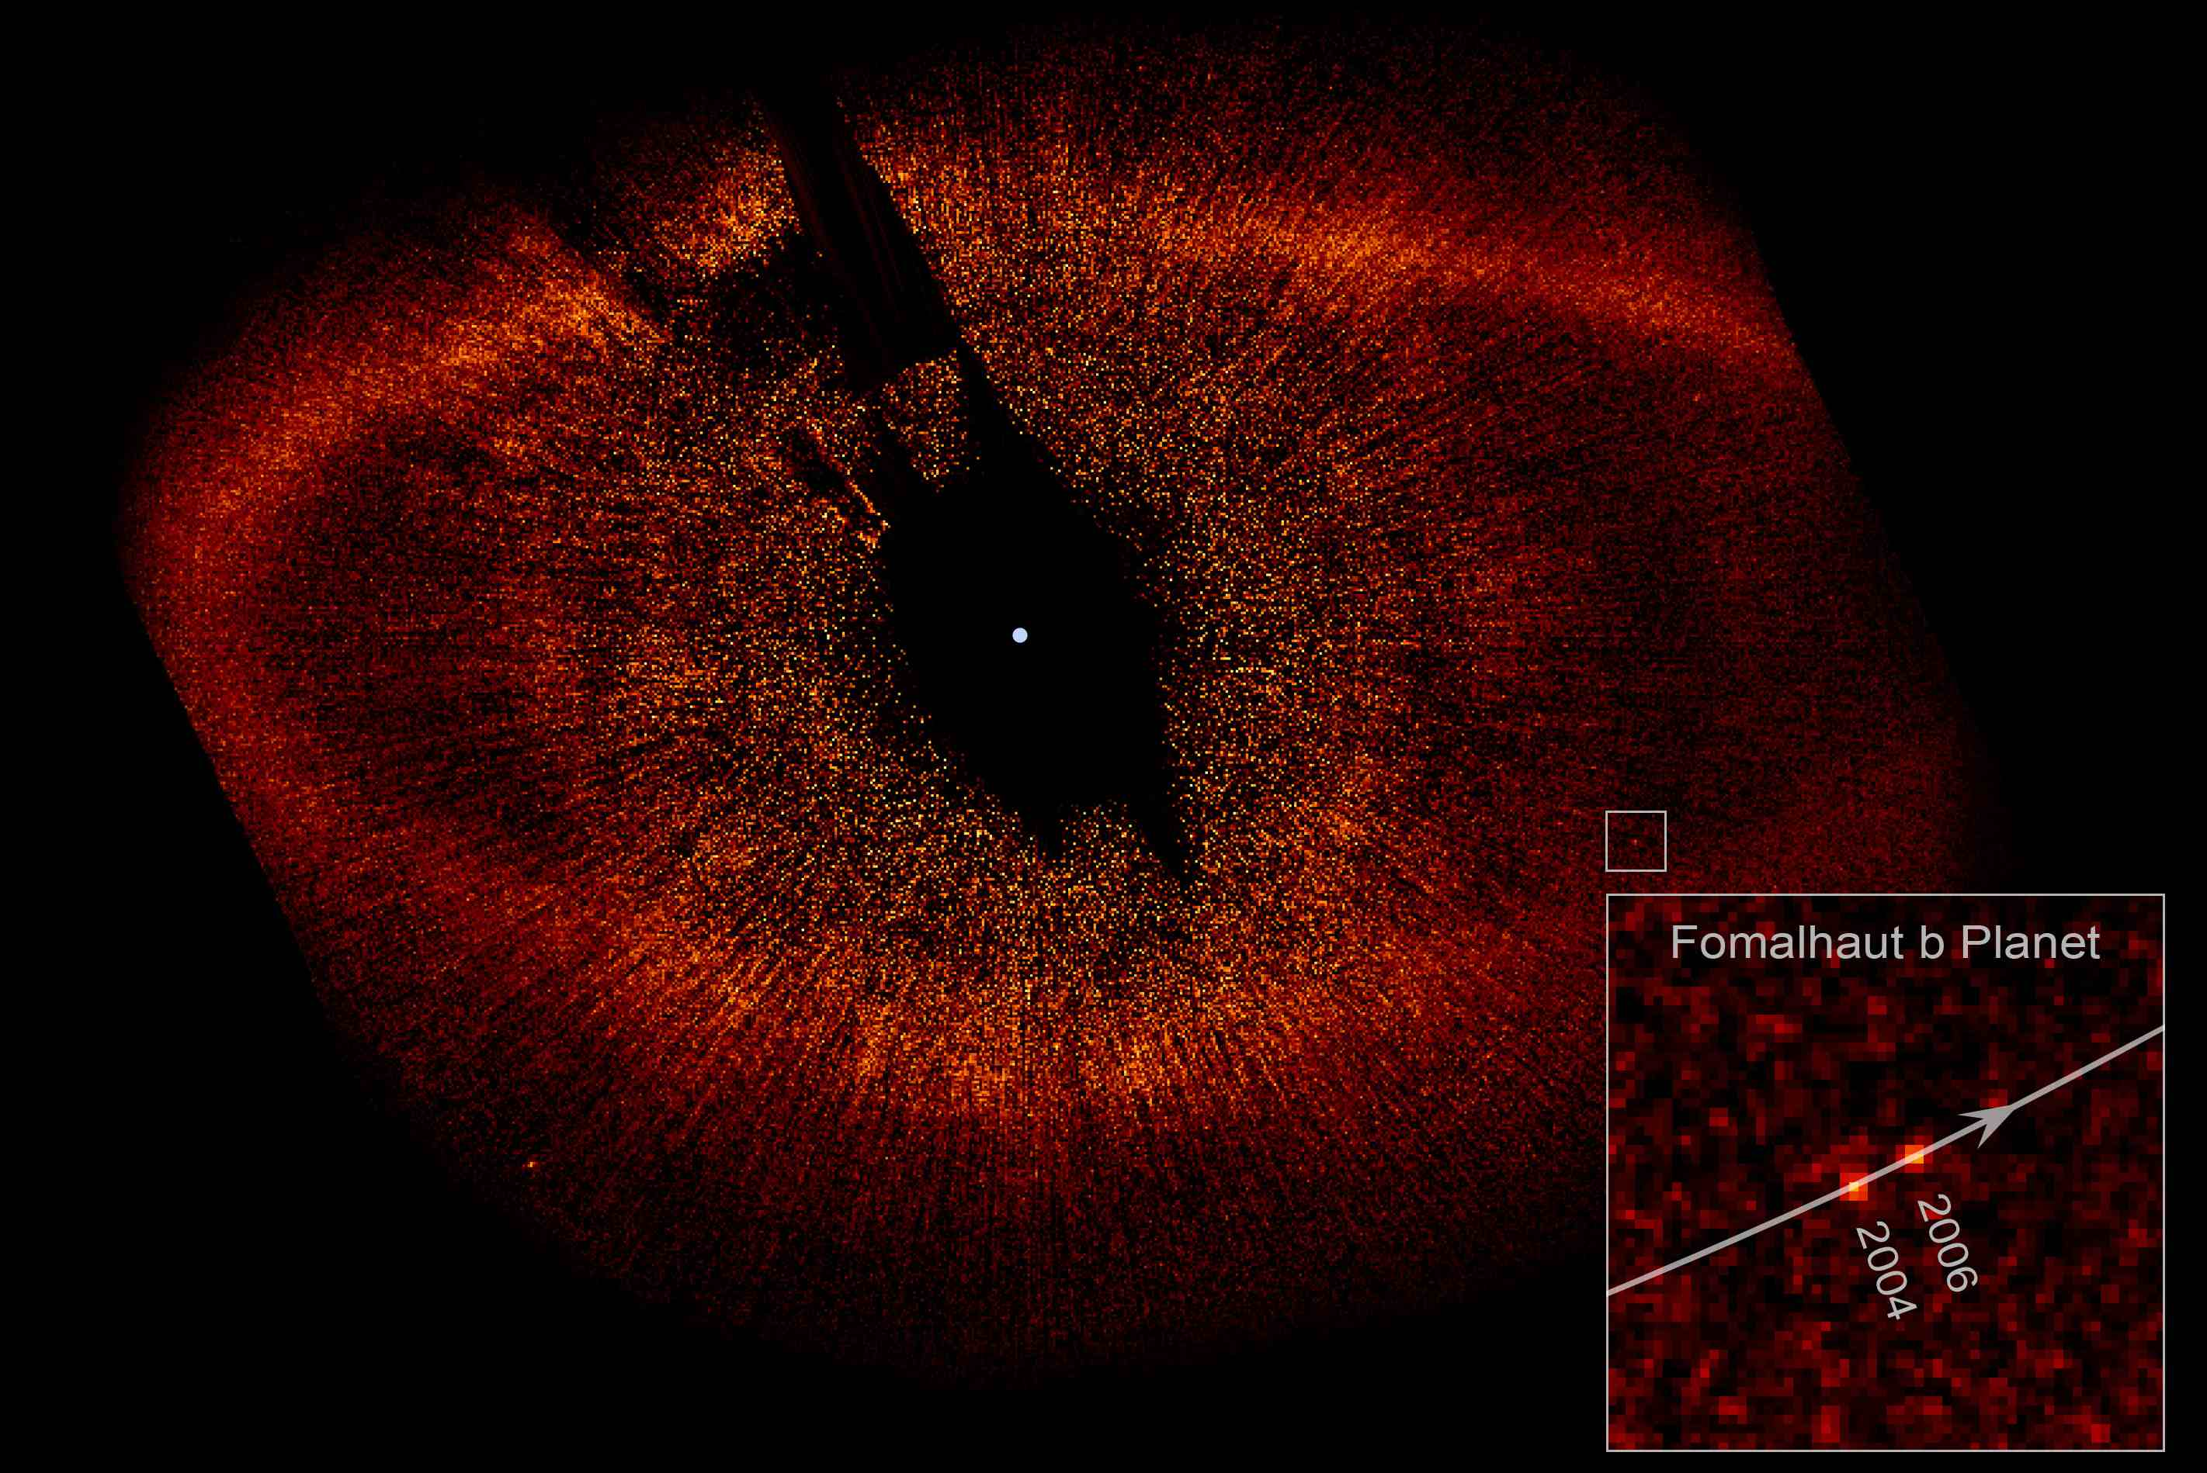
Thurso High School, Oct 2011

Slide 39
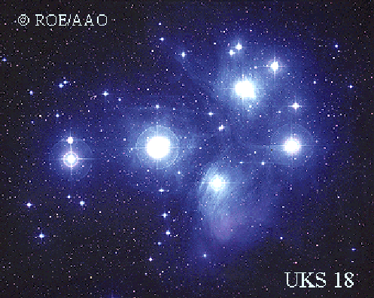
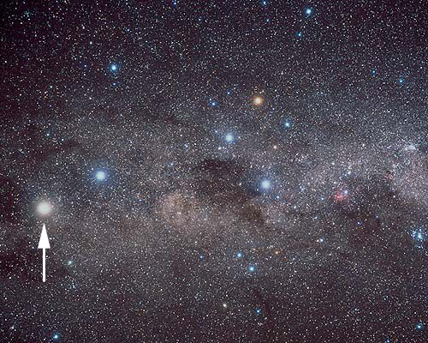
Thurso High School, Oct 2011

Slide 40
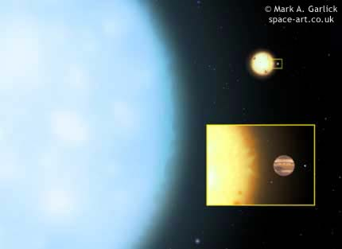
Thurso High School, Oct 2011

Slide 41
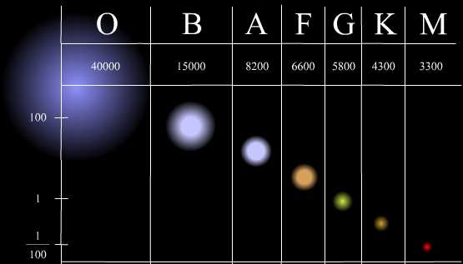
Spectral type (temperature)
Stellar mass
Thurso High School, Oct 2011

Slide 42
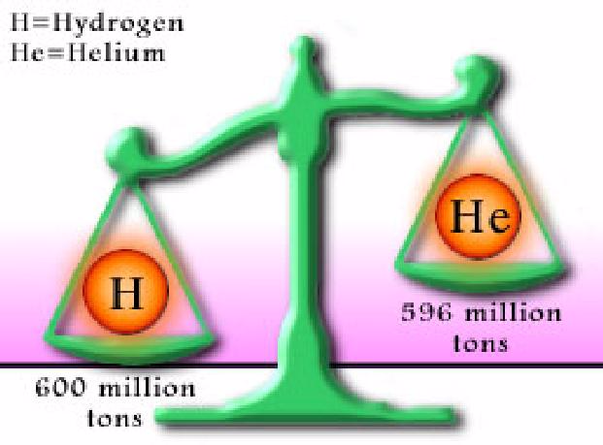
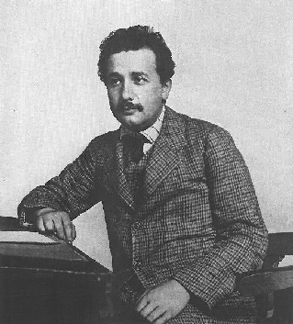
Hydrogen fusion – fuelling a star’s nuclear furnace
H = Hydrogen
He = Helium
E = mc
2
Speed of light
Thurso High School, Oct 2011

Slide 43
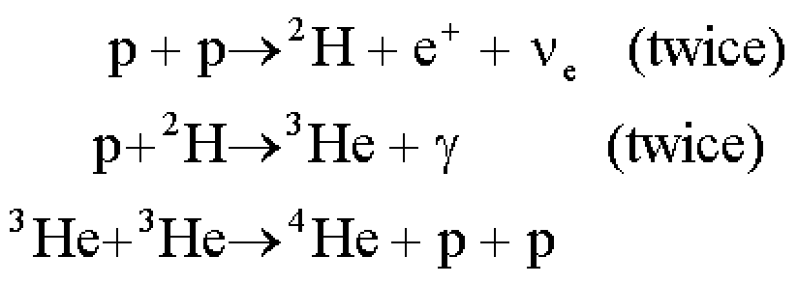
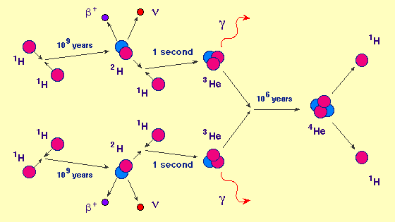
Thurso High School, Oct 2011

Slide 44
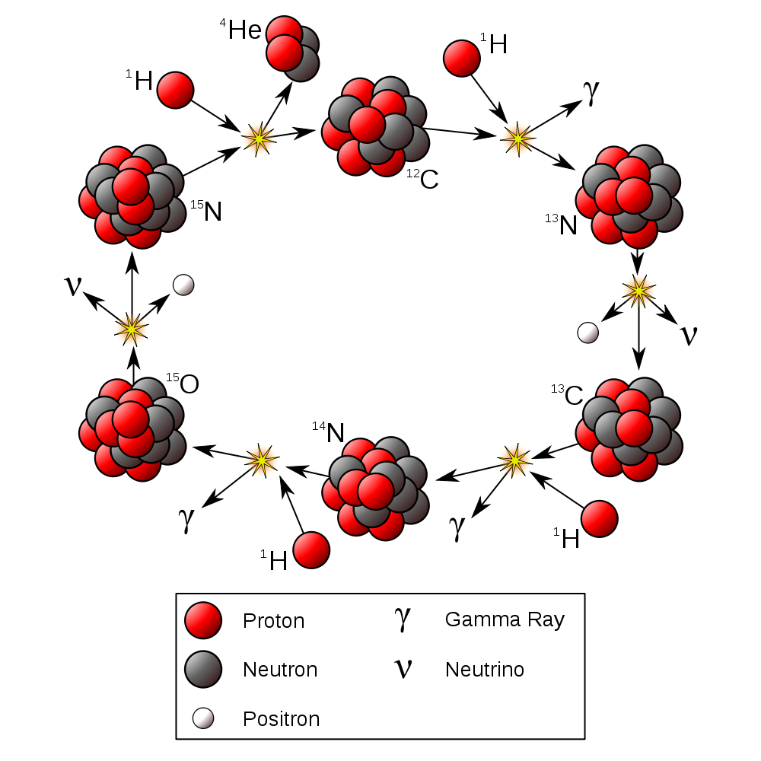
The CNO Cycle
Thurso High School, Oct 2011

Slide 45
The CNO Cycle
But how did the carbon, nitrogen and oxygen get there?...
Thurso High School, Oct 2011

Slide 46
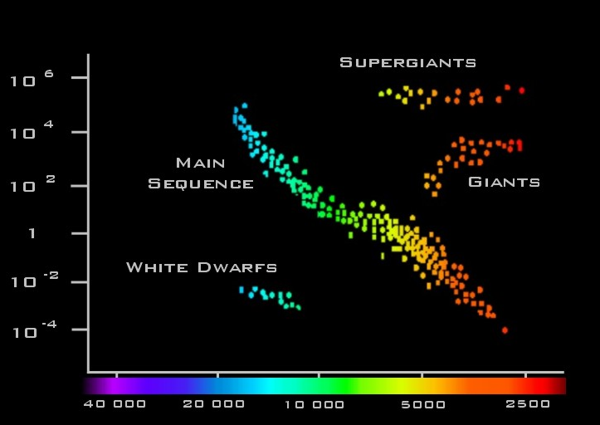
Luminosity
Spectral type (temperature)
Thurso High School, Oct 2011

Slide 47
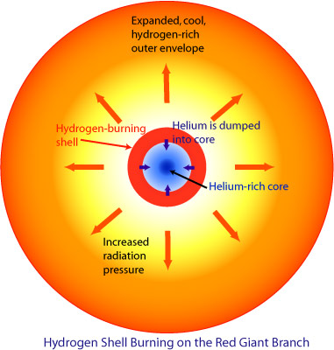
The “triple alpha” process
Thurso High School, Oct 2011

Slide 48
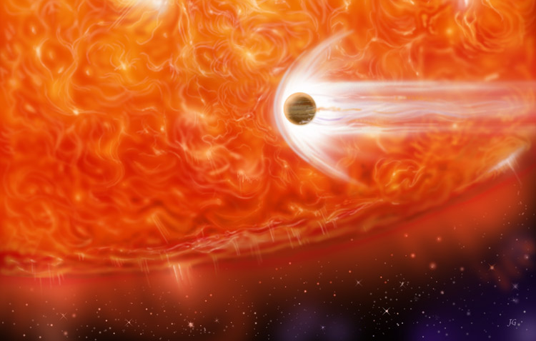
Thurso High School, Oct 2011

Slide 49
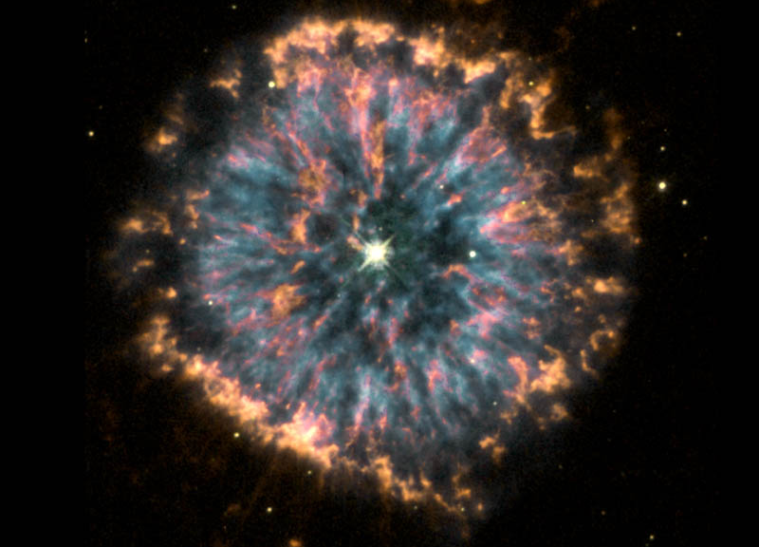
Thurso High School, Oct 2011

Slide 50
Inside a very massive star
conditions are hot and
dense enough to
fuse even heavier
elements,
all the way up
to Iron
Thurso High School, Oct 2011

Slide 51
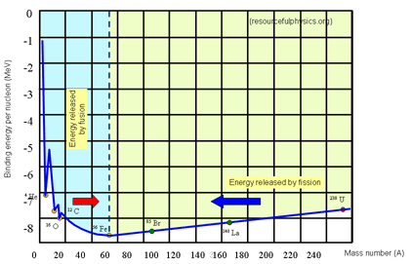
Thurso High School, Oct 2011

Slide 52
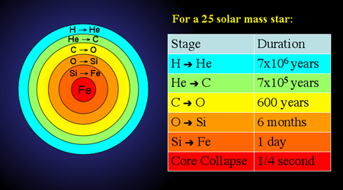
Thurso High School, Oct 2011

Slide 53
Thurso High School, Oct 2011

Slide 54
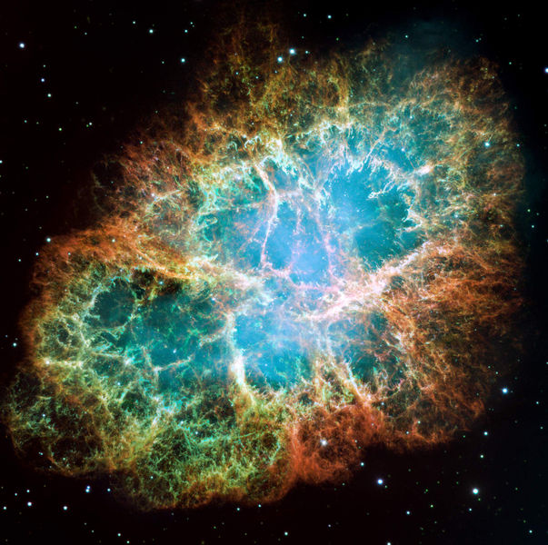
Thurso High School, Oct 2011

Slide 55
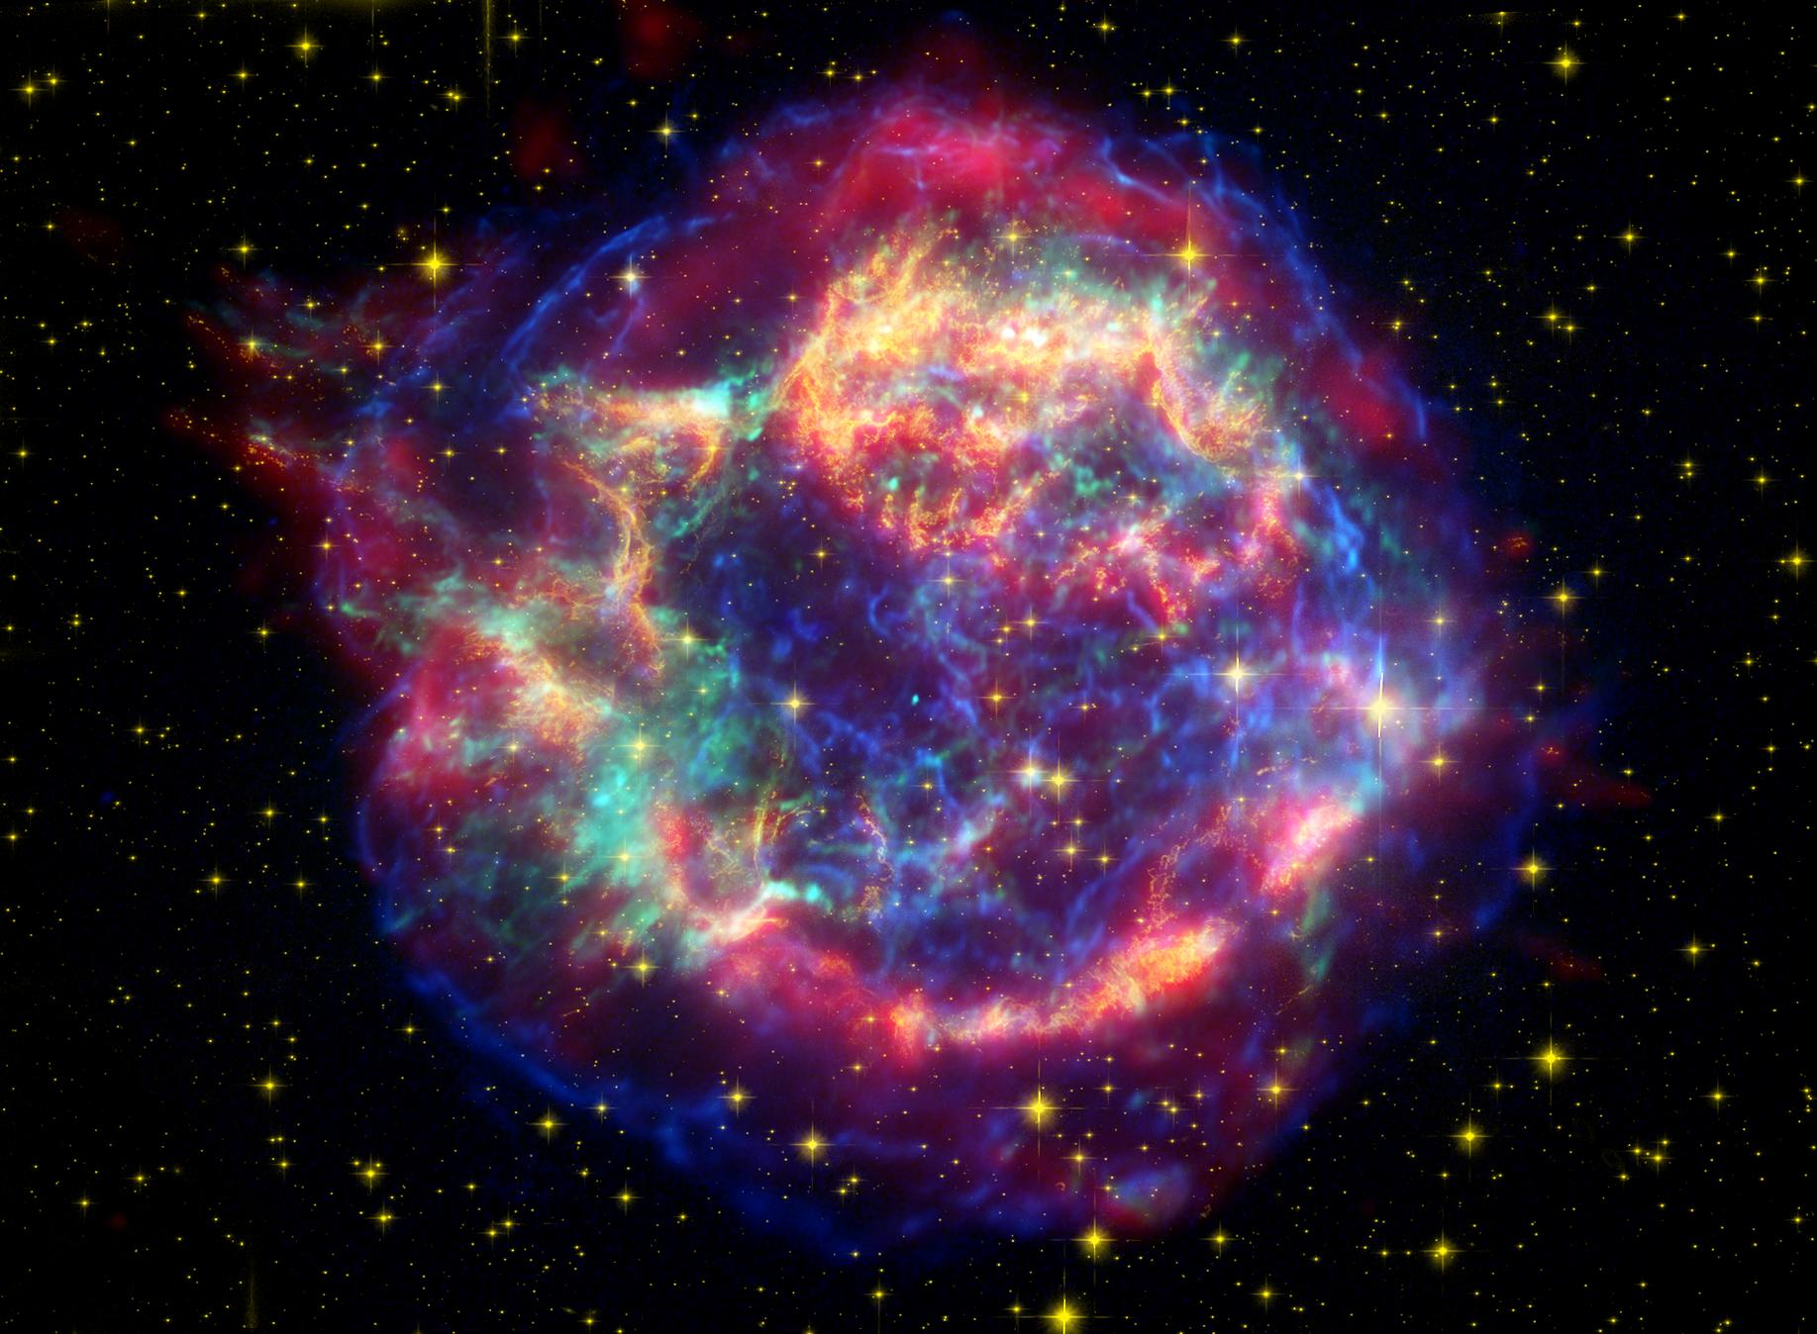
Thurso High School, Oct 2011

Slide 56
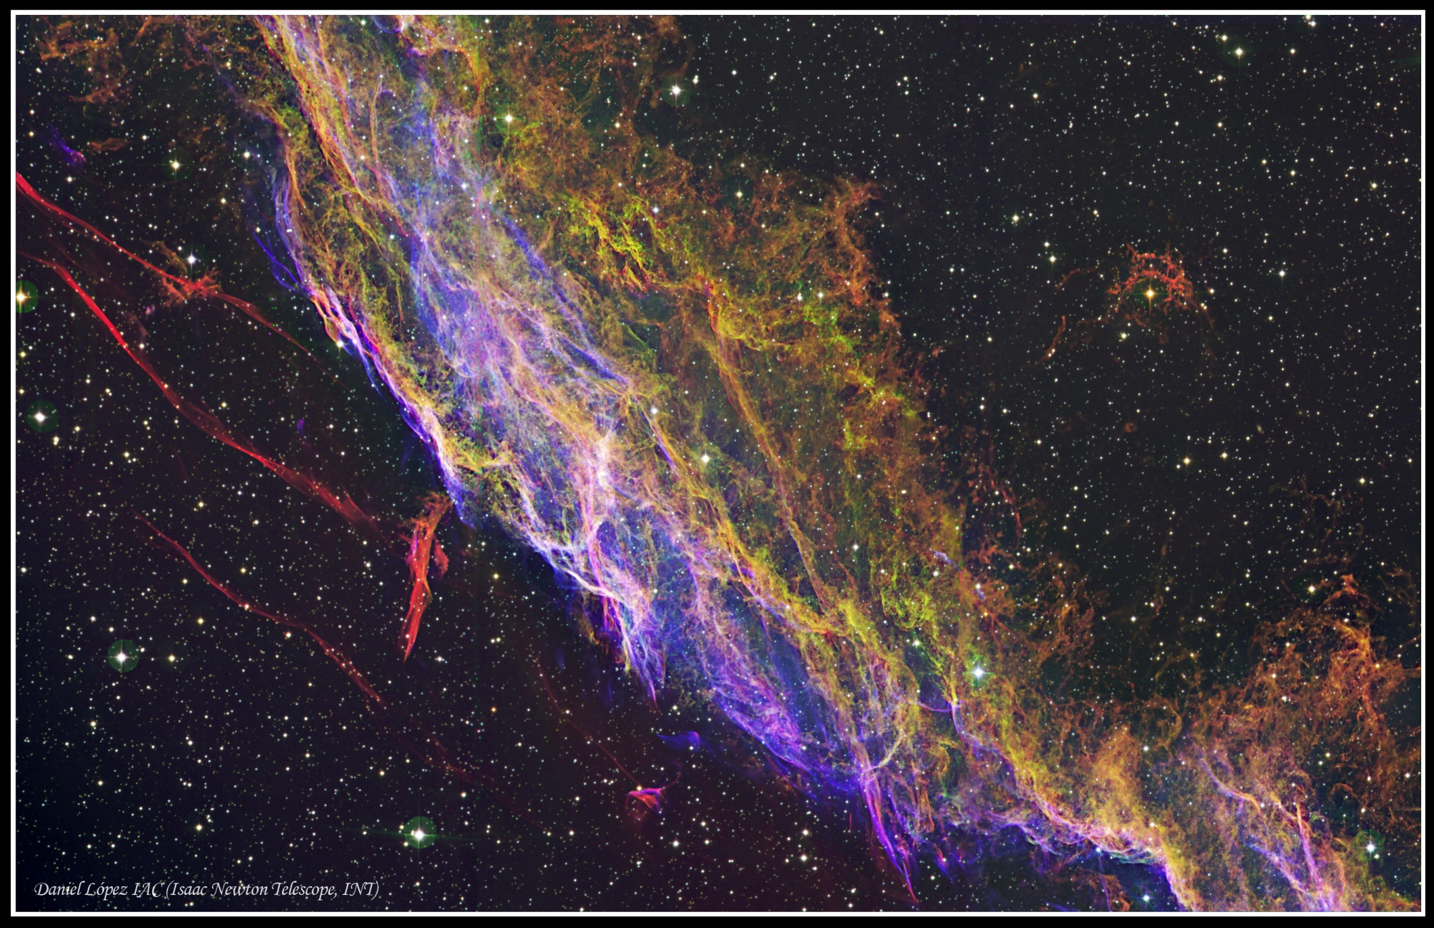
Thurso High School, Oct 2011

Slide 57
Thurso High School, Oct 2011

Slide 58
Thurso High School, Oct 2011

