Slide 1
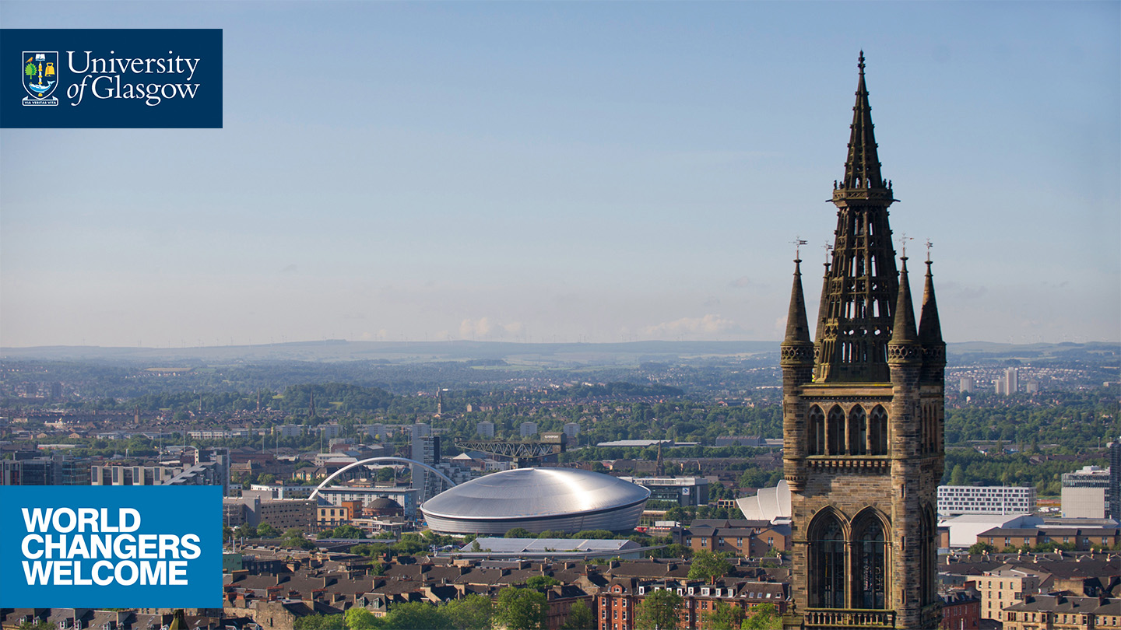
Open Day 2019
Physics and Astronomy
physics-ugadmissions@glasgow.ac.uk
astronomy-ugadmissions@glasgow.ac.uk
Student A - 3rd yr Undergraduate Theoretical Physics
Student B - Postgraduate Astrophysics

Slide 2
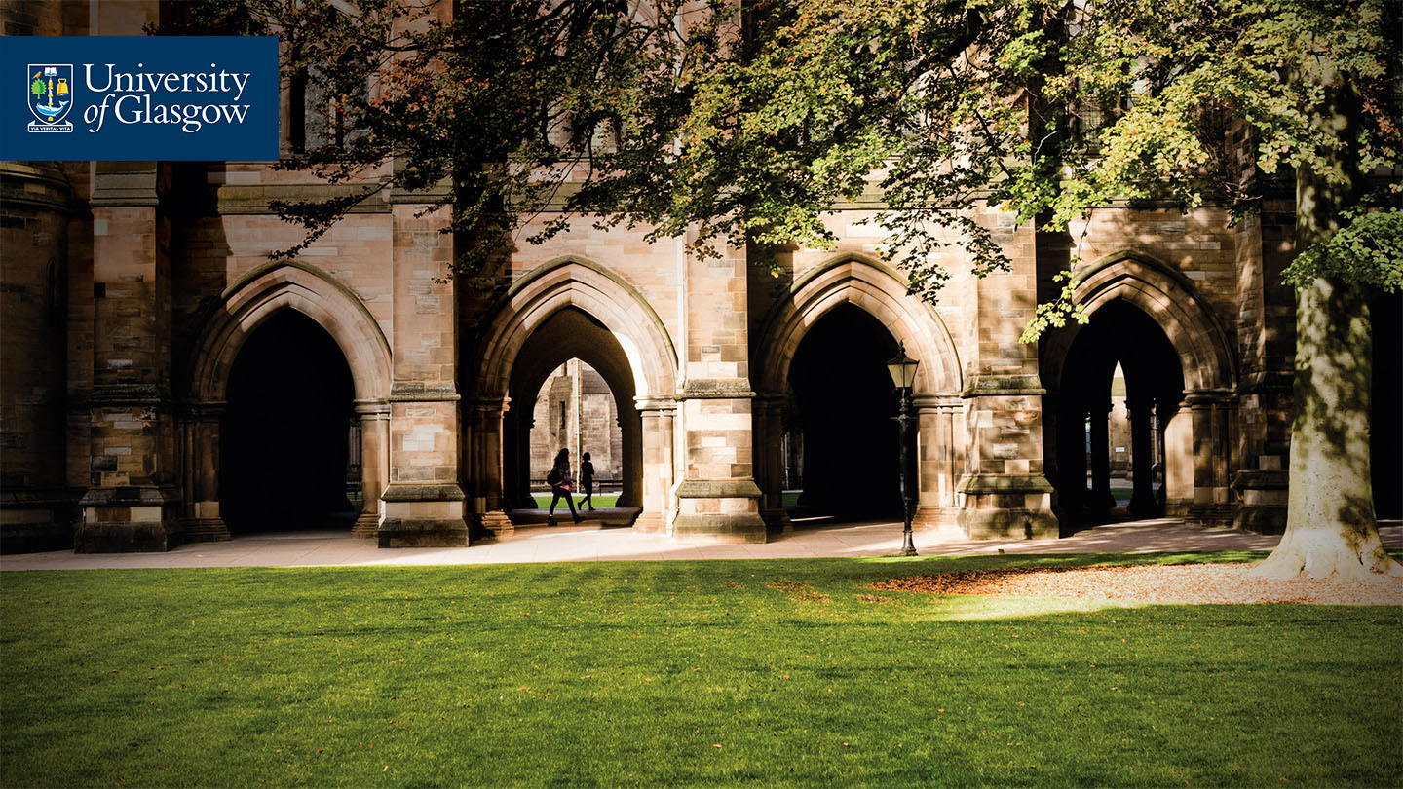
Why physics and astronomy at
Glasgow?
The study of physics and astronomy offers a fundamental understanding of the way the Universe works.
It brings you to the very forefront of technology, and Glasgow is at that forefront.
Some of the technologies you might be working on in the future do not yet exist.
It opens career paths in science, engineering, industry, finance, teaching, and many more sectors.
Notes:
Please provide introduction including headline USPs that distinguish the University of Glasgow from other universities and emphasise why students should pick UofG.

Slide 3
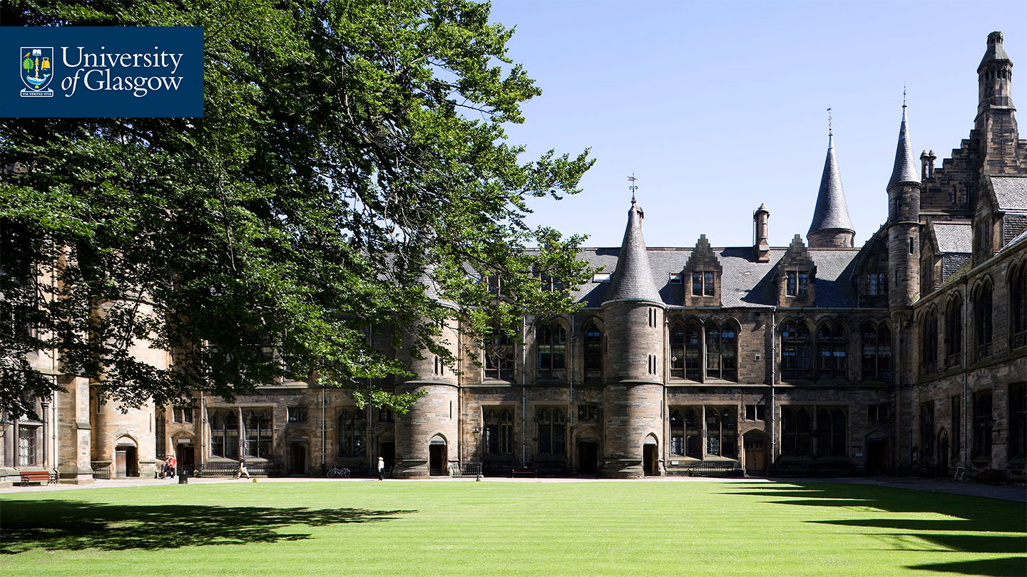
Why is Physics important?
>1,000,000 employee jobs in UK in sectors where the use of physics-based technologies or expertise is critical. This is equivalent to 4% of all jobs in the UK.
Gross value added (GVA) due to the physics-based sectors is about £77 billion, making up 8.5% of the economic output of the UK.
Productivity levels in physics-based sectors
in Scotland almost twice as high as the UK
average.

Slide 4
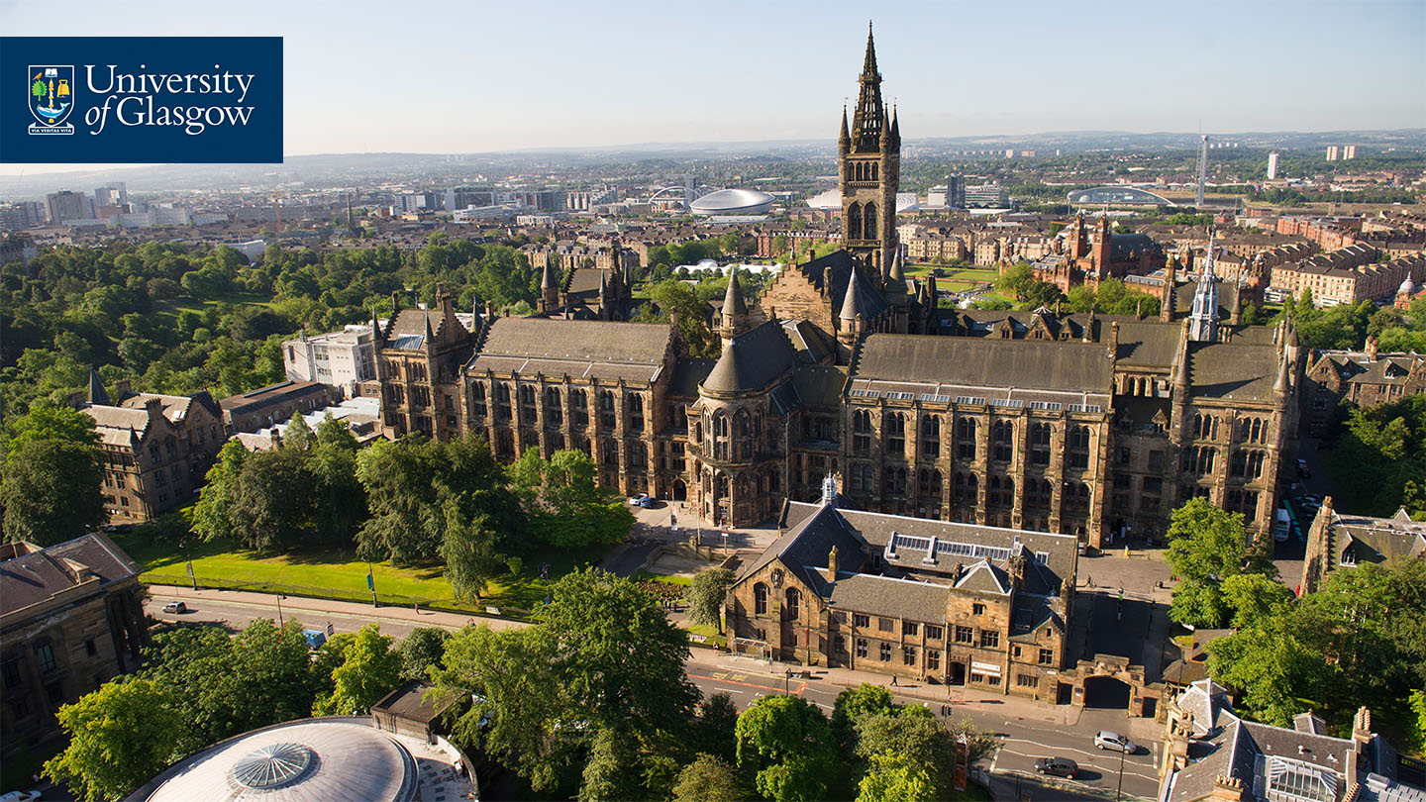
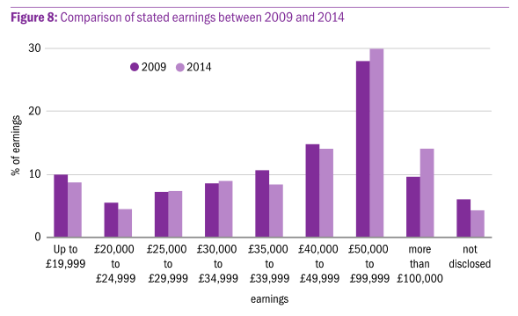
Why study physics?
Source: IoP, Physics in Scotland: the brightest minds go further, 2014

Slide 5
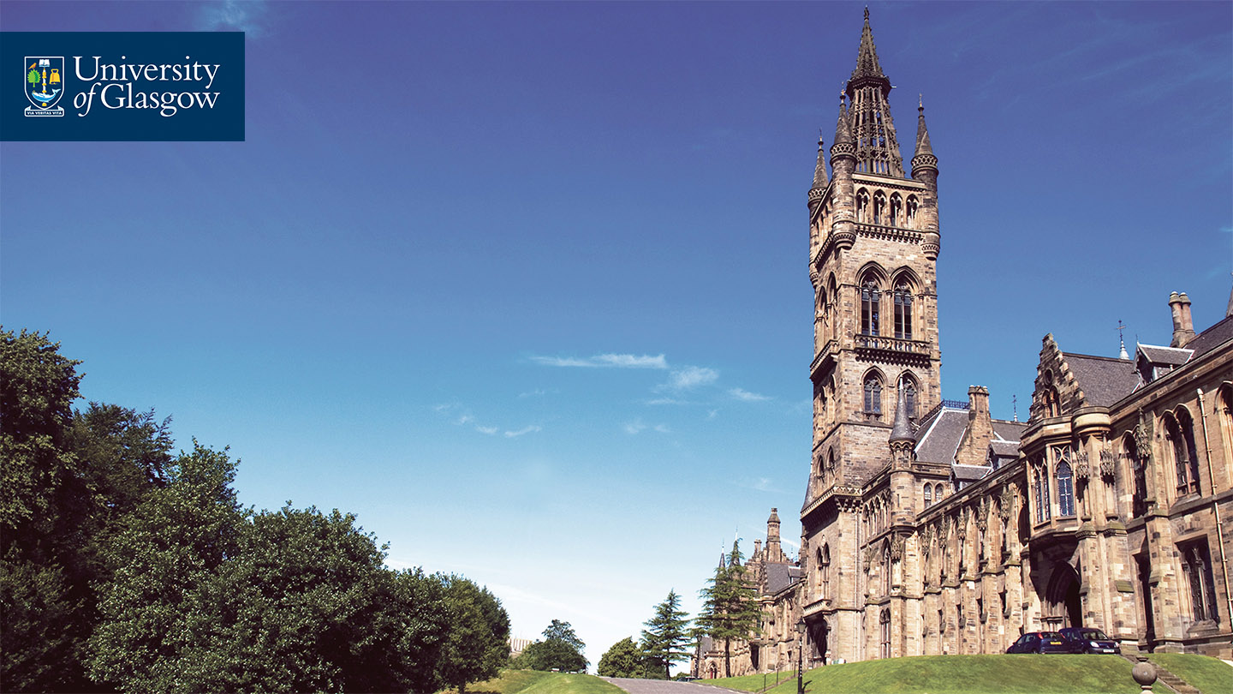
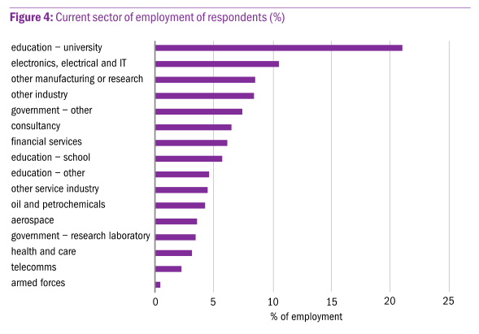
Why study physics?
Source: IoP, Physics in Scotland: the brightest minds go further, 2014

Slide 6
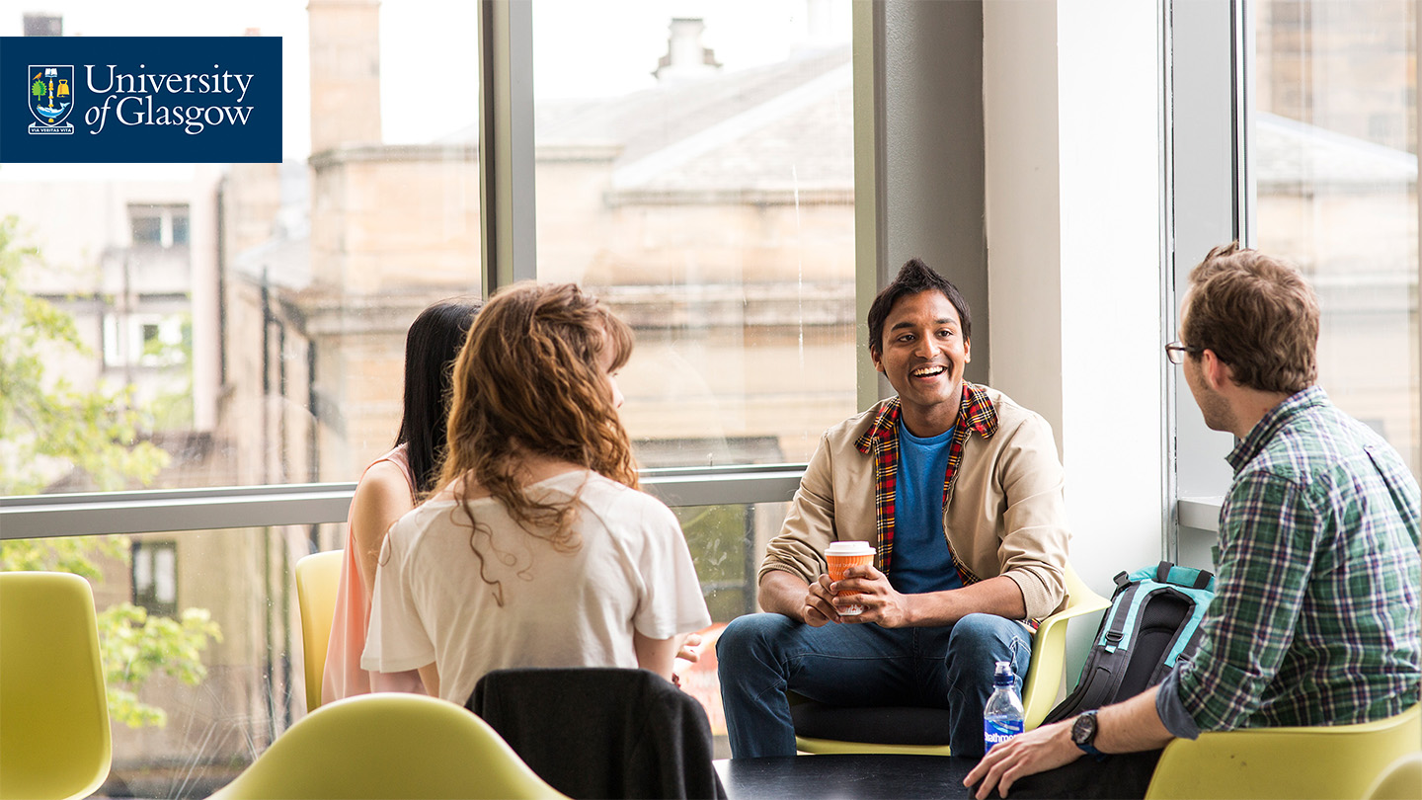
Why study physics?
Source: IoP, Physics in Scotland: the brightest minds go further, 2014

Slide 7
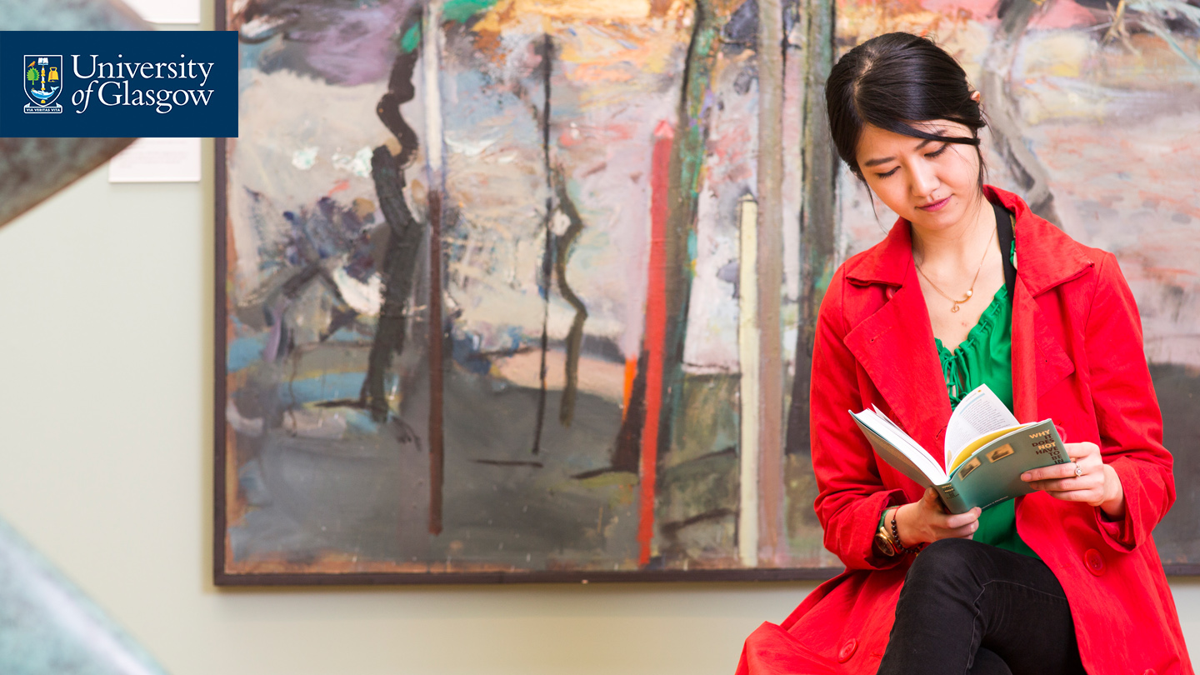
Learning & teaching
We teach our students to use physics and maths to investigate and explore the nature of the universe.
We strive to encourage an in-depth and integrated understanding of modern physics and astronomy.
We promote a wide range of transferable skills to prepare students for many possible careers.
At the heart of our learning and teaching strategy are the concepts of:
  Student-centered learning
  Graduate attributes
  Research-led teaching

Slide 8
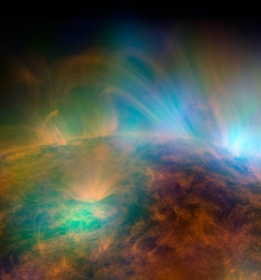


Research groups

Slide 9
Research groups
Astronomy and Astrophysics

Slide 10
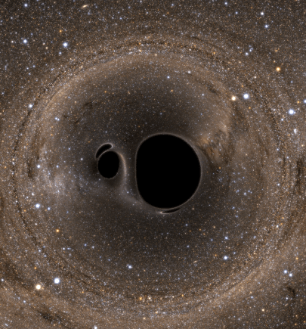
Research groups
Astronomy and Astrophysics
Institute for Gravitational Research

Slide 11
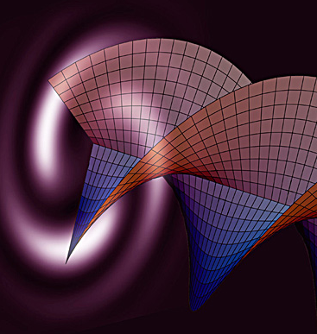
Research groups
Astronomy and Astrophysics
Institute for Gravitational Research
Optics:
  Imaging concepts
  Optics
  Quantum information

Slide 12
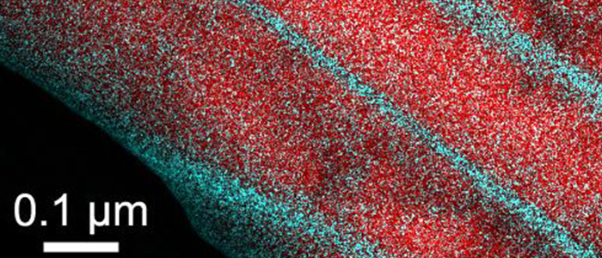
Research groups
Astronomy and Astrophysics
Institute for Gravitational Research
Optics:
  Imaging concepts
  Optics
  Quantum information
Materials and Condensed Matter Physics

Slide 13
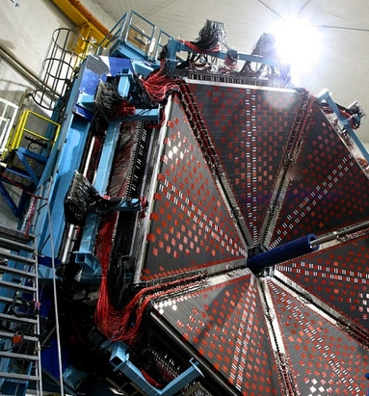
Research groups
Astronomy and Astrophysics
Institute for Gravitational Research
Optics:
  Imaging concepts
  Optics
  Quantum information
Materials and Condensed Matter Physics
Nuclear Physics

Slide 14
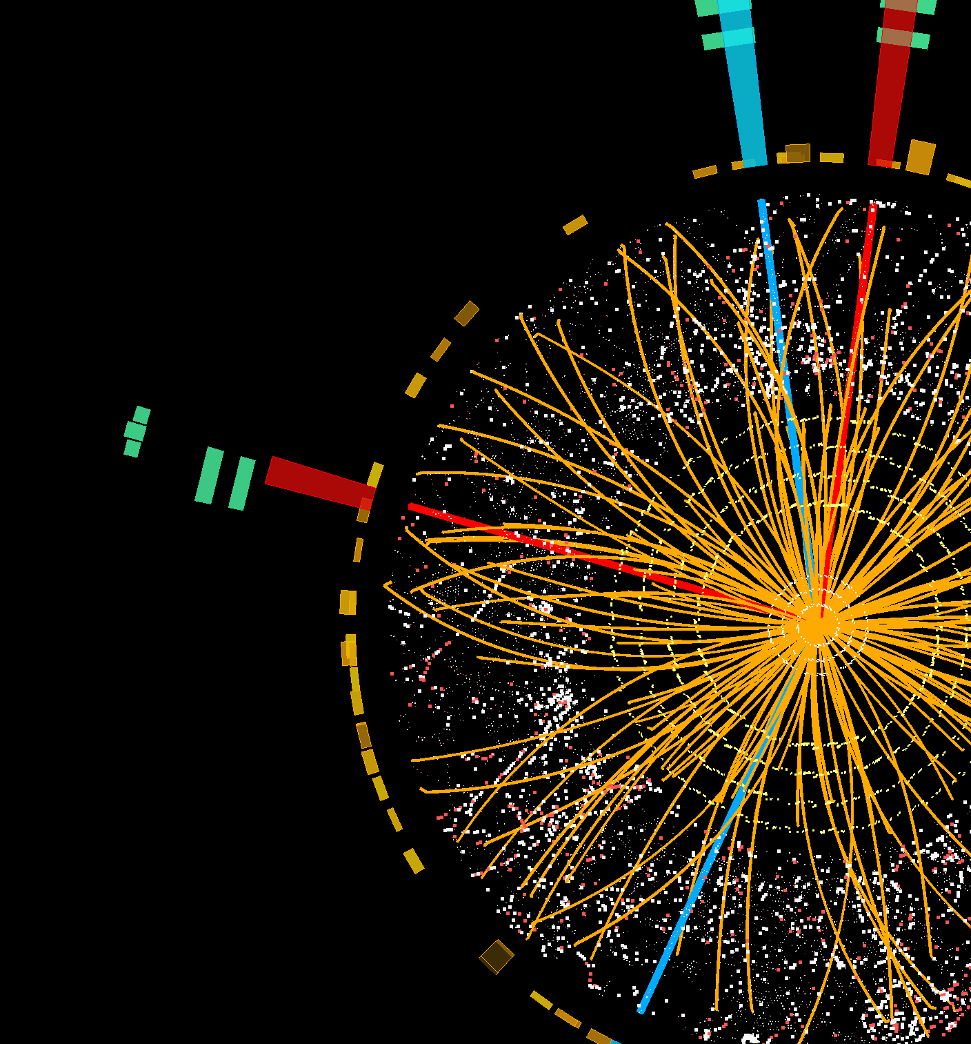
Research groups
Astronomy and Astrophysics
Institute for Gravitational Research
Optics:
  Imaging concepts
  Optics
  Quantum information
Materials and Condensed Matter Physics
Nuclear Physics
Particle Physics
  Experimental
  Theoretical

Slide 15
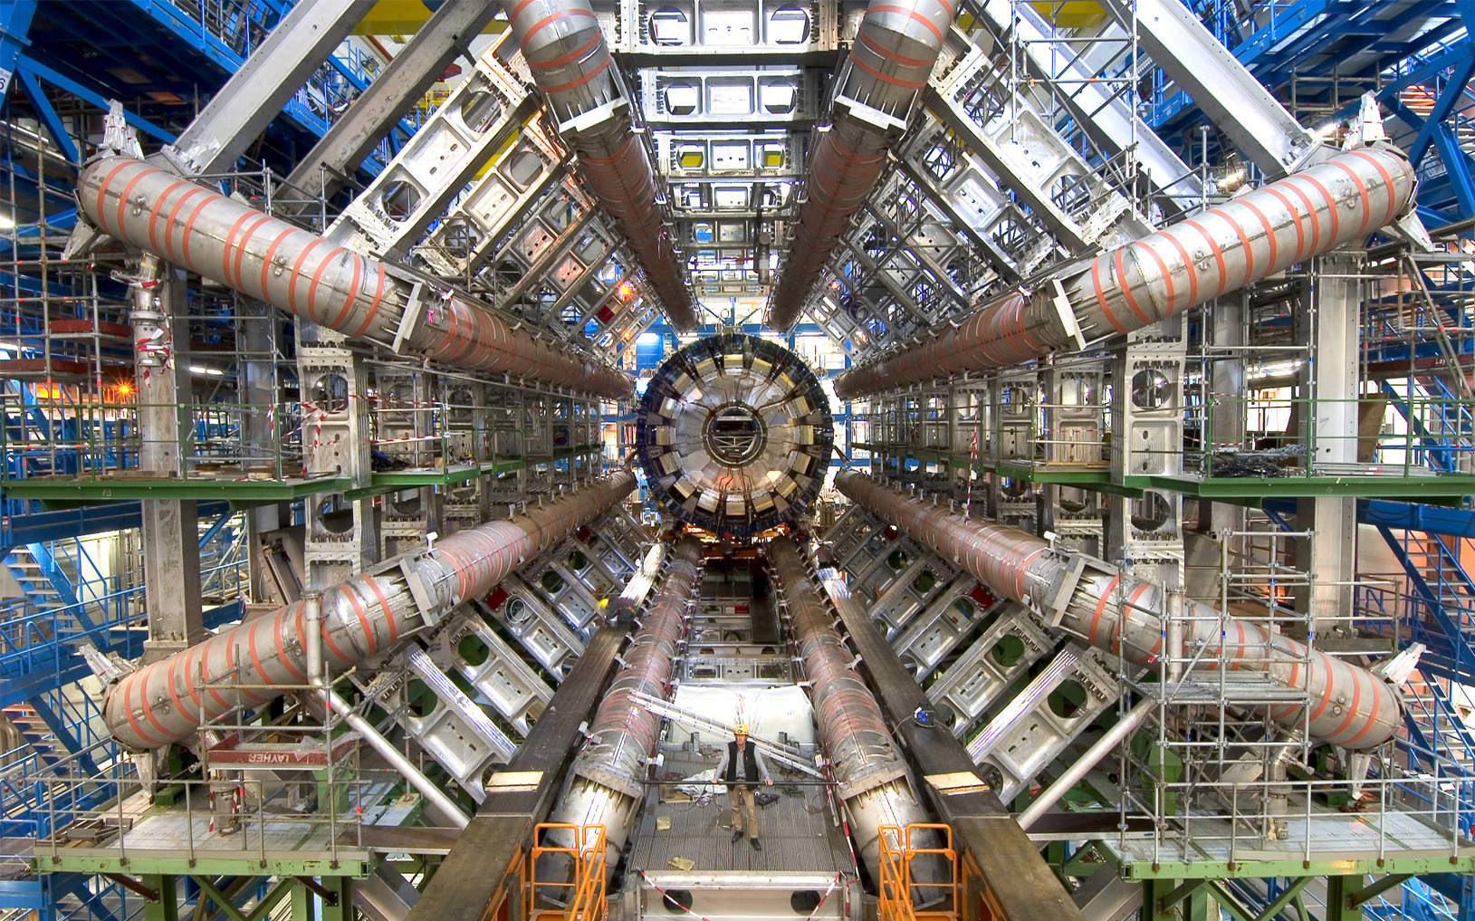
Research Highlights
Discovery of the Higgs Boson
In 2012, teams of scientists at the LHC in CERN announced the discovery of the Higgs Boson – the final piece of the Standard Model of Particle Physics. The Glasgow group has played a leading role in the ATLAS programme for over twenty years.

Slide 16
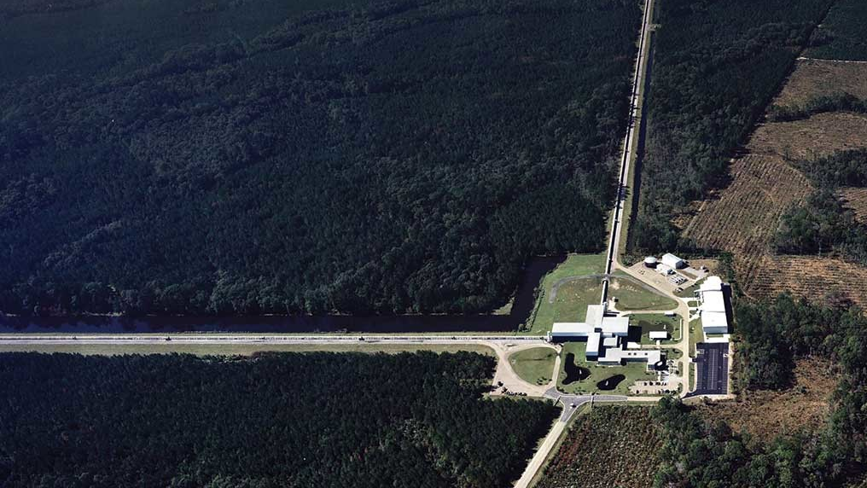
Research Highlights
The detection of gravitational waves
After more than thirty years leading international research, the Glasgow team was at the heart of the revolutionary 2016 discovery of gravitational waves. Ultra-sensitive detectors in the US observed two black holes colliding 1.8 billion years ago. The energy released in the collision was more than the energy from all the stars in the universe.

Slide 17

Degree Programmes
The Glasgow ethos is to allow students to keep their options flexible for as long as possible.
The choice of degree subjects can be made at the end of 2nd year.
The choice of whether to study for a BSc (4 years) or MSci (5 years) degree can be made in the middle of 3rd year.
All BSc and MSci degrees offered in Physics and Astronomy are accredited by the Institute of Physics.
Several specialised Postgraduate Taught Masters programmes have recently been introduced.

Slide 18
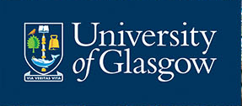
Degree Subjects

Slide 19
Physics 1
The class meets daily, with lectures at 9am or at 1pm.
There are weekly tutorials, and weekly laboratory workshops.
Topics studied include:
  optics, waves and lasers
  dynamics and relativity
  quantum phenomena
  electricity and magnetism

Slide 20
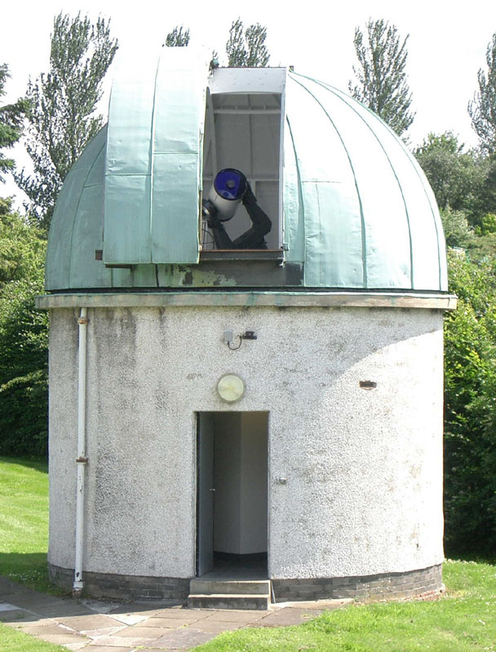
Astronomy 1
The class meets daily at 10am.
There are fortnightly tutorials and practical sessions at the observatory.
Topics include stellar physics, positional astronomy, cosmology and astronomical observations.

Slide 21
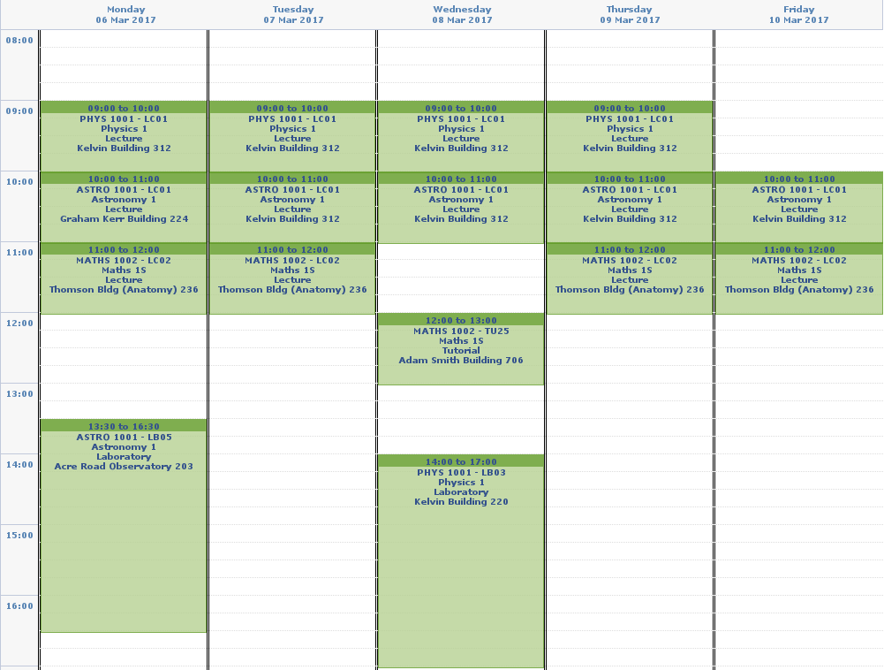
Physics 1 Example Timetable
Mon
Tue
Wed
Thu
Fri
8
9
10
11
12
13
14
15
16

Slide 22
Physics 3 Group Project
Students gain laboratory and computational research skills, experience in team work, presentations and report writing.
The range of projects include:
  X-ray radiography
  Biophysical thermography
  Compton camera
  Holography
  Temperature stabilization
  Java programming

Slide 23
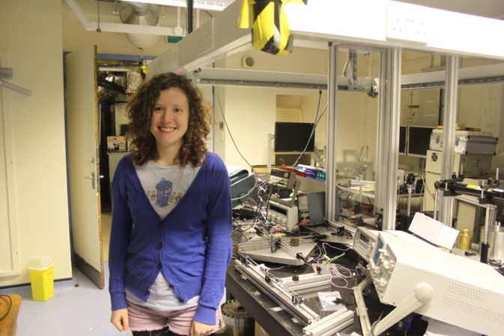
Final year project
Students spend a significant portion of their final year working on an independent research project.
Embedded in one of our 9 research groups, students can make a lasting contribution to world leading research.
Examples from recent years include:
  Top quark physics
  Blood flow imaging
  Quantum encryption techniques
  Advanced Sagnac interferometers

Slide 24
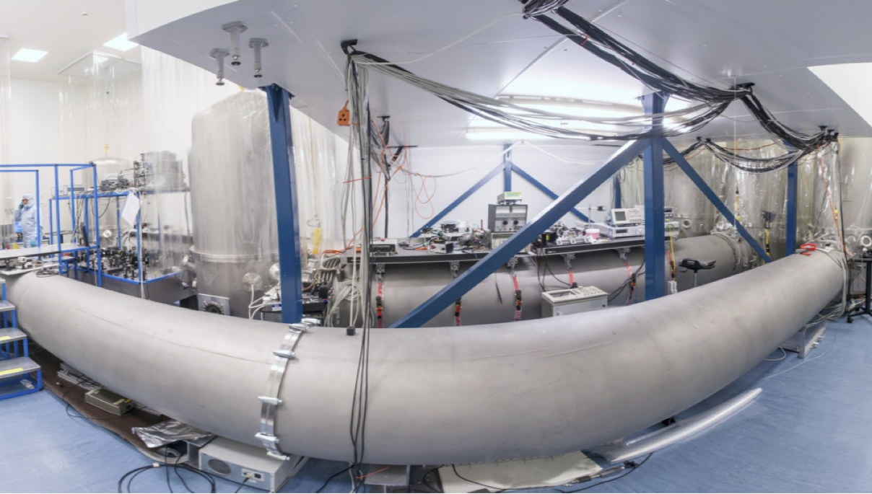
Summer Internships
The first experience in the research environment for many of our students is during a summer internship within the school.
These are usually six-week long paid placements, during which students can further improve their research and interpersonal skills.
The research covered during these internships covers the full range of our research groups: from applied to fundamental research; from the smallest to the largest distance scales.

Slide 25
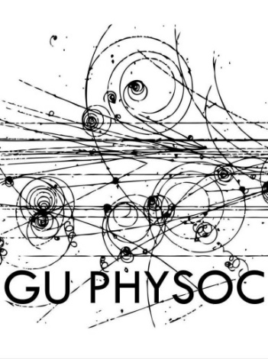

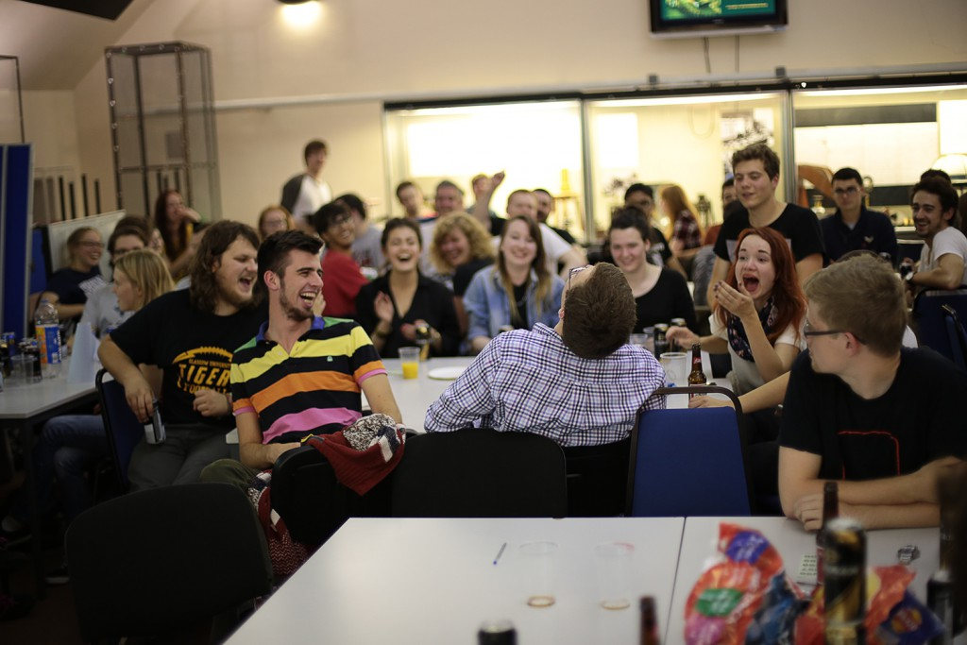
Student Societies
There are two student societies which organise a programme of guest lectures and social events for students and staff.
Physoc has an annual ceilidh.
Astrosoc has an annual Burns’ supper.
Other events include beer & doughnuts, film screenings, laser tag and observing nights…

Slide 26

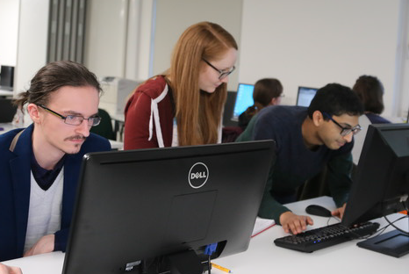
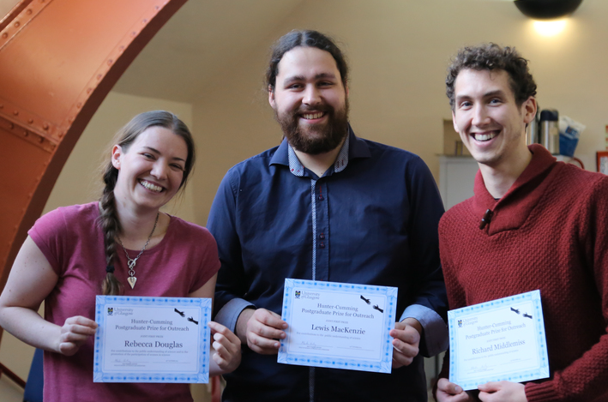
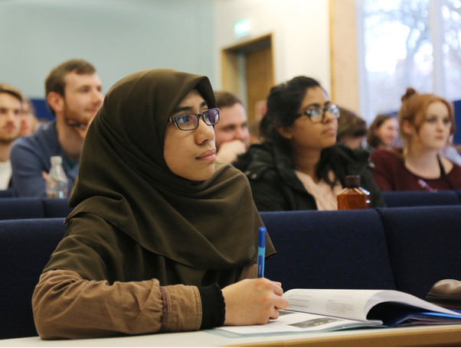


Equality & Diversity in GU P&A
We are committed to ensuring all members of the School are welcomed, and can flourish and succeed
We have two equality and diversity officers, to whom students can speak in confidence
Our Athena SWAN Silver, and Institute of Physics Juno Champion awards recognise our work in gender equality
We were the first physics department in Scotland to win these!

Slide 27


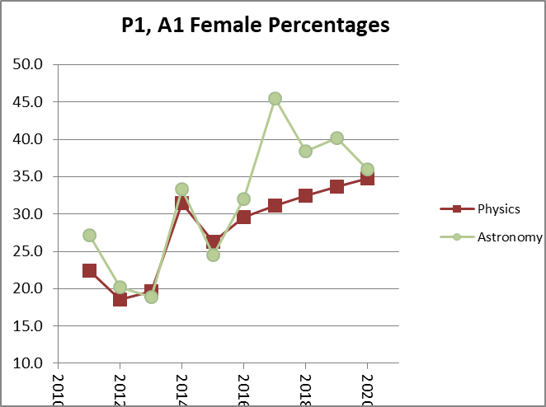
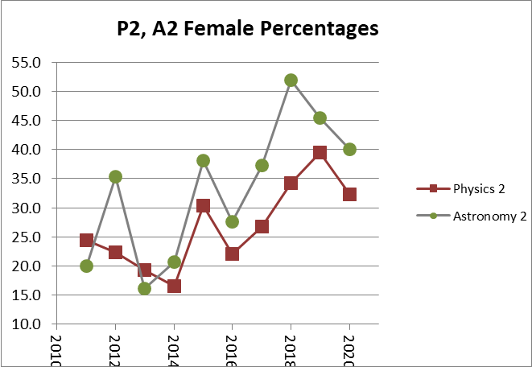
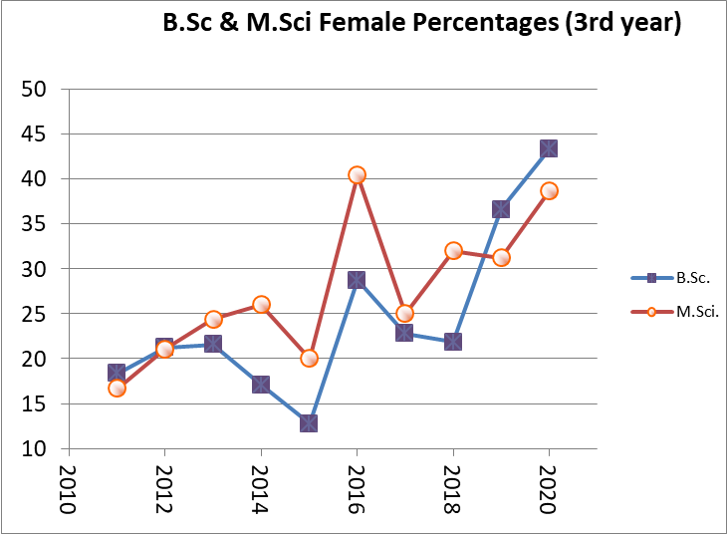
Gender Equality in GU P&A
Over 30% of our undergraduate students at all levels are female, consistently above the national average of 24%.
Our staff-student led Glasgow Women in Physics group hosts regular events.
In 2022 we will host the Conference for Undergraduate Women in Physics!

Slide 28
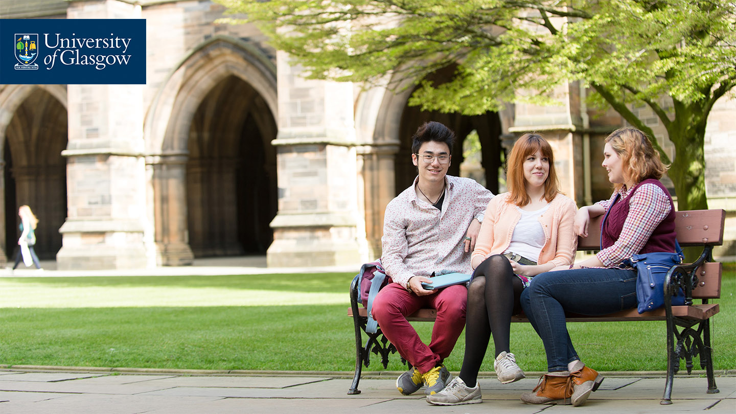
Why Physics and Astronomy?
Our flexible degree programmes promote:
  A logical and numerate mind;
  The ability to solve problems;
  Communication skills, developed through report-writing and presentations;
  Cutting-edge computational and experimental skills;
  Teamwork, planning, initiative and flexibility (essential for lab work and projects).

Slide 29
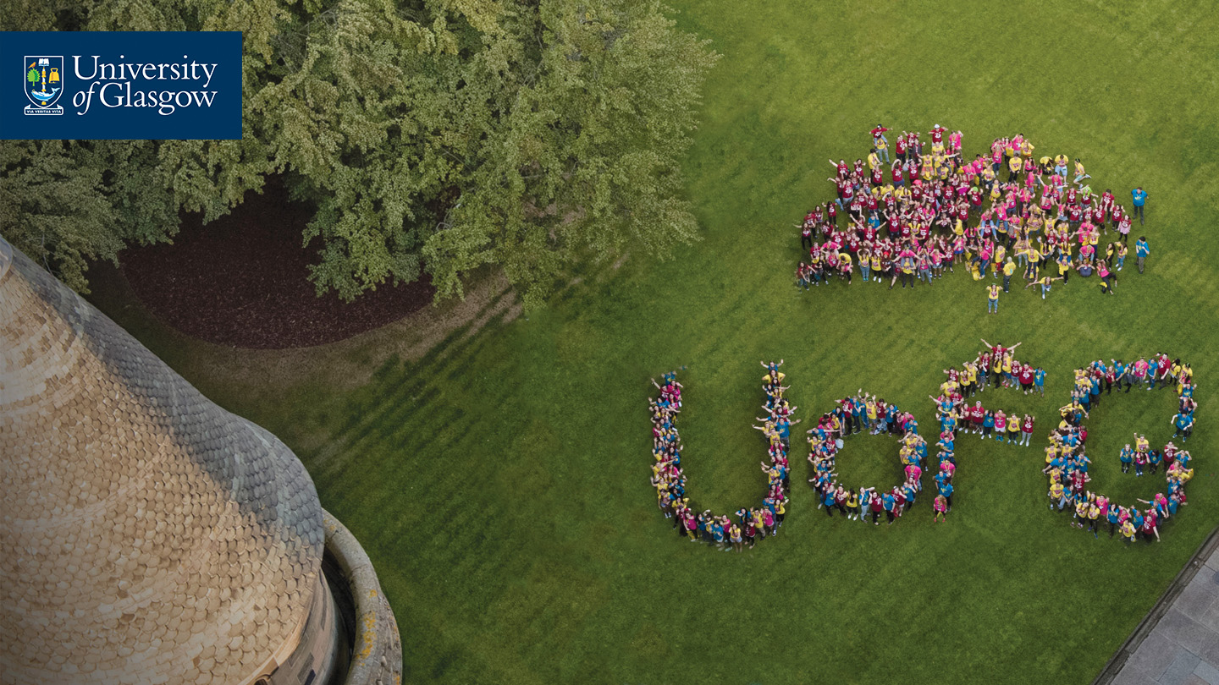
Why Glasgow?
An attractive campus in a cosmopolitan city
Student-centered learning
Excellent teaching
One-to-one student support
A research-led department
Student research opportunities

Slide 30
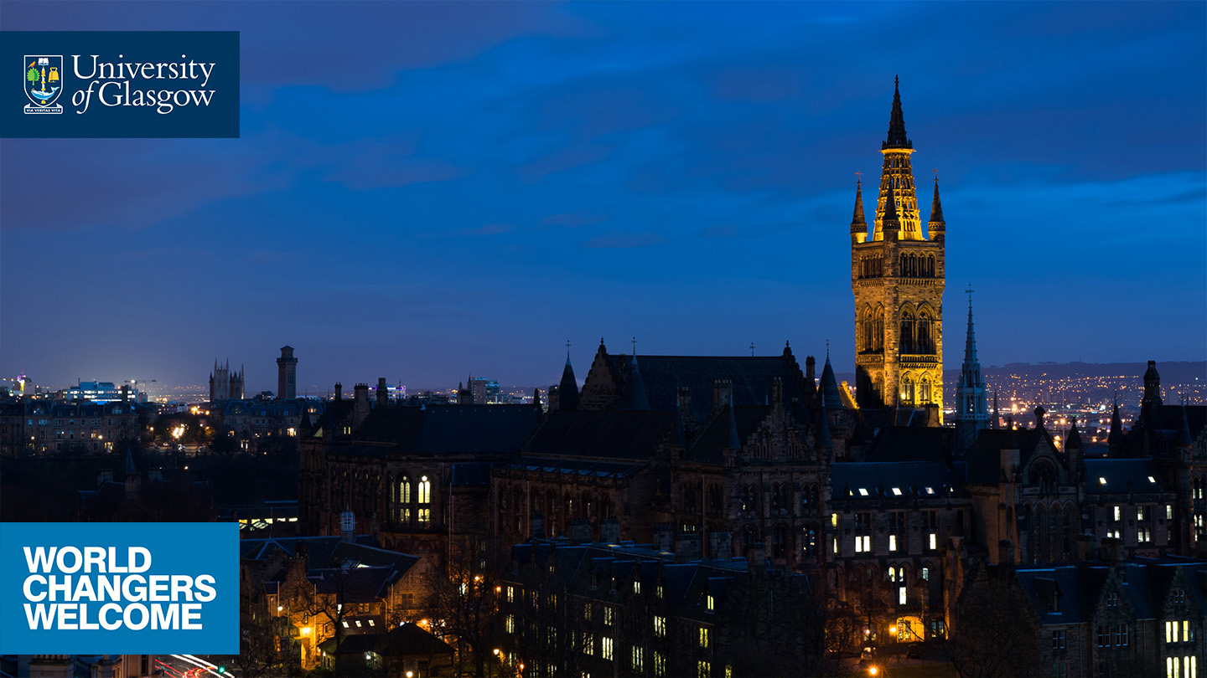









Thank you!
physics-ugadmissions@glasgow.ac.uk
astronomy-ugadmissions@glasgow.ac.uk
/glasgowuniversity
@UofGlasgow
Search: University of Glasgow
@UofGlasgow
UofGlasgow
#UofGWorldChangers

Slide 31
Extra slides

Slide 32
Exploring the Cosmos 1
A popular non-mathematical astronomy course, which can be taken by any student.
EXCOS1 (or Astronomy 1) is required for the Physics with Astrophysics degree.

