Slide 1
Applications of Machine Learning in Gravitational Wave Data analysis
Chris Messenger - University of Glasgow

Slide 2
Outline
Radford, Metz, Chintala, arXiv:1511.06434 (2015)
Introduction to the ML
  Detector characterisation
  CW searches
  Burst searches
Basic neural networks
CBC searches
Bayesian parameter estimation
Conclusions
https://github.com/WojciechMormul/vae

Slide 3
What is Machine Learning?
data
Good question Chris!
Is it just a useful black box? NO!
It is a complex system composed of many simple operations that is initially “stupid”. Through the sensible choice of incentive the system can be trained to do certain tasks.
It is often referred to as a universal function approximator.
disclaimer: This presentation is heavily biased towards activities at Glasgow (sorry)
answer

Slide 4
Why use Machine Learning?
Speed
  Front loading the cost - leads to rapid realtime analysis
  Simply saves CPU cycles and therefore cold hard cash
  Allows us to keep up with the detections
It’s just better (maybe)
  Existing techniques are (near) optimal when you know your model (signal and noise)
  ML has the potential to learn what we have approximated or incorrectly assumed.
  If faster then computationally limited searches - can be made more sensitive

Slide 5
Detector Characterisation
The fly in the ointment

Slide 6
Detector characterisation machine learning
Existing challenges and signal characteristics
  Unknown signal space with narrow and broad band signals
  Amplitudes could range from weak to very loud
  Crucial information is likely contained in auxiliary channels
The latest ML literature
  M. Zevin et al, “Gravity Spy: integrating advanced LIGO detector characterization, machine learning, and citizen science”, CQG Volume 34, Issue 6, article id. 064003 (2017)
  R. E. Colgan et al, “Efficient Gravitational-wave Glitch Identification from Environmental Data Through Machine Learning”, arXiv:1911.11831
  M. Razzanno & E. Cuoco, “Image-based deep learning for classification of noise transients in gravitational wave detectors”, CQG Volume 35, Issue 9, article id. 095016 (2018)

Slide 7
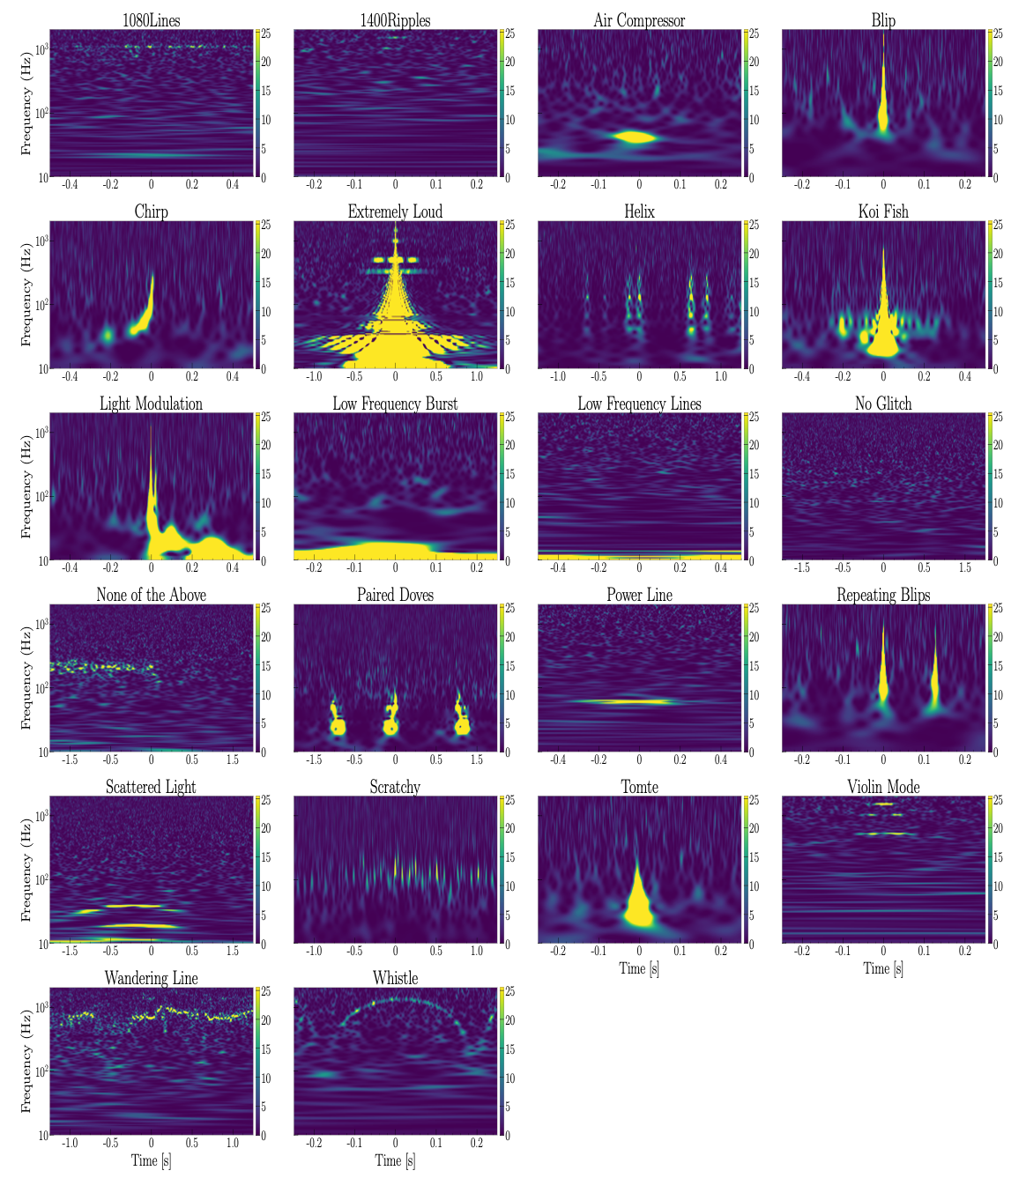
Gravity Spy
https://www.zooniverse.org/projects/zooniverse/gravity-spy
https://www.zooniverse.org/projects/zooniverse/gravity-spy
An elegant (if not complicated) mixture of human and machine learning.
The basic idea is to use humans to generate labelled training data.
Then use a CNN applied to the spectrogram (Omega scan) data to perform classification.
Information is fed back to better inform the human labellers.
S. Coughlin, Thesis (2019)

Slide 8
Continuous waves
Weak but always there

Slide 9
Continuous wave machine learning
Existing challenges and signal characteristics
  Vast parameter space - narrow band - but still large datasets (1year X 1kHz =~10 GB)
  Likely very weak signals - orders of magnitude below the noise
  Leading to traditional searches optimised at fixed computational cost - Generally slow - with ML this could no longer be a limit, and hence sensitivity can really improve
The latest ML literature
  F. Morawski et al, “Deep learning classification of the continuous gravitational-wave signal candidates from the time-domain F-statistic search”, arXiv:1907.06917
  C. Dreissigacker et al, “Deep-learning continuous gravitational waves”, PRD 100, 044009 (2019)
  Joe Bayley et al, “SOAP: A generalised application of the Viterbi algorithm to searches for continuous gravitational-wave signals”, PRD 100, 023006 (2019)

Slide 10
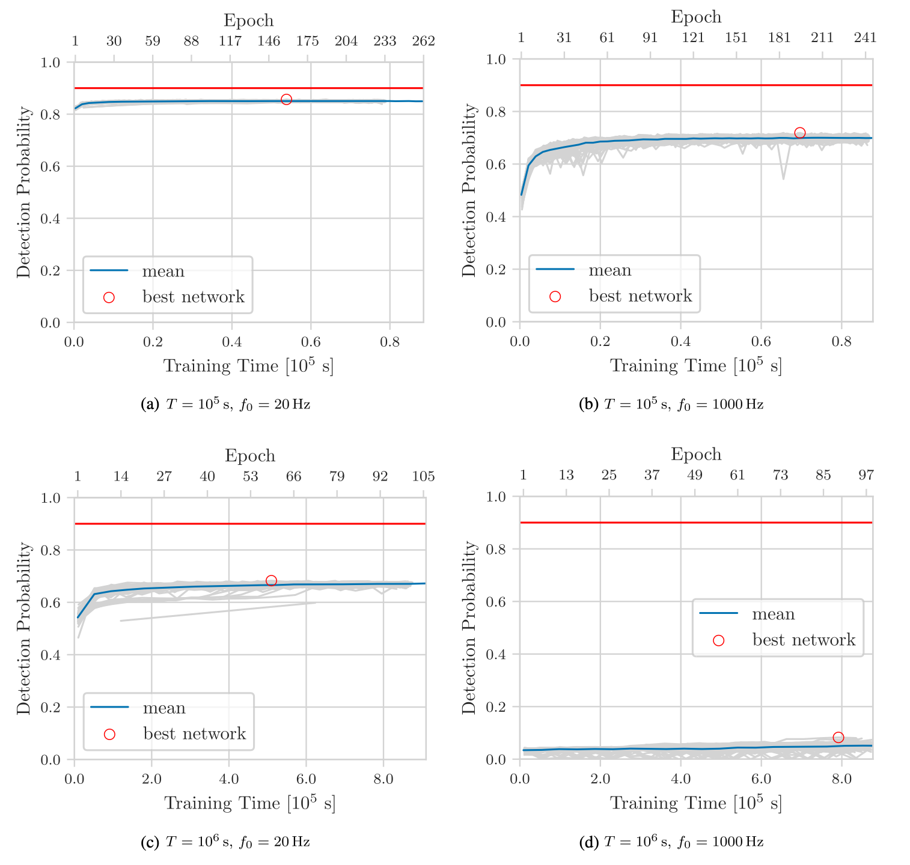
Modelled searches - Dreissigacker et al 2019
Based on the success of CNNs for compact binary searches
The task is significantly more difficult here
Fair comparison with fully coherent searches over a broad parameter space - close to optimal
The ML approach is reasonably competitive for the simplest of the cases studied
For 10⁶ sec observations at 1kHz perform significantly worse than matched filtering
C. Dreissigacker et al, PRD 100, 044009 (2019)

Slide 11
Burst searches
An ideal ML problem?

Slide 12
Burst machine learning
Existing challenges and signal characteristics
  Unknown signal space - broad band but short lived
  Likely strong signals - still buried in the noise
  Crucially - must be present in multiple detectors (different to detector characterisation problem)
The latest ML literature
  M. Chan et al, “Detection and Classification of Supernova Gravitational Waves Signals: A Deep Learning Approach”, in prep (2019)
  J. McGinn et al, “Generative Adversarial Networks for Gravitational Wave Burst Sources”, in prep (2020)
  R. Corizzo et al, “Scalable Auto-Encoders for Gravitational Waves Detection from Time Series Data”, in prep (2020)

Slide 13
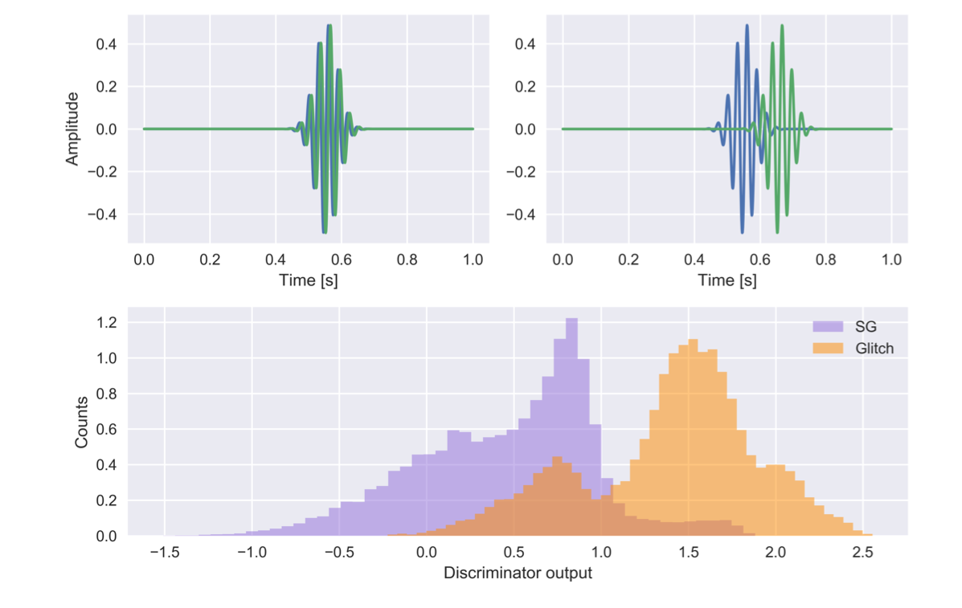
Burst analysis machine learning - McGinn et al
J. McGinn et al, in prep (2020)
Uses a conditional Generative Adversarial network (GAN) to learn how to make standard burst waveforms
Generation stage has the possibility to make signals spanning all training classes
Discriminator stage has the potential to be a general transient detection tool

Slide 14
Neural networks
They’re not that hard to understand
(honestly)

Slide 15
The MNIST dataset
LeCun et al. (1999)
http://yann.lecun.com/exdb/mnist/
Notes:
The benchmark and “hello world” for NNs
Dataset contains 60,000 + 10,000 handwritten numbers
Each number is a 28x28 pixel greyscale image

Slide 16















A single neuron
the specific values of the weights and bias are not determined until training is performed
input layer
Notes:
Flatten the input image (28x28 -> 784)
The neuron takes the input and converts it into a single number
A bias is added to do an overall shift up or down

Slide 17
Activation functions
you can think of this as a neutron firing but not in a binary (on,off) sense
must be analytically differentiable
Notes:
The output of the neuron is passed through a non-linear activation function
Unlike biological systems where the activation is a step here it is smooth
It is useful to rescale and limit the size of the output for the next layer
Different activations for different properties (trial and error)

Slide 18
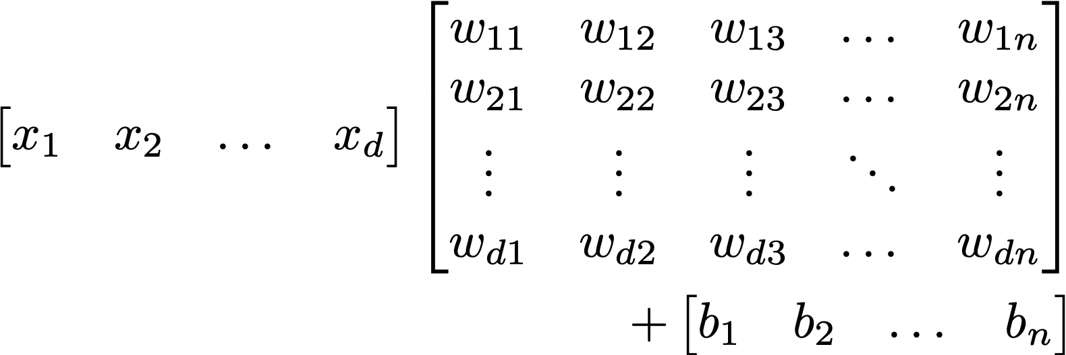
A simple network - A layer
Fully connected layer- all inputs to all neurons
Overall result is a big matrix operation
all outputs still processed through a non-linear activation function, e.g.,

Slide 19
A simple network - Multiple layers
multi-layer perceptron
model
input layer
hidden layers
output layer
the architecture is entirely your choice
classification
Notes:
1. Large number of parameters (perhaps 1000s, to millions)

Slide 20

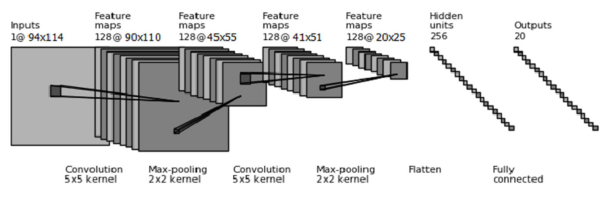
Convolutional neurons
5 | 2 | 4 | 6
3 | 9 | 7 | 1
7 | 5 | 4 | 4
8 | 7 | 1 | 8
14 | 9 | 5
8 | 13 | 11
14 | 6 | 12
1 | 0
0 | 1
Zevin et al CQG, 34, 6, 064003 (2017)
Notes:
input doesn’t have to be flattened - keep spatial structure
Less weights and biases

Slide 21
Training/Learning
“need input”
Johnny 5, Short Circuit (1986)
Notes:
1. Up to now we just have an empty brain

Slide 22
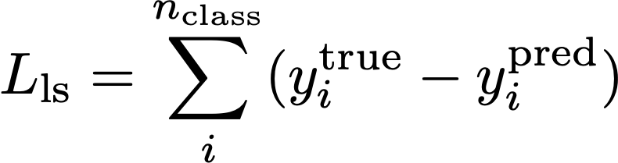




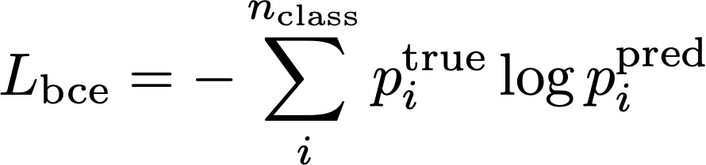
Loss functions
least squares
0.3
0
0.2
1
≡
0.5
0
binary cross-entropy
Notes:
Want to define a measure of how well the network is doing for a given set of weights
Usually send in batches of images and compute the average loss for each batch
This is supervised learning - we know the answer for the training data

Slide 23
Gradient descent
Very large number of parameters
Compute local gradient and move “downhill” in proportion
Tricks to avoid local minima
  Work in “batches” - stochastic gradient descent
  Learning rate
  Use momentum
in reality you can have millions of weights and biases
Machine “learning” here is simply minimising a loss function
Notes:
1. Mention learning rate

Slide 24

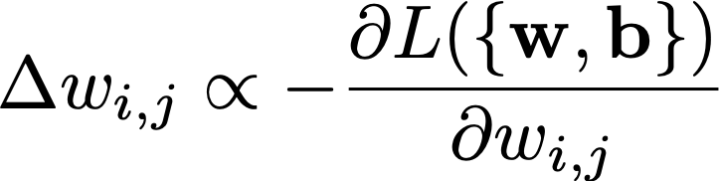
Back propagation
compute the nudges needed for each input summed over each output
0.3
0
0.2
1
0.5
0
propagate backwards
Notes:
An algorithm for computing the gradient
Not going into the maths - too many indices
Make sure everything is differentiable - use chain rule

Slide 25
Compact Binaries
These are the ones we’ve detected

Slide 26
Compact binary machine learning
Existing matched filtering searches are close to optimal and quite fast (~1 min latency)
  Matched filtering is very close to optimal sensitivity
  Not all of the parameter space is covered
  Non-Gaussian noise is well understood
ML searches can help if they are fast and do as well on detector noise artefacts
The latest ML literature
  D. George and E. Huerta, “Deep neural networks to enable real-time multimessenger astrophysics”, PRD 97, Issue 4, 044039 (2018)
  Gebhard et al, “ConvWave: Searching for Gravitational Waves with Fully Convolutional Neural Nets", Workshop at the 31st NIPS Conference, Long Beach, CA (2017)
  Gabbard et al, “Matching Matched Filtering with Deep Networks for Gravitational-Wave Astronomy”, PRL 120, 141103 (2018)

Slide 27
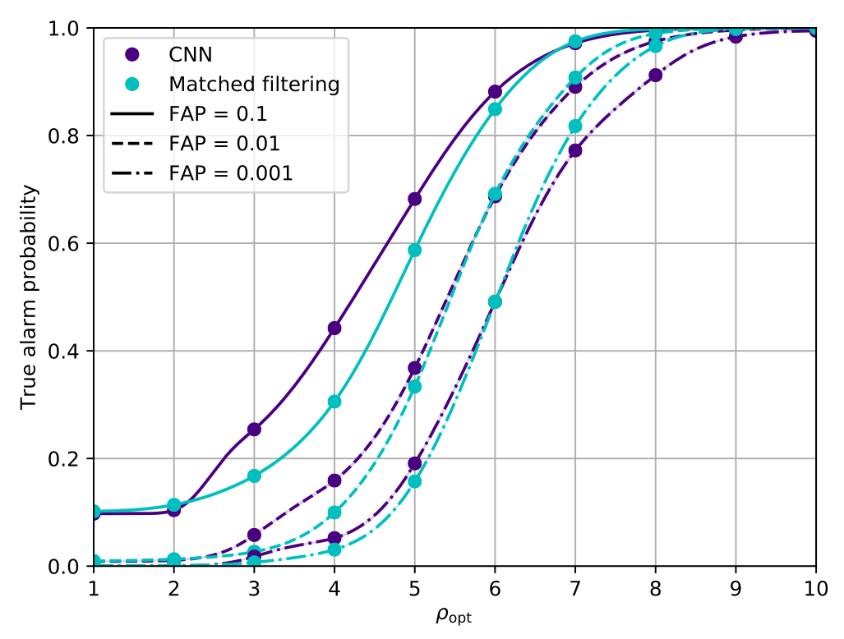
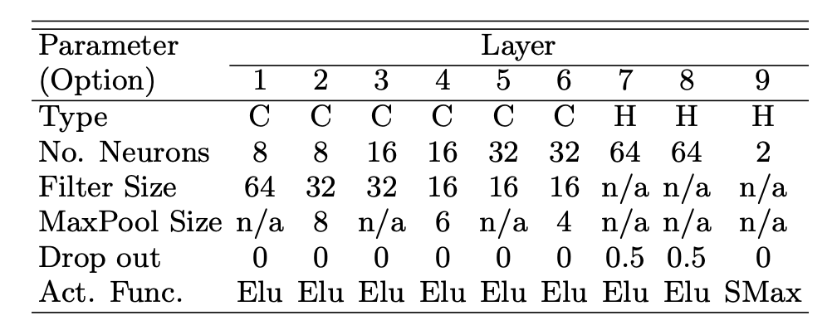
CBC machine learning - Gabbard et al (2018)
Gabbard et al PRL 120, 141103 (2018)
Design a network that takes in noisy GW time-series data and classifies it as noise or signal+noise
We used a single detector and did not consider non-Gaussianities
Randomised source parameters
The network achieves the same sensitivity as matched filtering
Other groups have looked at the performance with real detector noise

Slide 28
Parameter Estimation
What exactly did we just detect?

Slide 29
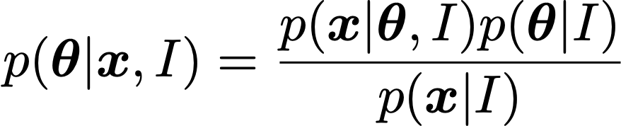
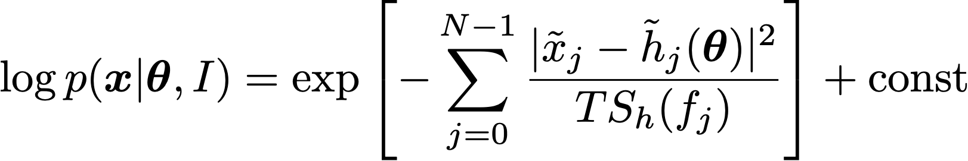
Bayesian Inference
We rely heavily on Bayesian parameter estimation.
We must make (motivated) assumptions regarding our noise distribution and the prior values of of the parameters.
In practice, obtaining posterior probability densities on system parameters is done via Monte-Carlo techniques (MCMC, nested sampling).
likelihood
prior
posterior
evidence
https://lscsoft.docs.ligo.org/bilby/

Slide 30
Motivation
L. Singer & L. Price, PRD 93, 2, 024013 (2016)
Existing Bayesian parameter estimation is optimal but very slow
For transient GW events and multi-messenger astronomy it is crucial that we produce data products very quickly.
LIGO-Virgo Collaboration, ApJ 848, 2, L12, 59 (2017)
LIGO-Virgo Collaboration, ApJ Volume 826, 1, L13, 8 (2016)

Slide 31
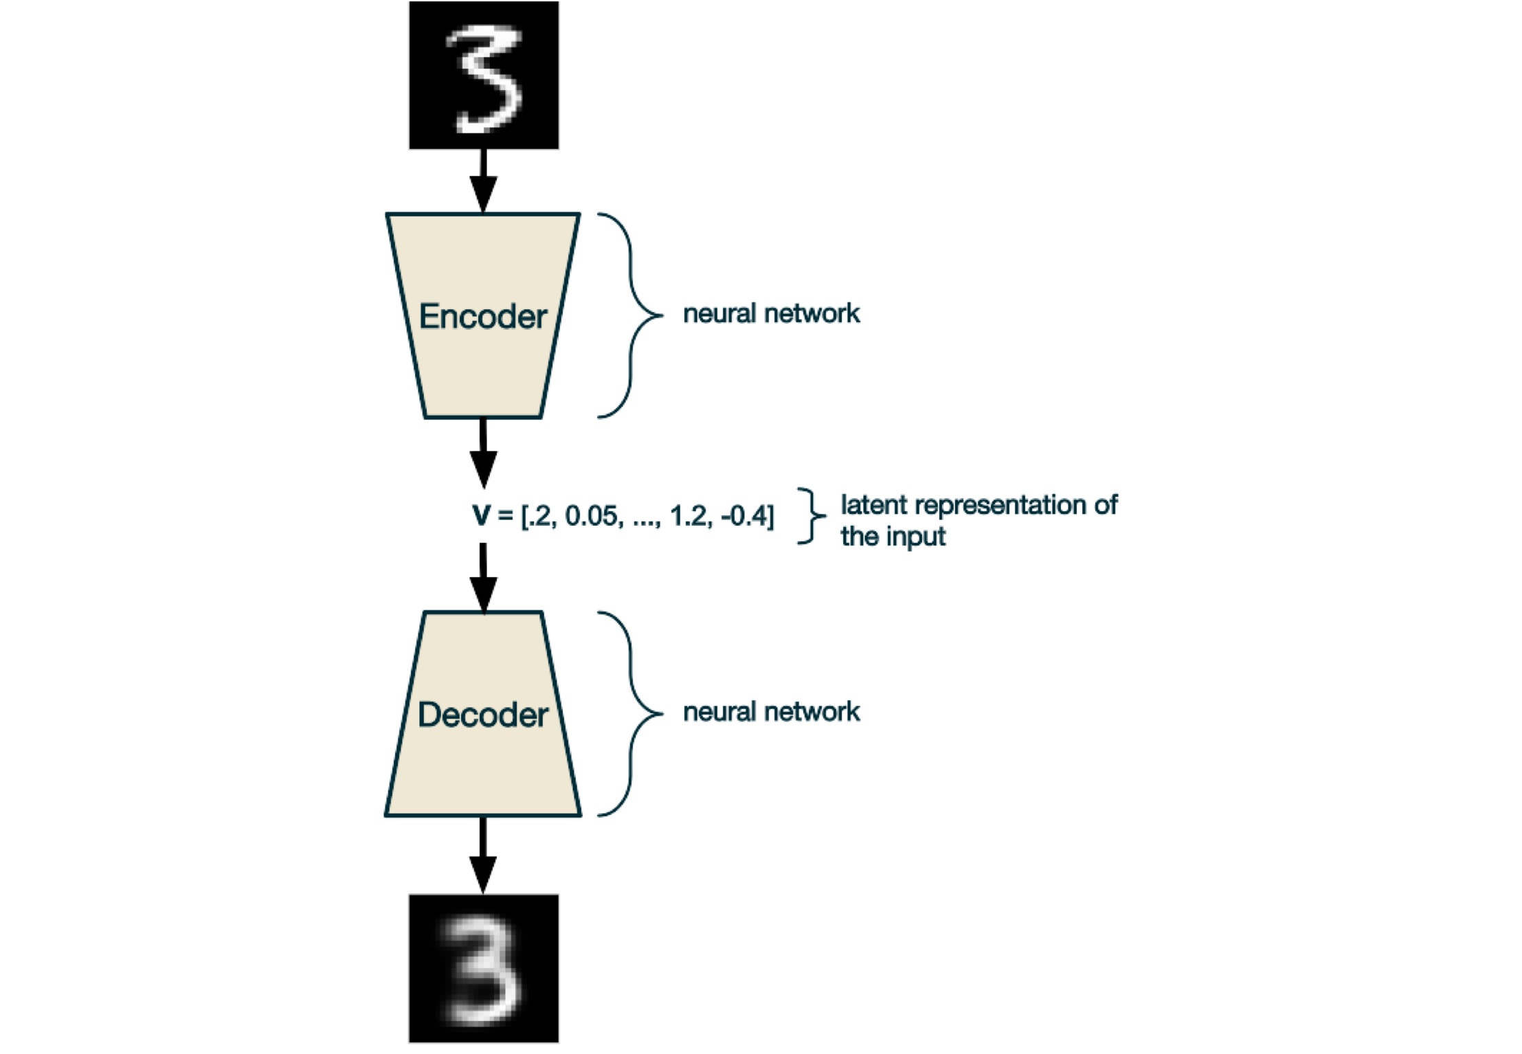
First - an autoencoder
source: https://ijdykeman.github.io/ml/2016/12/21/cvae.html
the mysterious “latent” space is jargon for some N-dimensional non-physical parameter space in which to represent your data
loss based on input/output similarity

Slide 32
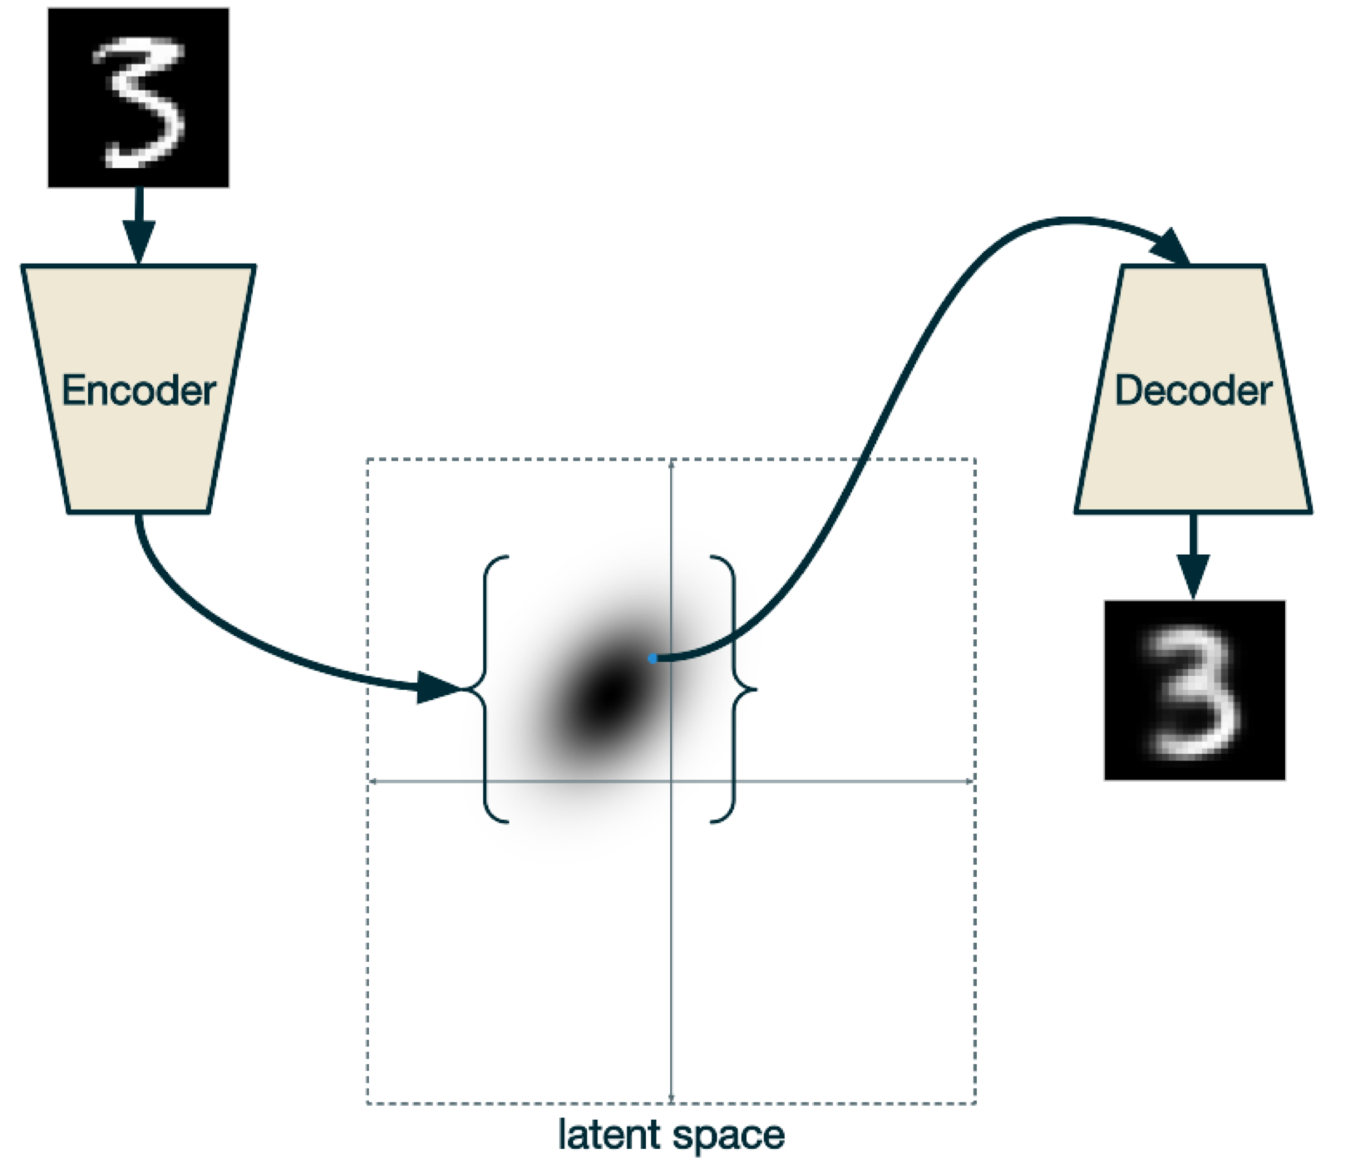
Next - a variational autoencoder
source: https://ijdykeman.github.io/ml/2016/12/21/cvae.html

Slide 33
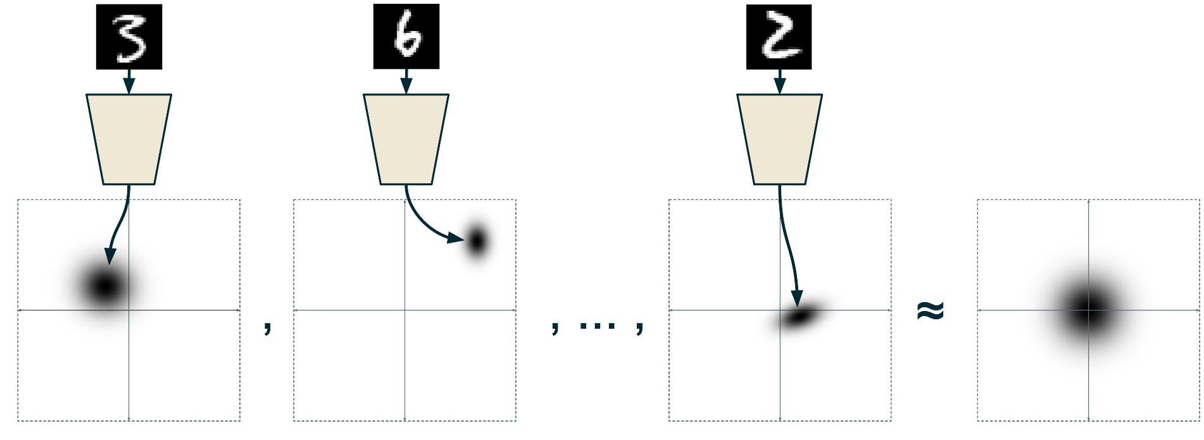
Next - a variational autoencoder
The loss function incorporates a KL-divergence term testing the Gaussianity of the total distribution in the latent space
random draw
can’t produce particular numbers on command
?
source: https://ijdykeman.github.io/ml/2016/12/21/cvae.html

Slide 34
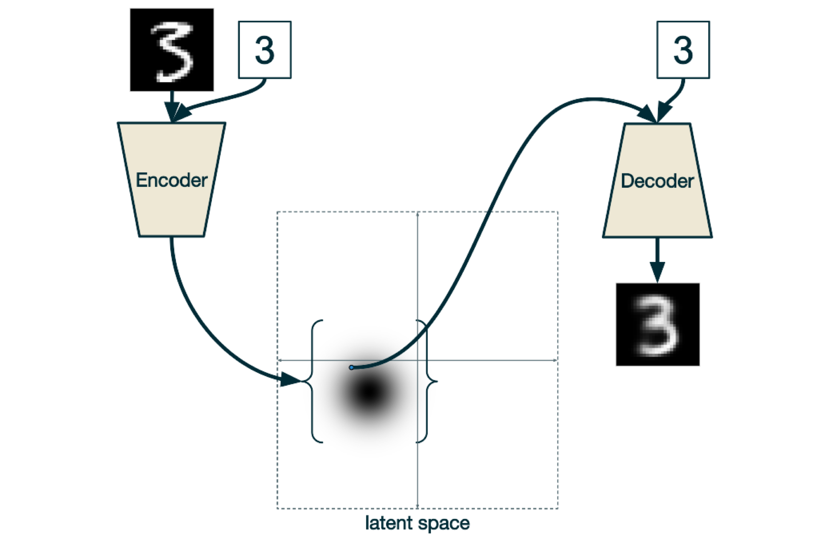
Then - a conditional variational autoencoder
label
label
Within training, the true “label” is passed with the data
now you can ask for a random “7” or “4”, etc…
source: https://ijdykeman.github.io/ml/2016/12/21/cvae.html

Slide 35
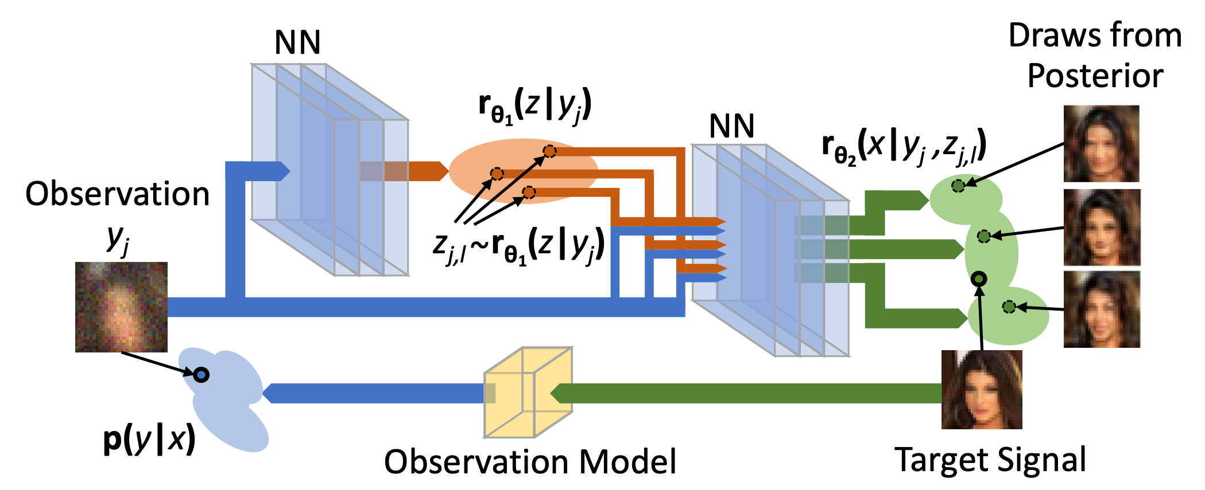
CVAEs for GW PE
Acronym acronym acronym
Tonolini et al, arXiv:1904.06264

Slide 36







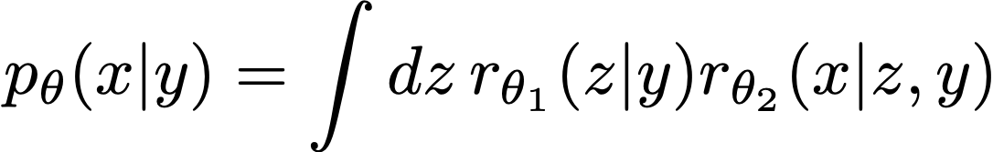
Some of the components of our scheme
The GW data
The GW parameters
The prior
The likelihood
The latent space parameters
The posterior
The recognition function
The target distribution
we generate lots of these
from this
we never have to evaluate this
we want this
we are going to use 3 neural networks to model each of these 3 functions
Gabbard et al, arXiv:1909.06296 (2019)

Slide 37
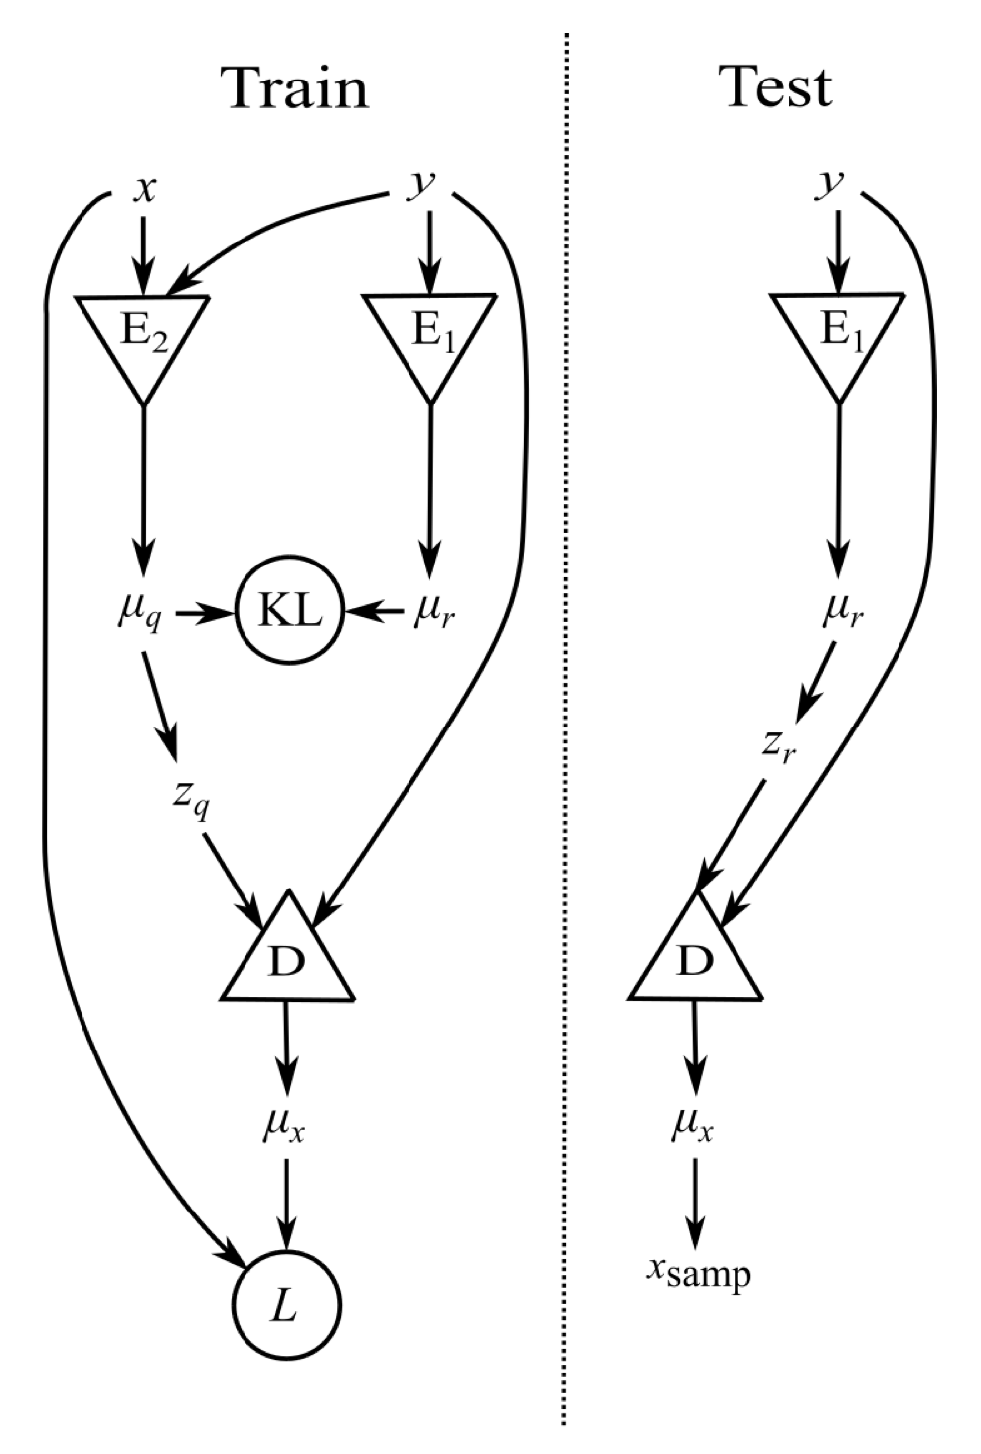
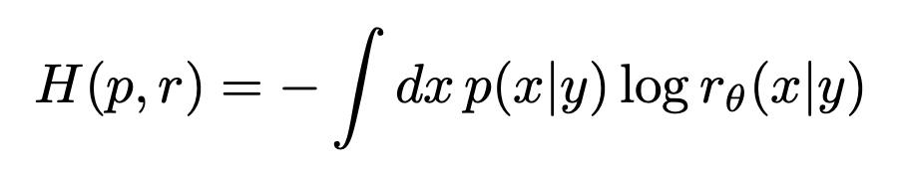
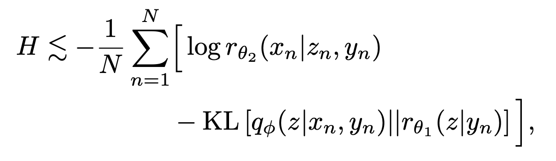
The scheme
We start by defining our cost/loss function (the cross entropy) as
after a bunch of mathematics we arrive at
D
E2
E1
Gabbard et al, arXiv:1909.06296 (2019)

Slide 38
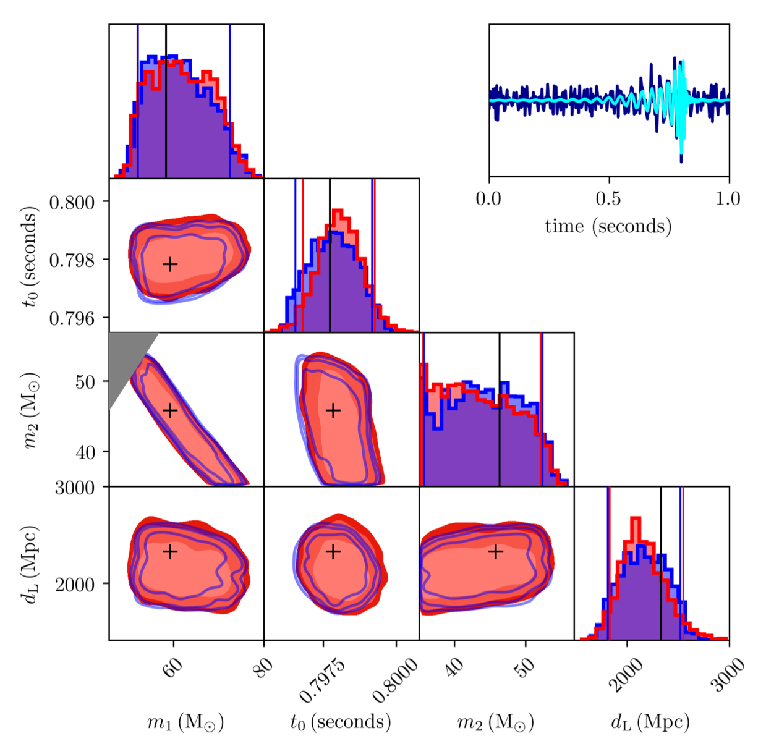
Reproducing posteriors
Gabbard et al, arXiv:1909.06296 (2019)
red = CVAE
blue = Bilby

Slide 39
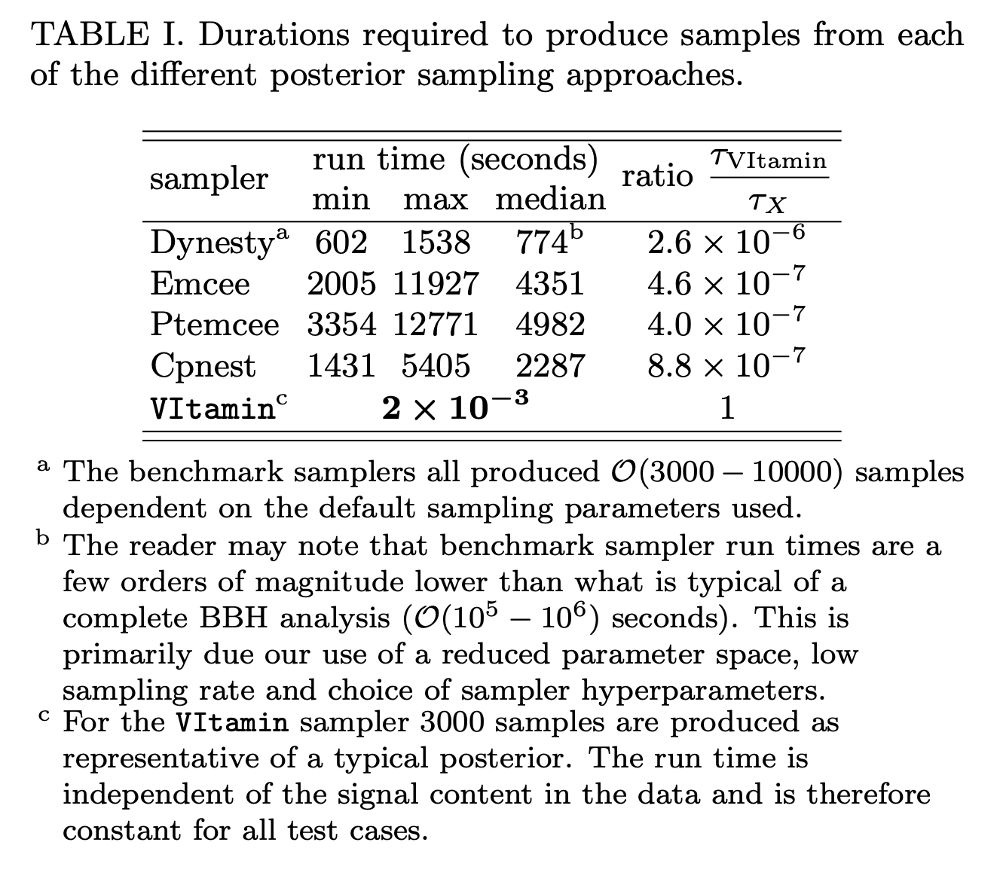
The speed
Gabbard et al, arXiv:1909.06296 (2019)

Slide 40
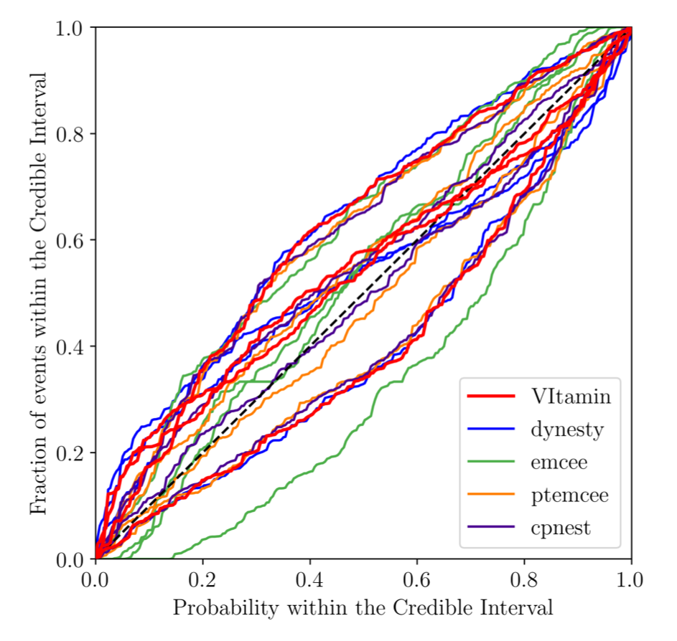
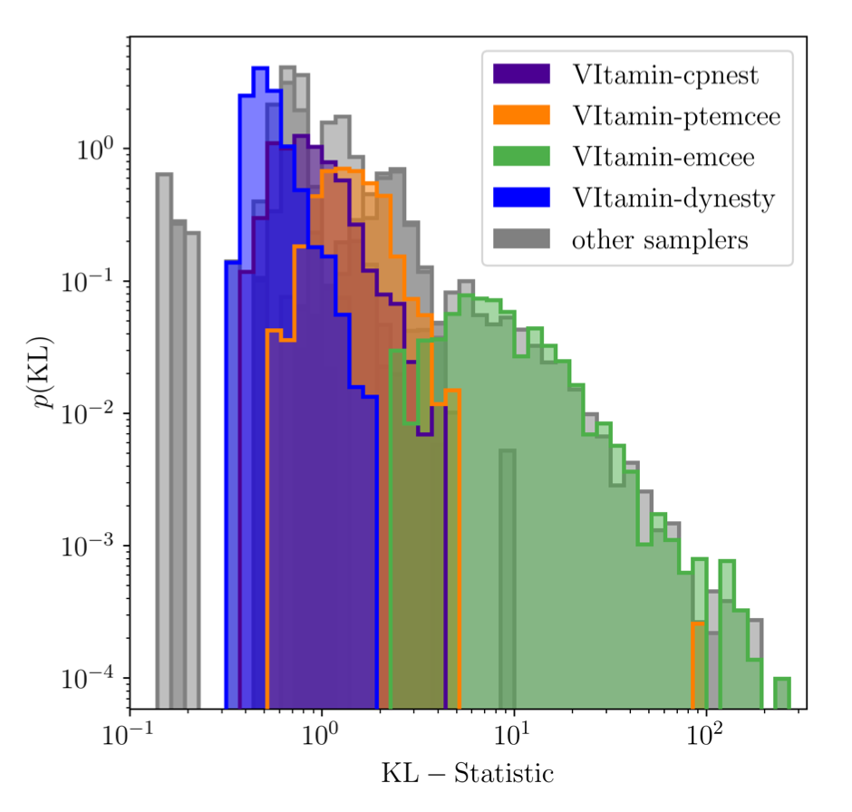
Validation
p-p plot
KL-divergence distributions
Gabbard et al, arXiv:1909.06296 (2019)

Slide 41
Conclusions
The take home message

Slide 42
Variational Inference - Future work
We’ve shown (and so have another group) [Chua & Valisneri, arXiv:1909.05966 (2019)] that variational inference is a powerful tool.
Extending this to more realistic cases is the next step.
The ultimate aim is to have this working on CBC signals containing matter.
Our pipeline is called VItamin and is available to play with here
https://github.com/hagabbar/VItamin

Slide 43

Summary
We covered some existing machine learning applications in GW data analysis
We then covered some ML basics
We discussed ML for CBC searches
We covered variational autoencoders
We finished off with variational inference for Bayesian parameter estimation.

