Slide 1
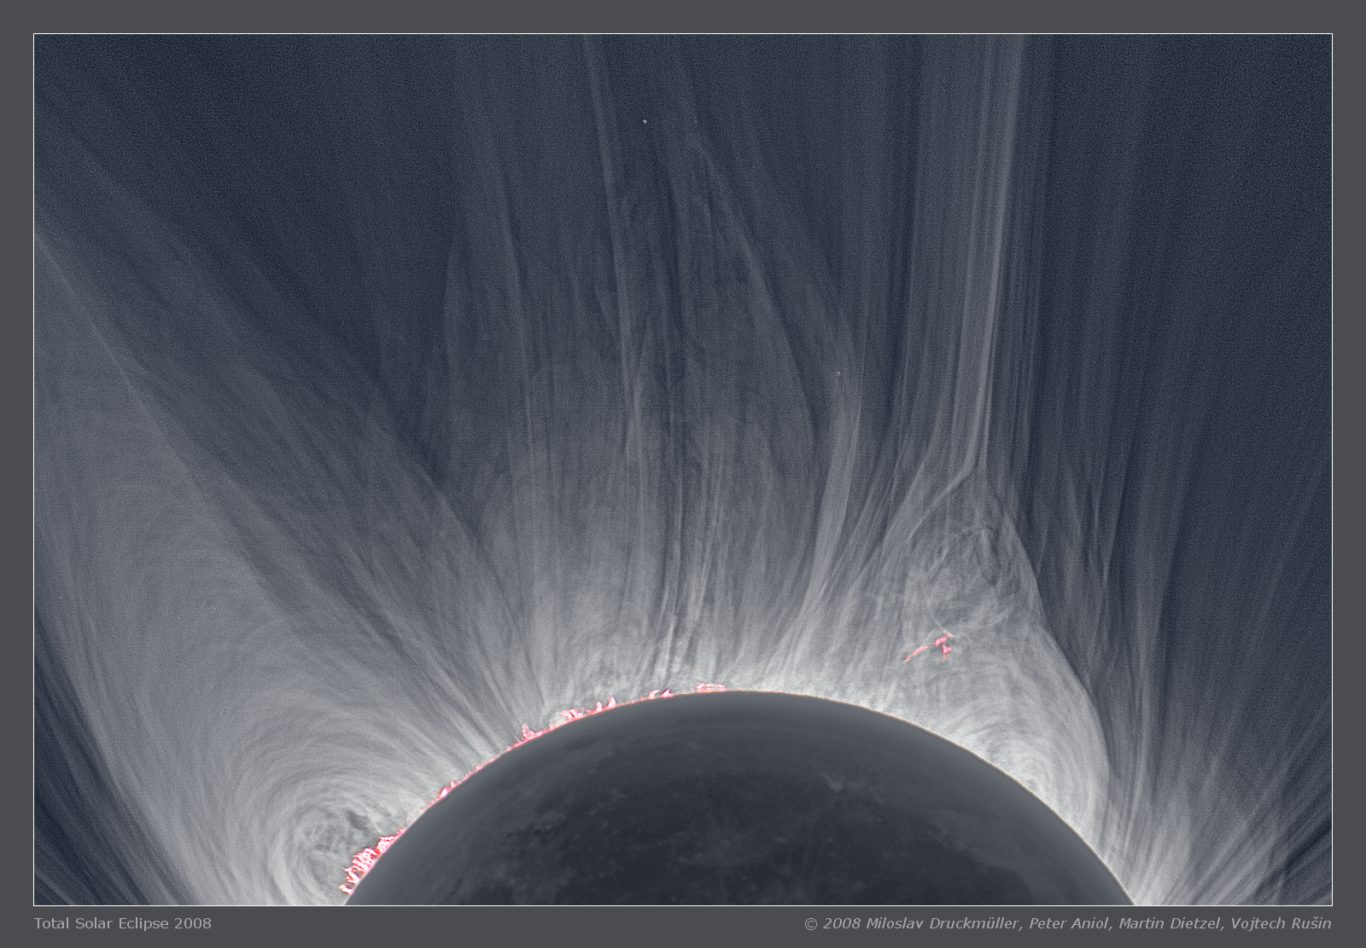
Prominences: B Field and Heliospheric Coupling
S. K. Antiochos NASA/GSFC
B adds structure and dynamics to corona and beyond
Couples across physical domains and spatial scales

Slide 2
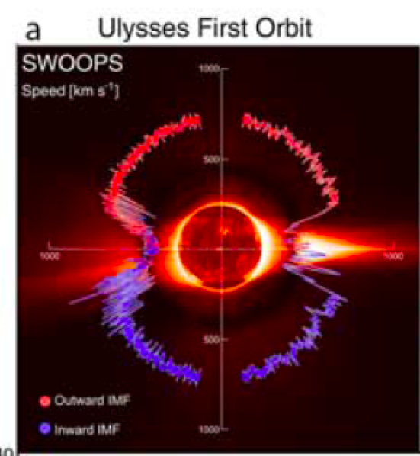
Magnetic Field Coupling
Solar wind speed in heliosphere (McComas et al)
Quasi-steady wind at high latitudes, from polar holes
Highly variable slow wind near streamers
Ultra-high res. VAULT image (Vourlidas et al)
Laminar field lines similar to laminar coronal loops
See little evidence for tangling

Slide 3
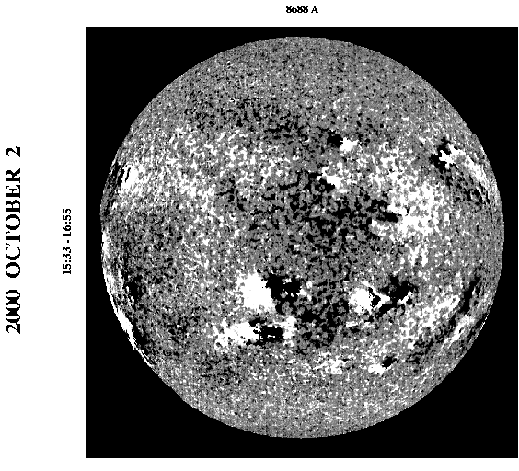
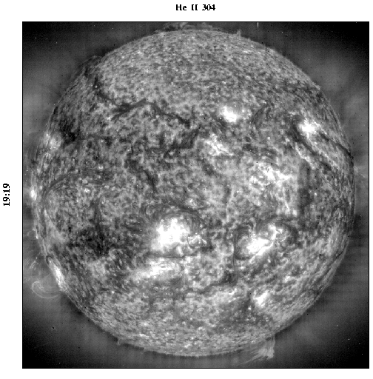
Prominences: Magnetic Field
Strong magnetic shear invariably builds up at PILs
Fundamental origin of ejective activity and heliospheric transients
But why does shear concentrate there??
Kitt Peak magnetogram EIT/SOHO UV

Slide 4
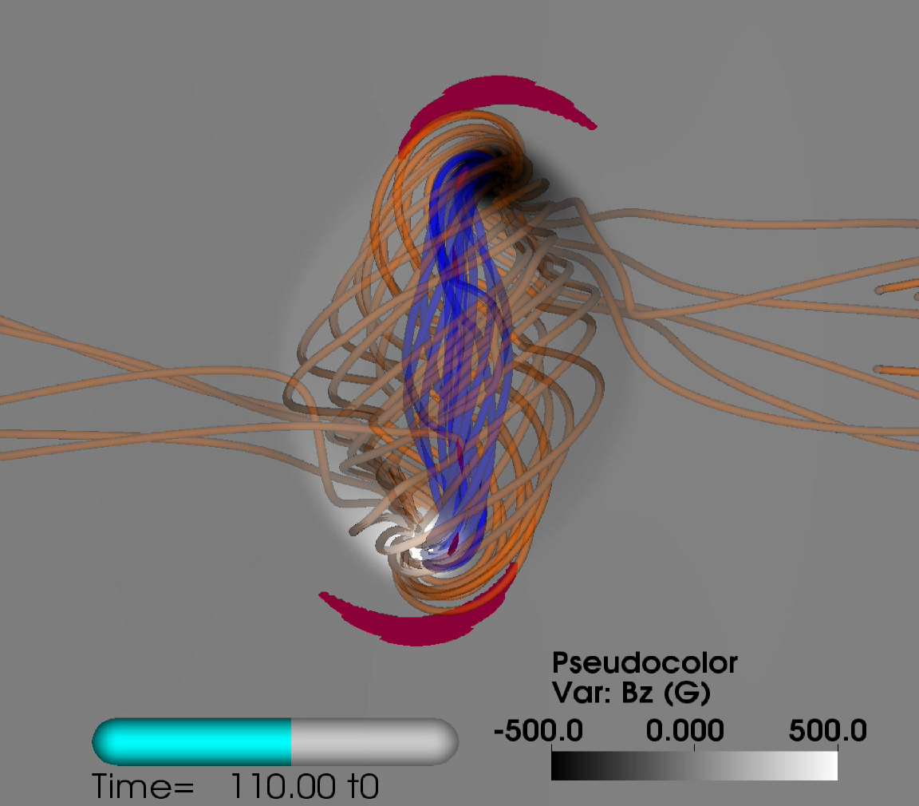
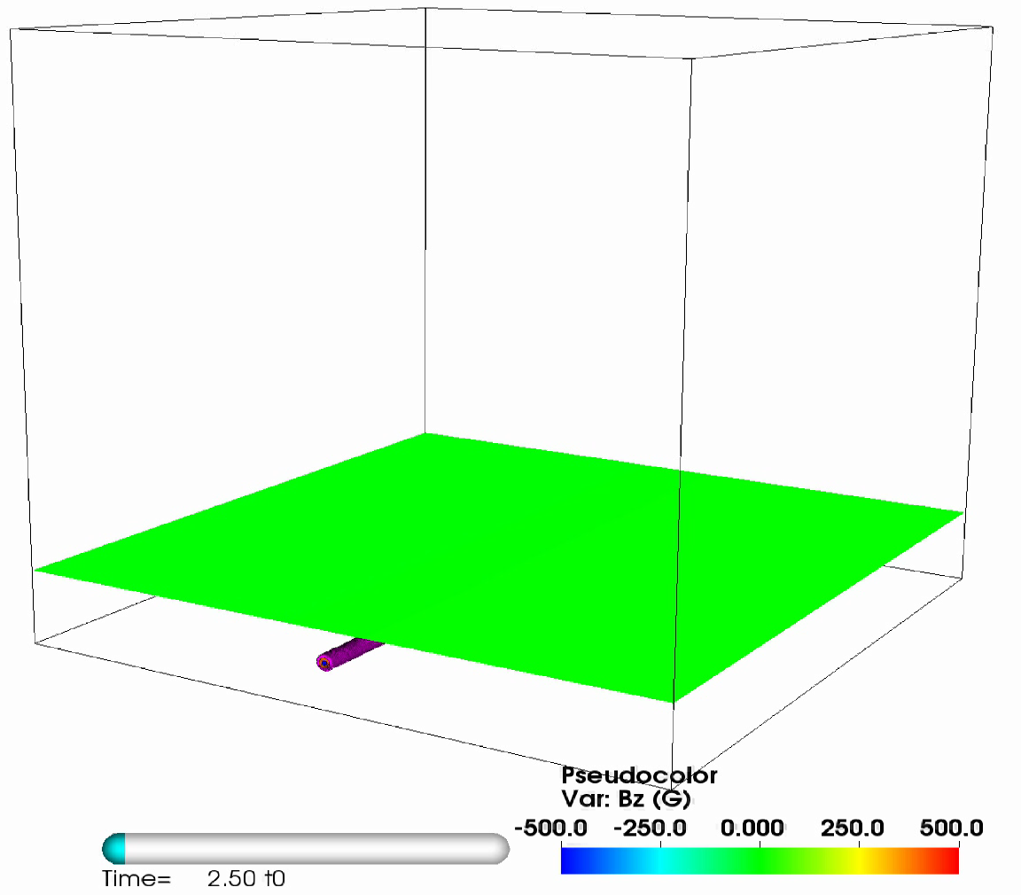
Theories for Prominence Magnetic Field
Flux emergence:
  Subsurface twisted flux rope rises into corona
  Outer twist field below surface becomes overlying potential arcade
  Inner axial field becomes shear field of filament channel
  Generally results in untwisted filament channel
(Leake et al 2014)

Slide 5
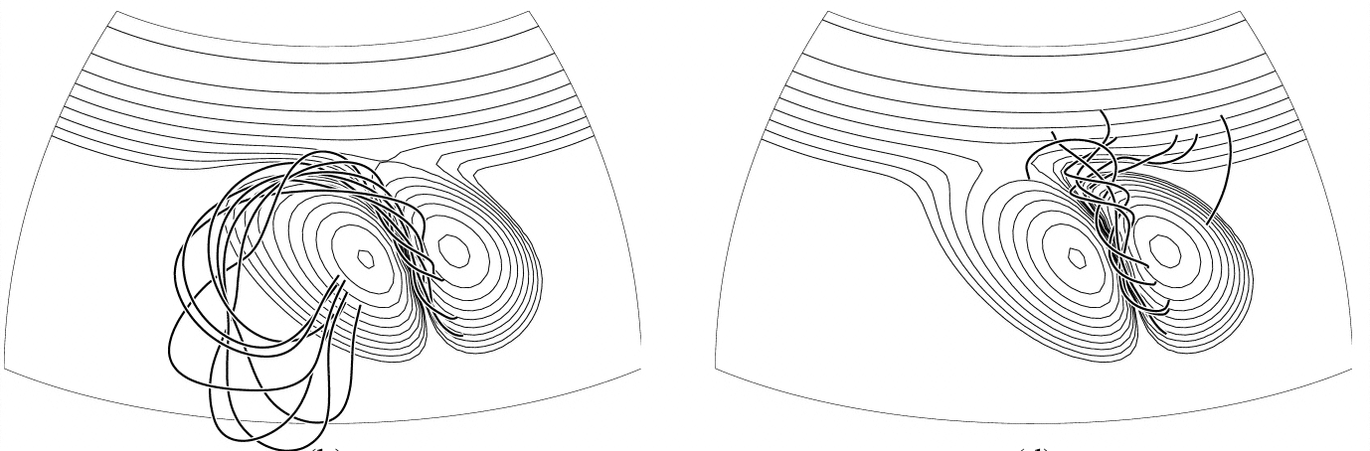
Theories for Prominence Magnetic Field
Flux cancellation:
  Helicity injected into corona by large-scale motions/emergence
  Collects at polarity inversion lines due to opposite polarities cancelling there – “diffusion”
  Normal field cancels but not tangential – conserve helicity
  Always results in twisted filament channel
  Does not always reproduce hemispheric rule
(Mackay & van Ballegooijen 2001)

Slide 6
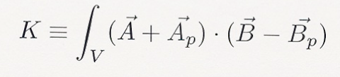
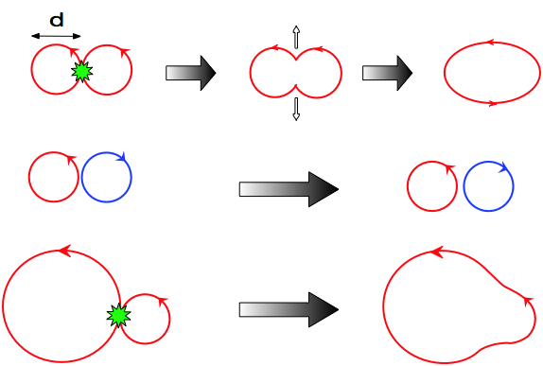
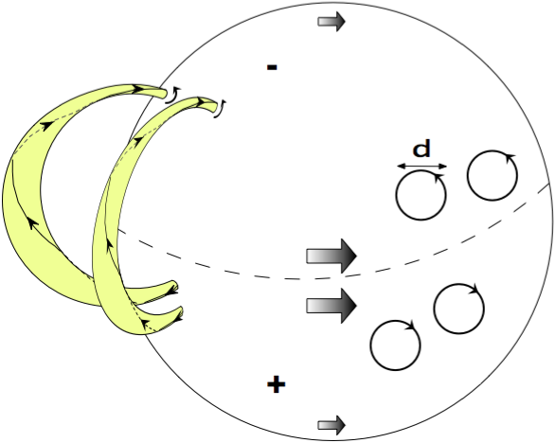
Theories for Prominence Magnetic Field
3. Helicity condensation:
  Helicity/free energy injected into corona by large-scale motions/emergence (e.g., granule or supergranule) primarily in form of twists
  Hemispheric preference clockwise in south and counter in north
  Like twists reconnect, unlike twists bounce
  But helicity K conserved
  Where does it go?
(Antiochos 2013)
(Finn and Antonsen 1985)

Slide 7
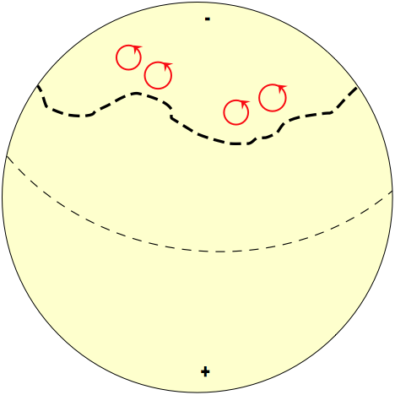
Coronal Helicity Evolution via Reconnection
Helicity (twist) cascades to largest scale
  Boundary of whole flux system is the PIL
  Helicity condenses to form sheared (untwisted) filament channels
  Coronal hole also boundary since no twist on open field lines

Slide 8
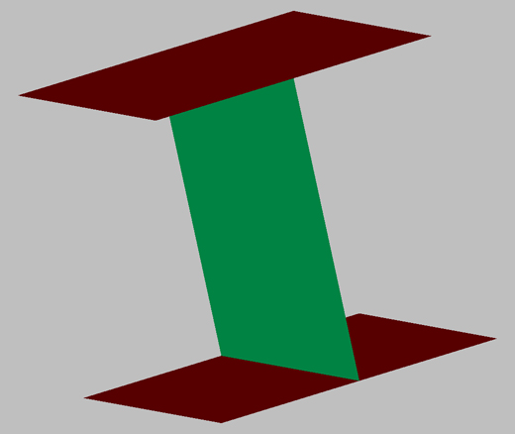
MHD Simulations of Helicity-Condensation
(Zhao, DeVore & Antiochos 2014)
Two twisted fluxtubes co-helicity reconnects, counter-helicity only kinks

Slide 9
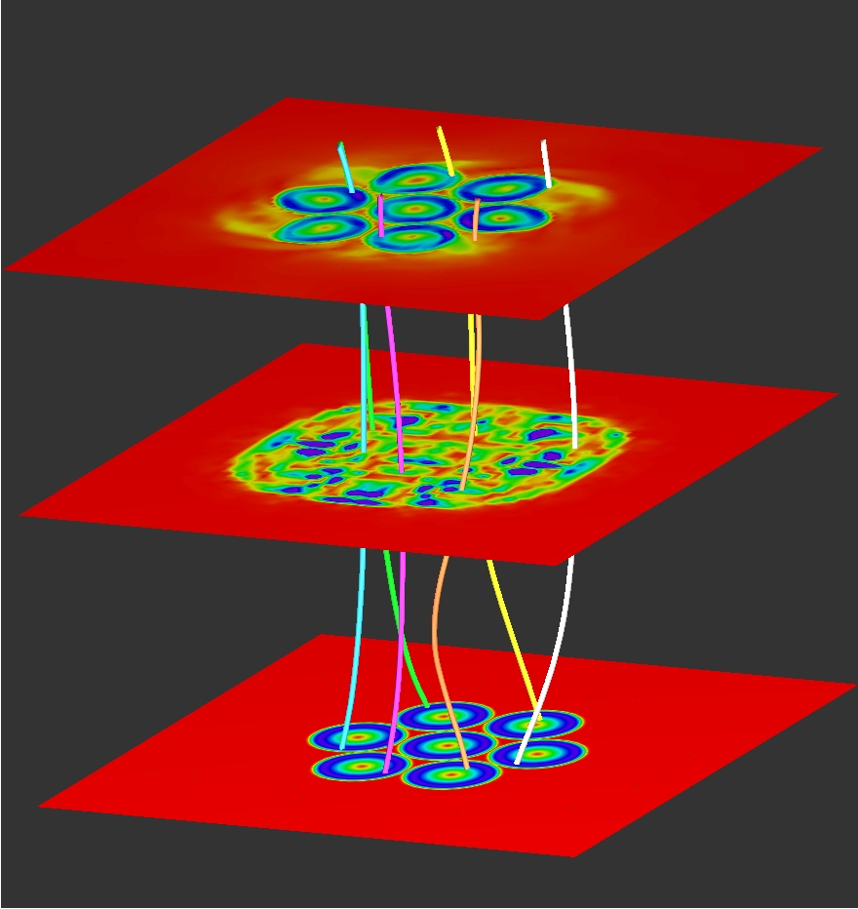
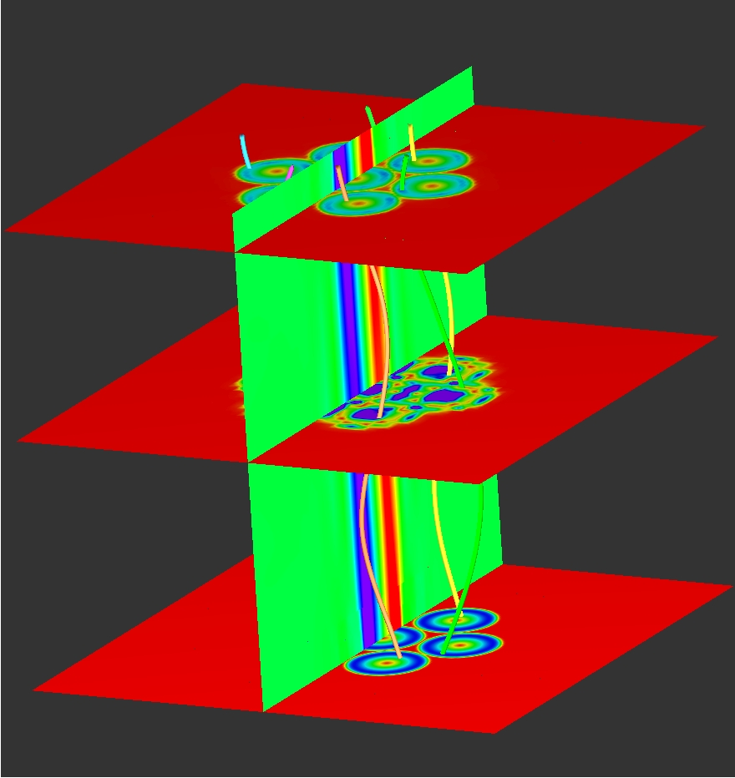
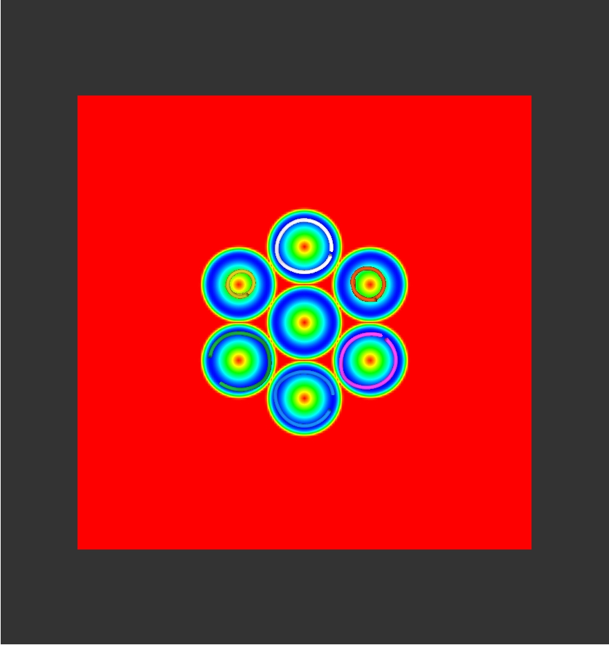
Simulations of Helicity-Condensation
Apply set of seven closely-packed rotations to uniform field between two line-tied plates
  Use full 3D MHD with AMR
Helicity injected only in localized regions

Slide 10
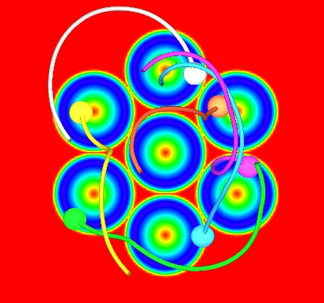
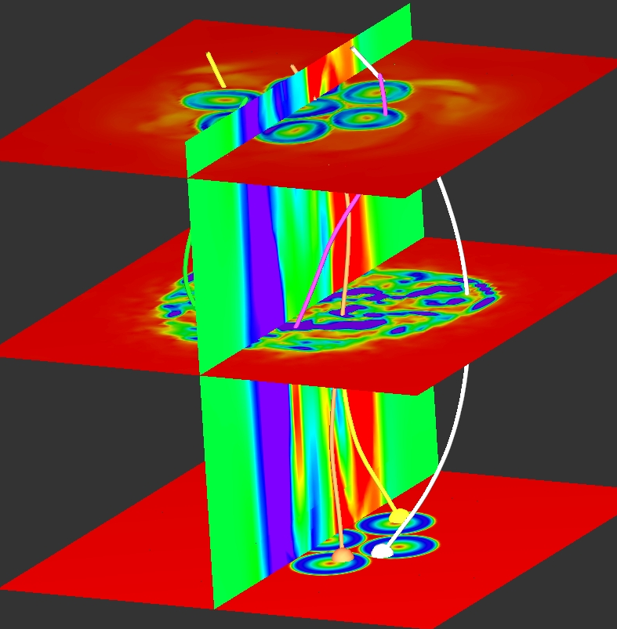
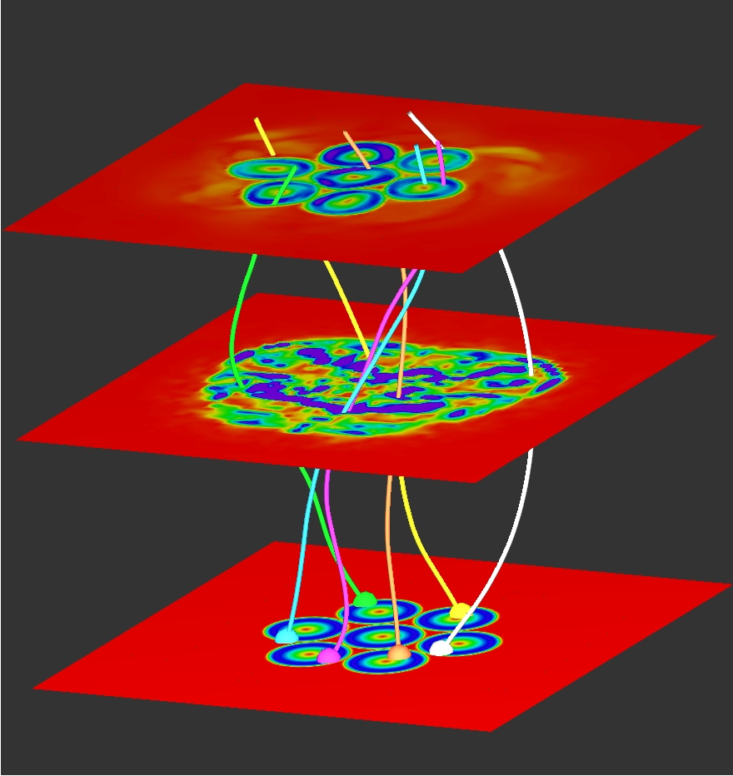
Simulations of Helicity-Condensation
After several rotations, reconnection transfers magnetic twist and, hence, helicity to edge of pattern
  Consistent with model

Slide 11
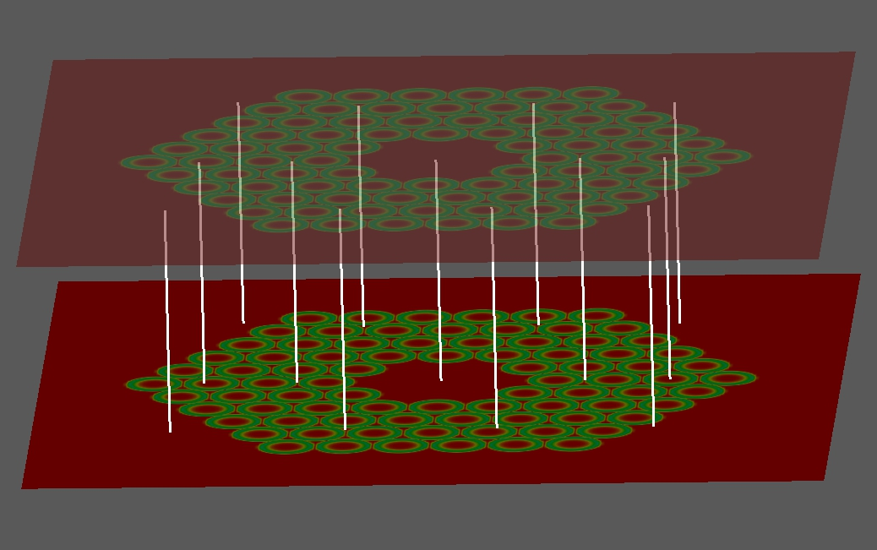
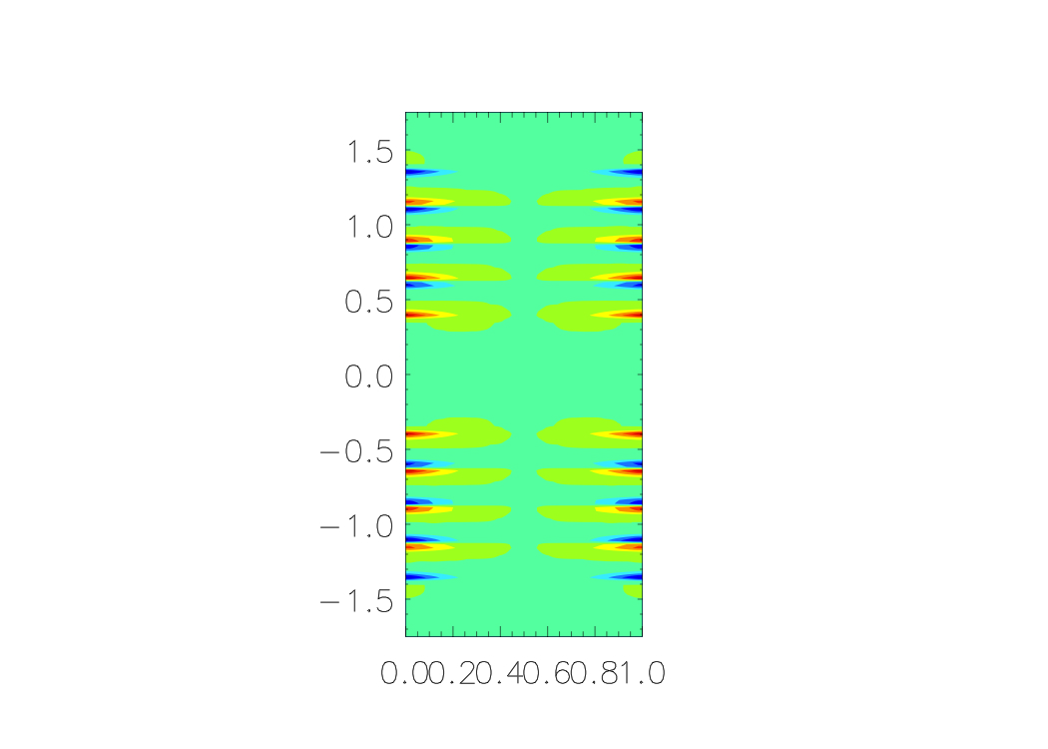
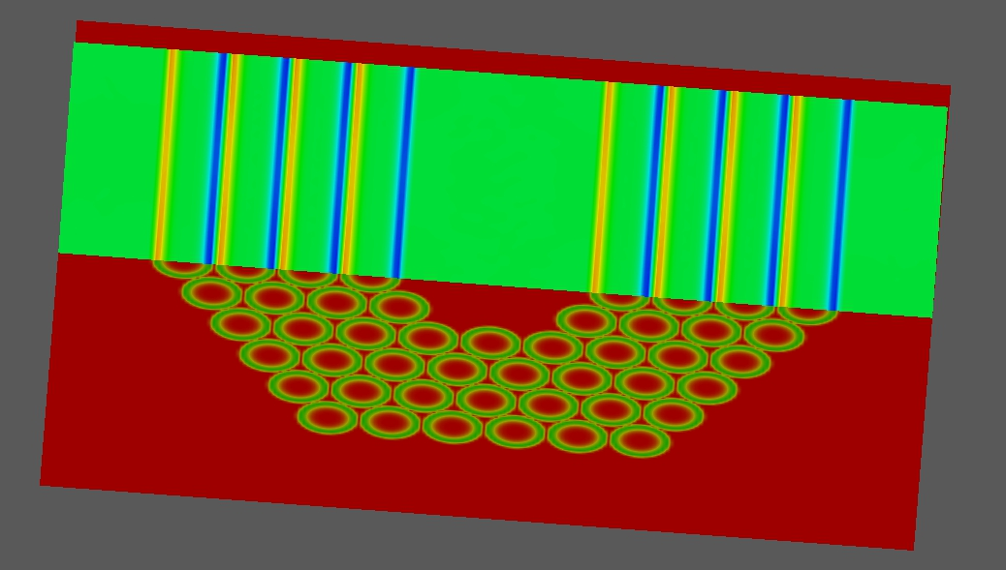
Simulations of Helicity-Condensation
Interaction of 84 rotations on uniform field ~ coronal loops & supergranular pattern
External bdy ~ PIL, internal ~ coronal hole
B twist condenses at both bdys (Knizhnik, DeVore & Antiochos)

Slide 12
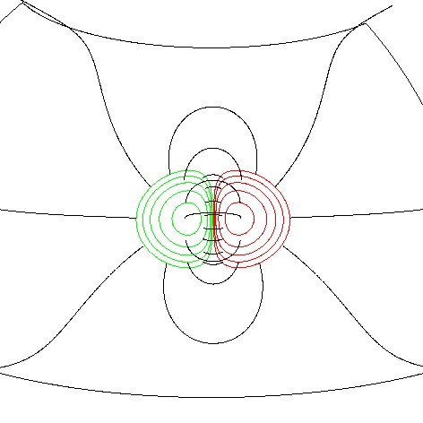
Simulations of Helicity-Condensation
(Mackay, DeVore, & Antiochos, 2014)
Add helicity condensation term to equations for global field evolution (e.g., Mackay & van Bellegooijen 2006)
Examine idealized distributions and effect of different mechanisms
Helicity condensation explains chirality of east-west filaments
Produces untwisted flux rope for filament channel

Slide 13
Future Directions
Helicity injection and transport appears to play a major role in the Sun – heliosphere dynamic coupling
Net helicity injected into polarity region condenses onto PIL
  Keeps coronal loops laminar
  Builds up PIL shear – origin of prominence field
  Interesting parallel with prominence mass – thermal non-equilibrium model (Antiochos 91)
  Ultimate reason for ejective eruptions
Predict that helicity also condenses onto CH boundaries
  Origin of slow wind and its variability
  Unexpected magnetic connection between prominences and heliosphere
Model needs much more theoretical and observational work!!

